Slide 1

Telling the Story of Title VI Programs:
Title VI Survey Report and Toolkit
Traci Wilson, Director of Research
April 19, 2022

Slide 2





(formerly the National Association of Area Agencies on Aging)

Slide 3
Serving Native Elders in Indian Country:
Title VI Programs Services and Needs
Traci L. Wilson, USAging

Slide 4
About the National Title VI Program Survey
The National Title VI Program Survey is conducted approximately every three years with funding through the U.S. Administration for Community Living.
The survey explores trends, new directions and evolving needs of Title VI programs across the country, including Title VI program budgets, staff, service provision and partnerships.
The 2020 survey was conducted September 2020 through December 2020, receiving 231responses from 276 Title VI grantees for a response rate of 84 percent.
All data in this presentation, unless otherwise noted, is from the 2020 National Title VI Program Survey. For details, visit www.usaging.org/2021titlevisurvey.

Slide 5
Title VI Survey Report and Toolkit Resources
Comprehensive survey report
Fact sheets
Regional Reports
Home modification data brief
Sample social media posts and newsletter articles
Customizable PowerPoint

Slide 6
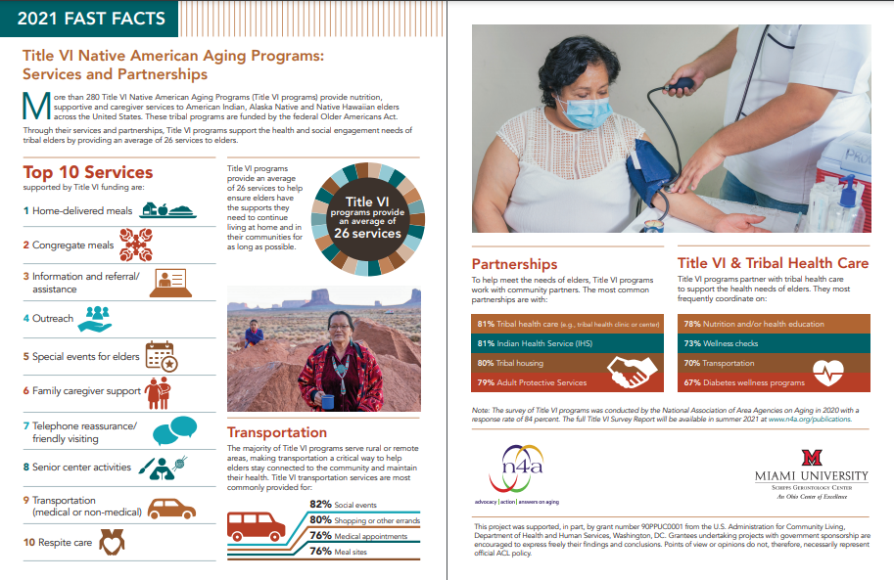
Fast Facts: Title VI Native American Aging Programs Services and Partnerships

Slide 7
Fast Facts: The Impact of COVID-19 on Title VI Native American Aging Programs and Services
Notes:
The survey was in the field during COVID-19 and before vaccinations became available. We asked Title VI directors what impact COVID-19 has had on their programs, services and elders. A two-page fast facts sheet is available which summarizes the findings.

Slide 8
Regional Data Reports
Organized by HHS region
Understand what other programs in your region are doing
Advocate for services and funding
Notes:
Another resource in the Title VI toolkit is the regional reports. Based on the Department of Health and Human Services regions, we produced data briefs comparing the regional median values with the national values. This allows Title VI directors to compare their program with others within their region, and their region to the nation.

Slide 9
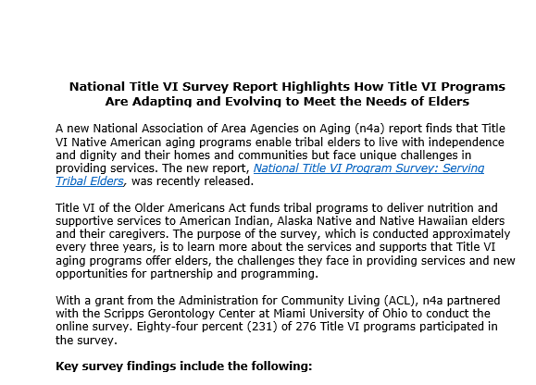


Dissemination Toolkit
Social Media Posts
Sample Newsletter Articles
Twitter Facebook

Slide 10
What Now?
Access resources at www.usaging.org/2021TitleVIsurvey
Next Title VI Program Survey is planned for Fall 2023
Questions? Contact me!
Traci Wilson
twilson@usaging.org

