Slide 1
National Indigenous Elder Justice Initiative Resources
Title VI Cluster Training
Maylynn Warne, MPH (Citizen of the Pawnee Nation & Santa Ana Pueblo)
March 3-5, 2020
Red Lake, MN
“Restoring respect and dignity by honoring Indigenous elders”

Slide 2
About NIEJI
Mission
Restoring respect and dignity by honoring Indigenous Elders
The National Indigenous Elder Justice Initiative (NIEJI) provides culturally appropriate information and community education materials on elder abuse, neglect, and exploitation in Indian Country.
www.nieji.org

Slide 3
Funding
NIEJI is funded by the Administration for Community Living and serves American Indian, Alaska Native, and Native Hawaiian communities.
It is located at the Center for Rural Health at the University of North Dakota School of Medicine and Health Sciences.

Slide 4
Services and Resources
Elder Abuse Prevention
Online Interactive Elder Justice Curriculum
Tribal Elder Protection Team Toolkit
Native Elders Maltreatment Survey
Tribal Elder Abuse Codes
Directory of State & Tribal Hotlines
Elder Abuse Product Catalog

Slide 5
NIEJI Home Page

Slide 6
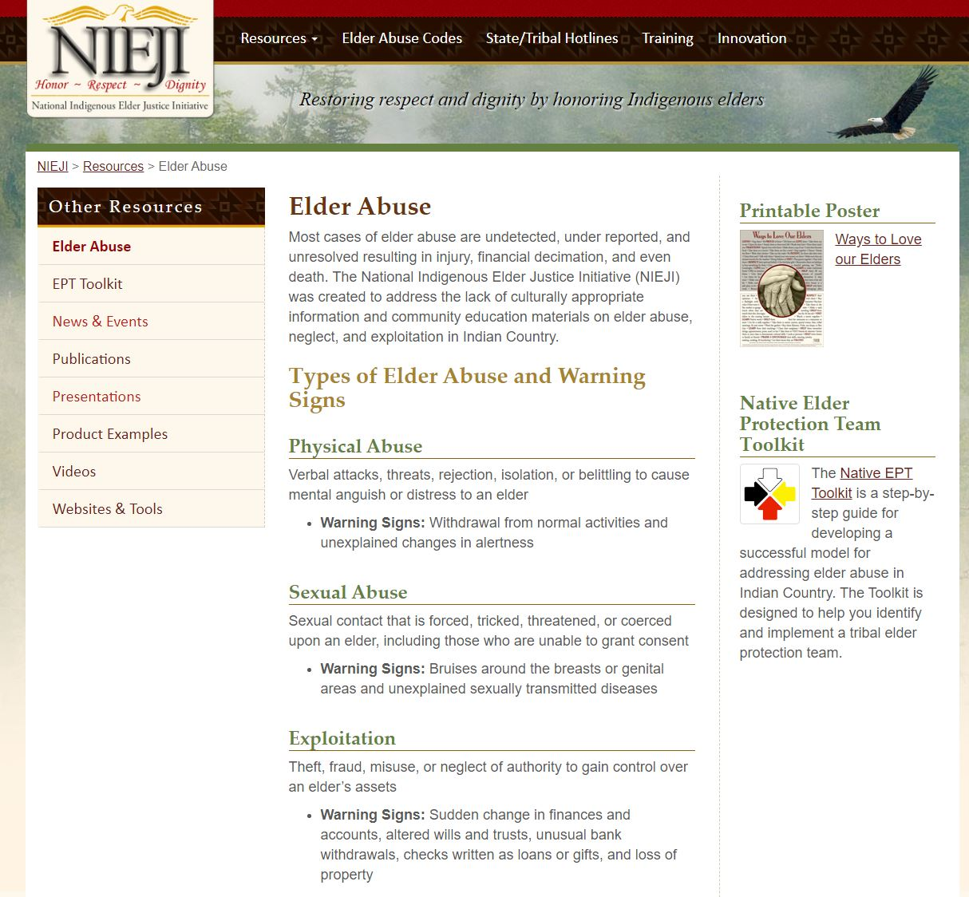
Elder Abuse Prevention
NIEJI provides technical assistance and education to address and prevent elder abuse, neglect, and exploitation through information, presentations, and sharing resources.

Slide 7
Elder Justice Curriculum
The NIEJI website has free online education modules to train those that work with Native American Elders to identify and address elder abuse.
Modules:
Elder Abuse
Caregiver
Financial Abuse
Healthcare
Legal
Policy
Social Services

Slide 8
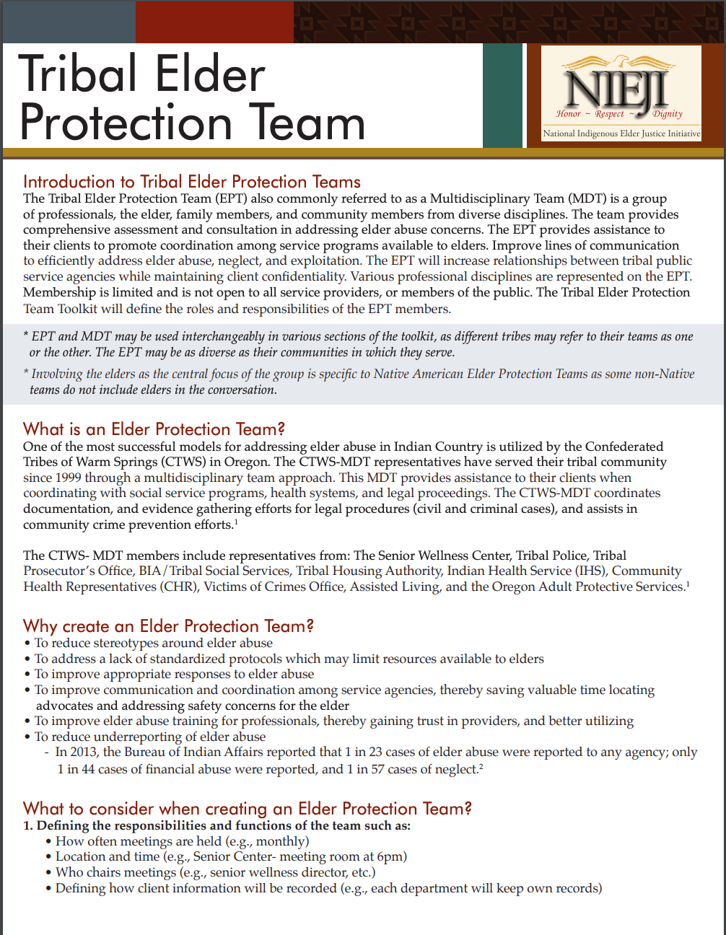
Tribal Elder Protection Team Toolkit
Tribal Elder Protection Team (EPT)or a Multidisciplinary Team is a group of professionals:
Elder, family members, & community members from diverse disciplines
EPT provides comprehensive assessment and consultation to address elder abuse
Downloadable toolkit
NIEJI provides technical assistance

Slide 9
Native Elders Maltreatment Survey
NIEJI provides technical assistance in the collection of local data of elder abuse
Technical assistance includes:
Guidance in obtaining tribal approval
Sampling methodology
Remote training for interviewers
Data entry and analysis
Data Storage
Meaningful data reports

Slide 10
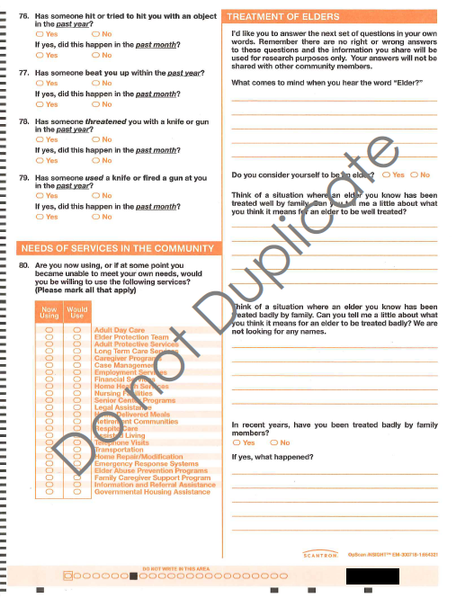
Native Elder Maltreatment Survey

Slide 11
Tribal Elder Abuse Codes
NIEJI provides technical assistance and resources to help tribal communities develop tribal elder abuse codes
NIEJI maintains a database of tribal abuse codes

Slide 12
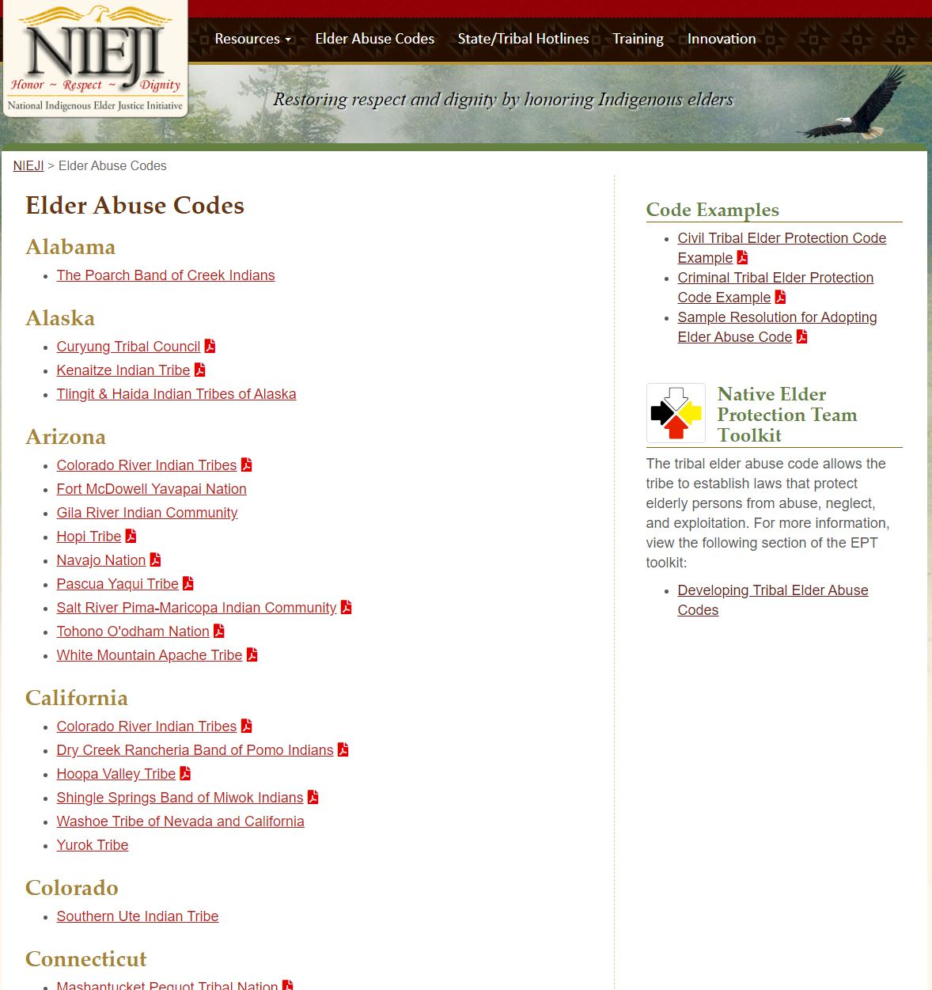
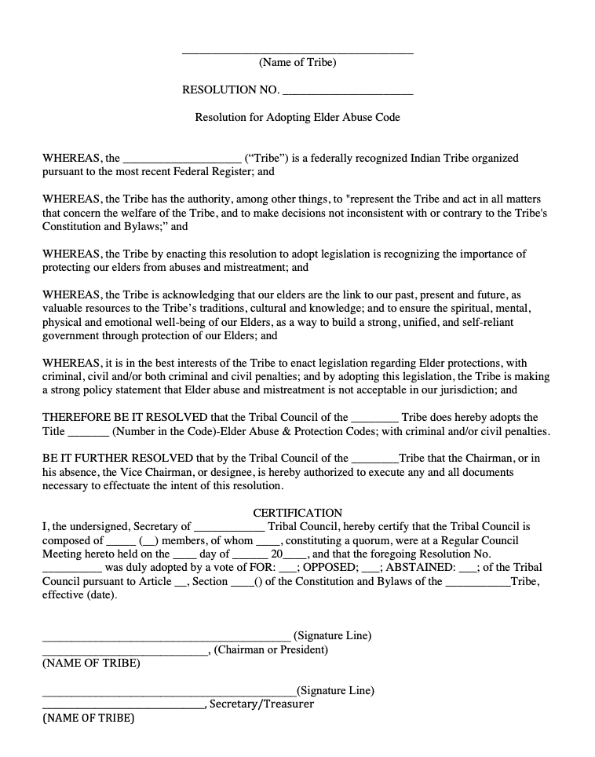
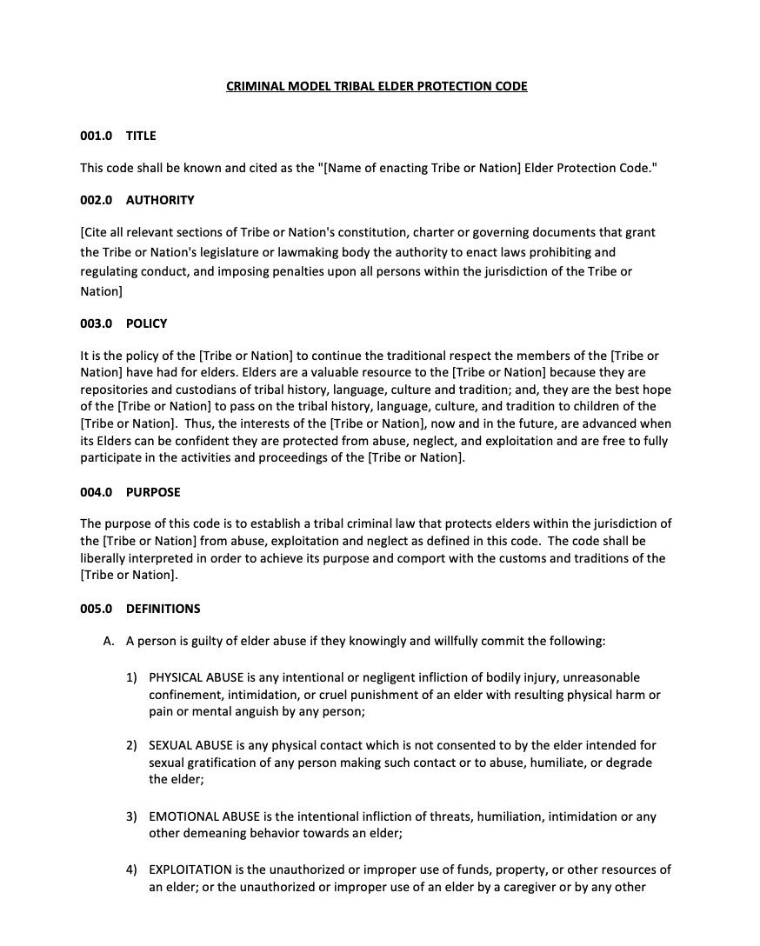
Tribal Elder Abuse Codes

Slide 13
Directory of State & Tribal Hotlines
NIEJI maintains an interactive map of state and tribal hotlines
Report elder abuse
Identify resources

Slide 14
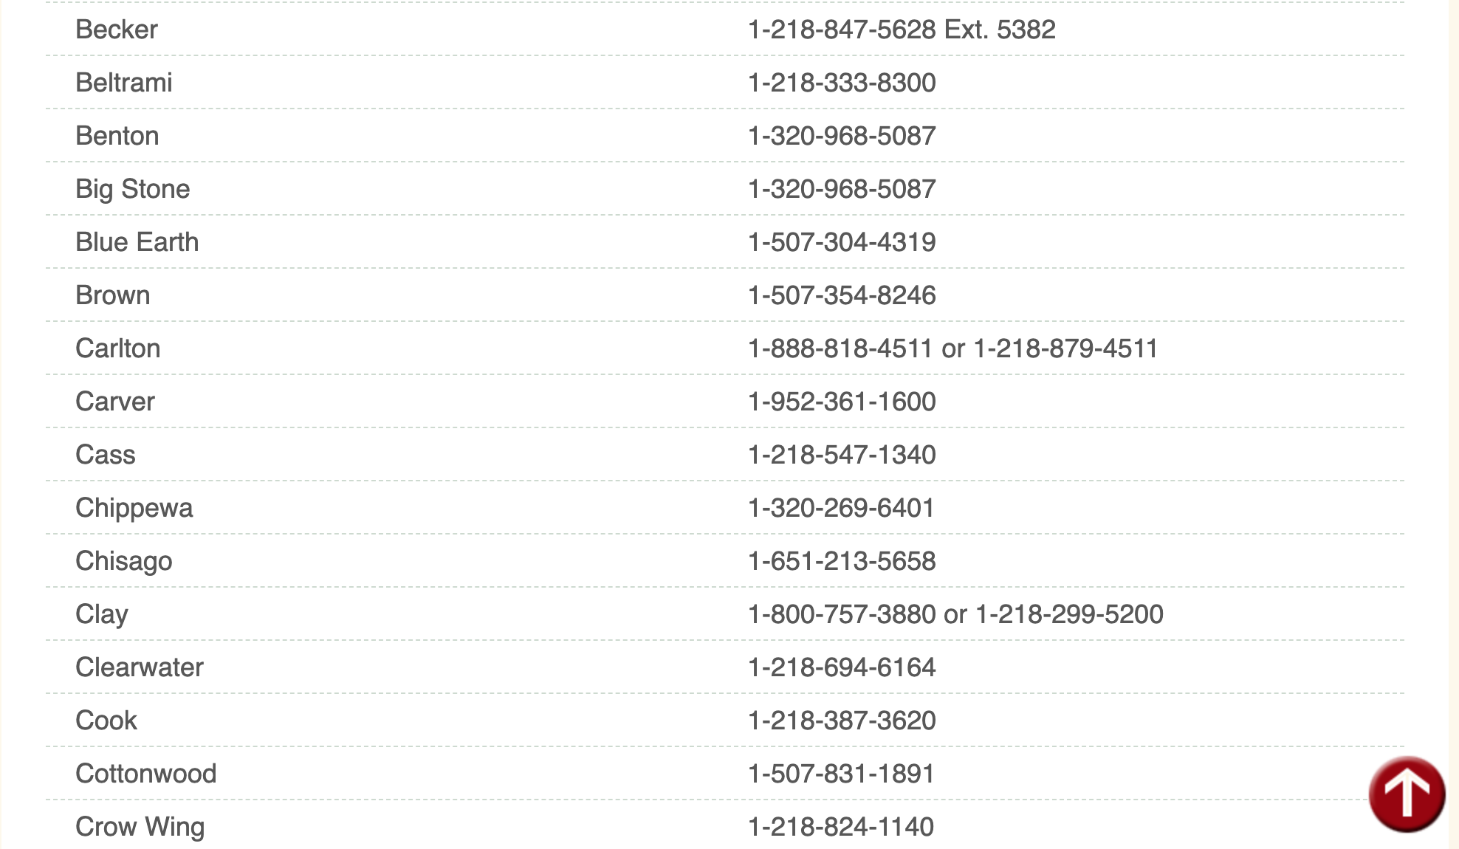
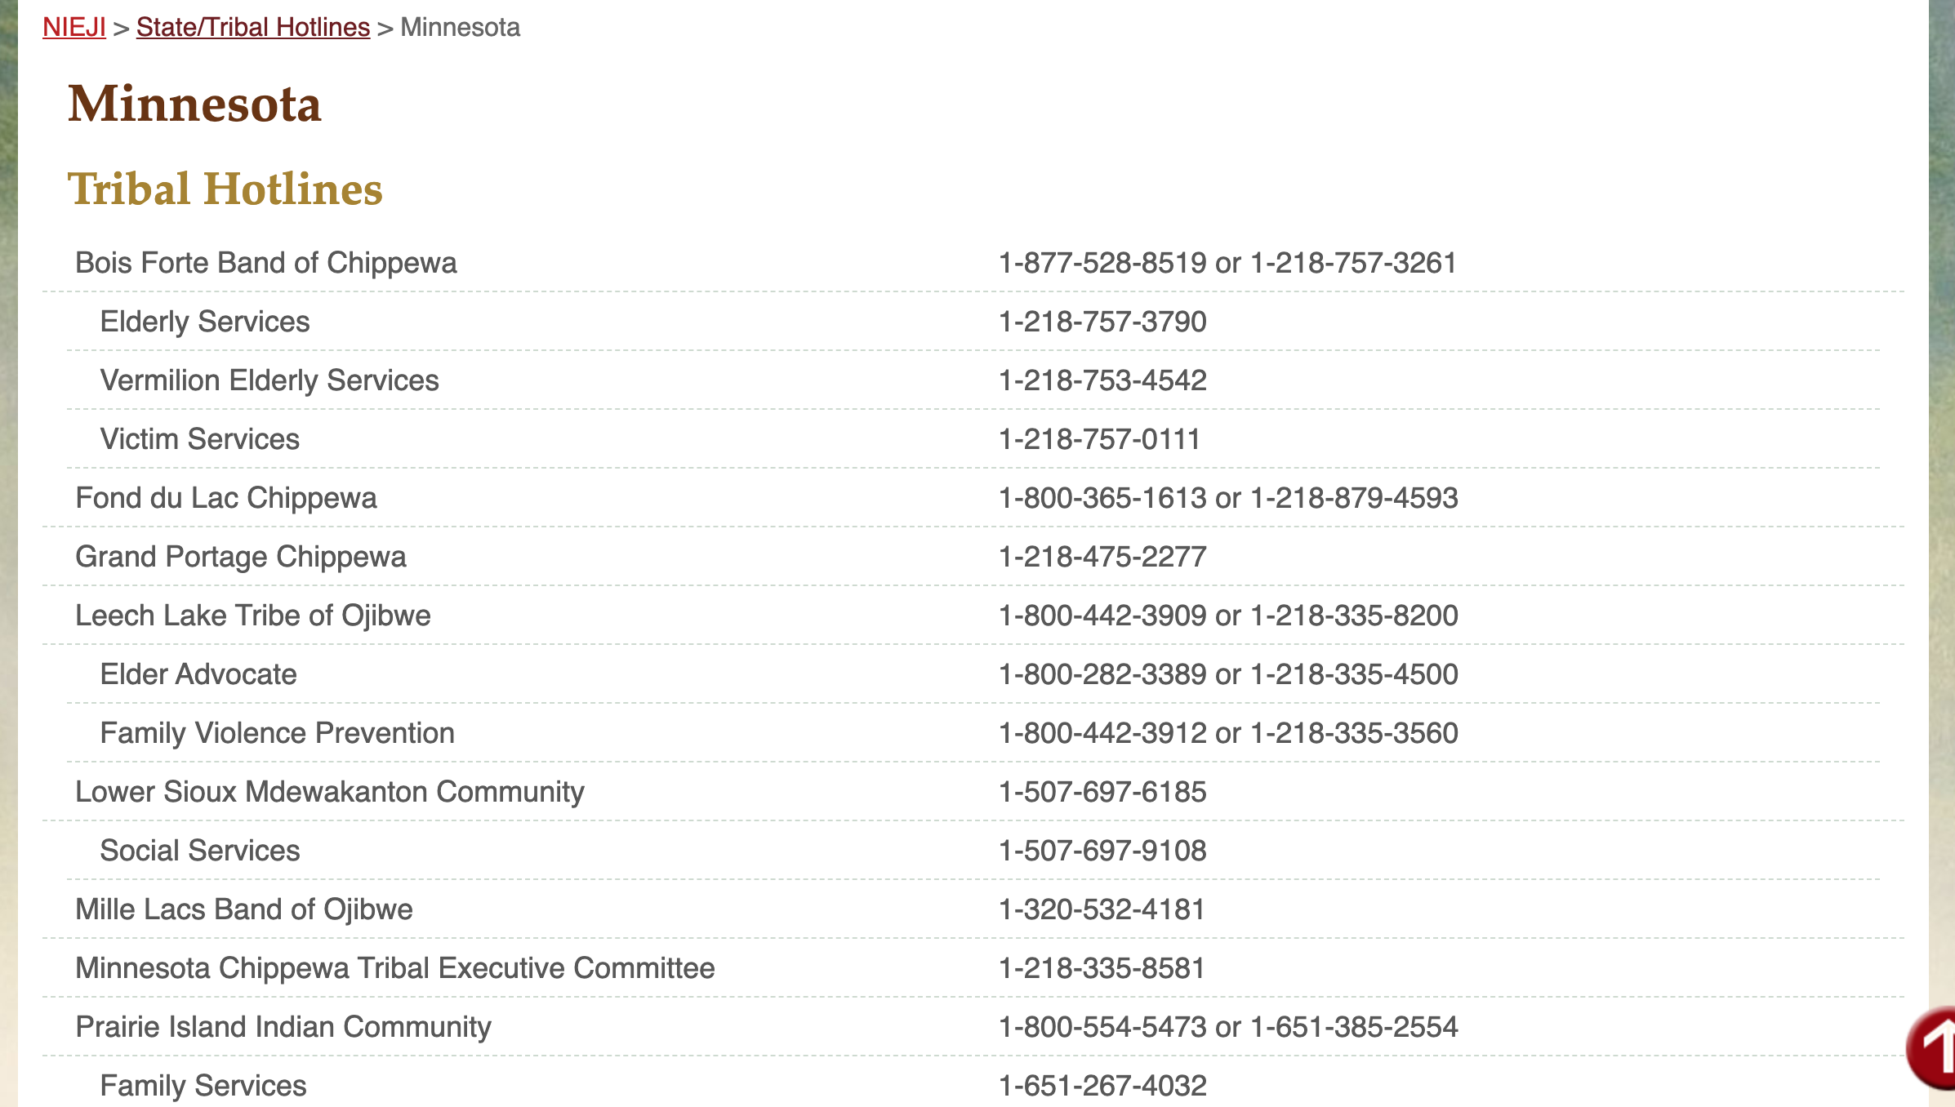
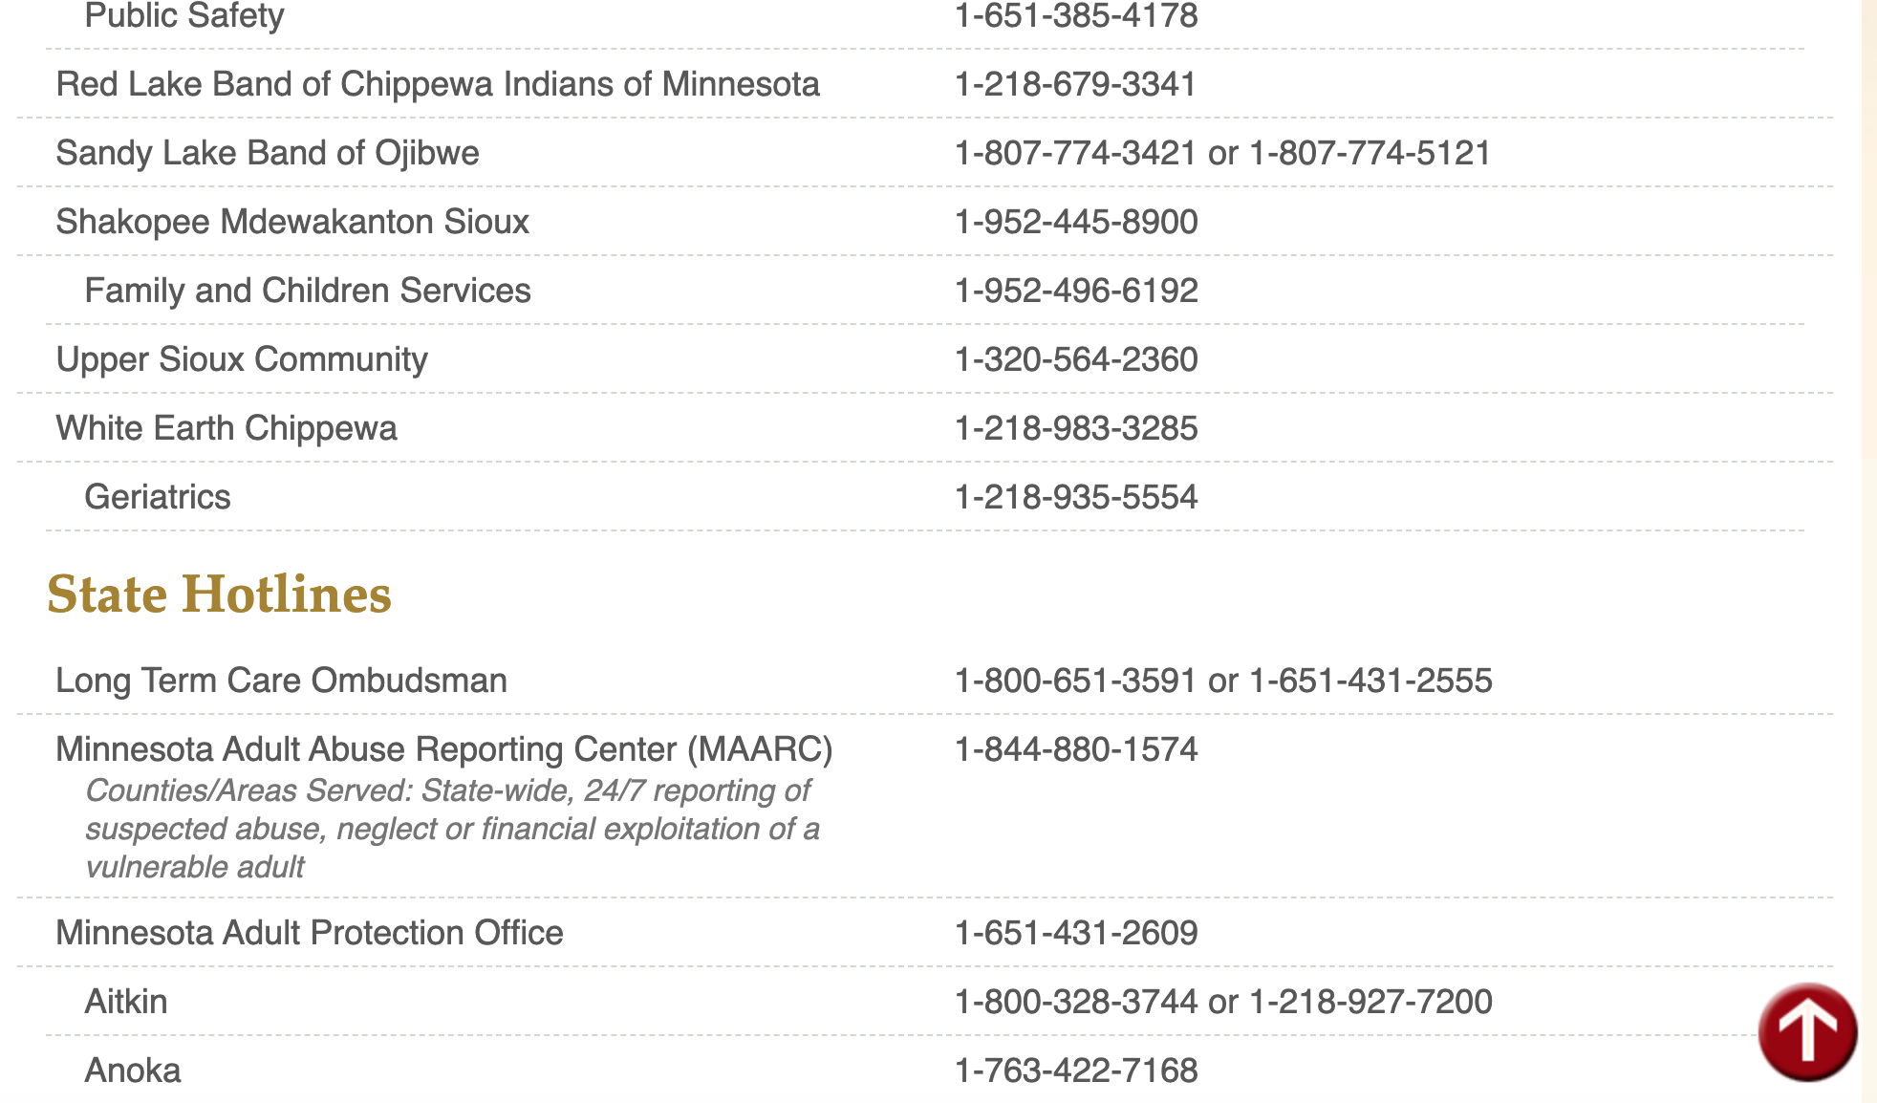
Minnesota State & Tribal Hotlines

Slide 15
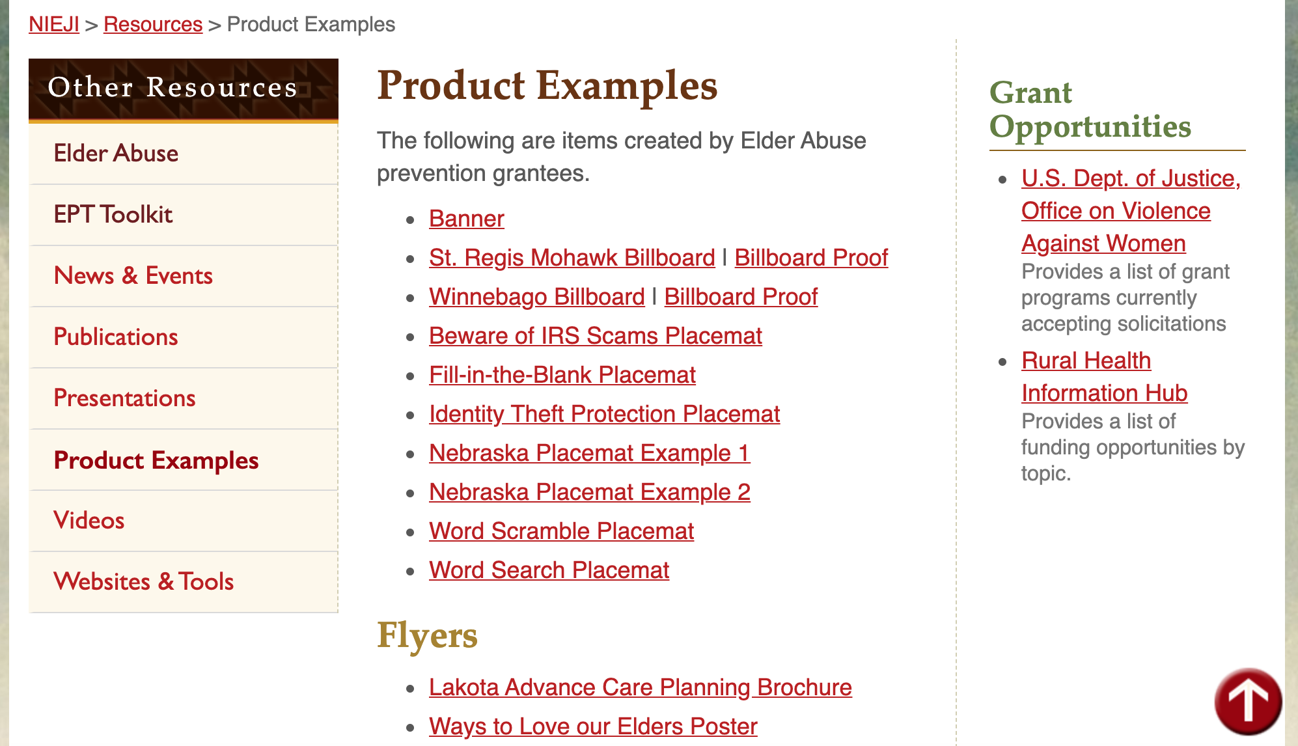
Elder Abuse Product Catalog

Slide 16
Poster, fact sheets, place mats

Slide 17
Billboard

Slide 18
Video Project

Slide 19
Other Resources

Slide 20
Resource Examples

Slide 21
For More Information
National Indigenous Elder Justice Initiative
Phone: 701-777-6780 E-mail: info@nieji.org Website: http://www.nieji.org
Thank You!

