Slide 1
Tribal Sovereignty in Healthcare : Partnerships with State Agencies

Slide 2
Sovereignty and Treaty Rights to Health
Tribal Nations are
Individual Governments
Treaties in Exchange for Territory
Tribal lands were not ceded without a price… Milwaukee and New York were not free!
Constitution of the United States recognizes Tribes as outside of the over-arching confederation of the States
Article 1 Section 2
Article 1 Section 8
14th Amendment, of which Section 2 amends Article 1 Section 2
Special Tribal Provisions are preserved in the Social Security Act and Federal Law
Older Americans Act, American Recovery &Reinvestment Act, Indian Healthcare Improvement Act and more
The United States government formally recognizes a responsibility to the Health and Welfare of all Tribal Nations and their People
There is no expiration date on Treaty Rights

Slide 3
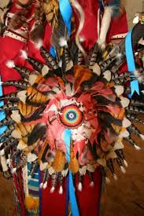
Tribal Health Authorities
Government (Tribal) Oversight
Provide for and oversee the Health and welfare of their People
Special
Provisions
Consultation on ALL changes with potential Tribal impacts (federal & state)
State
Medicaid
May contract directly with Providers and establish network
Enrollment activities*
Financial review*
Administer Waivers*
Design, participate in and administer health/wellness programs
Access Data as a covered entity per the privacy rule of HIPAA
Pay Providers a Medicare-Like Rate
Protected and exempt incomes and property for Medicaid
Tribal members are majority citizen in their Tribal Nation

Slide 4
Challenges For Tribes Serving Vulnerable Adults within Federal & State Programs
Access and Outreach
Rural locations mean increased service cost and lower staff retention
Tribal Programs
Need for meaningful support of Tribally operated programs (staffing and financial resources)
External Agencies
Historical trauma and continued friction with local and State agencies
Global understanding of provisions for Tribal members
Recognition of Tribal authorities for the health and welfare of their People
Data sharing
Need for technical assistance & information

Slide 5
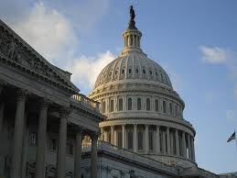
Accessing Services and Support
Medicaid is a State managed program in partnership with the Federal government
Many agency offices are located an hour or more from Reservations and Native communities
Most State and County agencies are unaware of Tribal provisions.
Most, if not all, forms and assessments require County agency staff and may not be in a culturally relevant format

Slide 6
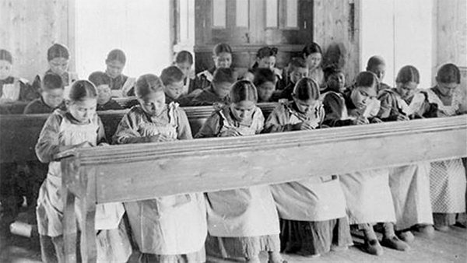
Working with a Traumatized Population
Forced assimilation through boarding schools
Last boarding school closed in 1973
A three-year-old Native child sent to boarding school in 1945 would be a 75-year-old Elder
Native peoples suffer from rates of disability 3% to 4% HIGHER than the national average

Slide 7
Trauma Facts
Trauma
Affects and changes methylation
This change is passed on genetically
Trauma
Methylation impacts DNA/gene expression
This “turns on” risk factors for disease
Trauma
Native Americans have higher rates of chronic illness and disease

Slide 8
HOW CAN WE PROTECT AND SUPPORT VULNERABLE ADULTS IN TRIBAL COMMUNITIES?
Outreach and Enrollment
Increase Tribal participation in programs such as Medicaid waivers
Tribal-HHS Partnership
Expand & empower Tribally provided services
Identify and resolve barriers between Tribal providers and Federal/State agencies
Ensure access to all resources/services
LISTEN!
LISTEN!

Slide 9
Federal Partnership
Respecting
Sovereignty
Government-to Government Relationship
Identify & Address Disparities
Increase Access to Federal/State Programs
Ensure MaximumTribal Reimbursements from all Fiscal Resources
Enhance Tribal Services & Infrastructure
Recognition of Unique Needs and Cultural Identity thru Program Design

Slide 10
Opportunities and the Future for Tribal Vulnerable Adults Services

Slide 11
{Hidden}
Technical Assistance
Dignity
Improved Services that Respect Unique Culture
Culture
Sovereignty
Funding & Investment
Respect
Improved Health Outcomes
Increased Tribal participation
Listening and Facilitation
Business Process through the Tribal lens
Data and Information

Slide 12
~Chi-Miigwech~ ~Pidamaya~ Thank you!

Slide 13
Sources
National Congress of American Indians FYR2016 Budget Report, http://www.ncai.org/policy-issues/tribal-governance/budget-and-approprations/07_FY2016_Health_NCAI_Budget.pdf
The Untold Story of the LDF Government Boarding School, Lakeland Times, 11/5/2010, online edition. Accessed at: http://eedition.lakelandtimes.com/main.asp?SectionID=14&SubSectionID=14&ArticleID=12164
https://www.nativetimes.com/archives/46-life/commentary/14059-truth-and-reconciliationkill-the-indian-and-save-the-man
Understanding the Impacts of Trauma
https://www.ncbi.nlm.nih.gov/books/NBK207191/#

Slide 15
{Hidden}
Aniwahya Consulting Services
Website: http://www.aniwahya.com
Office Number: 608.301.5197

