Slide 1
Training & Technical
Assistance Conference
2022 NATIONAL TITLE VI
April 18-21, 2022

Slide 2
Traditional & Community Healing
Dr. Aaron A. Payment
(Biiwaagajiig)

Slide 3
HISTORICAL CONTEXT
Manifest Destiny
Cultural Shock & Adaptation
Inter-National Treaty Blueprint & Legal Context
Northwest Ordinance & US Constitution
US Supreme Court Recognize Treaty Obligation
Indian Mission & Board Schools
    Forced Assimilation ~ Kill the Indian; Save the Man
    Loss of Traditions & Culture as a way to Deal with and Cope
    Learned Bad Behaviors ~ Predatory Behavior
    Imprinted Focus on Sin that Led to lack of Nurturing & Loving Behavior
Genocide ~ Small Pox, Trail of Tears, Internment Reservations

Slide 4
HISTORICAL CONTEXT
Long Term Systemic Mourning
  Loss of Culture
  Loss of Traditions and Healing/Wellness Practices
  Manifest Outcomes Borne Out Statistically
    US Commission on Civil Rights Broken Promises Report ~ Worst of the Worst
Historical & Inter-Generational Trauma
  Durkheim’s Social Anomie
    Normlessness
    Suicide, Transience, Low Education Attainment, High Unemployment, etc.
CRT ~ TCRT
  Perpetuation of downward cyclical trend

Slide 5
LAND LOSS ~ PROFOUND LOSS

Slide 6
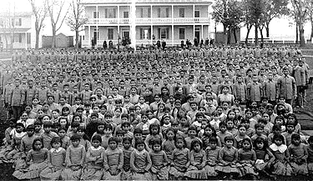
{Hidden}

Slide 7
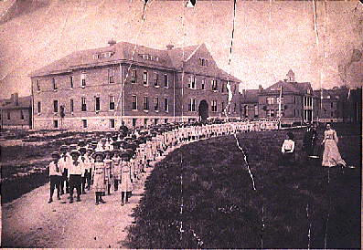
{Hidden}

Slide 8
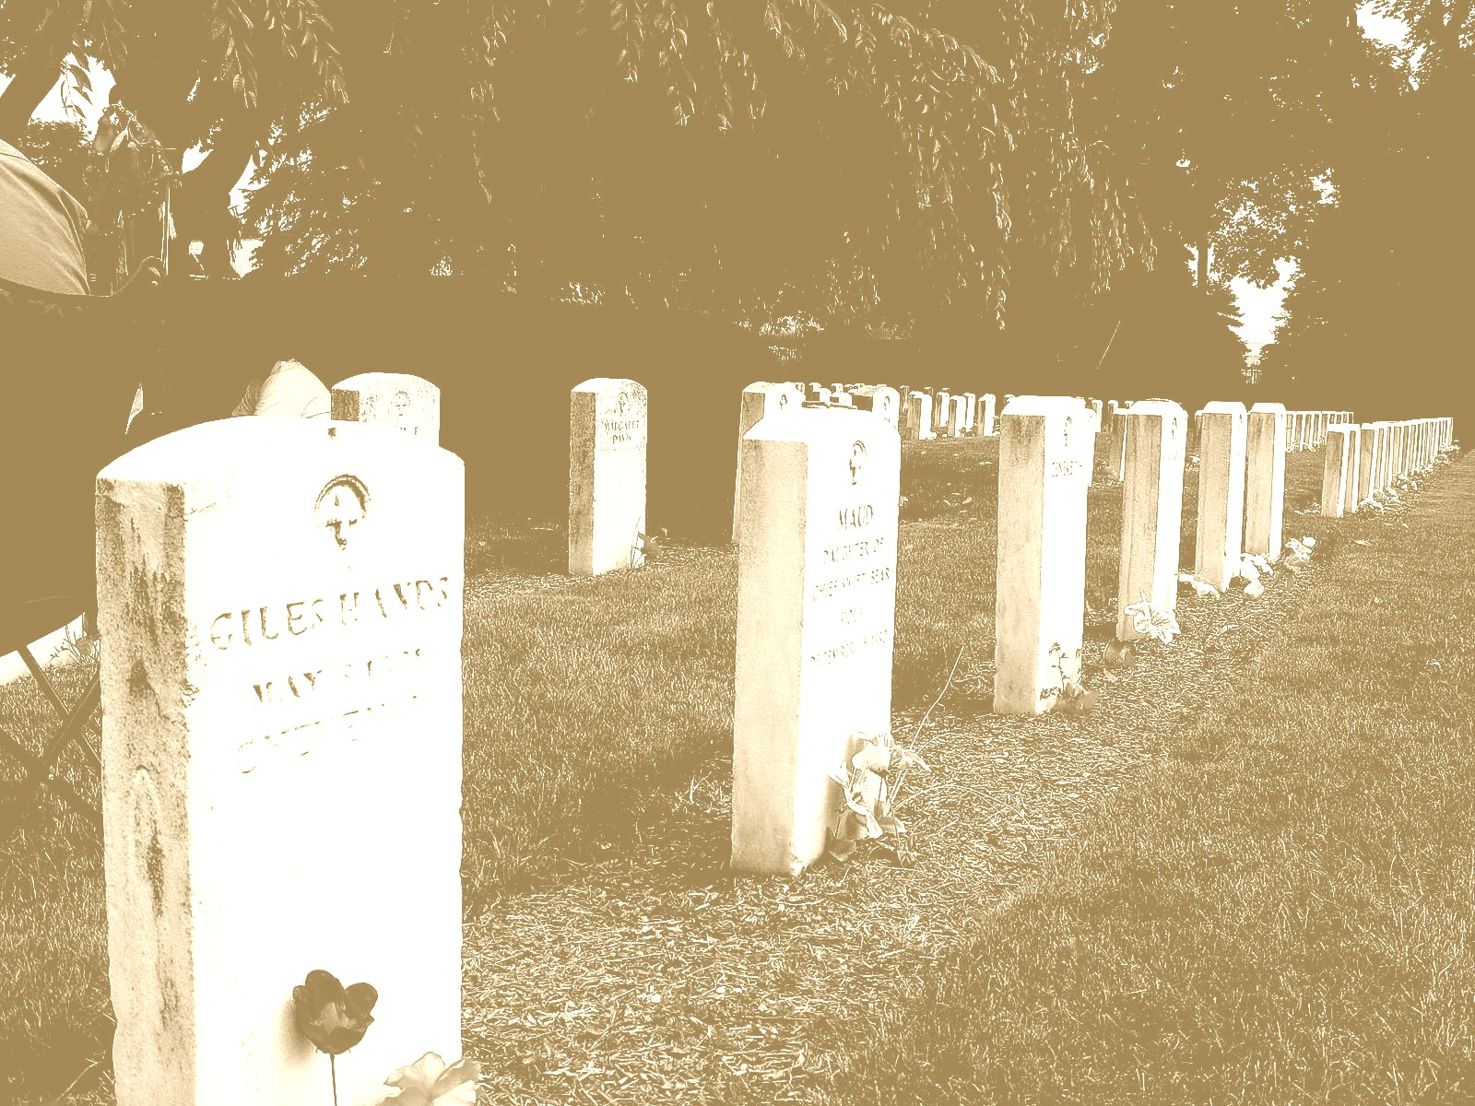
KILL THE INDIAN ~ SAVE THE MAN
Carlisle Cemetery:
The children who never came home/Photo by Brenda Norrell

Slide 9
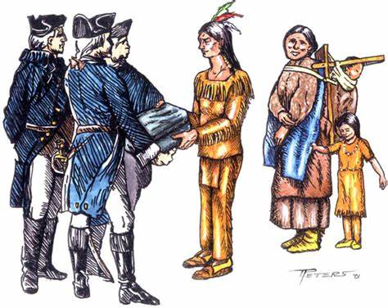
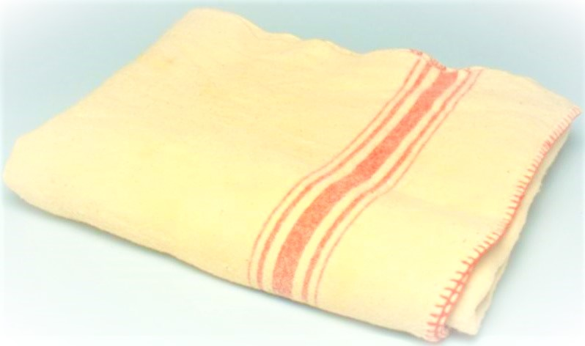
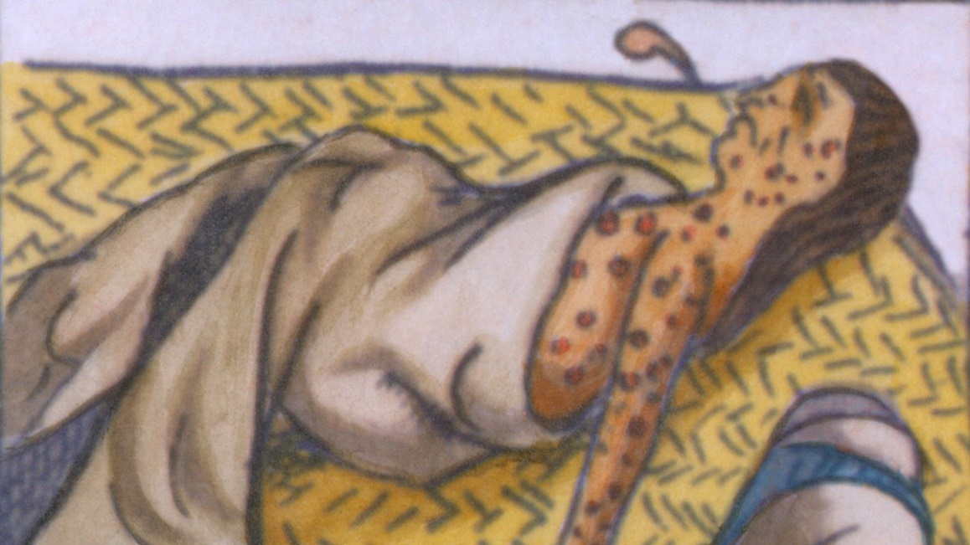
MANEFES T DESTINY OR GENOCIDE?

Slide 10
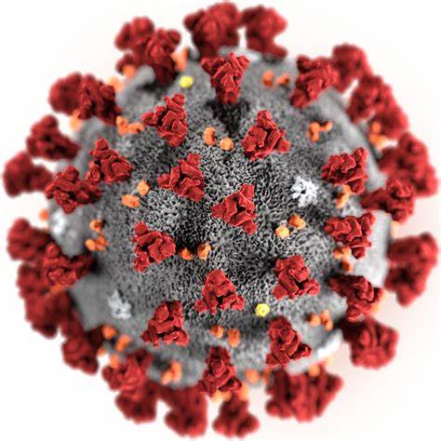
HISTORICAL TRAUMA FEAR

Slide 11
INSUFFICIENT DATA REPORTING
4/16/2020
MI | USA | World
29,263 | 664,201 | 2,127,873 | COVID19 Cases
2,093 | 33,633 | 141,454 | COVID19 Deaths
7.2% | 5.1% | 6.6% | Death Rate
0.6% | 0.0% | 0.0% | Change from previous report
 | 2.1% | MI Greater than USA
 | 0.5% | MI Less than World
4/17/2020
MI | USA | World
30,023 | 690,279 | 2,216,228 | COVID19 Cases
2,227 | 36,118 | 151,006 | COVID19 Deaths
7.4% | 5.2% | 6.8% | Death Rate
0.3% | 0.2% | 0.2% | Change from previous report
 | 2.2% | MI Greater than USA
 | 0.6% | MI Less than World

Slide 12
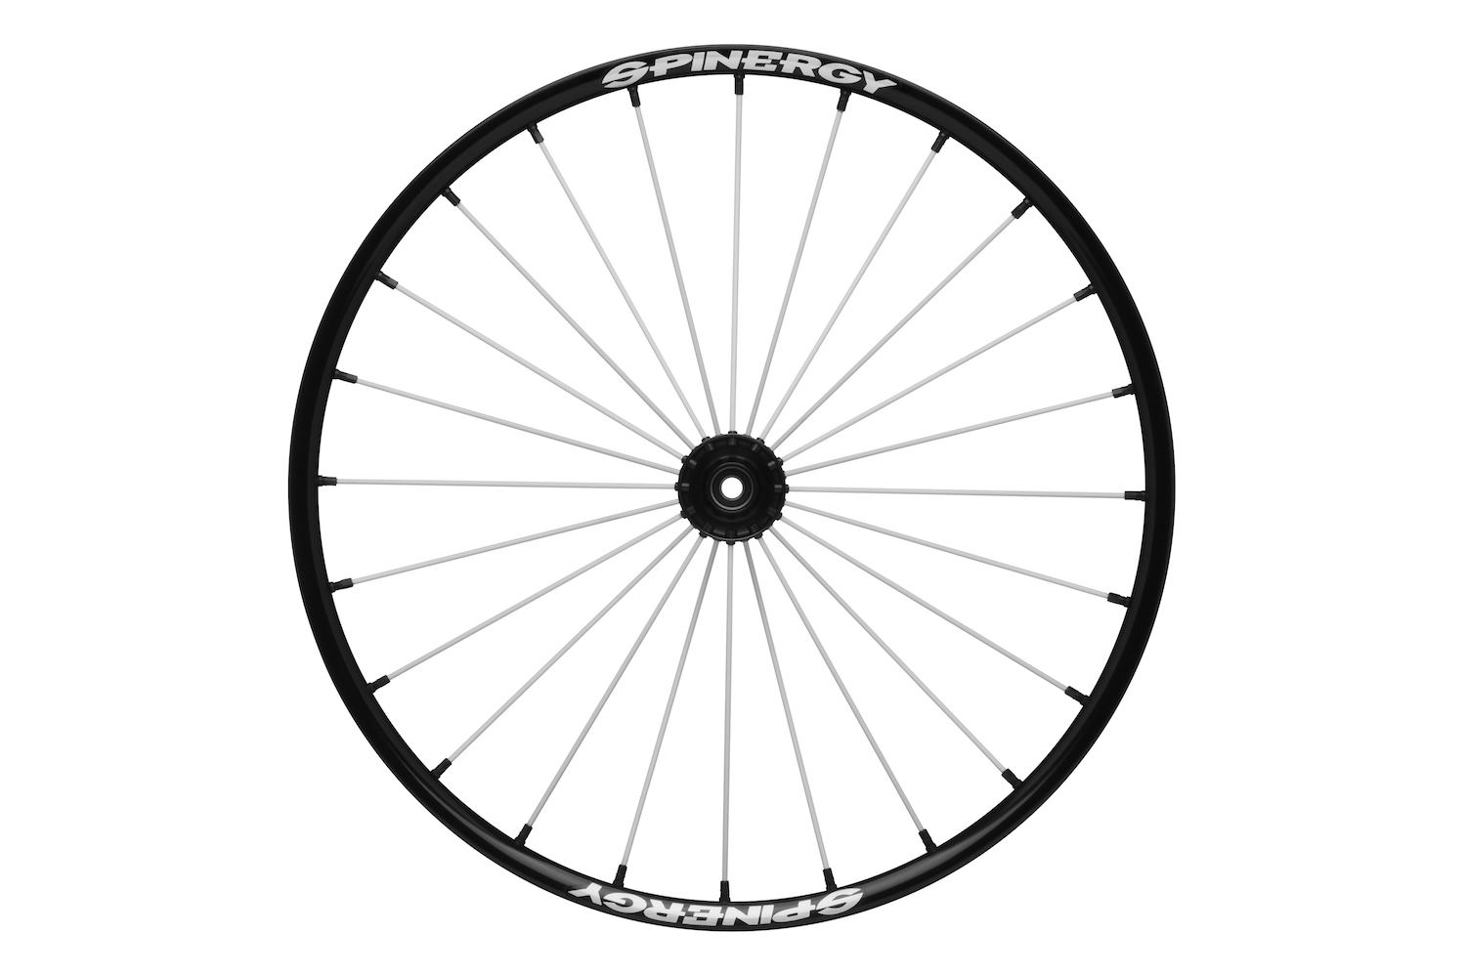
MEDICINE WHEEL TEACHINGS

Slide 13
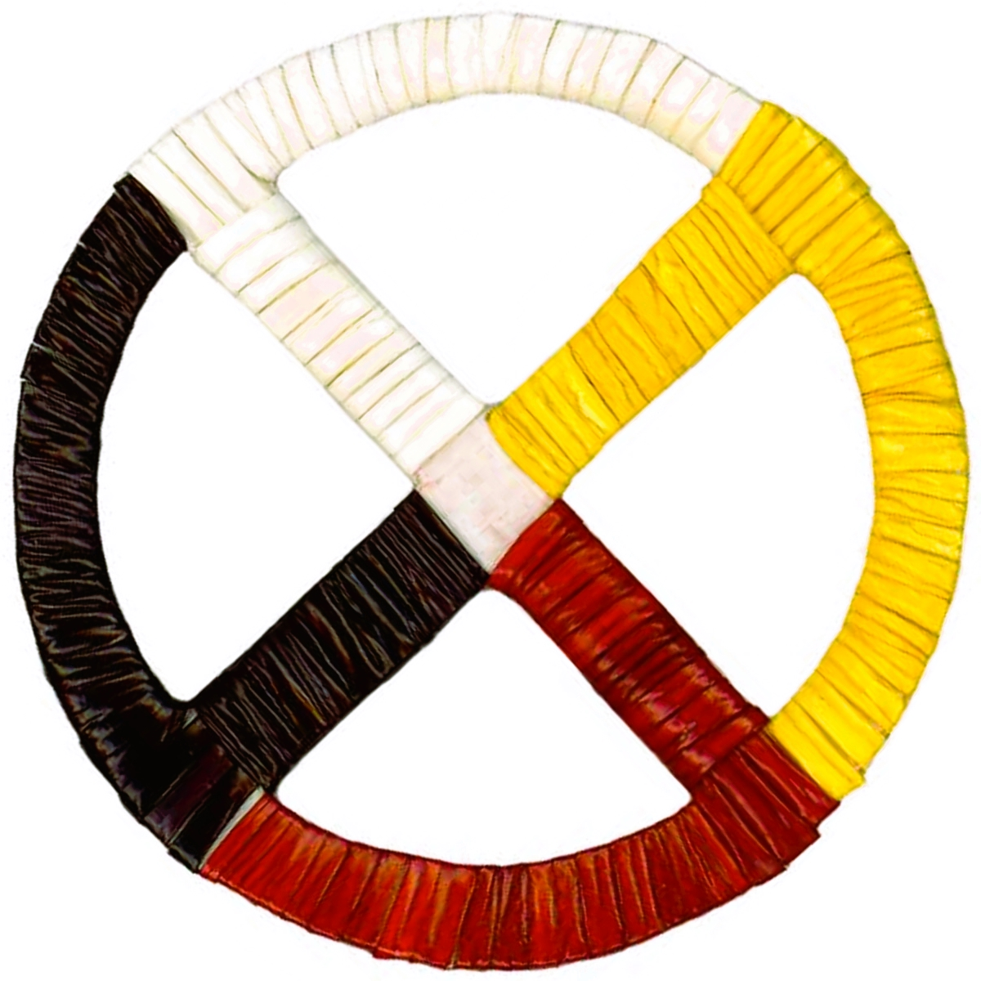
MEDICINE WHEEL TEACHINGS
ELDERS
ADULTS
BABIES
YOUTH

Slide 14
HISTORICAL & INTERGENERAL TRAUMA
The Solution is in Revival or Revitalization of Traditions & Teachings which embed age old coping mechanisms that our Elders have access to;
This makes a World Wide Pandemic Especially Unforgiving as those most vulnerable are the most knowledgeable as they hold the key to the our past;
Previous Conventions of waiting patiently for young to ask their Elders for teachings has to change;
We have to facilitate this generational sharing ~ Title VI is Key

Slide 15
BORROW FROM EKR ~ 5 STAGES OF GRIEF
Denial
  Insidiousness of pandemic ~ not able to effectively mourn. Out of sight out of mind.
Anger
  I anticipate, this will emerge as we begin to realize that family and friends are just gone. The politicization of dealing with the contractibility, testing, vaccinations, mask wearing, etc will become more real.
Bargaining
  I suspect we will be jockeying back and forth between wanting to get back to normal and waves of survivor guilt. Kind of like when you lose someone and while the pain subsides, it returns on holidays.

Slide 16
BORROW FROM EKR ~ 5 STAGES OF GRIEF
Depression
  As we come to terms with the reality of loss, we are likely to face waves of depression.
  It becomes more critical that we monitor and check in on our Elders
  As we return to “normal” with our congregate meals, be cognizant that you may need on site counseling or referrals.
  Offer workshops on how to detect depression and who to contact.
Acceptance
  As we return to normal, I highly recommend your tribes spare no expense to return feast, pow wows, potlach, etc. Also, offering teachings and workshops.
  Remembrance Memorials

Slide 17
NICOA CDC TRIBAL LEADERS PSA
https://www.youtube.com/watch?app=desktop&v=CzEiYcG80y4&feature=youtu.be

Slide 18
Chi MeGwitch, Nokomis~Mishomis auk!
Aaron A. Payment, EdD, EdS, MEd, MPA
Chairperson, Sault Ste. Marie Tribe of Chippewa Indians
aaronpayment@saulttribe.net
906-203-5159

