Slide 1
OAA Title VI & III Working Together
Leonard Geshick| Indian Elders Coordinator | MBA

Slide 2
Older Americans Act
Older Americans Act
Title I – Objectives, to assure older Americans:
Title II – Administration on Aging/ Administration for Community Living (AoA/ ACL)
Title III – Grants for State and community programs
Title IV – creates a number of specific projects related to the objectives of the act. These include healthcare service in rural areas, computer training, civic engagement, and Native American programs.
Title V – establishes a program for engaging low-income senior citizens in community service employment and volunteer opportunities.
Title VI – establishes grants for certain Native American-focused programs on aging.
Title VII – creates state grants for "vulnerable elder rights protection" programs, Ombudsman.
Notes:
Title I – Objectives, to assure older Americans:
1 An adequate income in retirement
2 Best possible physical and mental health
3 Suitable housing
4 Comprehensive long term care services
5 Employment opportunities
6 Retirement in health, honor & dignity
7 Civic, cultural, educational and recreational opportunities
8 Continuum of care for vulnerable elderly
9 Benefits from proven research
10 Freedom & independence to manage their own lives
Title II – Administration on Aging/ Administration for Community Living (AoA/ ACL)
Title III – Grants for State and community programs include the following programs ……
III – B Adult day, case management, chore, I&A, homemaker, home repair, outreach, personal care, respite, transportation
III C – Nutrition Services – Congregate and HDM – the reauthorization encourages the use of locally grown foods in meals programs
III D – Health Promotion Disease Prevention – the reauthorization ensures that all Title III-D programs are evidence-based.
III E – National Family Caregiver Support Program – the reauthorization clarifies that older adults caring for adult children with disabilities and older adults raising children under 18 are eligible to participate in the program.
Please note you were also given MBA handout on definitions of specific services allowed.
Title IV – creates a number of specific projects related to the objectives of the act. These include healthcare service in rural areas, computer training, civic engagement, and Native American programs.
Title V – establishes a program for engaging low-income senior citizens in community service employment and volunteer opportunities.
Title VI – establishes grants for certain Native American-focused programs on aging.
Title VII – creates state grants for "vulnerable elder rights protection" programs, Ombudsman.

Slide 3
Older Americans Act Service Delivery System
ACL
Notes:
The Administration on Aging (AOA) is the principal agency of the U.S Department of Health and Human Services designated to carry out the provisions of the Older Americans Act of 1965 (OAA), as amended (42 U.S.C.A. § 3001 et seq.). The OAA promotes the well-being of older individuals by providing services and programs designed to help them live independently in their homes and communities. The Act also empowers the federal government to distribute funds to the states for supportive services for individuals over the age of 60.
Administration for Community Living
The Secretary of the Department of Health and Human Services (Kathleen Sebelius, at the time) established ACL using her authority on April 18, 2012. This decision brought together the Administration on Aging, the Office on Disability, and the Administration on Developmental Disabilities.
ACL Regional Staff 10 Regions
Region V: IL, IN, MI, MN, OH, WI
Amy Wiatr-Rodriguez
Regional Administrator
amy.wiatr-rodriguez@acl.hhs.gov
312-938-9858

Slide 4
{Hidden
State Unit on Aging
56 State Units on Aging
Each of the 50 States
District of Columbia, Guam, Puerto Rico, American Samoa, the Mariana Islands and the Virgin Islands
Minnesota Board on Aging
Notes:
State Units on Aging (SUAs) are designated state-level agencies that are responsible for developing and administering multi-year state plans that advocate for and provide assistance to older residents, their families, and, in many states, for adults with physical disabilities. The 56 SUAs are located in each of the 50 states as well as the District of Columbia, Guam, Puerto Rico, American Samoa, the Mariana Islands, and the Virgin Islands.
The Minnesota Board Aging (MBA) is the federally-designated state unit on aging for Minnesota. It is the gateway to services for older Minnesotans and their families. The MBA administers federal and state funds to deliver a range of in-home and supportive services to older adults and their family, friends and neighbors caregiving.
OAA Title III Funding is allocated to each SUA based on the number of persons over the age of 60 in the state. 25 Governor appointed board, 3 are AI/AN:
Chief Executive Melanie Benjamin- Chief executive of the Mille Lacs band of Ojibwe. Also a board member of the American Indian Law Resource Center, Women Empowering Women for Indian Nations, the US Attorney General’s Tribal Nations Leadership Council, National Indian Gaming Association and MN Housing Finance Agency Board of directors.
Chairwoman Cathy Chavers- Chairwoman of the Bois Forte Band of Chippewa and is the President of the Minnesota Chippewa Tribe
Lac Courte Oreilles enrolled Stephanie Klinzing- Also serves as a member of the MN Housing Finance Agency Board of Directors, She has served as Sherburne County Commissioner and a representative to the MN House and Mayor of Elk River.

Slide 5
{Hidden
Area Agencies on Aging
629 Area Agencies on Aging
An Area Agency on Aging (AAA) is a public or private nonprofit agency designated by a state
AAAs are primarily responsible for a geographic area, also known as a planning and service area (PSA), that is either a city, a single county, or a multi-county district
Notes:
An Area Agency on Aging (AAA) is a public or private nonprofit agency designated by a state to address the needs and concerns of all older persons at the regional and local levels. AAA is a general term—names of local AAAs may vary.
AAAs are primarily responsible for a geographic area, also known as a planning and service area (PSA), that is either a city, a single county, or a multi-county district. AAAs may be categorized as a county, city, regional planning council or council of governments, private, or nonprofit.
AAAs coordinate and offer services that help older adults remain in their homes, if that is their preference, aided by services such as home-delivered meals, homemaker assistance, and whatever else it may take to make independent living a viable option. By making a range of supports available, AAAs make it possible for older individuals to choose the services and living arrangements that suit them best

Slide 6
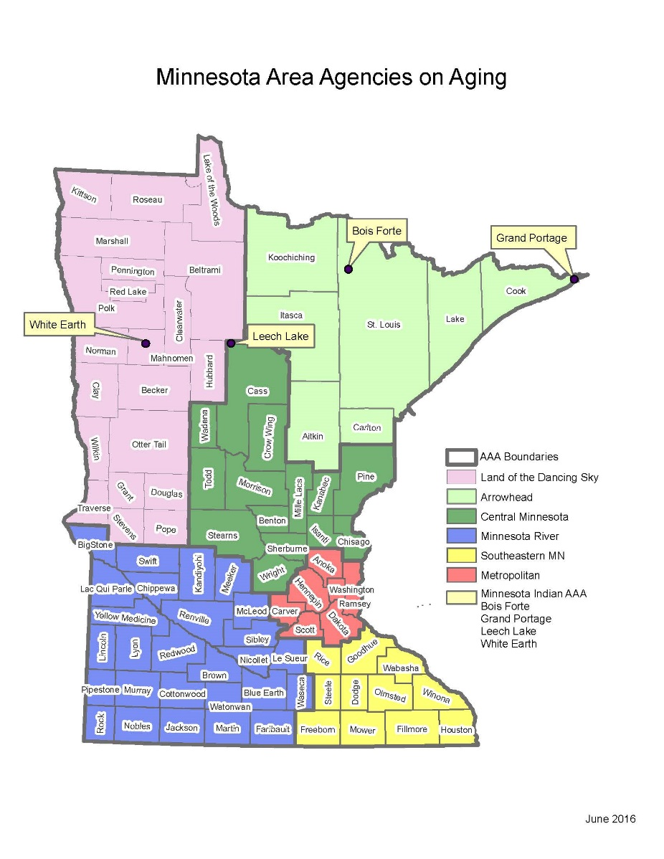
Minnesota Area Agencies on Aging
Dancing Sky AAA
Arrowhead Area Agency on Aging
Central Minnesota Council on Aging
Minnesota River Area Agency on Aging
Southeastern Minnesota AAA
Metropolitan Area Agency on Aging
Minnesota Indian AAA
Notes:
Land of the Dancing Sky AAA
Counties served: Becker, Beltrami, Clay, Clearwater, Douglas, Grant, Hubbard, Kittson, Lake of the Woods, Mahnomen, Marshall, Norman, Otter Tail, Pennington, Polk, Pope, Red Lake, Roseau, Stevens, Traverse & Wilkin.
Arrowhead Area Agency on Aging
Counties served: Aitkin, Carlton, Cook, Itasca, Koochiching, Lake, & St. Louis
Central Minnesota Council on Aging
Counties served: Benton, Cass, Chisago, Crow Wing, Isanti, Kanabec, Mille Lacs, Morrison, Pine, Sherburne, Stearns, Todd, Wadena, & Wright.
Minnesota River Area Agency on Aging, Inc.
Counties served: Big Stone, Blue Earth, Brown, Chippewa, Cottonwood, Faribault, Jackson, Kandiyohi, Lac qui Parle, Le Sueur, Lincoln, Lyon, Martin, McLeod, Meeker, Murray, Nicollet, Nobles, Pipestone, Redwood, Renville, Rock, Sibley, Swift, Waseca, Watonwan, & Yellow Medicine.
Southeastern Minnesota AAA
Counties served: Dodge, Fillmore, Freeborn, Goodhue, Houston, Mower, Olmsted, Rice, Steele, Wabasha, & Winona.
Metropolitan Area Agency on Aging
Counties served: Anoka, Carver, Dakota, Hennepin, Ramsey, Scott, & Washington
Minnesota Indian AAA
Reservations Served: Bois Forte, Grand Portage, Leech Lake, & White Earth.

Slide 7
OAA Titles III & VI Coordination
OAA Titles III & VI Coordination
March 30, 2018 SUA Letter
Sec. 614(a)(11) Title VI
Sec. 306(a)(11)(B) AAAs
Sec. 307 (a)(21)(A) SUA
Notes:
Dear State Unit on Aging Director,
Each year the Department of Health and Human Services (HHS) participates in a number of events to support the federal government' s commitment to help improve the health of American Indians and Alaska Natives through various health and human services programs administered by the Department. As an operating division of HHS, the Administration for Community Living (ACL) takes part in those events with our focus on the tribal aging population and persons with disabilities.
However, improving the lives of Tribal nations is contingent upon understanding the specific needs of Tribal communities. Tribal consultation is an essential tool in understanding the unique needs and ensuring government to government relations. The Federal Tribal Consultation Policy includes the responsibility of states to consult with Tribes when HHS has transferred the authority and funding for programs to states that are intended to benefit Tribes. States should consult with Tribes to ensure the programs that they administer with federal funding meet the needs of the Tribes in that state. Tribes should be considered full partners by states during the design and implementation of programs that are administered by states with HHS funding.
I am inviting you to consult with the tribes in your state and target tribal members as appropriate. The Older Americans Act (OAA) requires coordination between Titles Ill, VI and VII in efforts to meet the needs of tribal elders. There are a number of ways that coordination can be accomplished to support these requirements. Wisconsin is an excellent example of state and tribal coordination and collaboration under the OAA.
ACL is actively engaging in several different methods to increase information about tribes, tribal elders and the Title VI program on www.ad.gov. The Title VI program website
www .olderindians.acl.gov is linked to the ACL website and provides current information about the Title VI program and contact information for each Title VI program.
I believe that we share a common vision of the future where our nation is strong because every individual and community has the right to reach their full potential. That's exactly what the Administration for Community Living is all about. I am asking for your help to strengthen our partnership with Tribes and improve opportunities for older adults and persons with disabilities across each state.
Please contact my office or Cynthia LaCounte with questions.

Slide 8
{Hidden
OAA Titles III & VI Coordination
Sec. 614(a)(11) TVI
Each Title VI application shall contain assurances that the tribal organization will coordinate services provided under this part with services provided under Title III in the same geographical area

Slide 9
{Hidden
OAA Titles III & VI Coordination
Sec. 306(a)(11)(B) AAAs
Each Area Agency on Aging plan shall provide information and assurance concerning services to older individuals who are Native Americans, including an assurance that the Area Agency on Aging will, to the maximum extent practicable, coordinate the services the agency provides under this title with services provided under Title VI

Slide 10
{Hidden
OAA Titles III & VI Coordination
Sec. 307 (a)(21)(A) SUA
The state plan shall provide an assurance that the State agency will coordinate programs under this title and programs under Title VI, if applicable.

Slide 11
{Hidden
If you read the OAA, you won’t find much under Title VI
Programs are designed to follow the OAA Title III Programs and tribes will find most of the rules in that section of the OAA
If you can, ask your local Title III organization for copies of their standards and policy manuals, the rules are the same for both programs.
Look at the manual online at https://olderindians.acl.gov/
Or look to your State’s standards for assistance

Slide 12
OAA Titles III & VI Coordination
Additionally, several requirements in Title III apply to coordination with tribes
Sec. 306 Area Plans: (a)(1)
Sec. 306 Area Plans: (6)(G)
Sec. 306 Area Plans: (11)
Sec. 307 State Plans: (a)(21)(B)
Sec. 307 State Plans: (a)(24)
Notes:
Sec . 306 Area Plans: (a)(1) each area plan shall provide, through a comprehensive and coordinated system, for supportive services, nutrition services, and where appropriate, for the establishment, maintenance, or construction of multipurpose senior centers, within the planning and service area covered by the plan, including determining the extent of need for supportive services, nutrition services, and multipurpose senior centers in such areas (taking into consideration, among other things, the number of older individuals who are Indians residing in such areas), evaluating the effectiveness of the use of resources in meeting such need, and entering into agreements with providers of supportive services, nutrition services, or multipurpose senior centers in such area, for the provision of such services or center to meet such need. Sec 306 Area Plans: (b)(3) an area agency on aging (AAA), in cooperation with governmental officials, state agencies, tribal organizations, or local entities, may make recommendations to government officials in the planning and service area and the state, on actions determined by the AAA to build the capacity in the planning and service area to meet the needs of older individuals for health and human services, land use, housing, transportation, public safety, workforce, and economic development, recreation, education, civic engagement, emergency preparedness, and any other service as determined by such agency.
Sec . 306 Area plans: (6)(G) if there is a significant population of older individuals who are Indians in the planning and service area of the AAA, the AAA shall conduct outreach activities to identify such individuals in such area and shall inform such individuals of the availability of assistance under this Act.
Sec 306 Area plans: (11) provide information and assurances concerning services to older individuals who are Native Americans including information concerning whether there is a significant population of older Native Americans in the planning and service area and if so, an assurance that the AAA will pursue activities, including outreach, to increase access of those older Native Americans to programs and benefits provided under this title; an assurance that the AAA will, to the maximum extent practicable, coordinate the services the agency provides under this title with services provided under Title VI; and an assurance that the AAA will make services under the area plan available, to the same extent as such services are available to older individuals within the planning and service area, to older Native Americans.
Sec 307 State plans: (a)(21)(B) provide an assurance that the state agency will pursue activities to increase access by older individuals who are Native Americans to all aging programs and benefits provided by the agency, including programs and benefits provided under this title, if applicable, and specify the ways in which the state agency intends to implement the activities.
Sec. 307 State plans: (a)(24) the plan shall provide assurance that the state will coordinate public services within the state to assists older individuals to obtain transportation services associated with access to services provided under this title, to services under Title VI, to comprehensive counseling services, and to legal assistance
In addition to specific language in Title III for tribes, Native Americans and to Title VI, there are many other requirements for rural, low income, and limited English speaking older individuals. Most of our elders meet these definitions. If your tribe has not been involved in helping to develop the AAA and state plans, you are encouraged to get a copy of both plans and meet with the AAA and state directors to discuss how they can work with you to meet these requirements. Also, find out when the plans are being updated or rewritten (typically every 3-5 years) and ask to be on the advisory or other committees. Be sure to attend the public meeting when the plans are being developed so you can provide input so your elders can receive all the services they are eligible to receive.

Slide 13
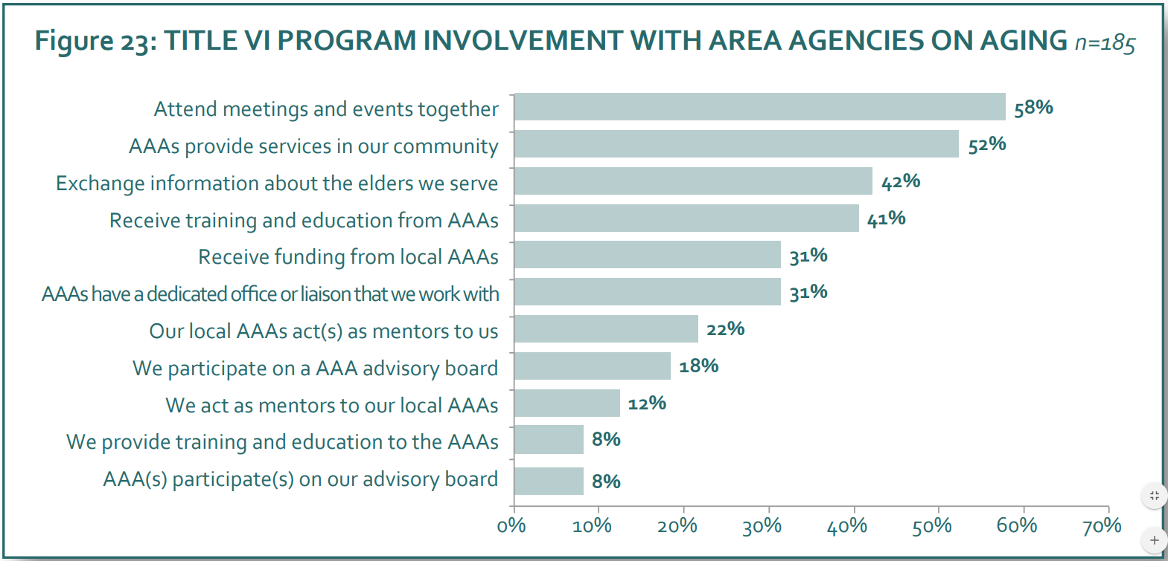
{Hidden
Notes:
The reasons for coordination are numerous and will differ from program to program. Below are reasons which could make a significant difference to the types of services Title VI provides to Elders.
As you coordinate with Title III you will increase your knowledge about the programs they have available which could benefit the Elders.
Many Elders have multiple needs. Through program coordination they can access additional services besides just what Title VI funds can provide.
Greater efficiency. Coordination can reduce duplication of services (the same services being provided by VI and III). This could free funds for additional services. Improved staff effectiveness. In working with other programs it makes available many new resources such as new staff skills, facilities, and equipment.
Increased community support. Each program has its own base of community support. When programs work together, it will service to expand the base of community support and can assist in bringing the different communities together.
More money. As you develop ties to Title III the possibility of receiving funding increases greatly. If your Tribe or Organization is in agreement to receiving funds from Title III it can significantly increase the type and quality of services you provide to Elders.
Knowing what is going on. In many cases Title III has access to resources and information that Title VI programs are still struggling to achieve. This information can be invaluable to Title VI for keeping them updated to what is available in Elder services, additional sources of program funding, staff training opportunities, etc.
Coordination with Title III and all other agencies that can provide services to older persons is the best way to meet the needs of Elders with the limited budgets most Title VI programs face.

Slide 14
State Title III and Tribal Title VI Services FFY 2018
STATE AND TRIBAL GRANT AREA | STATE OAA FUNDING TOTAL | TRIBAL TITLE VI FUNDING TOTAL
NORTH DAKOTA | $6,567,681 | $204,300
WISCONSIN | $23,825,226 | $1,519,700
MINNESOTA | $21,428,291 | $1,175,390

Slide 15
Each year the Department of Health and Human Services (HHS) participates in a number of events to support the federal governments commitment to help improve the health of American Indian and Alaska Natives through various health and human service programs administered by the department. As an operating division of HHS, the Administration for Community Living takes part in those events with our focus on the tribal aging population and persons with disabilities.”
Lance Robertson, Assistant Secretary for Aging and Administrator
March 30, 2018
Notes:
Lets replace the word “commitment” to “obligation”

Slide 16
{Hidden
Trust Responsibility
The United States has acknowledged its special trust responsibility to provide health services to AI/ANs. This responsibility is the direct result of treaties between the United States and Indian Tribes and of executive orders, and has been reaffirmed by judicial decisions, executive orders, and Acts of Congress.
Notes:
The federal trust responsibility to Indians, and the related power to exercise control over Indian affairs in aid of that responsibility, is rooted in the United States Constitution – most significantly the Indian Commerce Clause, the Treaty Clause, and the exercise of the Supremacy Clause. The Constitution contains no explicit language that defines the trust relationship. Rather, the parameters of the trust responsibility have evolved over time through judicial pronouncements, treaties, Acts of Congress, Executive Orders, regulations, and the ongoing course of dealings between the federal government and Indian tribal governments.
The earliest formal dealings between the federal government and Indian Tribes were undertaken through treaty-making. From the United States’ perspective, treaty objectives were essentially two-fold: cessation of hostilities to achieve and maintain public peace, and acquisition of land occupied by tribal members. Tribes doubtless had a peace-making motive as well, but in return for the vast tracts of land they relinquished to the more powerful federal government, Tribes also obtained the promise –expressed or implied – of support for the social, educational, and welfare needs of their people, including health care. These treaties/promises were the first expression of the federal government’s obligation to Indian tribes.
The initial express recognition that a trust responsibility existed came from the courts. In the landmark case of Cherokee Nation v. Georgia, 30 U.S, 1 (1831), Chief Justice John Marshall established the legal foundation for the trust responsibility by describing Indian Tribes as “domestic dependent nations” whose relationship with the United States “resembles that of a ward to his guardian.” Id. At 17. That theme – and the duty of the federal sovereign to Indian Tribes – carried forward some 50 years later when, in United States v. Kagama, 118 U.S. 375, 384 (1886), the Supreme Court acknowledged that Tribes are under the protection and care of the United States:
From their very weakness and helplessness, so largely due to the course of dealing of the federal government with them, and the treaties in which it has been promised, there arises the duty of protection, and with it the power [of protection].
Through nearly two centuries of case law, the courts have extensively examined the parameters of the trust responsibility to Indians, frequently in the context of whether the federal government has the authority to perform an action and whether there are limitations on the exercise of Congressional power over Indian affairs. While Congress has plenary authority over Indian matters through the Constitution, the “guardian-ward” relationship articulated by Chief Justice Marshall requires that federal actions be beneficial, or at least not harmful, to Indian welfare. This is not to say, however, that the United States has always acted honorably toward Indians throughout its history. Nonetheless, the fact that our government has failed in some instances to act in an honorable manner toward Indians does not and should not absolve the more powerful sovereign from its responsibility to carry out its obligations honorably.

Slide 17
Miigwech!
Leonard Geshick
leonard.geshick@state.mn.us
651-431-2608

