Slide 1
Talking about the Title VI Program Performance Report (PPR) and the Older Americans Act Performance System (OAAPS)
Talking about the Title VI Program Performance Report (PPR) and the Older Americans Act Performance System (OAAPS)
Kristen Hudgins
Administration for Community Living
April 19, 2022
Notes:
Page numbers are intentionally omitted from this title slide. An alternate title slide design is shown as Slide 2 in this template deck. Use only one or the other.

Slide 2
What We Will Cover Today
Some OAAPS basics
Getting an account
Signing in
Resources
Common issues with the PPR
Navigating the system
How different services are defined
Submission process
https://oaaps.acl.gov
https://oaaps.acl.gov/Resources/techDocs
Notes:
The Title VI Tracking Workbook boasts several features to aid you in tracking your data, and more importantly provides automatic calculations of totals for services and other reporting metrics required for the PPR.
The features include:
Captures data for one grant year. That way, you can keep each grant year’s data separate from one another. Each grant year, you simply start with a new workbook.
Create profiles client/elders and caregivers (if you provide services to caregivers under your grant). Profiles comprise names, addresses and contact information, notes, and other information to help you keep track of them.
Can split your clients/elders by site so you can easily tell who is where.
Enter the individual or group services you provide clients/elders and caregivers (if applicable). You enter counts of individual services like congregate meals and hours of chore services by person (based on profiles you create) and you enter counts for group services like contacts of telephoning and social events as a total – for example, two social events on a given day.
Enter staffing information like number of full time and part time staff and financing information like funds spent on congregate meals and other sources of funds that support your Title VI services. This information is required for your annual PPR.

Slide 3
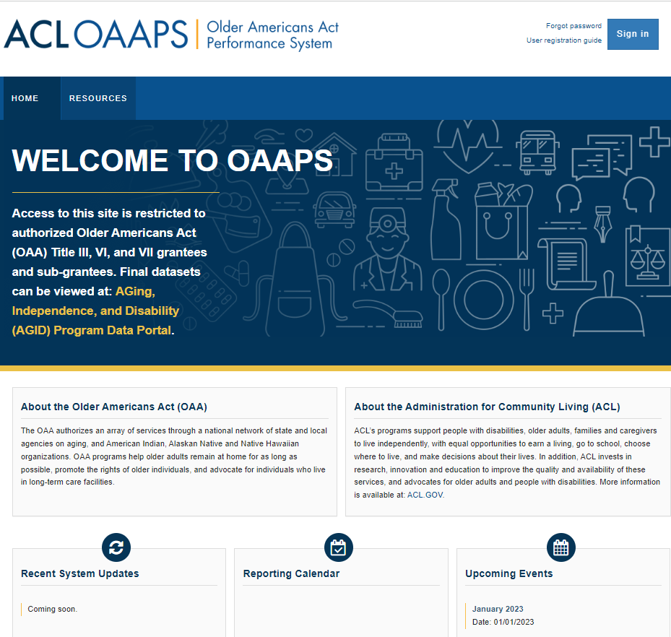
OAAPS and the PPR
OAAPS is the new reporting portal for Title VI’s PPR
Your reporting timeframe (the data you are collecting to report) is from April 1 – March 31
The reporting period (the time you have to report your data) is April 1 – June 30

Slide 4
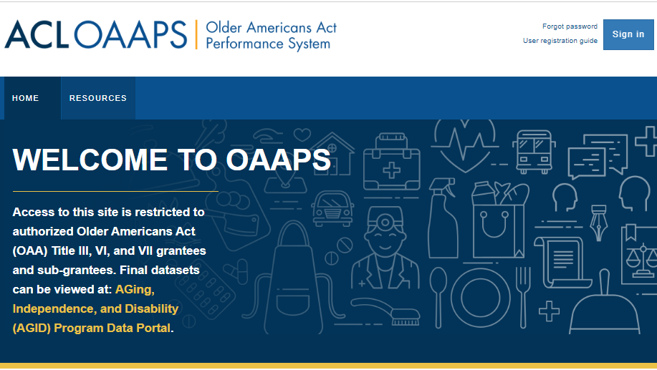
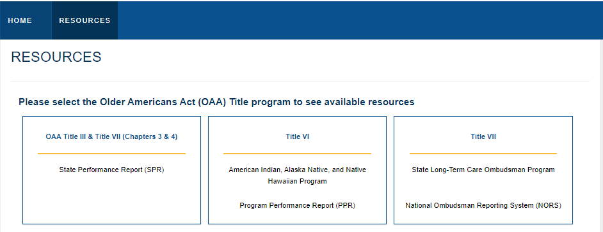
Getting Familiar with OAAPS
Use the Resource Page!
You can get to this page without signing in to OAAPS, it has A LOT of useful information about the system itself as well as the PPR

Slide 5
OAAPS Account Basics
Your username is your firstname.lastname@portal.acl.gov
If you have ever used OAAPS, you have an account
If you need OAAPS help, contact OAAPSHelpdesk@acl.hhs.gov
The OAAPS Resources Page has several How To Guides to help with common issues like logging in and resetting your password
Activating your OAAPS Account
Logging into your OAAPS Account
Resetting your Password

Slide 6
Setting up an OAAPS Account
If you do NOT have an OAAPS account you can contact OAAPSHelpdesk@acl.hhs.gov and give them the name, email address, and phone number of the person who needs an account and ACL will get that set up.
You will then get an email from noreply@okta.com to walk you through setting up your OAAPS account
If you do NOT get an email from noreply@okta.com it may be in your junk mail or spam – if it is not there, you may need to talk to your IT department about making “okta.com” a safe sender.

Slide 7
Getting into the PPR
The PPR has changed and categories have been updated
For instance:
Information and assistance was “unduplicated” elders – now it is “contacts”
Nutrition education was “hours” – now it is “sessions”
Transportation was only one-way trips – now also “unduplicated people”
We have new questions about number of people served in in-home services, we have questions about funding, social events.

Slide 8
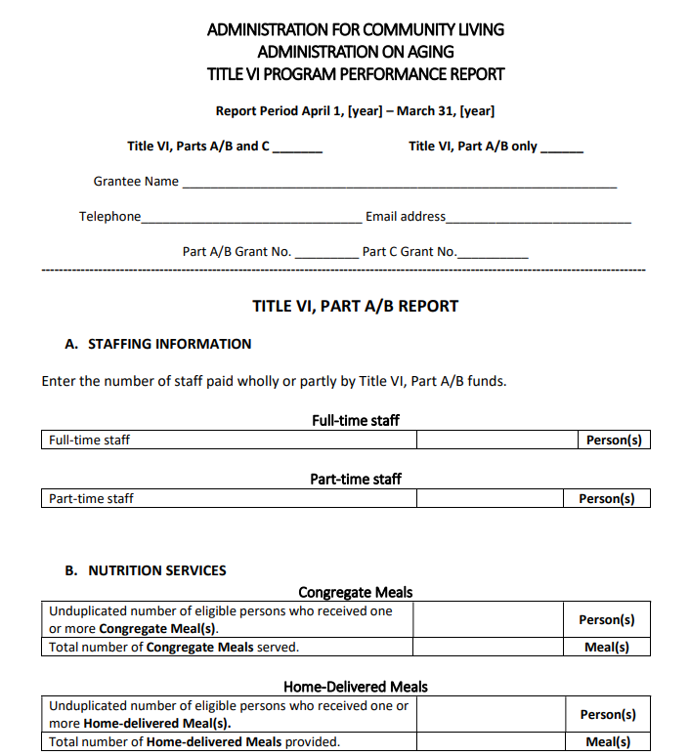
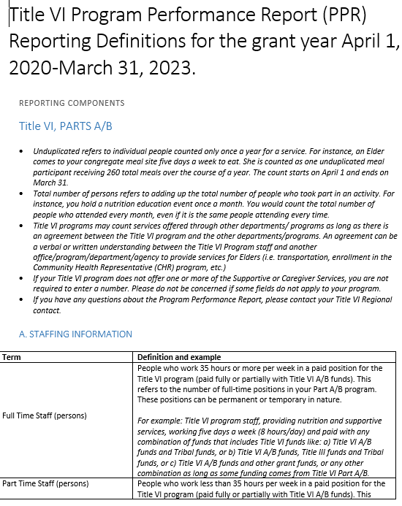
Keep a copy of the PPR and the Definitions on hand
Recommendation to keep a copy of each of these nearby and share with staff so you know how the services are defined and counted.
https://oaaps.acl.gov/api/upload/download?title=VI&downloadType=NewPPRForm
https://oaaps.acl.gov/api/upload/download?title=VI&downloadType=VIComponentsAndDefs

Slide 9
Reporting Basics
“Unduplicated” means “individual”
Contacts means calls, can be texts, or emails
If you have a Part A/B and a Part C program, make sure you are counting services based on who is requesting them and for what purpose.
An elder asking for a grab-bar in their home should be counted under Part A/B “other supportive service” – but if the grab-bar was requested by the elder’s son as the elder’s caregiver, then you should count this service as a home-modification/repair under Supplemental Services in Part C

Slide 10
A Note on Zeros and Variances
First things first, ZEROS ARE OK.
Variances are OK.
Variance are changes that are 30% above or below your numbers from the previous year.
Some of you will have variances on a regular basis because you serve small numbers of people and so small changes in your program make a big difference in your percentages.
Variance explanations in OAAPS are ways for you to explain any changes in your program from year to year. You can go back and look at them as a historical record; and they allow ACL to understand why changes took place when reviewing your annual report. They should always explain WHY your data changed.

Slide 11
Required Services
Part A/B
Meals – Congregate and Home-Delivered (unduplicated persons/meals)
Information and Assistance (contacts)
Part C
Information and Assistance (contacts)
Counseling (unduplicated persons/hours)
Support Group (sessions)
Caregiver Training (unduplicated persons/hours)
Respite (unduplicated persons/hours)
https://oaaps.acl.gov/Resources/techDocs
Notes:
View total counts of the services you provide clients/elders and caregivers (if applicable). You can view the total counts by month, quarterly, as well as year-to-date so you can see how well you are meeting your service delivery goals.
Get automatically compiled data for your PPR, including service total counts, that you can upload into OAAPS.
There’s also an optional budget feature that you can use to enter your revenues and direct and indirect expenses so you can see how well you are staying within your budget. A stand-alone version is also available in case you wish to manage your budget information separate from the Title VI Tracking Workbook.

Slide 12
Regularly Mis- or Under- reported – A/B
Staff (persons)
Only report if paid using ANY Title VI money. If not, put a ZERO.
Information and Assistance (contacts)
Every time someone calls you to ask a question about the program – what you offer, what’s for lunch – and you help provide them with an answer and some guidance, you count it as ONE contact.
Outreach (activities)
Traditionally this would have been a booth at a health fair, or radio spots, or anything that makes your wider community aware of your program and the services that you provide for elders. Putting up flyers one month would count as ONE activity, doing a radio spot would be ONE activity, having a Facebook announcement on the main tribal webpage could be ONE activity.
Notes:
View total counts of the services you provide clients/elders and caregivers (if applicable). You can view the total counts by month, quarterly, as well as year-to-date so you can see how well you are meeting your service delivery goals.
Get automatically compiled data for your PPR, including service total counts, that you can upload into OAAPS.
There’s also an optional budget feature that you can use to enter your revenues and direct and indirect expenses so you can see how well you are staying within your budget. A stand-alone version is also available in case you wish to manage your budget information separate from the Title VI Tracking Workbook.

Slide 13
Regularly Mis- or Under- reported – A/B
Nutrition Education (sessions)
Every time you send out a flyer on a specific nutrition issue that counts as ONE session, regardless of how many people you sent it to. If you put out a nutrition article in every one of your monthly newsletters, you would count 12 sessions. If you are holding in person sessions, you would count every time you gathered elders to discuss nutrition education.
Transportation (unduplicated persons/one-way trips)
One-way Trips – If you take an elder to the doctor, the pharmacy, and back home (so 3 stops) that counts as THREE one-way trips. If you take 4 elders and pick each one of them up and take them to the congregate meal site, and then take them back home that counts as EIGHT one-way trips.
Notes:
View total counts of the services you provide clients/elders and caregivers (if applicable). You can view the total counts by month, quarterly, as well as year-to-date so you can see how well you are meeting your service delivery goals.
Get automatically compiled data for your PPR, including service total counts, that you can upload into OAAPS.
There’s also an optional budget feature that you can use to enter your revenues and direct and indirect expenses so you can see how well you are staying within your budget. A stand-alone version is also available in case you wish to manage your budget information separate from the Title VI Tracking Workbook.

Slide 14
Regularly Mis- or Under- reported – A/B
Social Events (events)
Getting people together in person or virtually generally around an event. If you have a monthly elder birthday celebration, then you may have TWELVE or more social events a year.
Funding Questions
Congregate and Home-Delivered Meals/Supportive Services– ACL does not know how much it costs to run a Title VI program. We know how much ACL gives you; but what does it COST.
Notes:
View total counts of the services you provide clients/elders and caregivers (if applicable). You can view the total counts by month, quarterly, as well as year-to-date so you can see how well you are meeting your service delivery goals.
Get automatically compiled data for your PPR, including service total counts, that you can upload into OAAPS.
There’s also an optional budget feature that you can use to enter your revenues and direct and indirect expenses so you can see how well you are staying within your budget. A stand-alone version is also available in case you wish to manage your budget information separate from the Title VI Tracking Workbook.

Slide 15
Regularly Mis- or Under- reported – C
Caregiver to Elders or Individuals of any age with Alzheimer’s Disease and Related Disorders (persons)
These are the folks we typically think of caregivers. They are people caring for elders.
They can ALSO be caring for folks with Alzheimer's and related disorders.
DOES NOT have to be Elders with Alzheimer’s.
Elder Caregivers Caring for Children under the age of 18 (persons)
Grandparents raising grandchildren – should be elders, should be primary caregivers for the grandchildren.
Elder Caregivers Providing Care to Adults 18-59* with disabilities (persons)
Elders caring for adult children with disabilities that need support from the Title VI program for their roles as caregivers. *59 is a placeholder age for whatever the age of “elder” is in the program – at that age; the adult with disability would be considered an elder.
Notes:
View total counts of the services you provide clients/elders and caregivers (if applicable). You can view the total counts by month, quarterly, as well as year-to-date so you can see how well you are meeting your service delivery goals.
Get automatically compiled data for your PPR, including service total counts, that you can upload into OAAPS.
There’s also an optional budget feature that you can use to enter your revenues and direct and indirect expenses so you can see how well you are staying within your budget. A stand-alone version is also available in case you wish to manage your budget information separate from the Title VI Tracking Workbook.

Slide 16
Regularly Mis- or Under- reported – C
Information Services (activities)
This is essentially the same as “outreach” under Part A/B – it is letting the wider community of Caregivers know about the services you provide. If you do a radio spot and you talk about what you do for elders under Part A/B and what you do for Caregivers under Part C you can count it as TWO activities – ONE under Outreach(A/B), ONE under Information Services(C).
Information and Assistance (contacts)
Every time someone calls you to ask a question about the program – what you offer, when support group is– and you help provide them with an answer and some guidance, you count it as ONE contact.
Notes:
View total counts of the services you provide clients/elders and caregivers (if applicable). You can view the total counts by month, quarterly, as well as year-to-date so you can see how well you are meeting your service delivery goals.
Get automatically compiled data for your PPR, including service total counts, that you can upload into OAAPS.
There’s also an optional budget feature that you can use to enter your revenues and direct and indirect expenses so you can see how well you are staying within your budget. A stand-alone version is also available in case you wish to manage your budget information separate from the Title VI Tracking Workbook.

Slide 17
Regularly Mis- or Under- reported – C
Counseling (unduplicated persons/hours)
This can be a one-on-one or group service but should be led by someone who either have training as a counselor or experience as a caregiver to serve as a peer counselor. If 15 individuals participate in weekly 1 hour counseling sessions throughout the entire year, even in multiple sessions; you should report 15 unduplicated people, and 780 hours of counseling.
Support Group (sessions)
Support groups are a great way to bring different (or mixed) groups of caregivers together to talk and share their concerns or talk about what is working for them as caregivers. Every time you have a group meet you count that as ONE session.
Notes:
View total counts of the services you provide clients/elders and caregivers (if applicable). You can view the total counts by month, quarterly, as well as year-to-date so you can see how well you are meeting your service delivery goals.
Get automatically compiled data for your PPR, including service total counts, that you can upload into OAAPS.
There’s also an optional budget feature that you can use to enter your revenues and direct and indirect expenses so you can see how well you are staying within your budget. A stand-alone version is also available in case you wish to manage your budget information separate from the Title VI Tracking Workbook.

Slide 18
Regularly Mis- or Under- reported – C
Caregiver Training (unduplicated persons/hours)
This can be a one-on-one or group service to help caregivers with skills they may need. If you have 30 caregivers attend a 2-hour CPR training, you will count that as 30 unduplicated people and 2 hours of training.
Supplemental Services (service category/description of service/ unduplicated caregivers)
Most importantly, these must be services requested BY THE CAREGIVER.
The services may benefit an elder, but they must be at the request OF THE CAREGIVER.
Notes:
View total counts of the services you provide clients/elders and caregivers (if applicable). You can view the total counts by month, quarterly, as well as year-to-date so you can see how well you are meeting your service delivery goals.
Get automatically compiled data for your PPR, including service total counts, that you can upload into OAAPS.
There’s also an optional budget feature that you can use to enter your revenues and direct and indirect expenses so you can see how well you are staying within your budget. A stand-alone version is also available in case you wish to manage your budget information separate from the Title VI Tracking Workbook.

Slide 19
Regularly Mis- or Under- reported – C
Respite Care (unduplicated persons/hours)
This is reported by type of caregiver
Respite is a service that gives the caregiver a break from providing care
Respite means someone else watches the person who needs care so the caregiver can go to the store, can go to a doctor’s appointment, can go to work, can go and do whatever they need to without worrying about their loved one’s care.
Notes:
View total counts of the services you provide clients/elders and caregivers (if applicable). You can view the total counts by month, quarterly, as well as year-to-date so you can see how well you are meeting your service delivery goals.
Get automatically compiled data for your PPR, including service total counts, that you can upload into OAAPS.
There’s also an optional budget feature that you can use to enter your revenues and direct and indirect expenses so you can see how well you are staying within your budget. A stand-alone version is also available in case you wish to manage your budget information separate from the Title VI Tracking Workbook.

Slide 20
Quick OAAPS Walkthrough
Quick Overview
Signing In
Validating Data
Generating Variances
Submitting Data

Slide 21
Questions
Kristen.Hudgins@acl.hhs.gov
202-795-7732

