Slide 1
NEW! Title VI Monitoring Tool

Slide 2
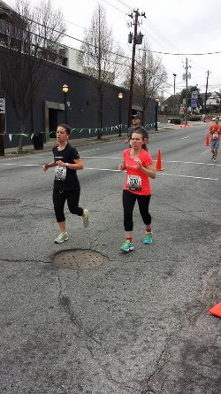
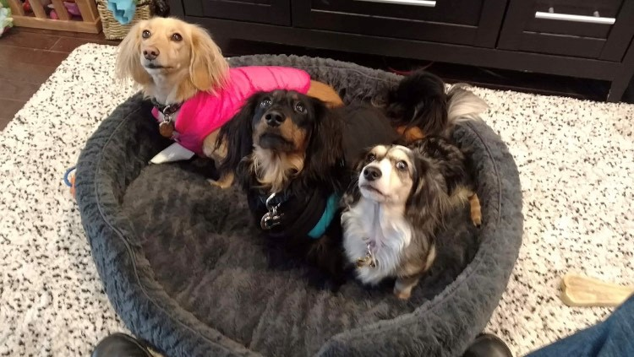
Who am I?
Jasmine Aplin
I am a new member on Cynthia’s team.
I have a JD and I’m also working on an MPH.
For the past 4 years, I’ve worked at the Center for Medicare and Medicaid Services (CMS).
My personal interests are running marathons and my 3 dachshunds.

Slide 3
Why am I here?
To get your input on a new VOLUNTARY monitoring tool for title VI grantees.

Slide 4
What is this tool?
This tool is intended to:
Assist you in tracking the progress of your grant.
Help you fill out your annual Title VI report.
Give you an opportunity to set goals for all aspects of your grant.
Help you identify areas of your grant that you have questions about.
Help ensure a smooth transition if you have any changes in your title VI staff.

Slide 5
What this tool is NOT
This monitoring tool is not mandatory.
ACL will not be collecting your report.
HOWEVER, we encourage you to share your report with the ACL team if you have any questions or would like to share your success.
***Please Note***This report does not substitute your title VI annual report or any financial information you enter in PMS.

Slide 6
Contents of the monitoring tool
Instructions Sheet
Data Sheet
Dashboard Sheet
Reflections Sheet

Slide 7
Instructions Sheet
The Instructions Sheet has directions for how to fill out the monitoring tool.
The Instructions Sheet is also available as a separate document so that you can easily refer to the instructions while you complete the monitoring tool.

Slide 8
Data Sheet
The Data Sheet is where you will fill out the numeric results of your grant.
To fill out the Data Sheet you will:
Step 1:

Slide 9
Dashboard Sheet
The Dashboard Sheet will give you charts, based on the information in the Data Sheet.
The charts show:
The total Title VI amount spent vs. the Title VI amount that’s unspent.
The total amount spent on indirect costs vs. the amount of indirect costs that’s unspent.
The number of elders served each month.
The amount of congregate meals served.
The amount of home-delivered meals served.

Slide 10
Reflections Sheet
This sheet is an opportunity for your grant to reflect on the activities of your grant.
There are four questions for you to answer each moth:

Slide 11
How do you get a copy of this monitoring tool?

