Slide 1
Caregiver Program Overview
Presented by:
Lacey Boven, Regional Administrator, Region VII and
Percy Devine, Regional Administrator, Region VIII
April 2022

Slide 2
{Hidden}
There are only four kinds of people in the world:
Those who have been caregivers
Those who are currently caregivers
Those who will be caregivers, and
Those who will need caregivers
First Lady, Rosalynn Carter

Slide 3
Title VI, Part C—Caregiver Support Services
Must also have a Part A/B grant
Services are for two types of unpaid caregivers:
informal provider of care to a frail older individual or to an individual with Alzheimer’s disease or a related disorder (for instance family, friends, or other relatives caring for an older individual)
older relative caregivers (for instance grandparents raising grandkids, or an elder caring for an adult with a disability)
Program services are for the caregiver; not for the elder who receives the care
Notes:
The caregiver is the client!

Slide 4
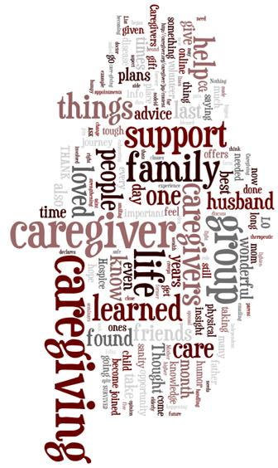
You might be a caregiver if…
You regularly look in on or call a friend or loved one to see how they are doing or if they need assistance
You are helping with, or are doing, routine tasks for someone, such as grocery shopping, bill paying, household chores, or transportation
You are assisting someone with medications or personal care tasks
You are communicating with health care professionals or other providers, services and agencies
You are providing complex medical care like wound care; changing IVs; operating medical equipment/devices

Slide 5
What do we mean by “Informal Caregiving”?
Family caregivers provide an array of services that can include:
Emotional,
Financial,
Nursing,
Social,
Homemaking,
and other services needed on a daily or intermittent basis.
Sometimes it means 24-hour care for someone who is unable to dress, feed, go to the bathroom, or think for him or herself.
Caregiving can last a lifetime or as little as a few days or months.

Slide 6
What do we mean by “frail”?
“Frail’’ means that the older individual is functionally impaired because the individual—
is unable to perform at least two activities of daily living without substantial human assistance, including verbal reminding, physical cueing, or supervision; or
due to a cognitive or other mental impairment, requires substantial supervision because the individual behaves in a manner that poses a serious health or safety hazard to the individual or to another individual.

Slide 7
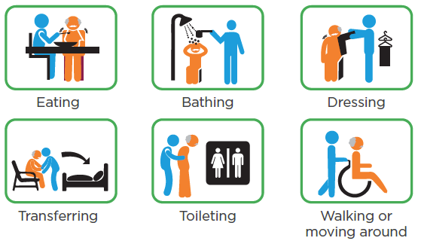
Activities of Daily Living
https://www.advancedrm.com/measuring-adls-to-assess-needs-and-improve-independence/#

Slide 8
Who are Caregivers?
In Indian Country, the most likely caregivers are family members, friends of the family, neighbors, or members of a church or social club who are close to the person needing care.
Many caregivers do not identify themselves as such since caring for elders is a traditional activity in Indian Country; caregivers see themselves as simply doing what needs to be done.

Slide 9
Title VI, Part C—Adult Family Caregiver: Defined
(3) The term ‘‘family caregiver’’ means an adult family member, or another individual, who is an informal provider of in-home and community care to an older individual or to an individual with Alzheimer’s disease or a related disorder with neurological and organic brain dysfunction [OAA Section 302 (3)].
Notes:
Must be 18 years or older
Provides services or support to an Elder(s) (tribally determined age) or an individual(s) of any age with Alzheimer’s disease and related disorders (such as dementia).

Slide 10
Title VI, Part C—Older Relative Caregiver: Defined
Older Relative Caregiver means a caregiver who—
(A)(i) is age 55 or older; and
(ii) lives with, is the informal provider of in-home and community care to, and is the primary caregiver for, a child or an individual with a disability

Slide 11
Title VI, Part C – Older Relative Caregiver: Grandparents Raising Grandchildren
(B) in the case of a caregiver for a child—
(i)is the grandparent, step grandparent, or other relative (other than the parent) by blood, marriage, or adoption, of the child; and
(ii) is the primary caregiver of the child because the biological or adoptive parents are unable or unwilling to serve as the primary caregivers of the child; and
(iii) has a legal relationship to the child, such as legal custody, adoption, or guardianship, or is raising the child informally; and
Notes:
A Grandparent or Step-Grandparent
Relative of a child by blood or marriage
55 years of age or older and
Lives with the child (not more than 18 years old)
Is the primary caregiver
Has legal or informal relationship

Slide 12
Title VI, Part C—Older Relative Caregiver: Caring for Someone with a Disability
(C )in the case of a caregiver for an individual with a disability, is the parent, grandparent, or other relative by blood, marriage, or adoption, of the individual with a disability.
Notes:
A Parent or a Grandparent (or Step-Grandparent)
Relative of a child by blood or marriage
55 years of age or older and
Lives with the child
Is the primary caregiver
Has legal or informal relationship
(2) INDIVIDUAL WITH A DISABILITY.—The term ‘‘individual with a disability’’ means an individual with a disability, as defined in section 3 of the Americans with Disabilities Act of 1990 (42 U.S.C. 12102), who is not less than age 18 and not more than age 59.

Slide 13
Examples of Caregiver and Services
A granddaughter provides care of a great-grandmother who is 80. The granddaughter is going on a trip and needs someone to take care of her grandmother while she is away.
Part C can pay for someone to help provide care for her grandmother while she is away.
A son provides care for his father who has Alzheimer’s disease and is having incontinence issues.
Part C can pay for incontinence supplies

Slide 14
Examples of Caregiver and Services cont.
A grandmother is the primary caregiver of her grandchildren who live with her, the grandmother is 56 years old and still works to support her grandchildren and will not have support during the summer while a babysitter is on vacation
Part C can pay for enrollment in a summer camp opportunity for the grandchildren.
A 35 year old person with a disability lives with a parent who is 70 and newly serves as a primary caregiver for their parent
Part C can pay for caregiver training and homemaking assistance for the new caregiver.

Slide 15
Identifying Caregivers
Caring for elders is a traditional activity in Indian Country, caregivers are simply doing what needs to be done.
It may be difficult for caregivers to identify themselves
In Indian Country, the most likely caregivers are family members (spouses, daughters, granddaughters, sons, grandsons, etc.), friends of the family, neighbors, or members of a church or social club who are close to the person needing care.
Advertise where the caregivers are located
Word of mouth is the best way to find caregivers.
Often an initial request is simply information, ensure intake staff are aware of the program

Slide 16
Group Discussion
How is your program currently identifying caregivers?
How are you notifying your community of the services available?

Slide 17
Meeting the Needs of Your Caregivers
It is important to recognize that the services available through this program include services for the caregiver, not for the elder who needs care.
If caregivers are supported while they do their work, they can provide care longer and better. This support can help the elder, but services must be directed to the caregiver.
If an elder doesn’t have a caregiver, Title VI part C resources are not available to them.

Slide 18
Meeting the Needs of Your Caregivers cont.
It is important to ask caregivers what would help them best.
Consider including clinic staff and churches in your discussion of what caregivers may need.
Both may be able to support your programs with training, volunteers, and identifying caregivers.
Notes:
Title VI Part C can help caregivers in a variety of ways.

Slide 19
Finding Out About Your Caregivers
Consider your intake process:
What is the experience of the person calling into your center?
Is the person answering the phone knowledgeable about services available and where to send the caller?
Are they able to identify a caregiver?
Will they ask questions beyond what the caller identified to assist with the needs of the caregiver?

Slide 20
Title VI, Part C – Required Services
Information to caregivers about available services
Assistance to caregivers in gaining access to the services
Individual counseling, organization of support groups, and caregiver training to assist the caregivers in the areas of health, nutrition, and financial literacy, and in making decisions and solving problems relating to their caregiving roles
Respite care to enable caregivers to be temporarily relieved from their caregiving responsibilities; and
Supplemental services, on a limited basis, to complement the care provided by caregivers

Slide 21
Required Service 1: Information
Information and assistance services may be one way to identify caregivers as it is often the first thing a caregiver seeks is information about caregiver services or assistance in getting the service.
Caregivers may need information about:
services, equipment, and the illness or condition their loved one is experiencing.
Notes:
A public and media activity that conveys information to caregivers about available services, which can include an in-person interactive presentation to the public. Examples include:
Public education - community meetings, Health Fairs, Elderfests
Mass media - PSA’s on radio/TV, Tribal newspapers, newsletters, calendars, websites, electronic billboards
Program Brochures, Bulletin Boards
Caregiver Resource Library
Helping Agency Resource Guides
Webinars

Slide 22
Required Service 2: Assistance Services
Assistance may be direct assistance with:
Paperwork, finding resources, or helping them access programs that can provide assistance with Medicare, Medicaid, yard work or heavy chores, housecleaning, or other tasks.
Your Title VI, Part A program may be able to provide the services identified.
Remember that assistance under the Caregiver Support Program is to assist the caregiver in accessing the service, not providing the service.
Notes:
Helping caregivers access services, including through:
Individual one-on-one contact linking family caregivers with services, supports and other opportunities.
Follow-up to ensure services are received.
Case management – Caregiver Assessment, wrap-around services, person-centered planning.
Help with applications
Information about accessing low cost medical equipment
“Hand hold” when necessary

Slide 23
Required Service 3: Caregiver Counseling, Training, and Support Groups – Counseling
Caregivers may need to learn new skills about helping with activities of daily living, medical treatments and prescription drugs, or changes that occur as their loved one ages and their illness progresses.
Caregivers may need counseling and training about the best way to take care of themselves and training in how to perform some caregiver responsibilities, such as getting an elder out of bed.

Slide 24
Required Service 3: Caregiver Counseling, Training, and Support Groups – Training
Training required by the OAA includes health, nutrition, and financial literacy, and training in making decisions and solving problems relating to their caregiving roles.
Training can be about general things such as communication with elders with dementia (including Alzheimer’s Disease), end-of-life signs, or incontinence or as specific as catheter care, tube feeding, or filling insulin syringes.
It is important that the person doing the training be qualified to provide it.
Notes:
For example: A gathering of two or more caregivers meeting in a room/space to talk and share and the group may be led by Title VI staff or another health professional is one session.

Slide 25
Required Service 3: Caregiver Counseling, Training, and Support Groups - Support Groups
In a support group, members provide each other with various types of nonprofessional, nonmaterial help for a particular shared issue.
The help may take the form of providing relevant information, relating personal experiences, listening to others’ experiences, providing sympathetic understanding and establishing social networks.
Some programs have used a Caregiver Stress Test to help open up the discussion.
Confidentiality is an important aspect of support groups.
Notes:
A service that is led by an individual, moderator, or professional to facilitate caregivers to discuss their common experiences and concerns and develop a mutual support system. Support groups are typically held on a regularly scheduled basis and may be conducted in person, over the telephone, or online. Caregiver support groups would not include caregiver education/training group or other groups primarily aimed at teaching skills or meeting on an informal basis without a facilitator.

Slide 26
Required Service 4: Supplemental Services
Include such things as:
Home Modification/Repairs: Putting in ramps or handrails into an Elder’s home.
Consumable Items: Incontinence supplies, Ensure, school supplies, uniforms for school or sports, cleaning supplies, etc…
Lending Closet: Clothing exchange; Durable Medical Equipment (chair lifts, wheelchairs, walkers, emergency response systems), anything lent on a short-term basis.
Financial Support: limited (emergency) help with utility bills
Homemaker/Chore/Personal Care Service: chopping wood, mowing a lawn, snow clearing.
Notes:
Really only supposed to be for caregivers of the “frail”. UNLESS you are a GRG over the age of 55 and the child must be under the age of 18. Preference can be given to GRGs raising children with disabilities.
Home Modifications
Assistive Technologies
Emergency Response Systems
Equipment
Incontinence Supplies
Transportation

Slide 27
Required Service 5: Respite
Respite care is care provided to caregivers so that they can have a break (preference to caregivers of the frail or grandparents raising grandchildren).
Respite care can be provided in the home of the elder or the caregiver or it can be provided at an out-of-home setting such as the respite person’s home, senior center, or day care center.
Some programs provide the care by giving the caregiver a voucher and allowing them to choose their own provider and circumstances.
Notes:
Really only supposed to be for caregivers of the “frail”. UNLESS you are a GRG over the age of 55 and the child must be under the age of 18. Preference can be given to GRGs raising children with disabilities.
A service for caregivers which offers temporary, substitute supports or living arrangements for care recipients in order to provide a brief period of relief or rest for the caregivers.
Provide funds to informal family caregivers for the purchase of respite and other assistance on a temporary, intermittent basis so the primary informal family caregiver gets a break
Senior Center activities
Adult Day Care
Summer camps for children
Get-a-way activities for Grandparents, Relative parents
This can be done a variety of ways. The program can arrange for and directly pay a provider for respite care, or the program can provide the informal family caregiver with a voucher that can be used to pay a provider for respite care, or the program may provide the informal family caregiver with a budget or actual cash for them to spend on a pre-determined set of services with a way to track what the informal family caregiver uses the money for.

Slide 28
Respite Policy Considerations
If the respite provider is not a family member, you will want to check your tribe’s policies about background checks.
It is important to develop policies on:
Who can provide respite – will you allow spouses or children, relatives vs paid providers,
How are you going to pay for respite – volunteer-based or paid (rate of pay)
How you are going to pay for respite – agency-based model, give money directly to family, voucher program
Other issues – service limits, service locations (at home or facility-based), service hours (weekdays/weekends/overnights)
Notes:
Archrespite.org has great training and technical assistance materials. For instance volunteer models and voucher models. Have templates, all that good stuff. Have worker training programs.

Slide 29
Volunteers
You are encouraged to use trained volunteers to expand the required services.
If possible, you are to coordinate with organizations that have experience in providing training, placement, and stipends for volunteers.
Examples include: programs administered by the Corporation for National and Community Service.
These would include VISTA Volunteers and Senior Corps Volunteers.

Slide 30
Coordinating Caregiver Programs
If there is another program providing a required service for caregivers in your community, you do not have to provide it with your funds, but must coordinate with the program to ensure caregivers can use the program.
The OAA also requires coordination with Title III programs.
Area Agencies on Aging can assist with information or application assistance, trainings, and supplemental services
Do you currently coordinate with the AAA responsible for your planning and service area?

Slide 31
Program Management
Management means getting the job done through planning, organizing, budgeting, staffing, directing, and evaluating.
Policies and procedures guide your program and help to assure all staff and clients are treated equally.
Confidential information must be protected at all times.
Program staff must have a “need to know” to have access to records.
Emergency/disaster planning is essential since elders have special needs and concerns during an emergency or disaster.
Can be a training need to support your caregivers

Slide 32
Planning and Organizing
Identify what you want to accomplish – your program goals.
Conduct a needs assessment.
Identify actions for both meeting grant requirements and addressing the priority needs.
Identify what results you expect to accomplish because of these actions.
Establish a work plan with specific tasks.
Prioritize duties.
Plan for evaluating program outcome.

Slide 33
Programming Around Need
Listen to your elders and caregivers – understand their needs and likes.
Respect their personal dignity and uniqueness.
Get to know them personally and understand their history.
Design services which are varied enough to match individual preferences and skills.

Slide 34
Budgeting
Although a budget is not a required part of your Title VI application, many Tribal Councils require programs to submit a budget.
Even if you are not required to, you are encouraged to develop a budget as soon as you know your funding amount.
You need to find out what indirect cost your tribe is charging your program, as well as what is included in that cost.
Coordinate your record keeping with your finance office so that everyone has the same information on which to make decisions.
While carry over of unexpended funds are allowed within a project period, large carry over amounts indicate poor program planning or may be a red flag that your program is in trouble.

Slide 35
Policy
Policies guide the implementation of programs.
For Title VI programs, any of the OAA requirements should have a written policy.
Policies usually require high-level approval. (ex. The number of respite hours allowed per person, per month, and/or per year)
Examples?

Slide 36
Procedures
Procedures are the steps or activities necessary to achieve the policy.
Examples for Part C?

Slide 37
Policy and Procedure Manual
Every Title VI program is different and your policies and procedures should reflect these differences by individualizing policies to meet local situations.
A standard format in your policy and procedure manual will make it easier to use.
Policies should be dated so that older policies can be reviewed in the light of new legislation or tribal regulations.
The policies and procedures must clearly spell out the confidentiality rules and anyone having access to confidential records must receive training on maintaining confidentially of records.
The confidentiality rules also should be stated in job descriptions.
Policies and procedures need to specify the disciplinary action that will be taken for breaking the confidentiality policies.

Slide 38
Implementation and Training
Implementation and training is another important step in developing a policy and procedures manual.
All staff must understand the need to follow the approved policies and procedures and need to be aware of new or revised policies and procedures.
If there is a major change, program directors should conduct a formal training session so all staff will get the same information.

Slide 39
Records
Records with information about program participants must be protected.
A record is defined as any information, whether or not it is written down and recorded, that is collected by a program.
This includes information obtained from a program participant or about a program participant.
Records may be kept in a folder, binder, file cabinet, or computer system.
Examples include: Participant Logs, Intake Forms, Sign in sheets, Assessment forms, Referral Reports, Follow up reports, Dates and purposes of contacts, etc.

Slide 40
Records Policies
Many people working with elders and their families provide documentation about a specific problem or need.
Thus, it is important to develop policies and procedures on who has access to which records and under what circumstances, who can make copies, who can provide information about elders to telephone callers and who has the responsibility to determine emergency situations.
Your policy should specify who will make the final decision about who is able to view information in a client’s record.

Slide 41
Intake
Generally first point of contact and can help identify a potential eligible caregiver
Services are specific to age, so will be important to determine eligibility for Title VI services
Emergency contact information can help to identify a caregiver in a role that they may not identify as caregiving
Identify needs, concerns, and referrals
Follow up with the individual
Notes:
Provide a reminder on the age limits of caregivers

Slide 42
Discussion
How do you use intakes to identify caregivers?
Is there a checkbox on your current form that would trigger a referral to caregiver services?
What types of questions could be asked on intake to identify caregivers roles and needs for assistance?

Slide 43
Service Plan
Review needs and available services with your caregiver.
Authorize services based on your policy and procedure manual, budget, and need.
Coordinate, as needed.
Record what was offered, accepted/declined, date(s) of service(s).
Consider tracking unmet need if you are unable to develop a plan of service to support the caregivers needs.
Maintain records and ensure confidentiality.

Slide 44
Keeping Track of Services Provided
Keeping track of the elders and caregivers who participate in your services is an essential part of the Title VI Director’s job.
The records you keep on a daily basis will become the annual report required by your grant.
Having a good way to keep track of each caregiver who receives services, which services they received, and frequency will help you to apply for grants, contact service providers about needs, and keep track of the number of participants your grant is serving.

Slide 45
Quality Assurance
Quality assurance can be used for many purposes, including program management, program improvement, and accountability.
Quality assurance can help you decide if you are providing timely and relevant services, if your services are improving the quality of life for the family caregivers and the areas in which you can improve.
By using regular quality assurance measures, you can help ensure you are providing quality family caregiver support services that meet the needs of your caregivers.
Because of the diversity of programs, no single approach or set of criteria for quality assurance will apply to all programs.
Review Steps for Developing Quality Assurance

Slide 46
Preparing for Emergency and Disaster Situations
An emergency/disaster requires immediate and effective intervention of multiple government and private sector organizations to help meet the needs of the community and area just after the disaster occurs and the area and people begin to recover.
Just in Case: “Emergency Readiness for Older Adults and Caregivers” has step-by-step information to help older adults prepare for a disaster/emergency.
It includes helpful checklists, contact lists, and a medication list that can be filled in.

Slide 47
Remember…
Program services are for the caregiver; not for the elder who receives the care.
While there may be a need to find a caregiver for a person who lives alone and does not have a family caregiver, a grantee cannot hire a caregiver for them with their Title VI Part C funds.
Notes:
A stand in caregiver could be a professional caregiver or someone else that is chosen to be responsible for the care recipient for a limited period of time. The funds for respite care can given directly to the informal caregiver to pay directly to a stand-in caregiver or given as a voucher from the Title VI program to the informal caregiver whereby the stand-in caregiver would be paid directly by the Title VI program.

Slide 48
Caregiver Resources
There is a wealth of information on the Internet designed to assist family members and caregivers of older adults. Here are a few useful links to get you started.
National Alzheimer’s Call Center The National Call Center is available to people in 56 states and territories, 24/7, 365 days a year, to provide expert advice, care consultation, information, and referrals and can help with questions about memory problems, how to deal with challenging behaviors, and tips for taking care of someone with Alzheimer’s disease or other forms of dementia.
ARCH –The National Respite Locator Service This service helps parents, caregivers, and professionals find respite services in their state and local area that match their specific needs.
Ask Medicare This initiative offers information, tools and materials to assist the caregiver and their loved ones in making informed healthcare decisions.
Family Caregiver Alliance This site features information on programs at national, state and local levels that support and sustain caregivers.
National Alliance for Caregiving This site features publications and resources for caregivers, including the Family Care Resource Connection, where you can find reviews and ratings of more than 1,000 books, videos, websites and other materials on caregiving.

Slide 49
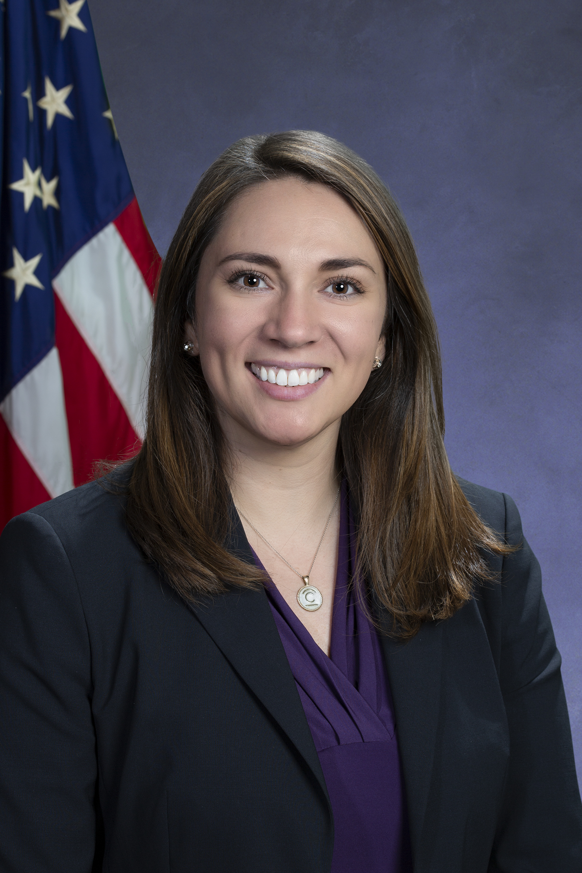
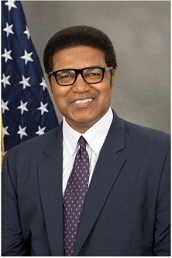
Questions
Lacey Boven
Regional Administrator
Administration for Community Living
Center for Regional Operations – Kansas City
PHONE: 816.702.4180 EMAIL: Lacey.Boven@acl.hhs.gov
Percy Devine
Regional Administrator
Administration for Community Living
Center for Regional Operations – Denver
PHONE: 303.844.7815 EMAIL: Percy.Devine@acl.hhs.gov

