Slide 1
Training & Technical Assistance Conference
2022 NATIONAL TITLE VI
April 18-21, 2022

Slide 2
Tracking the AI Voice in State Alzheimer’s Policy
Michael Splaine, Splaine Consulting
April 20, 2022

Slide 3
Acknowledgments
My elders Steve Chapman, J. Neil Henderson, Dave Baldridge, Jacque Gray
Advisory board and staff at International Indigenous Aging
Funding
This research is supported by the Centers for Disease Control and Prevention (CDC) of the U.S. Department of Health and Human Services (HHS) as part of a financial assistance award totaling $348,711 with 100 percent funded by CDC/HHS. The contents are those of the author(s) and do not necessarily represent the official views of, nor an endorsement, by CDC/HHS, or the U.S. Government.
And all errors are mine.

Slide 4
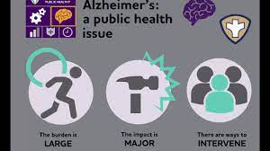
Alzheimer’s: a public health issue

Slide 5
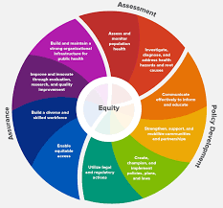
Assurance, Assessment, Policy Development Wheel

Slide 6
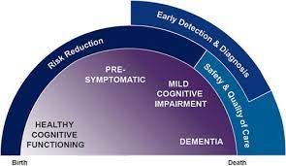
Early Detection & Diagnosis

Slide 7
Healthy Brain Initiative Road Map

Slide 8
Health Brain Initiative: Road Map for Indian Country

Slide 9
Search 1: Tribal Law and Dementia
Find Digital Resources
Identify key words
Caregiver
Dementia
Alzheimer’s
Search
Findings: Nearly Nil, But NIEJI in evidence many places

Slide 10
Search 2: State Alzheimer Plans
Background
Method
15 most populous as a % of population
Findings
Policy specific to AI/AN community has grown over time!
Washington state

Slide 11
Existing Plans and Inputs
 | Alaska | Oklahoma | New Mexico | South Dakota | Montana | North Dakota | Arizona | Wyoming | Oregon | Washington
Plan year | 2012 | 2018 - 2022 | 2017 | 2018 | 2016 | Update pending | 2015 | 2018 | 2012 Update pending | 2014, 2019
Significant inputs | x |  | x |  | x |  |  |  |  | x
Culturally tailored awareness | x |  | x | x | x |  |  |  |  | x
Research participation | x | x | x
Special tribal- based support programs |  |  | x |  | x |  |  |  |  | x
Ongoing workgroup |  | X clinical trial participation |  | X Survey for needs |  |  |  |  |  | x

Slide 12
Next Steps
Publish and disseminate
Next five states
Monitor
Possibly some uniform materials
International

Slide 13
Key websites
https://www.cdc.gov/aging/healthybrain/indian-country-roadmap.html
https://iasquared.org/brain-health/

Slide 14
Contact
Mike@splaineconsulting.com
1.443.630.9226

