Slide 1
Training & Technical Assistance Conference
2022 NATIONAL TITLE VI
April 18-21, 2022

Slide 2
Setting up a Respite Program & Lending Closet
Lacey Boven, Regional Administrator, Administration for Community Living
Tami Fleeman, CPN Coordinator Elder Center, Potawatomi Nation

Slide 3
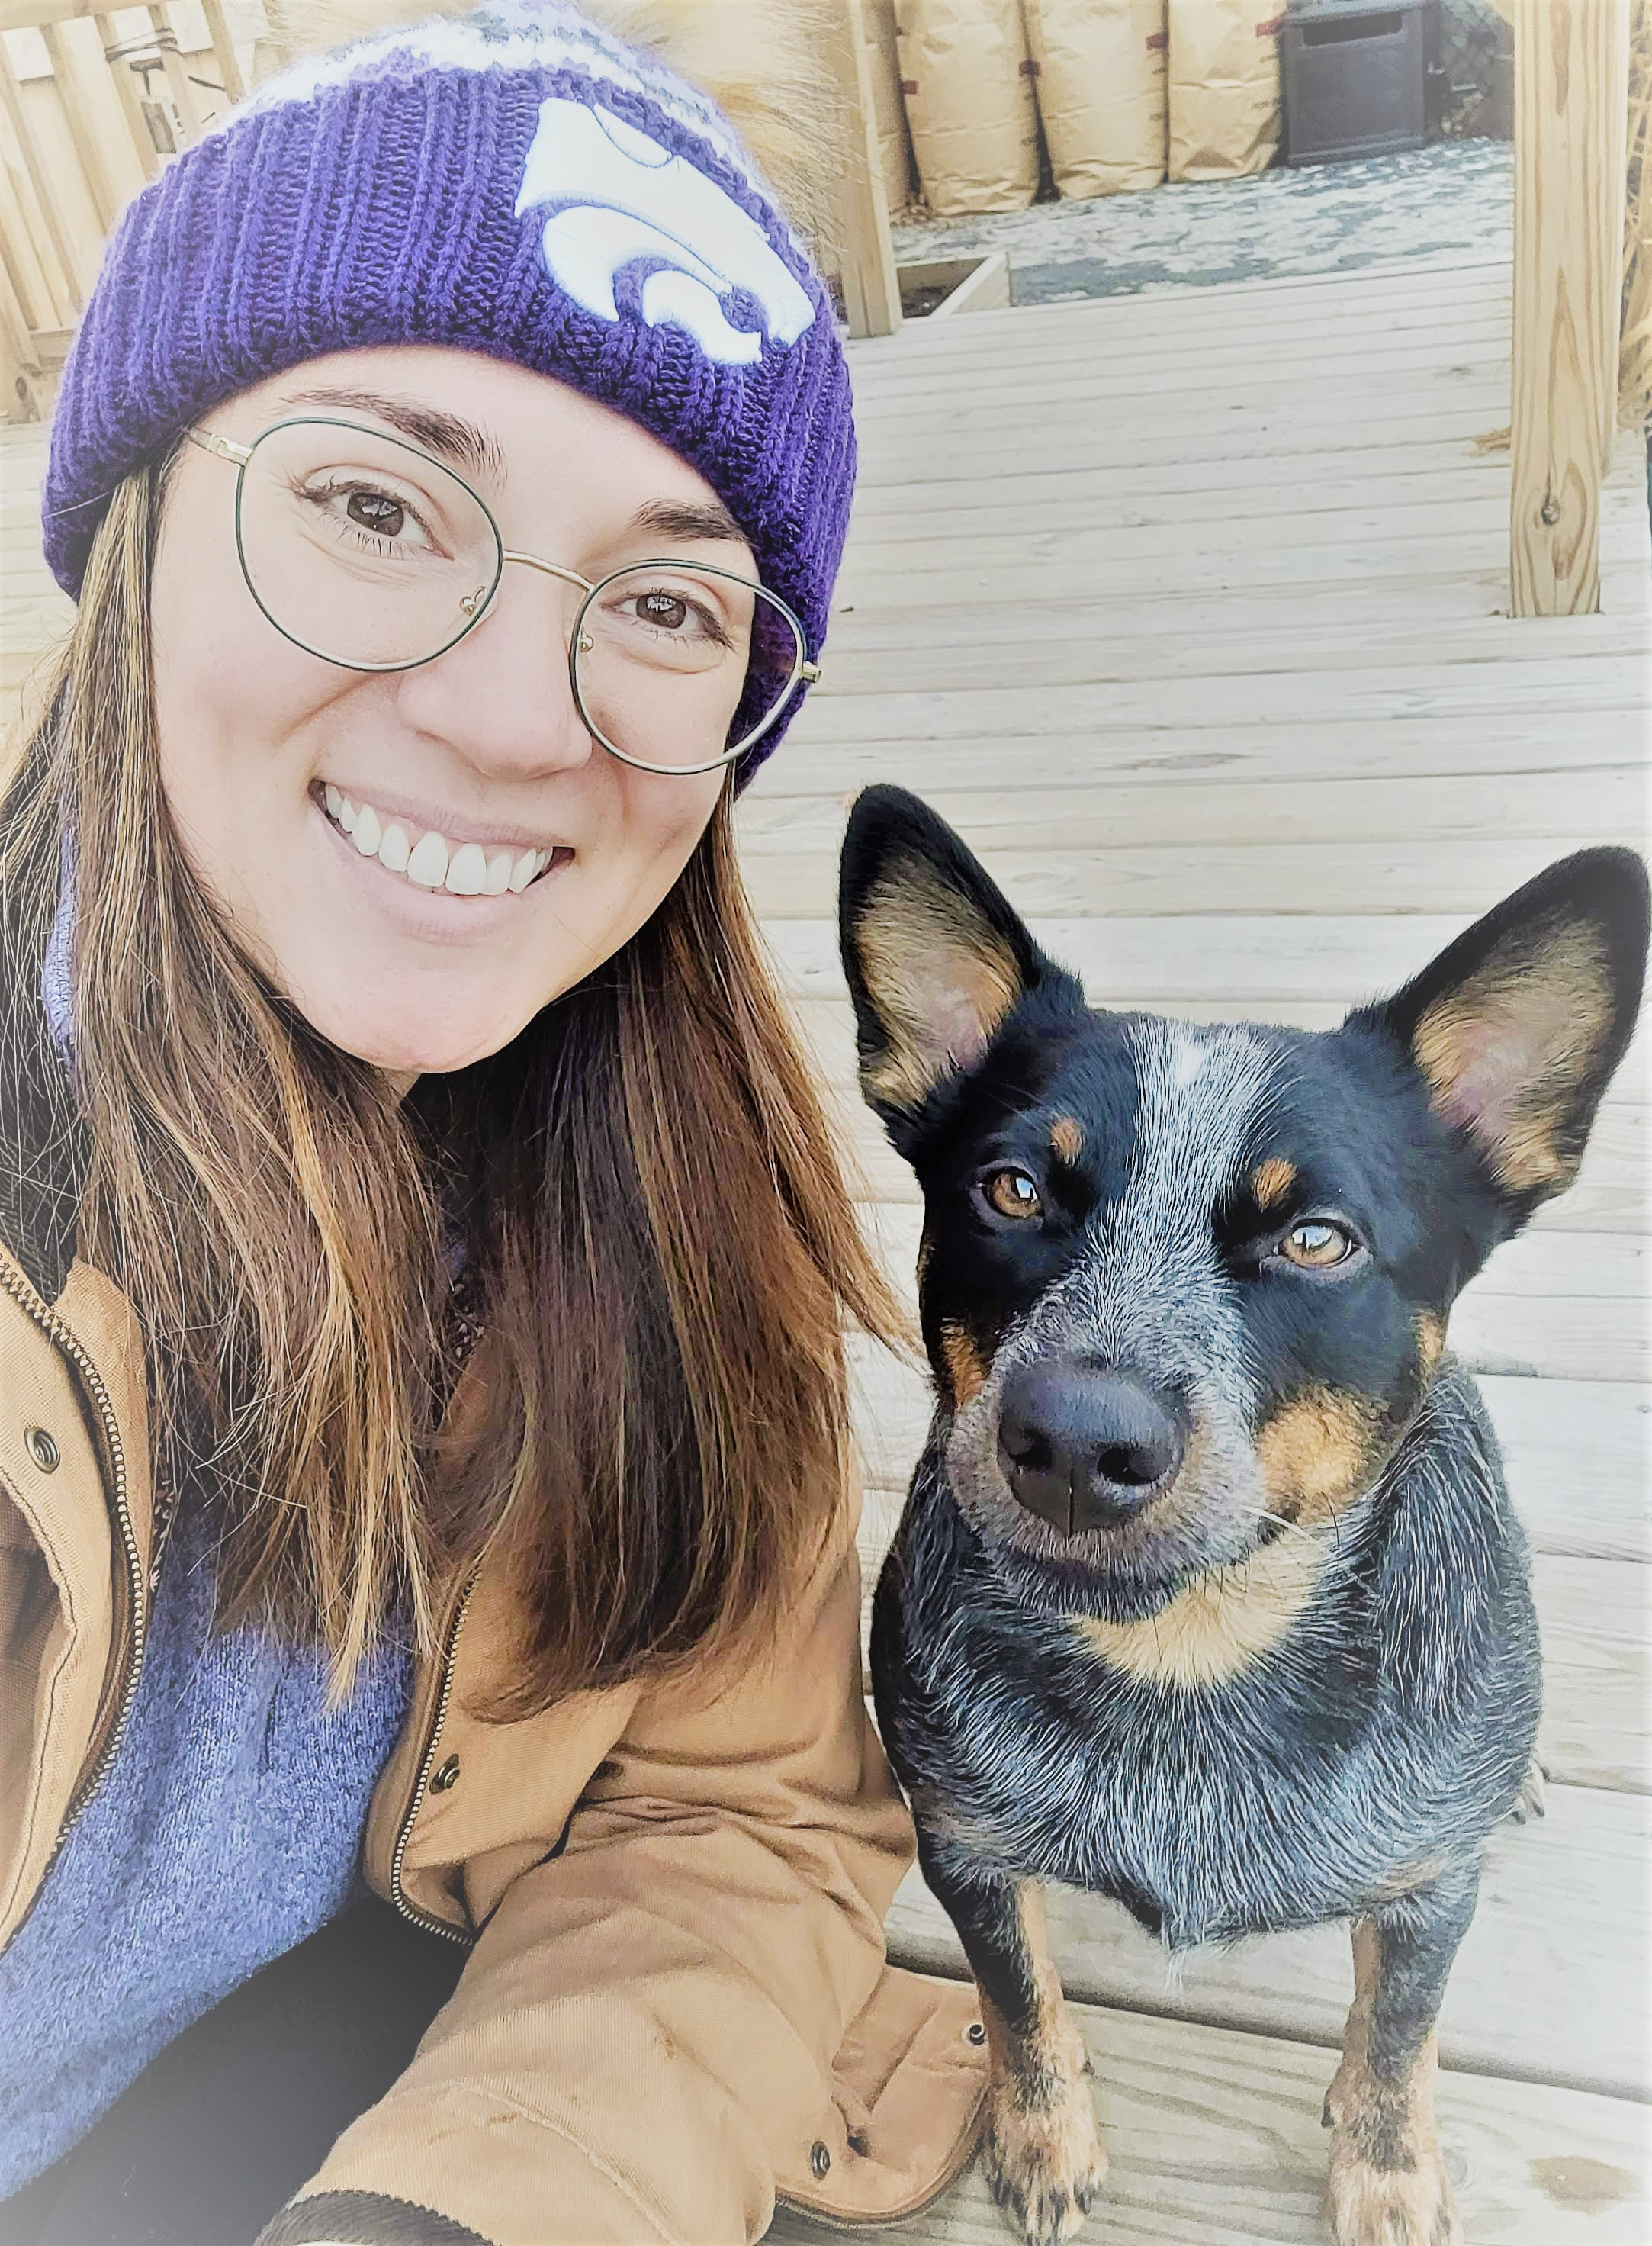
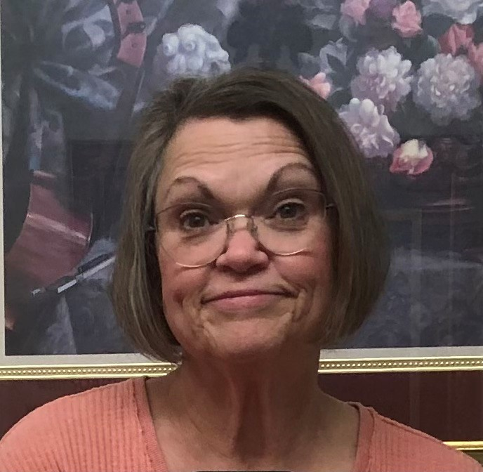
Presenters
Tami Fleeman, RN
CPN Coordinator Senior Support/Elder Center
Potawatomi Nation, Oklahoma
PHONE: 405.214.5111 EMAIL: tfleeman@potawatomi.org
Lacey Boven
Regional Administrator
Center for Regional Operations – Kansas City
Administration for Community Living
PHONE: 816.702.4180
EMAIL: Lacey.Boven@acl.hhs.gov

Slide 4
Title VI, Part C—Caregiver Support Services
Must also have a Part A/B grant
Services are for two types of unpaid caregivers:
informal provider of care to a frail older individual or to an individual with Alzheimer’s disease or a related disorder (for instance family, friends, or other relatives caring for an older individual)
older relative caregivers (for instance grandparents raising grandkids, or an elder caring for an adult with a disability)
Program services are for the caregiver; not for the elder who receives the care

Slide 5
What do we mean by “Informal Caregiving”?
Family caregivers provide an array of services that can include:
Emotional,
Financial,
Nursing,
Social,
Homemaking,
and other services needed on a daily or intermittent basis.
Sometimes it means 24-hour care for someone who is unable to dress, feed, go to the bathroom, or think for him or herself.
Caregiving can last a lifetime or as little as a few days or months.

Slide 6
What do we mean by “frail”?
“Frail’’ means that the older individual is functionally impaired because the individual—
is unable to perform at least two activities of daily living without substantial human assistance, including verbal reminding, physical cueing, or supervision; or
due to a cognitive or other mental impairment, requires substantial supervision because the individual behaves in a manner that poses a serious health or safety hazard to the individual or to another individual.

Slide 7
Activities of Daily Living
https://www.advancedrm.com/measuring-adls-to-assess-needs-and-improve-independence/#

Slide 8
Who are Caregivers?
In Indian Country, the most likely caregivers are family members, friends of the family, neighbors, or members of a church or social club who are close to the person needing care.
Many caregivers do not identify themselves as such since caring for elders is a traditional activity in Indian Country; caregivers see themselves as simply doing what needs to be done.

Slide 9
Title VI, Part C – Required Services
Information to caregivers about available services
Assistance to caregivers in gaining access to the services
Individual counseling, organization of support groups, and caregiver training to assist the caregivers in the areas of health, nutrition, and financial literacy, and in making decisions and solving problems relating to their caregiving roles
Respite care to enable caregivers to be temporarily relieved from their caregiving responsibilities; and
Supplemental services, on a limited basis, to complement the care provided by caregivers

Slide 10
Required Service 4: Supplemental Services
Include such things as:
Home Modification/Repairs: Putting in ramps or handrails into an Elder’s home.
Consumable Items: Incontinence supplies, Ensure, school supplies, uniforms for school or sports, cleaning supplies, etc…
Lending Closet: Clothing exchange; Durable Medical Equipment (chair lifts, wheelchairs, walkers, emergency response systems), anything lent on a short-term basis.
Financial Support: limited (emergency) help with utility bills
Homemaker/Chore/Personal Care Service: chopping wood, mowing a lawn, snow clearing.
Notes:
Really only supposed to be for caregivers of the “frail”. UNLESS you are a GRG over the age of 55 and the child must be under the age of 18. Preference can be given to GRGs raising children with disabilities.
Home Modifications
Assistive Technologies
Emergency Response Systems
Equipment
Incontinence Supplies
Transportation

Slide 11
Lending Closet Considerations
Space for goods or coordinated events
Sanitation for Donated Goods
Process for inventory
Procedures for check out and return
Training for specialized products
Delivery for large items
Budget for new items
What to purchase and evaluation of need and use

Slide 12
Required Service 5: Respite
Respite care is care provided to caregivers so that they can have a break (preference to caregivers of the frail or grandparents raising grandchildren).
Respite care can be provided in the home of the elder or the caregiver or it can be provided at an out-of-home setting such as the respite person’s home, senior center, or day care center.
Some programs provide the care by giving the caregiver a voucher and allowing them to choose their own provider and circumstances.
Notes:
Really only supposed to be for caregivers of the “frail”. UNLESS you are a GRG over the age of 55 and the child must be under the age of 18. Preference can be given to GRGs raising children with disabilities.
A service for caregivers which offers temporary, substitute supports or living arrangements for care recipients in order to provide a brief period of relief or rest for the caregivers.
Provide funds to informal family caregivers for the purchase of respite and other assistance on a temporary, intermittent basis so the primary informal family caregiver gets a break
Senior Center activities
Adult Day Care
Summer camps for children
Get-a-way activities for Grandparents, Relative parents
This can be done a variety of ways. The program can arrange for and directly pay a provider for respite care, or the program can provide the informal family caregiver with a voucher that can be used to pay a provider for respite care, or the program may provide the informal family caregiver with a budget or actual cash for them to spend on a pre-determined set of services with a way to track what the informal family caregiver uses the money for.

Slide 13
Respite Policy Considerations
If the respite provider is not a family member, you will want to check your tribe’s policies about background checks.
It is important to develop policies on:
Who can provide respite – will you allow spouses or children, relatives vs paid providers,
How are you going to pay for respite – volunteer-based or paid (rate of pay)
How you are going to pay for respite – agency-based model, give money directly to family, voucher program
Other issues – service limits, service locations (at home or facility-based), service hours (weekdays/weekends/overnights)
Notes:
Archrespite.org has great training and technical assistance materials. For instance volunteer models and voucher models. Have templates, all that good stuff. Have worker training programs.

Slide 14
Coordinating Caregiver Programs
If there is another program providing a required service for caregivers in your community, you do not have to provide it with your funds but must coordinate with the program to ensure caregivers can use the program.
The OAA also requires coordination with Title III programs.
Area Agencies on Aging can assist with information or application assistance, trainings, and supplemental services
Do you currently coordinate with the AAA responsible for your planning and service area?

Slide 15
Volunteers
You are encouraged to use trained volunteers to expand the required services.
If possible, you are to coordinate with organizations that have experience in providing training, placement, and stipends for volunteers.
Examples include: programs administered by the Corporation for National and Community Service.
These would include VISTA Volunteers and Senior Corps Volunteers.

Slide 16
Meeting the Needs of Your Caregivers
It is important to recognize that the services available through this program include services for the caregiver, not for the elder who needs care.
If caregivers are supported while they do their work, they can provide care longer and better. This support can help the elder, but services must be directed to the caregiver.
If an elder doesn’t have a caregiver, Title VI part C resources are not available to them.

Slide 17
Meeting the Needs of Your Caregivers cont.
It is important to ask caregivers what would help them best.
Consider including clinic staff and churches in your discussion of what caregivers may need.
Both may be able to support your programs with training, volunteers, and identifying caregivers.
Notes:
Title VI Part C can help caregivers in a variety of ways.

Slide 18
Finding Out About Your Caregivers
Consider your intake process:
What is the experience of the person calling into your center?
Is the person answering the phone knowledgeable about services available and where to send the caller?
Are they able to identify a caregiver?
Will they ask questions beyond what the caller identified to assist with the needs of the caregiver?

Slide 19
Program Implementation
Tami Fleeman, RN

Slide 20
Starting a Respite Program
Assess the need in your population:
Do a Needs Assessment
Visit with Elders & CHRs
Assess outside agencies who offer services ie: AoA, Title III, other Title VI programs
Get appropriate paperwork you will need & compile a list of respite workers if needed
Reach out to Elders in need to offer services

Slide 21
Having Problems?
Common problems you might encounter:
No respite/chore workers available
Caregiver hesitant to leave the Elder
Unsafe conditions in the home
Care needed is too complex
Finding contractors for needed improvements

Slide 22
CPN Caregiver Program
We offer a Respite Program for Caregivers of Native American Elders.
The Caregiver choses the person to do respite care. We meet with the Elder, Caregiver, and Respite Worker to do intake assessments, review policy, & sign agreements.
The $600 contract can be renewed every three months if needed as long as funds are available.
The Respite Worker is responsible for turning in their time sheet for payment.
We have a staff Respite Worker who can assist them for a limited time until they can find someone.

Slide 23
DME Lending Closets
How to start???
Storage-where to put it?
Let people know you are accepting donations:
CHRs
Elders & Families
Providers
Hospice Companies
Tribal Newspapers

Slide 24
Important DME Considerations
Always thoroughly inspect all equipment!
Clean with 20% bleach or approved medical grade wipes before storage & loaning out
Discard any broken or unsafe equipment
Understand how equipment should be fitted. Work with a Physical Therapy department, or nursing staff. Youtube is an excellent video resource as well
We use a Release of Liability form when loaning out equipment

Slide 25
Release of Liability

Slide 26
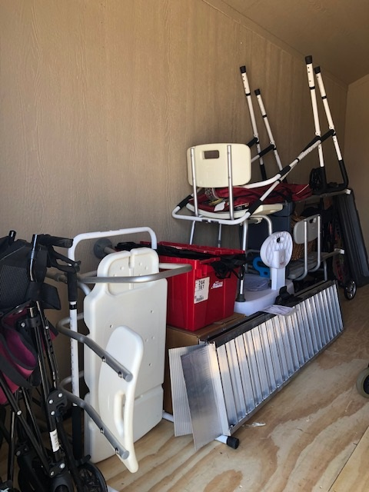
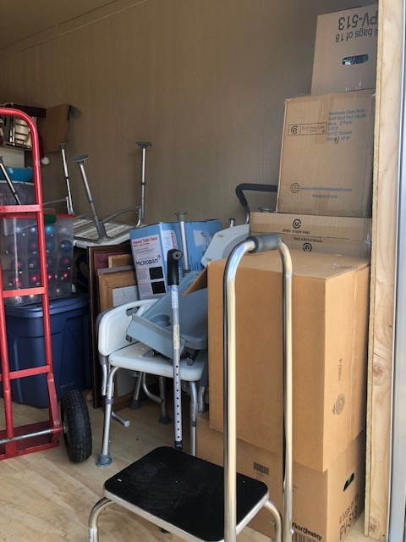
Lending closet photos – storage area

Slide 27
Questions?

