Slide 1
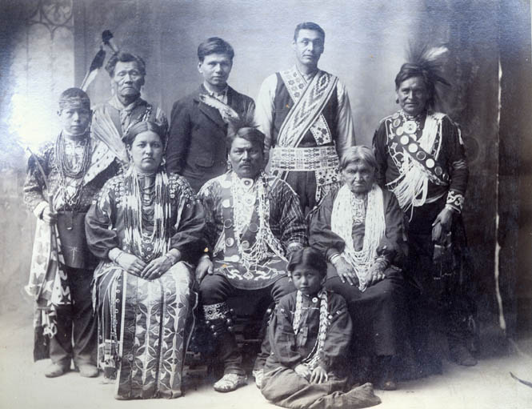
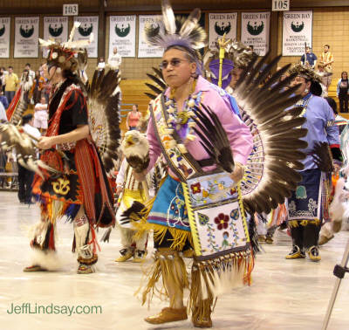
Title III & VI Working Together
Tribal Technical Assistance Center
Notes:
1

Slide 2
Older Americans Act
Requires Title VI and Title III to coordinate those services that are provided within the Title VI service area
Each Title VI application shall contain assurances that the tribal organization will coordinate services provided under this part with services provided under Title III in the same geographical area. Sec. 6l4(a)(ll)
Each Area Agency on Aging plan shall provide information and assurance concerning services to older individuals who are Native Americans, including an assurance that the Area Agency on Aging will, to the maximum extent practicable, coordinate the services the agency provides under this title with services provided under Title VI. Sec. 306(a)(ll)(B)
The state plan shall provide an assurance that the State agency will coordinate programs under this title and programs under Title VI, if applicable. Sec. 307 (a)(2l)(A)

Slide 3
Older Americans Act
Additional Requirements
Each area plan shall provide, through a comprehensive and coordinated system, for supportive services, nutrition services, and where appropriate, for the establishment, maintenance, or construction of multipurpose senior centers, within the planning and service area covered by the plan, including determining the extent of need for supportive services, nutrition services, and multipurpose senior centers in such areas (taking into consideration, among other things, the number of older individuals who are Indians residing in such areas), evaluating the effectiveness of the use of resources in meeting such need, and entering into agreements with providers of supportive services, nutrition services, or multipurpose senior centers in such area, for the provision of such services or center to meet such need.

Slide 4
Older Americans Act
Additional Requirements
An area agency on aging (AAA), in cooperation with governmental officials, state agencies, tribal organizations, or local entities, may make recommendations to government officials in the planning and service area and the state, on actions determined by the AAA to build the capacity in the planning and service area to meet the needs of older individuals for health and human services, land use, housing, transportation, public safety, workforce, and economic development, recreation, education, civic engagement, emergency preparedness, and any other service as determined by such agency.

Slide 5
Older Americans Act
Additional Requirements
If there is a significant population of older individuals who are Indians in the planning and service area of the AAA, the AAA shall conduct outreach activities to identify such individuals in such area and shall inform such individuals of the availability of assistance under this Act.
Provide information and assurances concerning services to older individuals who are Native Americans including information concerning whether there is a significant population of older Native Americans in the planning and service area and if so, an assurance that the AAA will pursue activities, including outreach, to increase access of those older Native Americans to programs and benefits provided under this title; an assurance that the AAA will, to the maximum extent practicable, coordinate the services the agency provides under this title with services provided under Title VI; and an assurance that the AAA will make services under the area plan available, to the same extent as such services are available to older individuals within the planning and service area, to older Native Americans.

Slide 6
Older Americans Act
Additional Requirements
State plans will assure that the state agency will pursue activities to increase access by older individuals who are Native Americans to all aging programs and benefits provided by the agency, including programs and benefits provided under this title, if applicable, and specify the ways in which the state agency intends to implement the activities.
State plans shall provide assurance that the state will coordinate public services within the state to assists older individuals to obtain transportation services associated with access to services provided under this title, to services under Title VI, to comprehensive counseling services, and to legal assistance.

Slide 7
Aging Plans
The State aging plan assures that the state agency will pursue activities to increase access by older individuals who are Native Americans to all aging programs and benefits provided by the agency, including programs and benefits provided under this title, if applicable, and specify the ways in which the state agency intends to implement the activities
The AAA also states in their aging plan that there will be a coordination between Title III and Title VI. In Wisconsin the Title III funds are contracted to the tribes to administer in their service areas, which are determined by each Tribe.
Tribes must engage older individuals in developing the Tribal Aging Plans, which identify needs and wants of the elders, which helps determine the goals.

Slide 8
Common Identity
In the autumn of 2005, the Director of Bureau of Aging and Disability Resources (BADR) appointed the membership of the Aging Network Leadership Council to help solicit public involvement regarding the desired outcomes identified in the Common Identity and create a fully developed plan to modernize the network.
The members of the Council were chosen to represent the rich variety of people and organizations in the Aging Network, as well as other interested constituencies. As a way to endorse a key element of the Common Identity, “Seniors Really in Charge,” a majority of the members (13 of 20) on the Leadership Council were older people.
To guide their work, they developed the following purpose:

Slide 9
Building A Common Identity for the Aging Network
“We, the Leadership Council, realize and agree the Aging Network MUST change in order to survive. The Council, a diverse group of individuals, considered many points of view, engaged others, and explored the fiscal, political, technological, and geographical realities of change. We created this plan to assure that older people have a strong voice in public policy in Wisconsin and to assure that quality core services are readily accessible to older people. We believe this plan achieves this goal and honors the principles of the Older Americans Act.”

Slide 10
Wisconsin Elders Act
https://docs.legis.wisconsin.gov/statutes/statutes/46/82
Wisconsin Statute 46.82 is referred to as the “Wisconsin Elders Act”
Defines the Composition, Terms, Powers & Duties
Full Time Aging Unit Director
Older individuals shall constitute at least 50 percent of the advisory board / committee

Slide 11
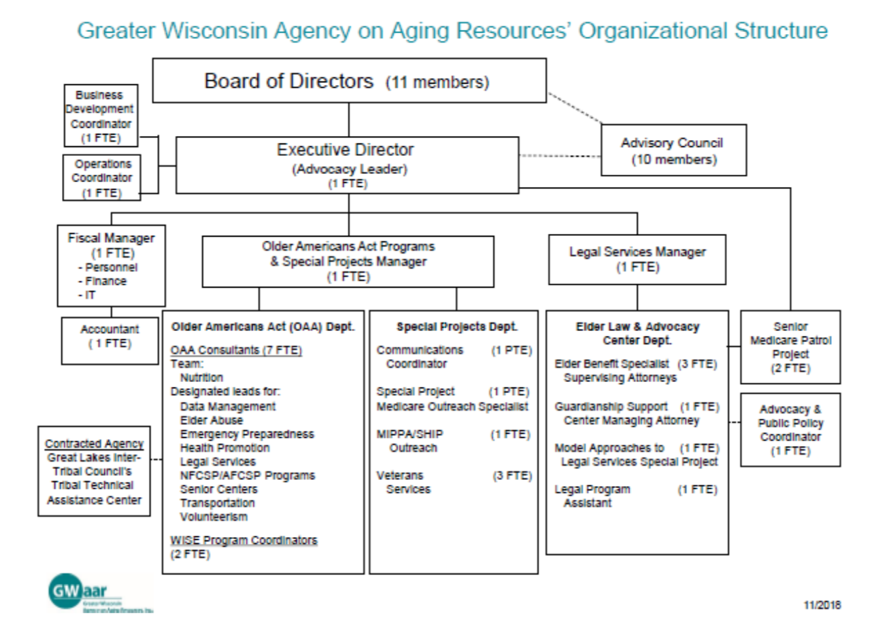
Wisconsin has 3 AAAs: Dane, Milwaukee and GWAAR (70 Counties and 11 Tribes)

Slide 12
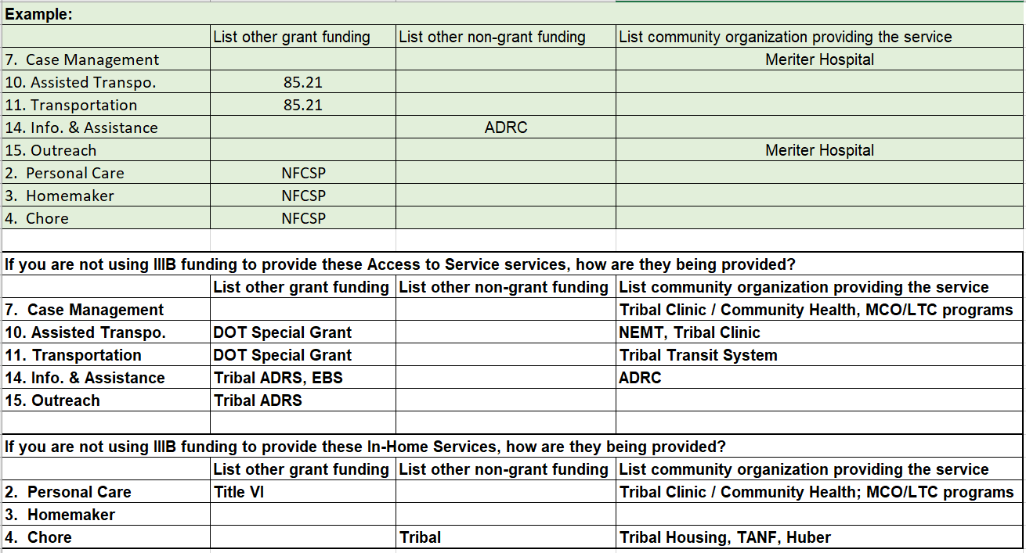
Coordination with other programs

Slide 13
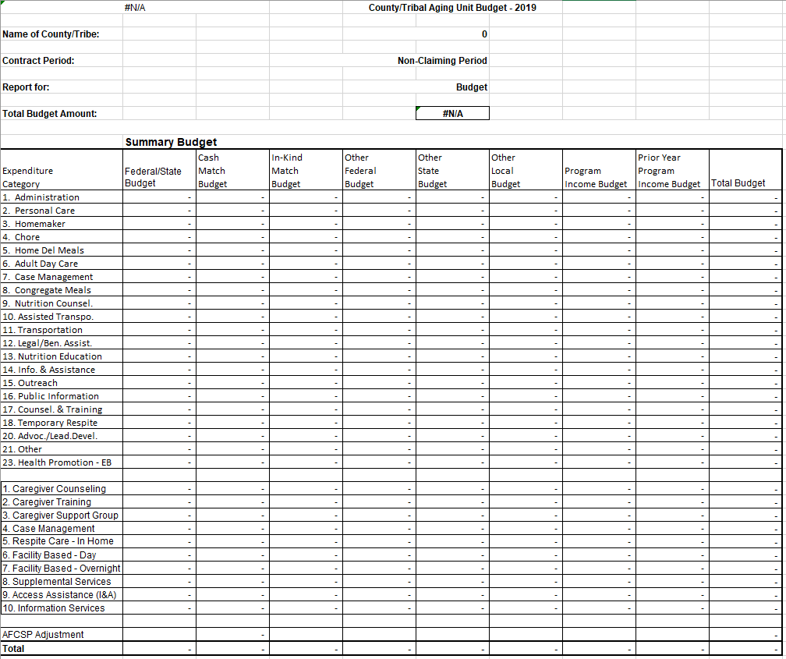
Budget Summary

Slide 14
Great Lakes Inter-Tribal Council, Inc.
Tribal Technical Assistance Center (TTAC)
Mary Wolf, Program Director
mwolf@glitc.org
(715) 588-3324 Ext. 178

