Slide 1
Public Health Partnerships to Support Brain Health

Slide 2
OUR WORK IS ABOUT PEOPLE AND SCIENCE
The Alzheimer’s Association is a global organization working to advance care, support and research across the world
Notes:
Main takeaway: The Alzheimer’s Association works to enhance care and support for people living with the disease, and also to eradicate Alzheimer’s through biomedical research
The multi-faceted approach to end Alzheimer’s is a great strength of our organization, what makes us unique, and makes us the leader of the cause
Everything we do - care and support, advocacy, research -- is rooted in the most up-to-date research in the field
The global scientific community knows we have a relentless focus on helping people and their families every day

Slide 3
CONTINUUM OF COGNITIVE IMPAIRMENT
Impairment does not interfere with activities of daily living
Impairment in two or more cognitive functions that interfere with activities of daily living
Cognitively Unimpaired
Mild Cognitive Impairment
Mild Dementia
Moderate Dementia
Severe Dementia
MCI is a known risk factor for dementia
Everyone who experiences dementia passes through MCI
When you prevent new cases of MCI, you are preventing new cases of dementia
Notes:
Main takeaway: Alzheimer’s disease occurs over a continuum.
Researchers now understand that cognitive impairment occurs across a continuum, spanning many years.
We start off cognitively unimpaired, but as we age, some individuals will progress to stages of Mild Cognitive Impairment (or MCI).
MCI is impairment that does not interfere with activities of daily living. But biological changes in the brain have started to occur.
But if individuals go on to develop dementia, they will progress through mild, moderate, and severe stages.
Dementia is defined as impairment in two or more cognitive functions that interfere with activities of daily living.
Now, MCI is a known risk factor for dementia, but not all individuals who develop MCI will go on to develop dementia.
But, everyone who experiences dementia will have passed through a stage of MCI.
This provides an opportunity for treatment and potential prevention, if we can prevent new cases of MCI, we may be able to prevent new cases of dementia.

Slide 4
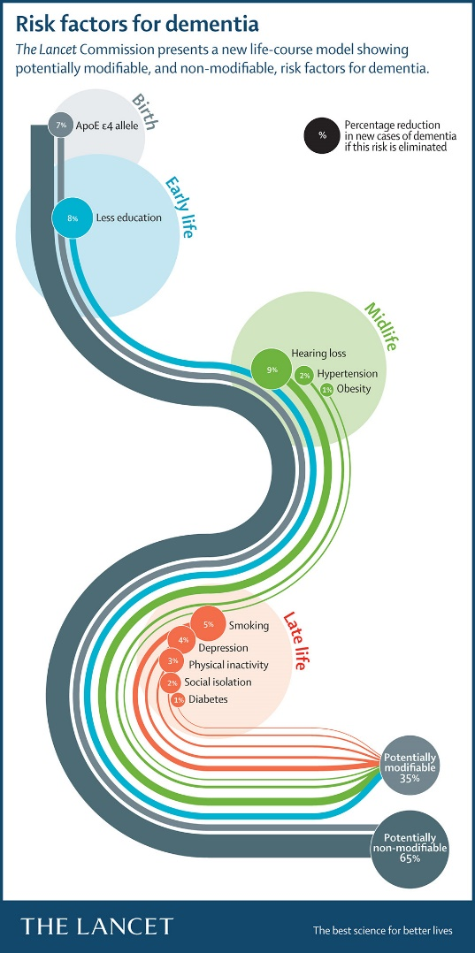
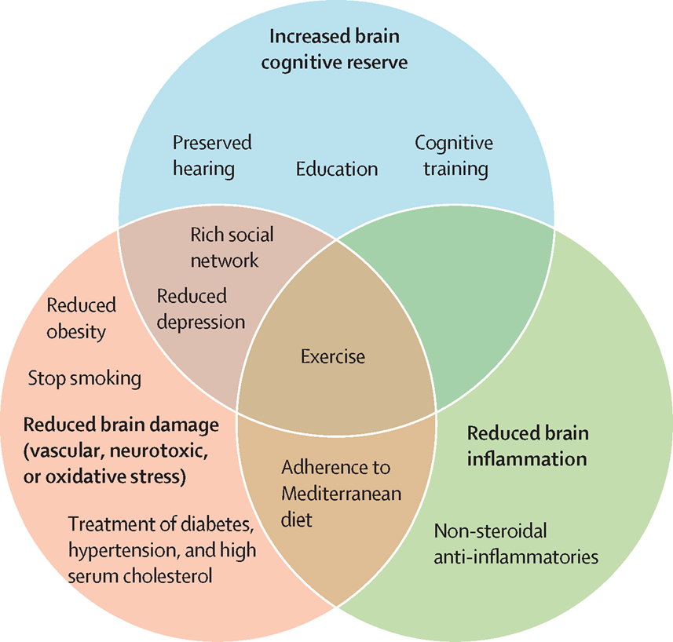
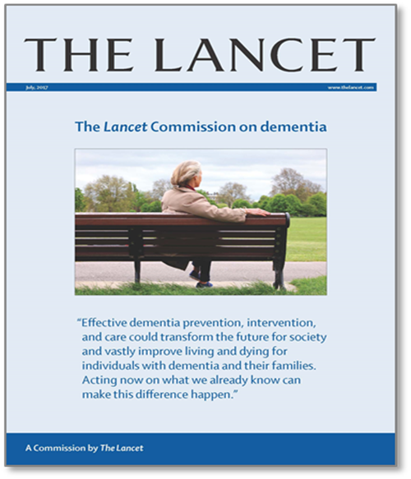
FOCUS ON RISK REDUCTION 2020*
Global Dementia May be Preventable
*Air Pollution
Traumatic Brain Injury
Excessive Alcohol Use
Notes:
3 circles graph is potential brain mechanisms for preventative strategies in dementia

Slide 5
Impact of Alzheimer’s Disease
1 in 10 people in the U.S. over the age of 65 have Alzheimer’s.
1 in 3 American Indian/Alaska Native (AI/AN) people over 65 develop dementia, including Alzheimer’s.
Between 2014-2060, the number of AI/ANs aged 65 and older living with dementia is projected to grow over five times.

Slide 6
Perceptions of Alzheimer’s Disease
About two-thirds (65%) of Native Americans say that they know somebody with Alzheimer’s.
Only 25% of Native Americans say that they are worried about developing Alzheimer's disease.
More than one-third of Native Americans (35%) say that they do not expect to live long enough to develop Alzheimer's.
More than half (53%) of Native Americans believe that significant memory or cognitive losses are a normal part of aging.

Slide 7
History of Public Health

Slide 8
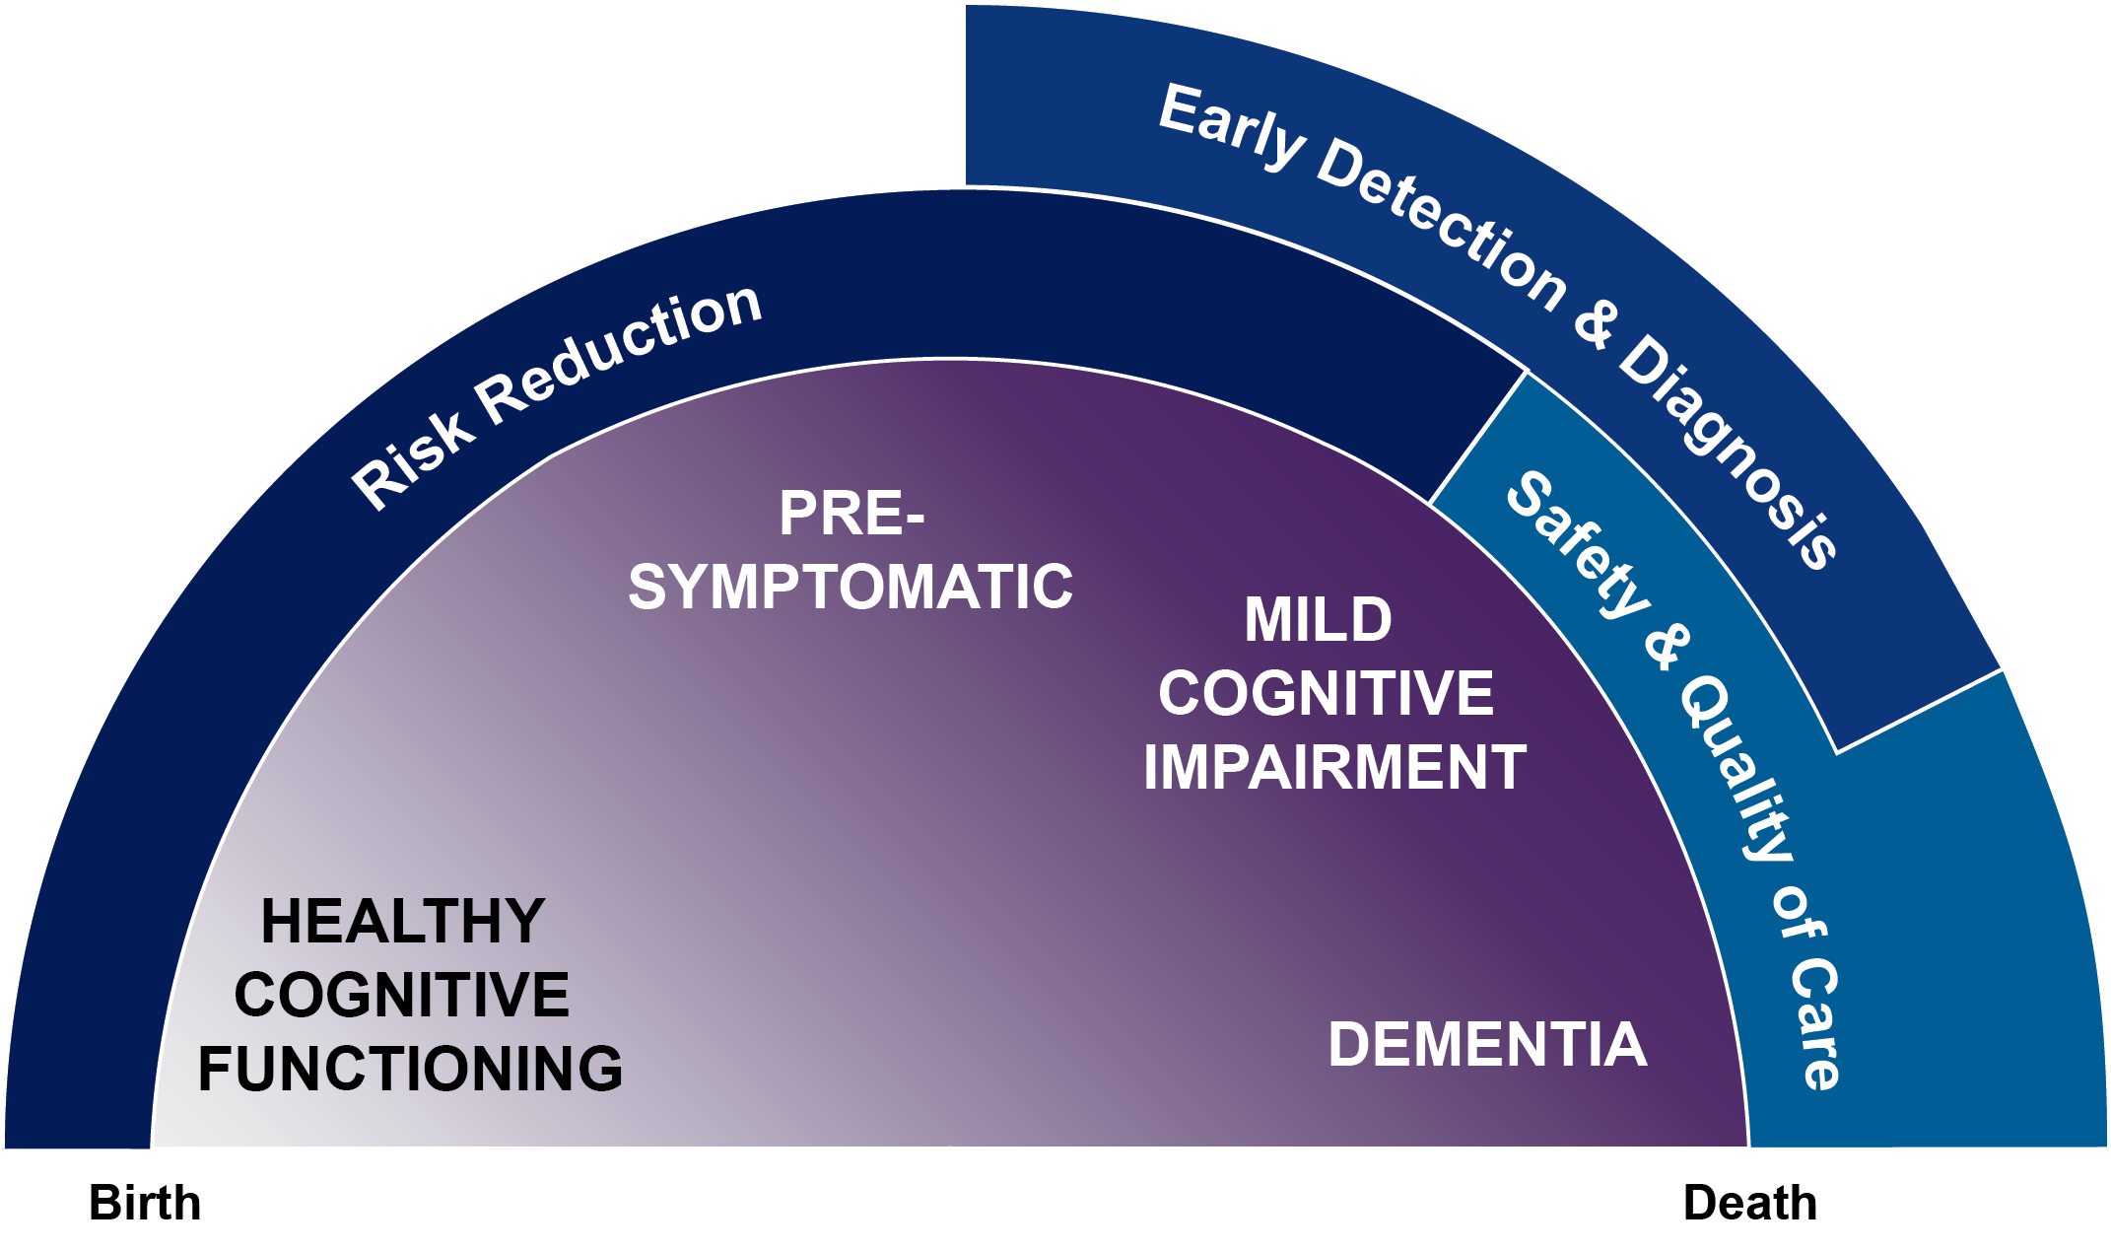
Life-Course Perspective and Public Health

Slide 9
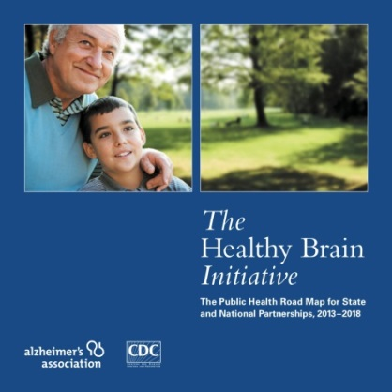
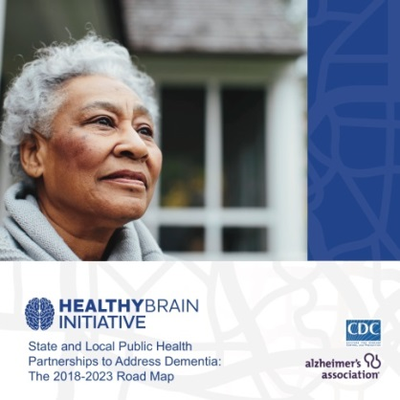
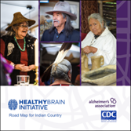
Public Health Road Maps

Slide 10
Road Map Development
Need for guidance tailored to the unique needs and strengths of AI/AN communities
Input from tribal leaders throughout Indian Country who recognize dementia as a growing problem
Develop framework that promotes community priorities and heritage

Slide 11
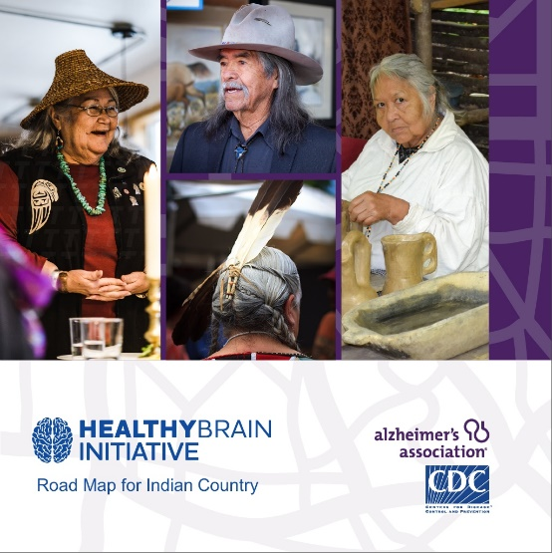
Road Map Approach
Conversation starter
Prompt local planning
Public health strategies

Slide 12
Road Map Strategies
Eight public health actions grouped into three categories
Educate and empower community members
Collect and use data
Strengthen the workforce

Slide 13
Public Health Resources
CDC Alzheimer’s Disease Resources
Data
Tipsheets
Dissemination Guide
Alzheimer’s Association Healthy Brain Initiative
Planning guide
Implementation examples
Background and development

Slide 14
HBI Road Map ACTION
St Regis Mohawk Nation
Collaboration with SUNY Plattsburgh
Provides caregiver support services, including education, support groups, respite care, transportation to medical appointments

Slide 15
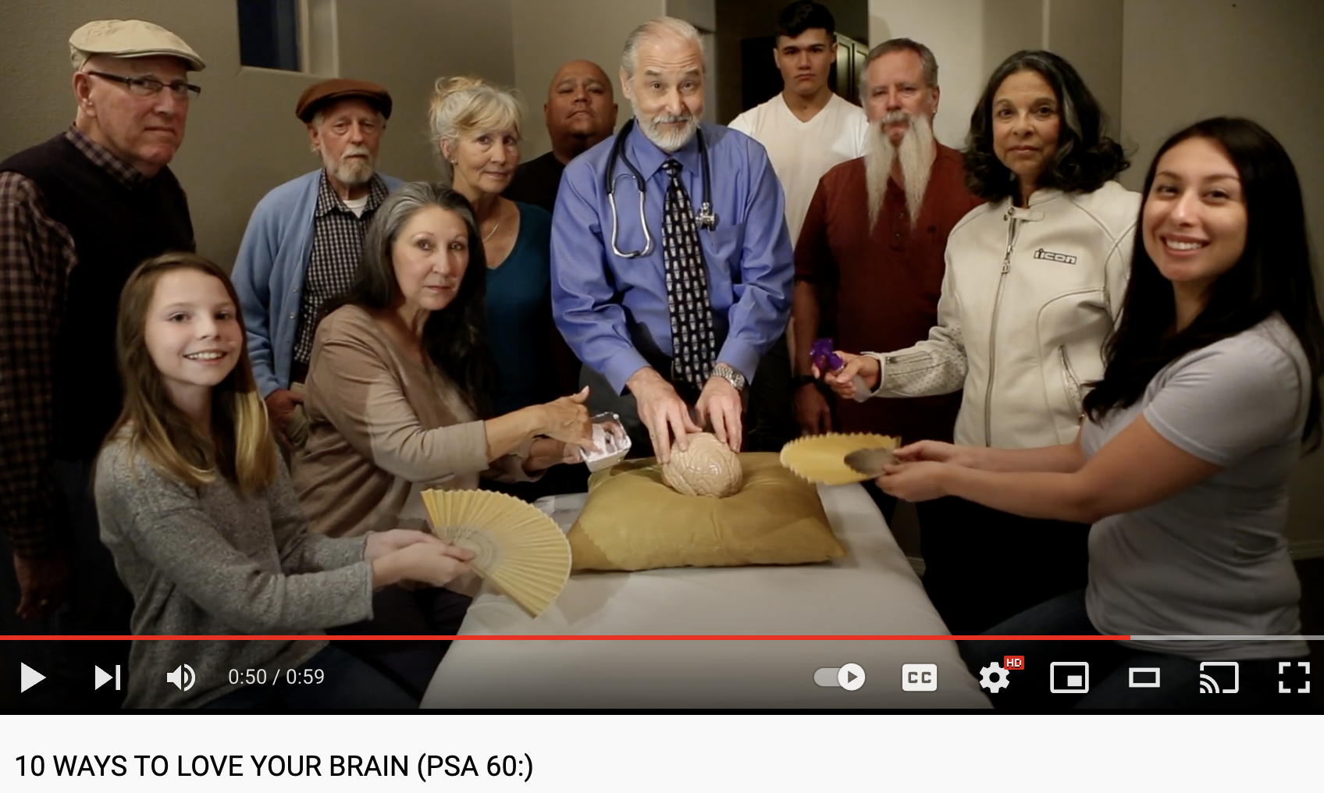
HBI Road Map ACTION
New Mexico Department of Health developed a series of PSAs on ways to reduce the risk of cognitive decline and promote cognitive health
Played on local TV stations
Purposefully created so other health departments can utilize the same PSAs in their jurisdictions
Played in 30 and 60 second clips. Utilized by at least 5 other health departments

Slide 16
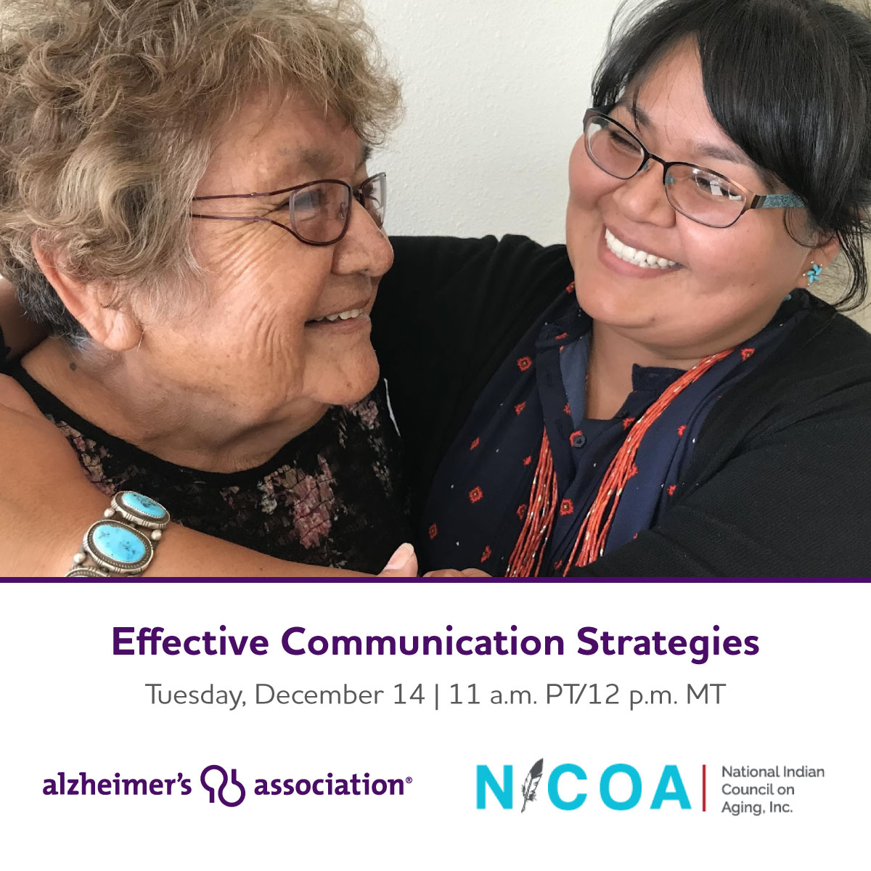
National Partnership
Notes:
UAD Recording: Topic: Understanding Alzheimer's and Dementia
Meeting Recording:
https://alz-org.zoom.us/rec/share/pjqB1DTOceeLvT4PiWO1y8PzqrVwGa_f7-DlAnJAYd8b_XonKRbHqli_XKrbG3wc._7mJfr4OY2Ml1Ais
Access Passcode: sDht5w@r
Effective Communication Strategies
Recording: https://alz-org.zoom.us/rec/share/740xol3-HAX8A2DOTS2iHEY0X83kFaRUS_9WwR4LQpIwue3mgAo2Yon94Vi8FWWK.rfapJwFndbrFFFY5?startTime=1639508441000 (Passcode: O6Xv0C&*)

Slide 17
Local Partnership
New Mexico
Awareness and training for frontline staff
PSAs from New Mexico chapter
Native Americans and Alzheimer’s Resource Page

Slide 18
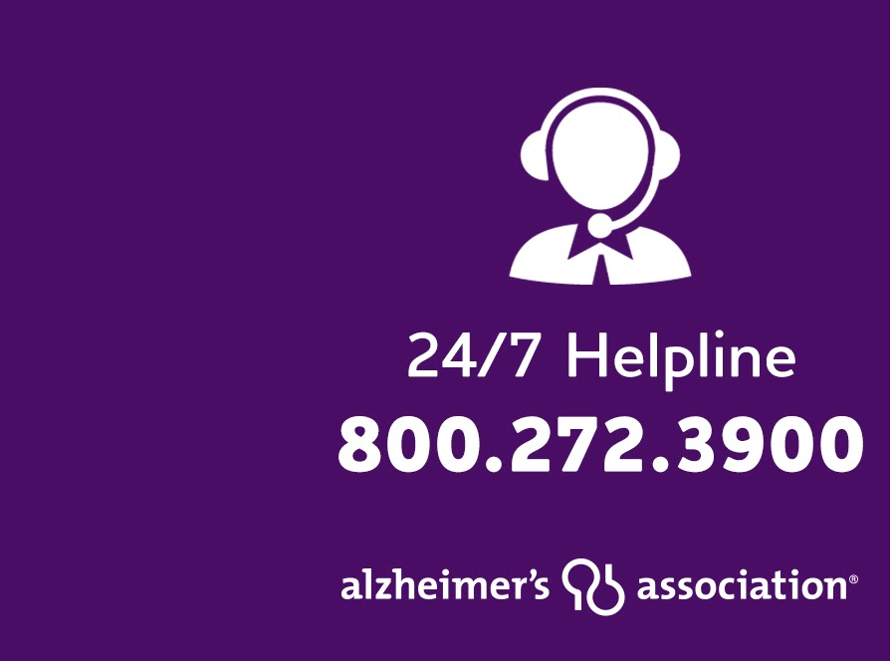
Resources and Support
Helpline, available around the clock, 365 days a year
Education Programs
Support Groups
Care Consultations
Early Stage Programs
Notes:
The Alzheimer’s Association 24/7 Helpline (800.272.3900) is available around the clock, 365 days a year. Through this free service, specialists and master’s-level clinicians offer confidential support and information to people living with the disease, caregivers, families and the public.
Contact the Helpline day or night to:
Speak confidentially with master’s-level care consultants for decision-making support, crisis assistance and education on issues families face every day.
Learn about the symptoms of Alzheimer’s and other dementias.
Find out about local programs and services.
Get general information about legal, financial and care decisions, as well as treatment options for managing symptoms.
Receive help in your preferred language through our bilingual staff or translation service, which accommodates more than 200 languages.
Access support through our TTY service (TTY: 866.403.3073) if assistance is required via a teletype device.

Slide 19
CHANGING THE TRAJECTORY OF ALZHEIMER’S DISEASE:
Delayed Onset
If we develop a treatment by 2025 that delays the onset of Alzheimer’s by just 5 years…
2050
2025
5.7
million people
expected to develop Alzheimer’s in 2050 would not.
2015
Notes:
Main takeaway: To be able to slow and change the trajectory of the disease will have a major impact.
All of the science we have been discussing today boils down to an effort to change the trajectory of Alzheimer’s disease.
We believe that if we can develop a treatment by 2025 (this could be medicines or through lifestyle intervention) that delays the onset of Alzheimer’s by just 5 years…
Then it is projected that 5.7 million people expected to develop Alzheimer’s by 2050 would not.
This would have a huge impact for our families and our society.

Slide 20
End of Presentation
Thank you! Learn more: alz.org/publichealth cdc.gov/aging
Edie Yau
eyau@alz.org
312.335.5898
Meghan Fadel
mlfadel@alz.org
202.638.7535

