Slide 1

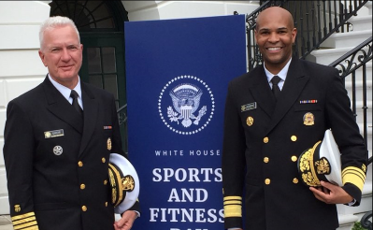



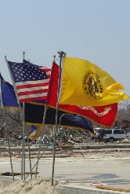


COMBATING THE OPIOID EPIDEMIC
OFFICE OF THE ASSISTANT SECRETARY FOR HEALTH
BRIEFING TO THE
ELDER JUSTICE COORDINATING COUNCIL
ADMIRAL BRETT P. GIROIR, M.D.
Assistant Secretary for Health and Senior Advisor for Opioid Policy

Slide 2
THE STATE OF OPIOID MISUSE IN AMERICA (2017)
11.4 million
people misused opioids
in the past year
  11.1 million misused pain relievers
  886,000 used heroin
  562,000 both misused pain relievers and heroin
2.1 million
people had an opioid
use disorder
  1.7 million people with a prescription pain reliever use disorder
  0.7 million people with a heroin use disorder
53.1%
obtained the last pain reliever they misused from a friend or relative
36%
from a prescription from a healthcare provider
Main reasons for opioid misuse: Pain 62.6%
NSDUH, 2017 Data; published Sept. 2018

Slide 3
OPIOIDS AND ELDERS: MEDICARE PART D, 2017 DATA
Nearly 1 in 3 Part D beneficiaries received at least one prescription opioid
(14.1 million enrollees)
Medicare Part D paid for 76 million opioid prescriptions
1 in 10 Part D beneficiaries received opioids for three or more months
Frequent use of opioids was more likely among seniors who were poor or low income, and seniors living in rural areas
36.1% of hospitalizations for opioid poisoning listed Medicare as the primary source for payment
12.7% of ED visits for opioid poisoning listed Medicare as the primary source for payment

Slide 4
U.S. DRUG OVERDOSE DEATHS
THE MOST CRITICAL PUBLIC HEALTH CHALLENGE OF OUR TIME
70,237
All Drug Overdoses
47,600
Opioid Overdoses
SOURCE: NCHS, National Vital Statics System, Mortality

Slide 5
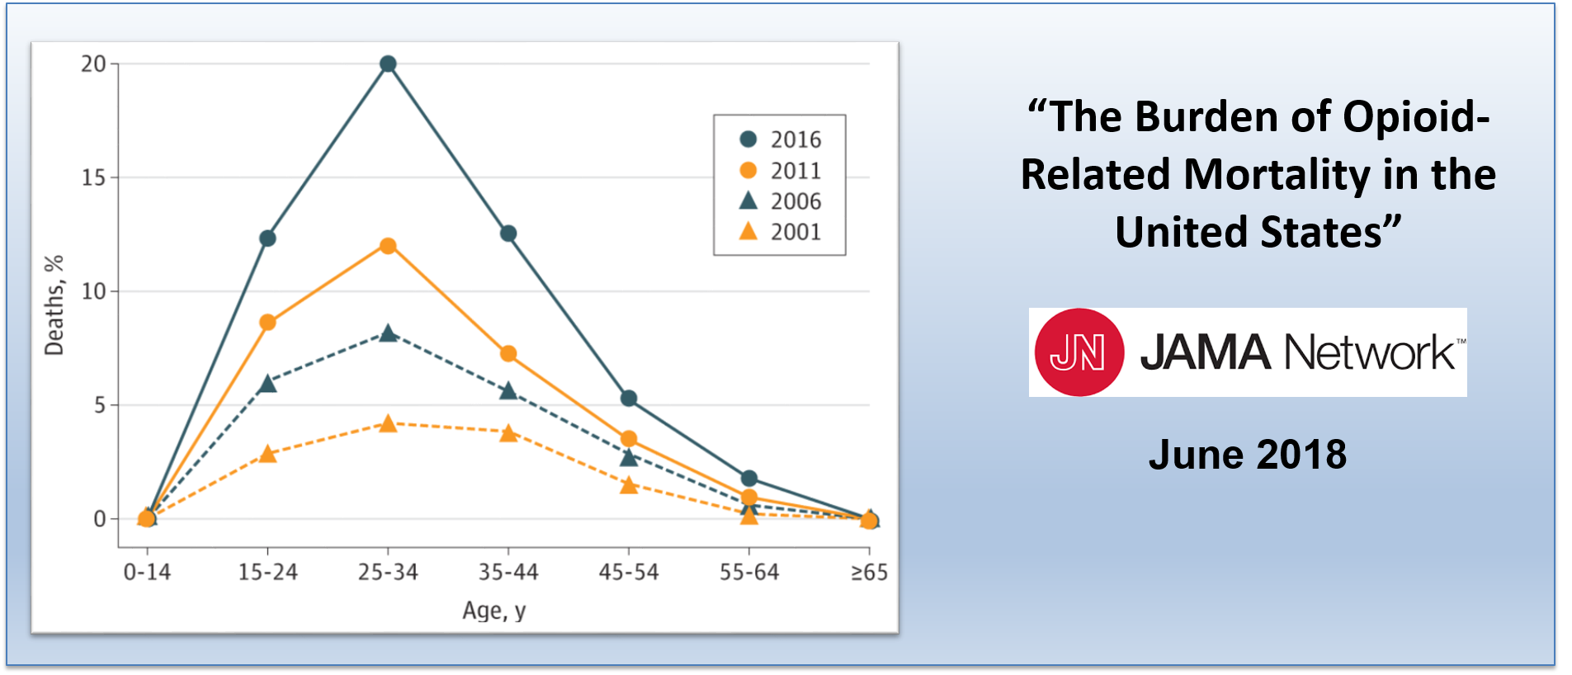
PROPORTION OF DEATHS RELATED TO OPIOIDS
BY AGE GROUP: 2001, 2006, 2011, and 2016

Slide 6
U.S. DRUG OVERDOSE DEATHS: OPIOID CATEGORIES
SOURCE: NCHS, National Vital Statics System, Mortality

Slide 7

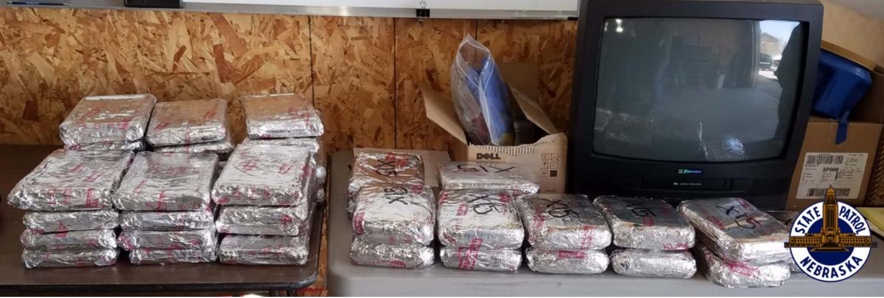
CRITICAL ROLE OF LAW ENFORCEMENT
CURBING ILLICIT IMPORTATION
State troopers seized 118 pounds of fentanyl
That amount of fentanyl would contain enough lethal doses to potentially kill more than 26 million people
Largest fentanyl seizure in state history and one of the largest in the United States
May 25, 2018
Inside a truck in Nebraska, troopers found enough fentanyl to kill millions of people
Nebraska State Patrol, courtesy

Slide 8
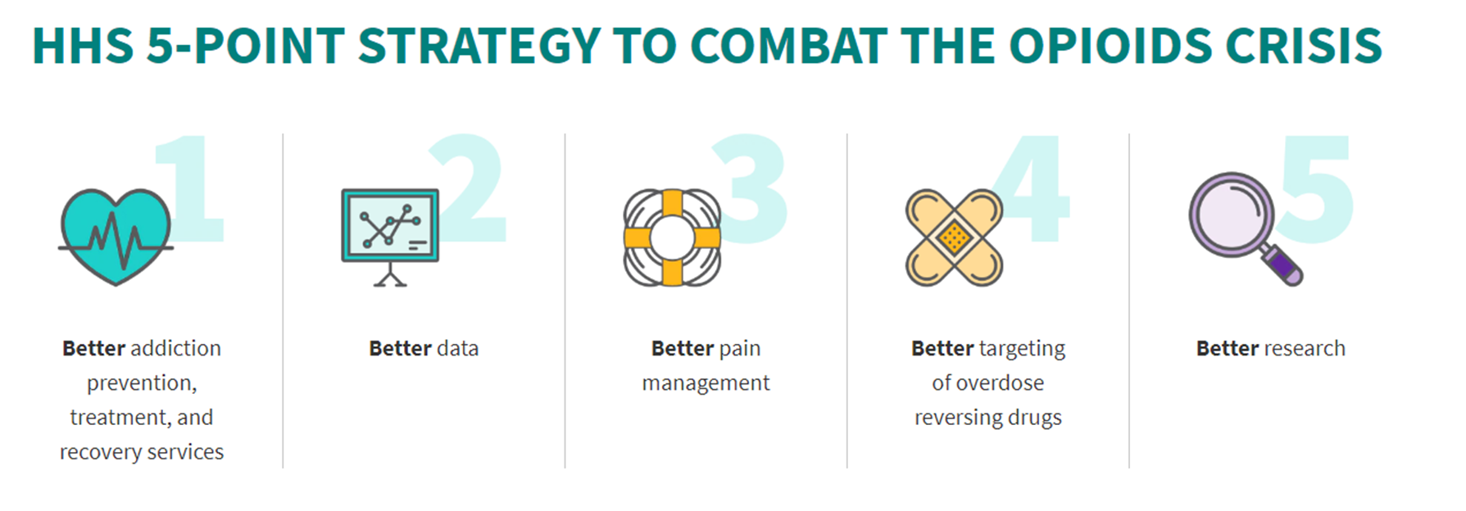

HHS 5-POINT STRATEGY TO COMBAT THE OPIOIDS CRISIS
https://www.hhs.gov/opioids/

Slide 9
CDC GUIDELINES

Slide 10
ADVOCATING FOR EVIDENCE-BASED TREATMENT
FDA-approved Medication (MAT)
  Naltrexone: once a month injectable medication, blocks effects of opioids;
  Methadone: long acting, once-daily, opioid from specially licensed programs;
  Buprenorphine/naloxone: long acting, once daily/once monthly, opioid from doctor’s offices
  Psychosocial Therapies
  Education, coping skills, relapse prevention, PDMP monitoring and toxicology screening
  Recovery Services - Rebuilding One’s Life
  Social supports to welcome into a healthy community: family, friends, peers, faith-based supports
  Assistance with needs that can impact treatment - recovery housing, transportation and child care
  Employment/Vocational training/education
  Naloxone

Slide 11
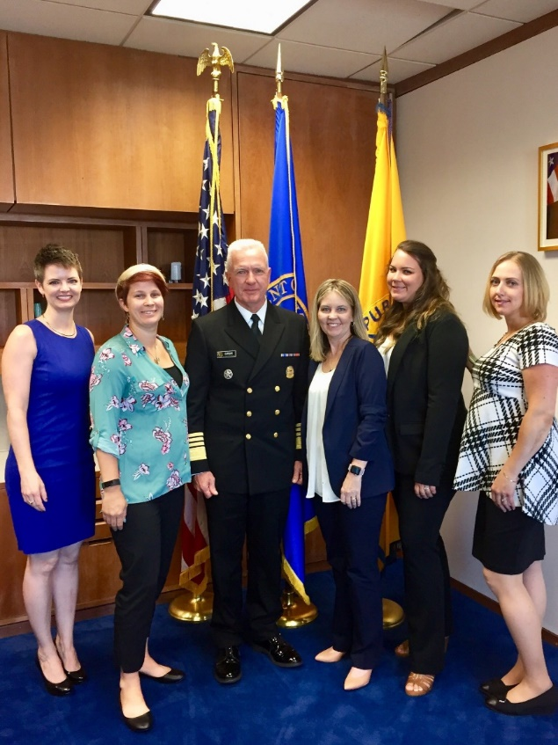

HHS FURTHER INTENSIFIES EFFORTS 2018
SAMHSA: Award of State Opioid Response Grants ($930 million) Funds could be used for training and technical assistance on elder abuse
HRSA: Community Health Centers, Rural Focused Opioid Progress, Behavioral Health Workforce Education and Training ($396 million)
CDC: Surveillance, Prevention Strategies, and Local Public Health Support including Tribes ($194.5 million)
Surgeon General Report: Spotlight on Opioids Update
Pain Management Best Practices Task Force: DRAFT report posted soon

Slide 12
ACHIEVING RESULTS IN COMBATTING THE OPIOID EPIDEMIC
SINCE JANUARY 2017
The total morphine milligram equivalents dispensed monthly by retail and mail-order pharmacies declined by 27.8%.
Number of unique patients receiving buprenorphine monthly from retail pharmacies increased by 21%.
The number of naltrexone prescriptions per month from retail pharmacies has increased more than 47%.
Naloxone prescriptions dispensed monthly by retail and mail-order pharmacies have increased by 367%.

Slide 13
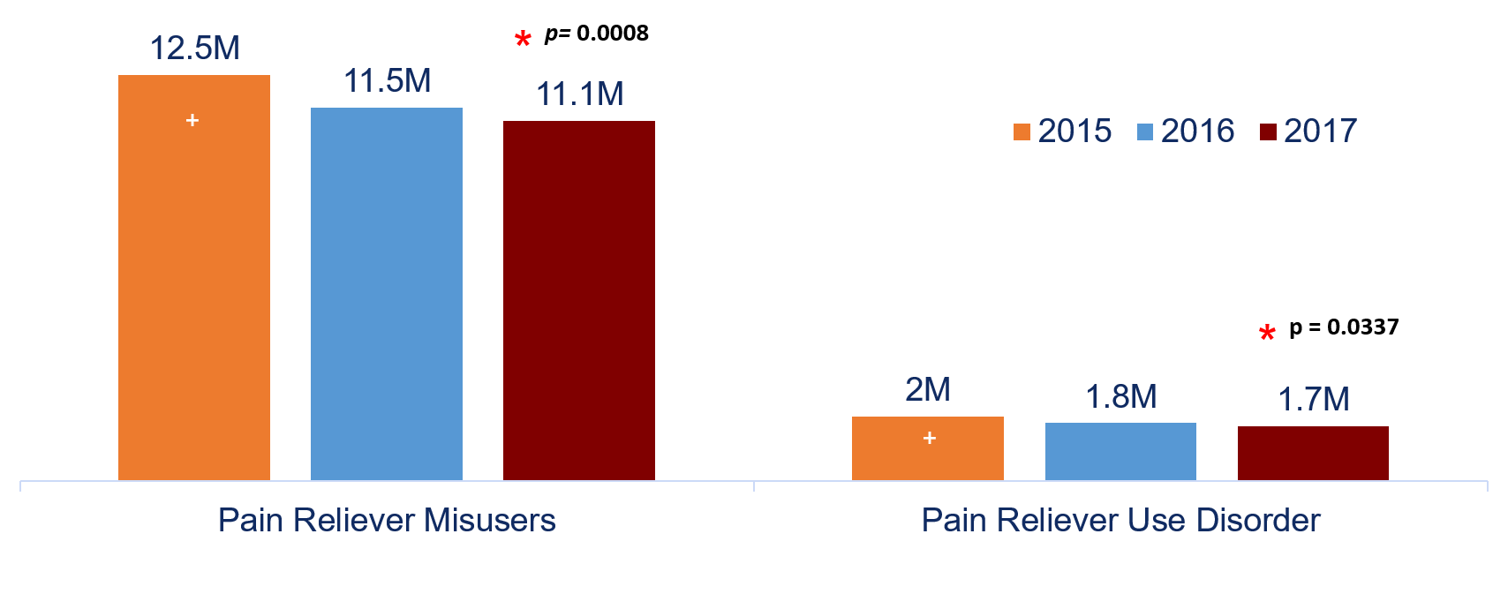
PAIN RELIEVER USE DISORDER IS DECREASING
NSDUH, 2017 Data; published Sept. 2018

Slide 14
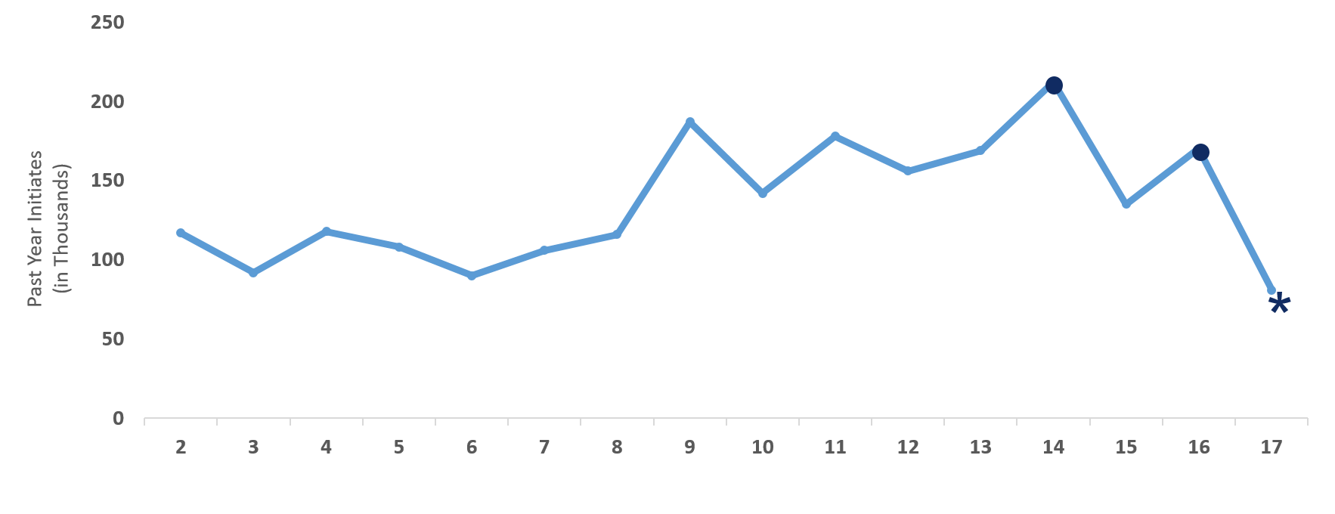
NATIONAL SURVEY ON DRUG USE AND HEALTH, 2017
FIRST TIME HEROIN USERS DROPPED BY >50% (2016-2017)
Past Year Heroin Initiates among People Aged 12 or Older (in Thousands): 2002-2017
NSDUH, 2017 Data; published Sept. 2018
Notes:
In 2017, an estimated 9,000 adolescents aged 12 to 17, 46,000 young adults aged 18 to 25, and 26,000 adults aged 26 or older used heroin for the first time in the past year (Figure 30). The number of adolescents in 2017 who were recent heroin initiates was similar to the numbers in most years between 2005 and 2016, but it was lower than the numbers in 2002 to 2004. The number of young adults aged 18 to 25 in 2017 who were past year heroin initiates was similar to the numbers in most years from 2002 to 2016, although the number in 2017 was lower than the numbers in 2009, 2011, and 2012. Among adults aged 26 or older in 2017, the number of past year heroin initiates was similar to the numbers in most years from 2002 to 2015, but it was lower than the estimate in 2016. Caution is advised in interpreting the fluctuations in the numbers of heroin initiates in single years because the relatively small numbers of recent initiates per year can contribute to these fluctuations.³⁷

Slide 15
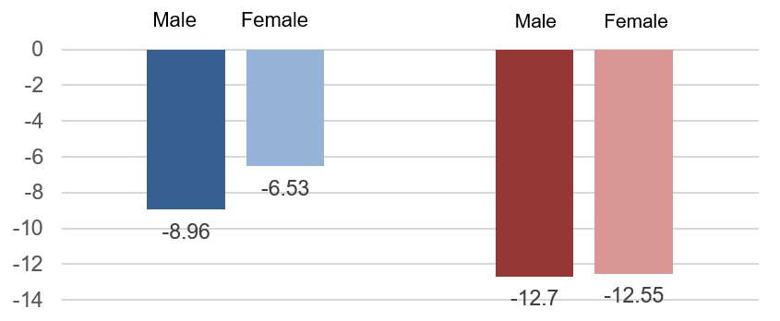
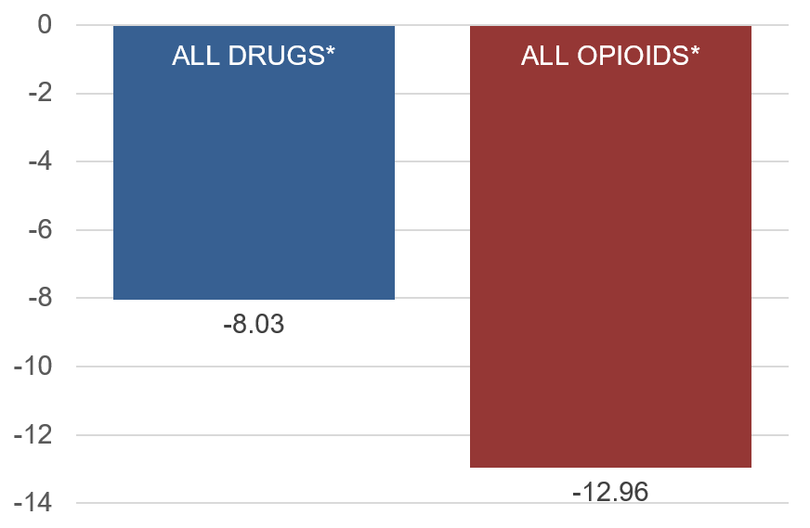
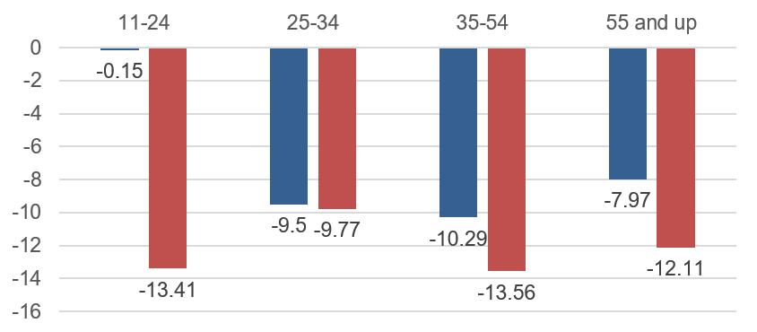
ED VISITS FOR SUSPECTED DRUG OVERDOSE (% CHANGE)
Q3 2017 – Q4 2017
* 21 States Reporting
* 25 States Reporting
Source: CDC Enhanced State Opioid Overdose Surveillance Program (ESOOS)

Slide 16
12 MONTH OVERDOSE MORTALITY: CDC NOVEMBER 2018
HHS OPIOIDS TEAM GOAL:
Reduce US drug overdose mortality
by at least 15% (>10,000 lives annually)
by January 2021
12-months ending in April 2018

Slide 17
HOW TO CONTACT ADM BRETT P. GIROIR, M.D.
BRETT P. GIROIR, M.D.
ADM, U.S. Public Health Service
Assistant Secretary for Health,
Senior Advisor for Opioid Policy
WWW.HHS.GOV/ASH
WWW.USPHS.GOV
@HHS_ASH
Brett.Giroir@hhs.gov

