Slide 1
Identifying Needs to Empower Native Elders

Slide 2
Collette Adamsen, PhD Turtle Mountain Band of Chippewa Indians Research Assistant Professor, UND School of Medicine & Health Sciences (UND SMHS) Center for Rural Health Director, NRCNAA collette.adamsen@und.edu

Slide 3
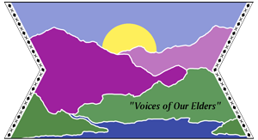
Funder & Sister Sites
Administration for Community Living
330 C St SW
Washington, DC 20201
(202) 401-4634
National Resource Center for Alaska Native Elders
University of Alaska Anchorage College of Health & Social Welfare
3211 Providence Drive Suite 205
Anchorage, Alaska 99508
(907) 786-4329
Hā Kūpuna - National Resource Center for Native Hawaiian Elders
University of Hawaii School of Social Work
1800 East-West Road
Honolulu, HI 96822
(808) 956-7009

Slide 4
Celebrating over 27 years! From Left: Cynthia LaCounte; Shawn Egeland (representing Dr. Leigh Jeanotte); Kathy Allery & Gina Allery (representing the late Dr. Allery); Dr. Richard Ludtke; Brad Hawk (representing Dr. Russ McDonald); Dr. Twyla Baker; Dr. Paula Morin-Carter; and Dr. Collette Adamsen.

Slide 5
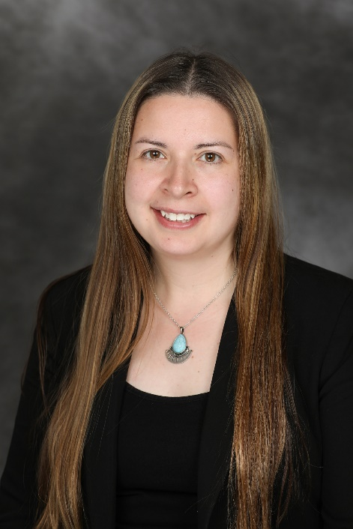
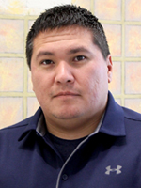
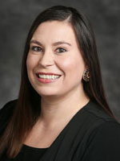
Title VI Needs Assessment
Primary Contacts
Collette Adamsen, PhD
Director
collette.adamsen@und.edu
Jordan Dionne
Project Coordinator
jordan.dionne@und.edu
Courtney Davis Souvannasacd
Outreach Coordinator
courtney.davis@und.edu

Slide 6
NRCNAA Needs Assessment Survey
Benefits:
Meets the Title VI Grant Application requirements
No Cost for Participation or Analysis
Data is owned by the Tribe
Comprehensive data for additional Nutrition, Support, & Caregiving services grant

Slide 7
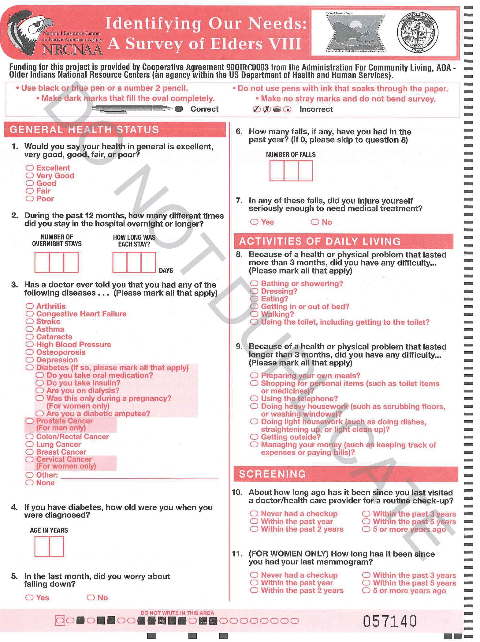
Categories
General health status
Indicators of chronic health conditions
Activities of Daily Living (ADLs)
Screenings
Indicators of visual, hearing, & dental
Memory & Disability
Health Care Access
Tobacco & alcohol use patterns
Diet, nutrition, & exercise
Social support pattern & housing
Social Functioning
Use & acceptance of services
Demographics

Slide 8
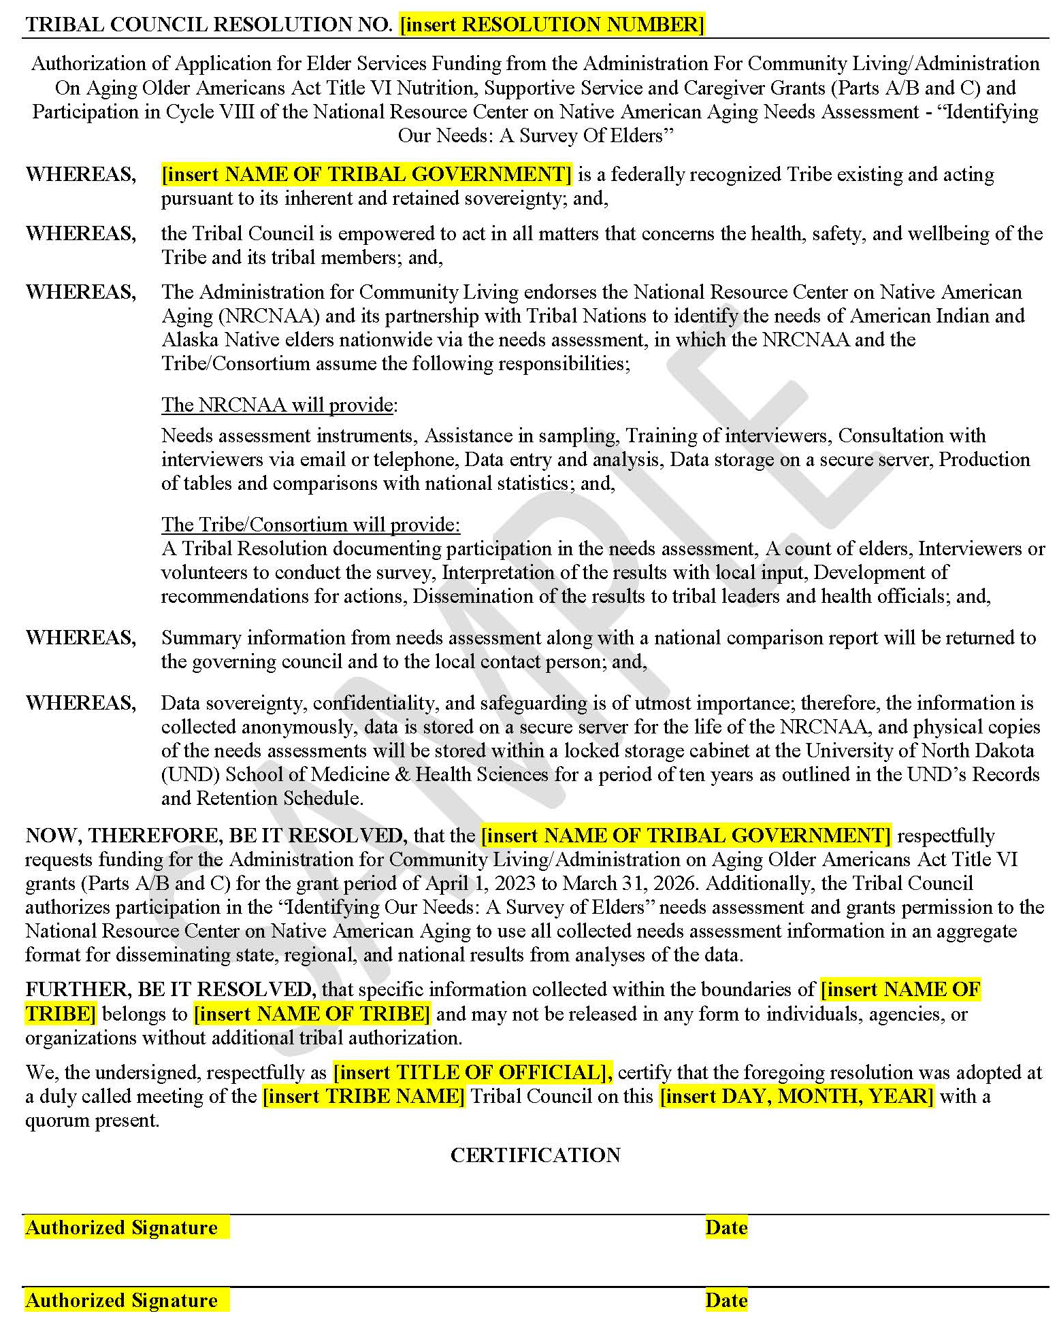
Title VI Needs Assessment Survey Process
Step 1: Get Permission to Participate via Tribal Resolution
Update: Only need to obtain 1 (ONE) resolution for ACL & NRCNAA to participate!

Slide 9
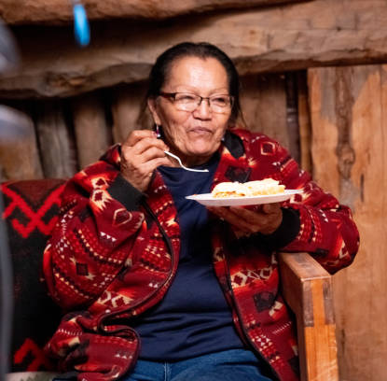
Title VI Needs Assessment
Survey Process
Step 2: Count Your Elders
We do not need the names of any elders
We will mail an appropriate number of surveys at no cost

Slide 10
Title VI Needs Assessment
Survey Process
Step 3: Begin the Process of Interviewing Elders
The survey is confidential
The survey is completely voluntary

Slide 11
Important: New surveys are created each cycle and each survey has its own unique scanning code. Please: Do not use surveys from former cycles Do not make photocopies of surveys Do not bend or fold surveys If you are in need of additional surveys, please contact us.

Slide 12
Title VI Needs Assessment Survey Process
Step 4: Mail Completed Surveys & Tribal Resolution For Processing
National Resource Center on Native American Aging
UND Center for Rural Health
1301 North Columbia Road Suite E231
Grand Forks, ND 58202-9037

Slide 13
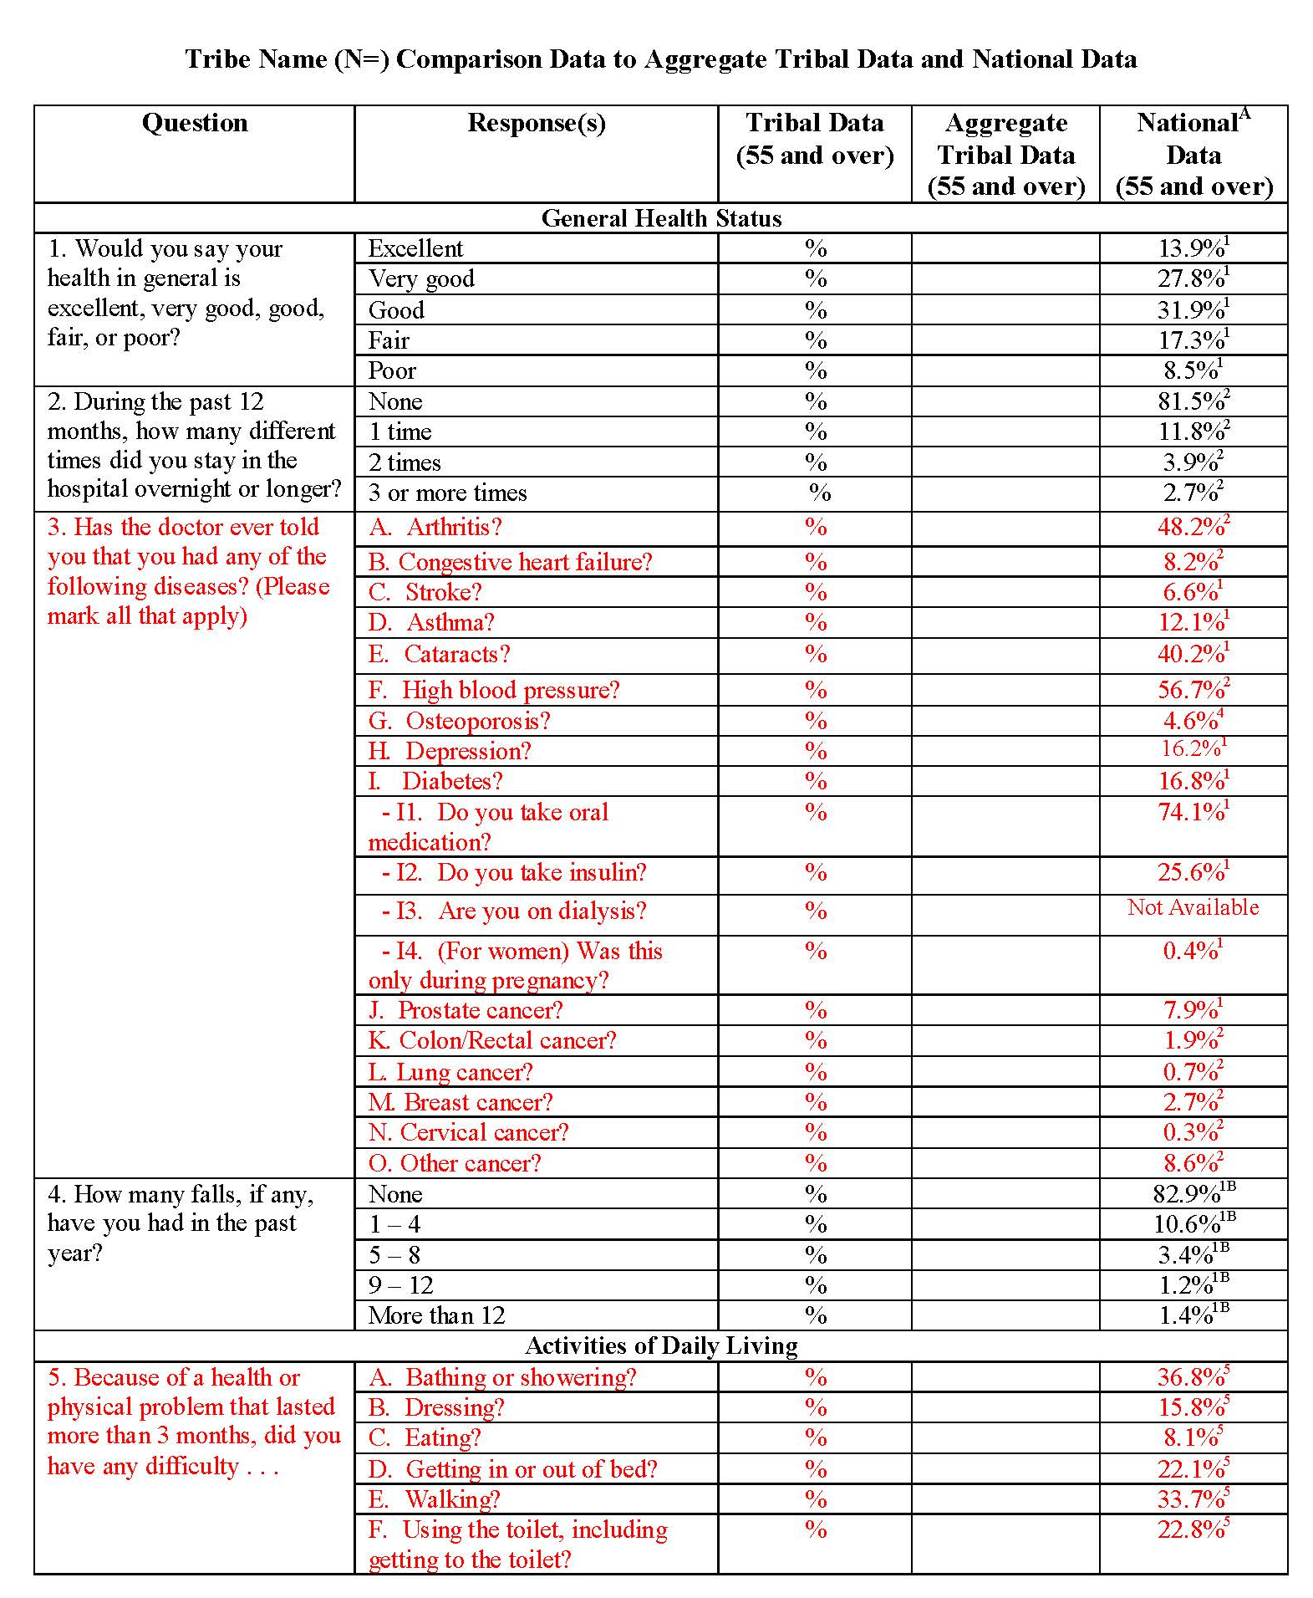
Title VI Needs Assessment
Survey Process
Step 5: Receive Report via a “Comparison Sheet”
Tribal Data
Aggregated Tribal Data
National Data

Slide 14
What goes into the Data Analysis?
Preparing the data instrument (Survey)
Collecting Data (Interviews)
Scanning the surveys
Cleaning data with statistical software
Analyze the data
(Comparison sheets)
Model the data
(Infographics)

Slide 15
Title VI Needs Assessment Participation: Cycles I - VII
Total Number = 112,863 surveys

Slide 16
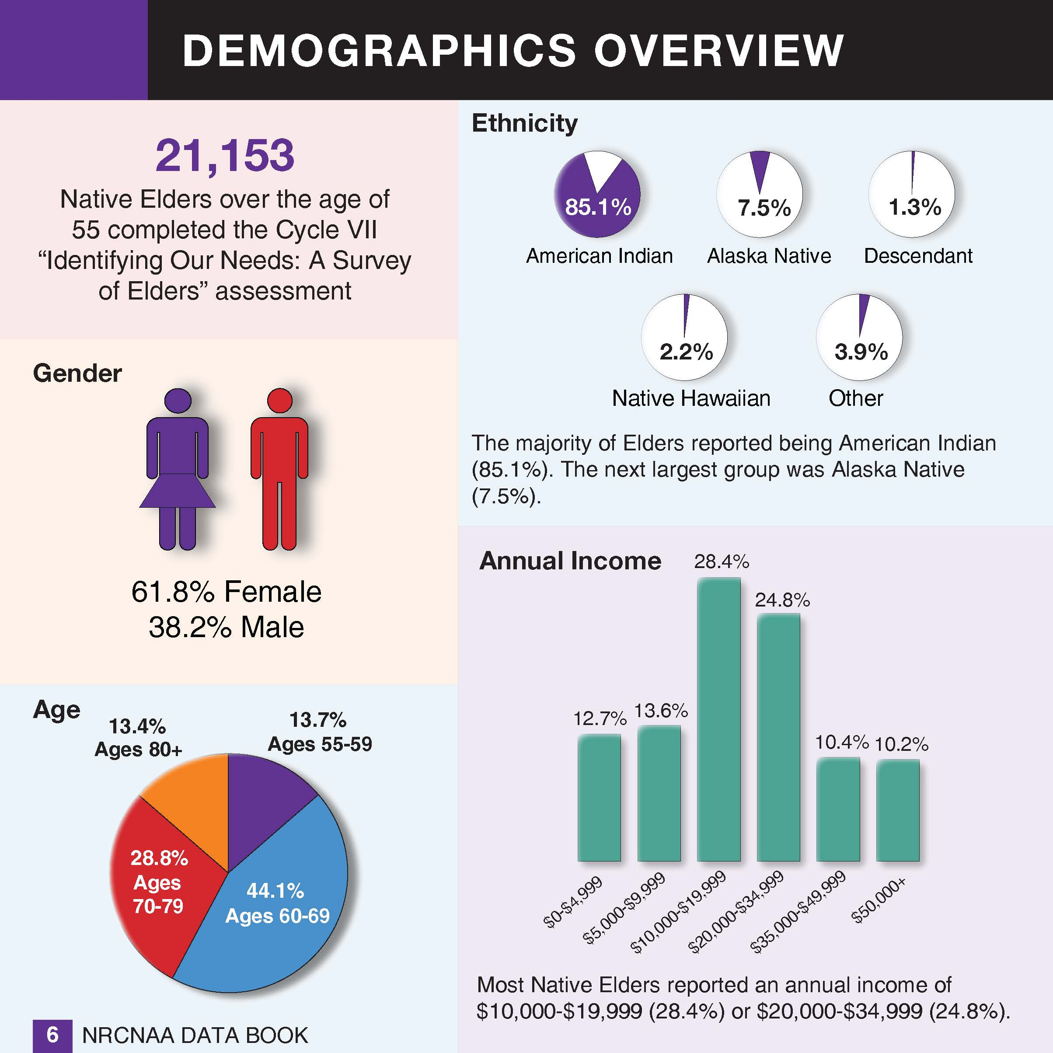
NRCNAA.org

Slide 17
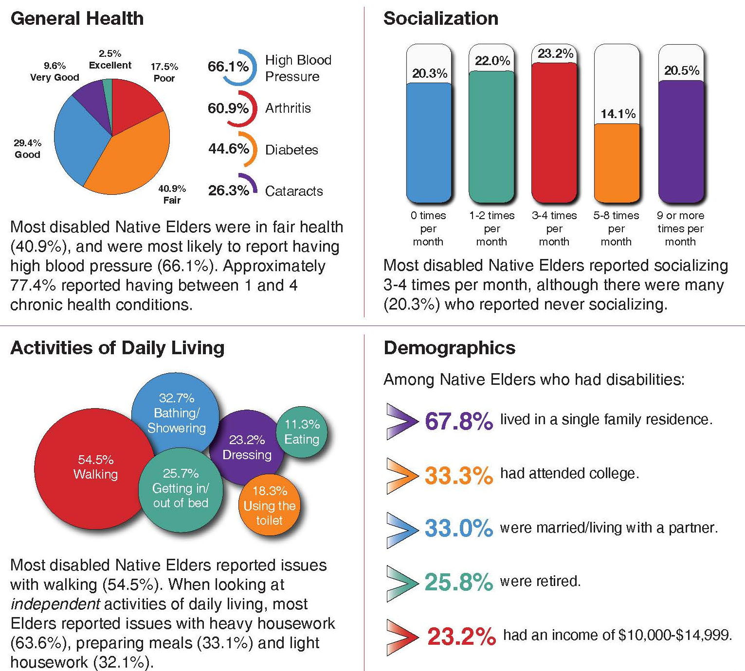
NRCNAA.org

Slide 18
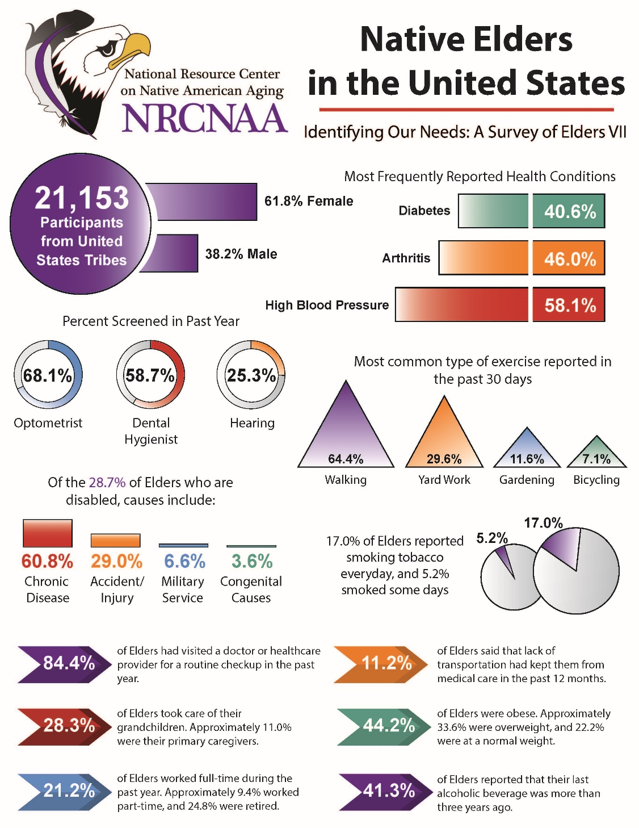
NRCNAA can produce infographics with the tribal and aggregated data.

Slide 19
NRCNAA Native Elder Service Locator
Does your tribe offer the following services?
Adult day care
Caregiver programs
Case management
Elder abuse prevention programs
Emergency response systems
Employment services
Financial assistance
Home health services
Home repair
Home modification
Information & referral assistance
Legal assistance
Home delivered meals
Congregate meals
Personal care
Respite care
Assisted living
Retirement communities
Nursing facilities
Government assisted housing
Shared housing
Senior Center programs
Telephone reassurance
Transportation
Volunteer services

Slide 20
Title VI Needs Assessment
Primary Contacts
Collette Adamsen, PhD
Director
collette.adamsen@und.edu
Jordan Dionne
Project Coordinator
jordan.dionne@und.edu
Courtney Davis Souvannasacd
Outreach Coordinator
courtney.davis@und.edu

Slide 21
National Resource Center on Native American Aging Address
UND SMHS Center for Rural Health 1301 North Columbia Road Suite E231 Grand Forks, ND 58202-9037

