Slide 1
Check out: https://olderindians.acl.gov
Program Management
New Director Training: National Title VI Conference
April 22, 2022

Slide 2
Learning Objectives
At the end of this session learners will…
  Understand the importance of self-assessment
  Have increased understanding of the importance of role as Director of a Title VI program
  Expand knowledge of the Older Americans Act programs

Slide 3
Presentation Outline
Self Assessment
Title VI Director Role
Older Americans Act Requirements
Program Basics
Data & Reporting
Know Your Resources
Notes:
I use the term Title VI Director to describe your role and understand that you may have a different job title and may even manage more programs than Title VI

Slide 4
Strengths & Weaknesses
Self-Assessment
Notes:
Before we talk about the nuts and bolts of program management, I like to take a step back and talk about self-assessment. Successful leadership means that you get to know the program and your strengths and weaknesses in the context of being a Title VI Director.

Slide 5
Self-Assessment
If new in this role…
If new to the Tribe and location
If highly experienced
  Think about this and ask yourself
    What area(s) do I need to give more attention?
Notes:
Many of you come to the Title VI Director position having worked within the program – i.e., as the cook, van driver or other supportive role. Think for a minute about your background – if you are new to this role, you probably have a lot to learn about the management of a program, for example, collecting data, reporting, managing a budget, purchasing, hiring staff, etc. Depending on your skill set you may need to push yourself into learning new skills such as developing a budget; writing a job description or developing programs.
Others may be very experienced as Director of other programs and are new to Title VI or new to the Tribe and even the surrounding area. You may bring strong program management skills and know how to provide services but have to focus more on developing relationships with tribal staff, with elders and with other agencies.

Slide 6
Self-Assessment
Before you can fully manage a program, you need to know…
  What you don’t know
  Who are the key leaders?
    Fiscal, other departments such as housing & clinic
  Who are the Elders?
  What are the grant requirements?
Notes:
We come to our jobs with expertise and with blinders – for instance, you may be a long time Title VI Director and your practices, polices and procedures have not changed – it’s not broken so don’t fix it. I get it and that can make sense – then we have Covid come along – everyone had to scramble. It is also encouraging people to look at providing services in different ways – it has also opened out eyes to the many unmet needs.
Think about how you spend your days – is it chaos – ensuring that meals are prepared and delivered? Is it focused on re-opening congregate meal sites? Are there elders in crisis who need your attention? Part of program management and your self-assessment is to look at how and where you spend your time.
If you’ve been a Title VI Director for a few years – is it time to re-evaluate how your program operates? Are there better ways?
If you’re new – do you see how things operate and wonder – is that the best way? Can we do this differently?
In either case, you don’t need to make any fast changes – instead, you want to ask the Elders, ask your co-workers, being a program manager – brand new or old hand – you want to be inclusive, and you need to understand the requirements of the grant.

Slide 7
Homework
Think about your strengths and weaknesses as a Title VI Director
Find a half hour each week to learn something new about your Tribe/Tribal organization or another agency that serves elders

Slide 8
Your Role As Title VI Director
Leadership

Slide 9
Your Role as Director
You are a Leader with a Mission
  To ensure the delivery of nutrition services, supportive services and caregiver services on behalf of Tribal Elders
  Voice and Face of the program serving as a point of contact for Elders and Caregivers
  Direct Service Provider - may be providing direct services to elders and caregivers by cooking/serving meals, providing transportation, doing assessments and care coordination, and more
Notes:
Whether your official title is Title VI director, Elderly Nutrition Program Director, Social Service Director, or otherwise, if you are leading the Title VI program you will be filling the following roles

Slide 10
Role: Manager
Leader of Title VI Program
  Understands the requirements of the grant
  Makes sure resources (staff, food, materials) are in place to serve elders and caregivers
  Keeps records and maintains policies and procedures
  Submit report
Notes:
This talks about what you do – equally important is how you do this work – clear communication with others is essential
“sit in relationship with Elders”

Slide 11
Role: Relationship Builder
Point of contact for others in your Tribal Organization about elder and caregiver issues
  Communicate with Tribal Leadership
  Supervises & manage staff that work on Nutrition, Supportive Services, Caregiver, and other programs
  Coordinate with colleagues if responsibilities for Title VI grant are split (for example a different person manages the Part C program)
  Coordinates with Accounting, Health Clinic, Family Services, Housing, and other Tribal departments

Slide 12
Role: Connector
Point of contact for others in your Area or State regarding elder and caregiver issues in your Tribe/Tribal Organization
  For example, local Medicaid office, veteran’s organizations, religious & other social service organizations
Point of contact for ACL
  For general questions about Title VI Part A/B, NSIP, and Part C grants
  About PPR completion or questions
Notes:
Spending down dollars

Slide 13
You Are Not Alone!
As the leader of the Title VI program you have many responsibilities
Use the resources from your Tribe/Tribal Organization
Other community contacts
Your Title VI peers, and
All of us at ACL to support you in your leadership roles.
Notes:
As the leader of the Title VI program, you have many responsibilities and more.
The job can sometimes feel lonely. Be sure to reach out – call or e-mail. Participate in the TA calls and webinars – we want to see your programs blossom!

Slide 14
Law and Authority
Program Basics

Slide 15
What you need to know
Older Americans Act & Regulation
Tribal Law and Policies & Procedures
Service Provision
Program’s Polices & Procedures
Budget and how to read fiscal reports
Data collection & reporting
Notes:
Goal broad based overview – point that

Slide 16
Law, Regulation, Guidance
Law =
Older Americans Act
Public Law 109-365
42 U.S. Code Chapter 35
45 CFR Part 1321
(Title III)
45 CFR Part 1322 & 1323
(Title VI)
Regulation =
Guidance =
Program Instructions
Frequently Asked Questions (FAQ’s)
Letters to states and grantees
Notes:
New laws are assigned a public law (PL) number. For example: The Older Americans Act as amended In 2006 known as Public Law 109-365
The United States Code contains the general and permanent laws of the United States. For example: 42 U.S.C. Chapter 35 - PROGRAMS FOR OLDER AMERICANS (Older American Act) (CONGRESS)
Federal Regulations (sometimes a group of regulations is collectively called a “federal rule”) are issued by federal agencies, boards, or commissions. They explain how the agency intends to carry out a law. By law, federal agencies must consult the public when creating, modifying, or deleting rules in the Code of Federal Regulations (CFR).

Slide 17
The Older Americans Act
The Older Americans Act was first a law in 1965
Nutrition Programs were first added in 1971 and Title VI programs followed in 1978
The “Act” is divided in to separate chapters called “Titles”
    Like in a book, each Title (chapter) deals with a different subject
    Under each Title, there are separate sections called “Parts”
    Under each Part, there are separate sections called “Sections”

Slide 18
Older Americans Act: Key Provisions
Title I — Objectives
Title II — Administration on Aging
Title III — Grants for State & Community Programs
    A. Administration
    B. Supportive Services & Senior Centers
    C-1. Congregate Nutrition Services
  C-2. Home Delivered Nutrition Services
    D. Evidence-Based Disease Prevention & Health Promotion Services
    E. National Family Caregiver Support Program
Notes:
These next two slides show the outline of the Act.
Title I is objectives and vision
Title II establishes the Administration on Aging & talks about what we do at the federal level
Title III very important for setting up State and AAA structure & services and funding
Title III – Grants for State and community programs include the following programs ……
III B Adult day, case management, chore, I&A, homemaker, home repair, outreach, personal care, respite, transportation – etc…
III C – Nutrition Services – Congregate and HDM
III D – Health Promotion Disease Prevention – only evidence-based programs
III E – National Family Caregiver Support Program

Slide 19
Older Americans Act: Key Provisions
Title IV – Activities for Health, Independence and Longevity
Title V - Community Service Senior Opportunities Act
Title VI - Grants for Native Americans
  Part A – Indian Program
  Part B – Native Hawaiian Program
  Part C – Native American Caregiver Support Program
Title VII – Allotments for Vulnerable Elder Rights Protection

Slide 20
Title VI Requirements
If you read the OAA, you won’t find much under Title VI or Code of Federal Regulation (CFR) citations:
  Grants for Indian Tribes for Support and Nutrition Services: Older American Act Regulation (1988), 45 CFR Part 1326 (Title VI)
  Grants for Supportive and Nutritional Services to Older Hawaiian Natives: Older American Act Regulations (1988), CFR Part 1328 (Title VI)
Programs are designed to follow the OAA Title III
Programs and tribes will find most of the rules in that section of the OAA

Slide 21
Tip – Service Alignment in the OAA
Service | Title VI | Title III
Transportation | Part A/B | Part B
Chore | Part A/B | Part B
Information & Assistance | Part A/B | Part B
Case Management | Part A/B | Part B
Congregate Meals | Part A/B | Part C-1
Home Delivered Meals | Part A/B | Part C-2
Health Promotion/Disease Prevention | Part A/B | Part D
Caregiver Support (Caregivers of Elders or people with dementia of any age) | Part C | Part E
Caregiver Support (Older Relative Caregivers caring for children or adults with disabilities) | Part C | Part E
Notes:
As mentioned previously Title III and Title VI provide basically the same services, but they are organized slightly differently in the OAA. This slide is a handy reference guide if you are trying to decode what the State/AAA is talking about when they talk about Title III services.
You might use this chart to help your Title III colleagues to better understand how Title VI is organized.
The services listed in green (the top 7 services) are services for older adults/elders. These services are allowable under Title VI Part A/B. They are also allowable under Title III, but there are separate parts (in other words grants) for Congregate Meals, Home Delivered Meals, Health Promotion, and Transportation and Case Management and other services.
The service listed in yellow (bottom 2 services) are allowable under Title VI Part C, and Title III Part E.

Slide 22
Services
Program Basics

Slide 23
Part A/B Grants - Nutrition Services
Required Nutrition Services:
  Congregate Meals
  Home Delivered Meals
  Nutrition Education and Nutrition Counseling, as appropriate

Slide 24
Part A/B Grants –
Nutrition Services - PERMITTED
Traditional foods activities
Other traditional activities
Diet counseling
Sponsorship of Farmers Market programs
Distribution centers for food banks
Blood Sugar checks
Diabetes education
Foot Care
Blood Pressure Checks
Evidence-based health programs
Falls avoidance education
Medication management
Support groups
Socialization activities
Exercise Classes
Notes:
Traditional food activities – gardening, harvesting, fishing, hunting. Title VI funds can pay for necessary supplies
Farm Market – Older Indians Website has a farm market directory.
Purchasing items from on-farm markets for your Title VI program* is a great way to get fresh, in season products to serve to your elders while also supporting your local economy. Additionally, farmers in your community might offer traditional foods that may be difficult to find from retail grocery stores or food vendors. Buying goods from on-farm markets may also serve as a reliable alternative for products in times of crisis or economic instability.
*Some tribal governments may only allow their Title VI programs to purchase items from pre-approved food vendors. If this is a requirement for your program, then there may be a process to get an on-farm market added as a pre-approved vendor if it is not already listed. Please contact your tribal government for more information.

Slide 25
Part A/B Grants -
Supportive Services - Required
Information is a required service
  Simple provision of information to people; can be in a group session or one-on-one
  Maintain a list of all services that are available to older Indians in the service area
  Maintain a list of services needed or requested by the older Tribal members
Assistance is required service
  Aiding older tribal members to help them access assistance
Notes:
You’ll learn a lot more in an upcoming session on Supportive Services

Slide 26
Part A/B Grants -
Supportive Services - Permitted
A tribal organization may provide any of the supportive services mentioned under Title III of the Older Americans Act, and any other supportive services that are necessary for the general welfare of older Indians
(45 C.F.R. §1322.13 (a))
Notes:
Review on next slide

Slide 27
Part A/B Grants -
Supportive Services – Permitted Examples
Outreach
Case Management
Transportation
Legal Assistance
Homemaker Services
Personal Care/Home Health Aide
Chore Services
Visiting
Telephoning
Health Promotion Activities
Snow Removal
Wood Chopping

Slide 28
Part C—Caregiver Support Services
Must also have a Part A/B grant
Services are for two types of unpaid caregivers:
  Person (family, friend or other relative) who has responsibility for the care of an older adult in need of assistance including persons with Alzheimer’s disease or a related disorder
  Older relative caregivers, for instance grandparents raising grandkids, or an elder caring for an adult with a disability
Program services are to benefit the caregiver
Notes:
The caregiver is the client! Program services are to benefit the caregiver (whether the elder or other care recipient receives a service or other assistance)

Slide 29
Who are Caregivers?
In Indian Country, the most likely caregivers are family members, friends of the family, neighbors, or members of a church or social club who are close to the person needing care.
Many caregivers do not identify themselves as such since caring for elders is a traditional activity in Indian Country; caregivers see themselves as simply doing what needs to be done.
Notes:
As a Title VI Director you may need to spend time raising awareness and encouraging caregivers to ask for support.

Slide 30
Part C – Services - Required
Information to caregivers about available services
Assistance to caregivers in gaining access to the services
Individual counseling, organization of support groups, and caregiver training to assist the caregivers in the areas of health, nutrition, and financial literacy, and in making decisions and solving problems relating to their caregiving roles
Respite care to enable caregivers to be temporarily relieved from their caregiving responsibilities; and
Supplemental services, on a limited basis, to complement the care provided by caregivers

Slide 31
Homework
Take a half hour to read Title VI of the Older Americans Act
Take a half hour read Title III of the Older Americans Act
Take a half hour to read the regulations (see slide 26 for the links)

Slide 32
Policies and Procedures
Program Basics
Notes:
Policies and procedures are always a good place to start. If you are new, policies and procedures will help you learn what needs to be done and how to do it. They may also help you find gaps that need to be addressed or questions that you need to ask.
If you have been doing the work for a while, policies and procedures may also be a good read – you can find things that may need to be added or edited, or you may find out that “we have to do it this way” isn’t necessarily what your policies and procedures require!

Slide 33
Policies and Procedures (P&P)
What are P&P’s?
Describe the details of how your program works day to day
Can make your job easier by assisting you with:
  Daily decision making
  Service provision
  Program monitoring
  Staff development

Slide 34
Policies and Procedures (P&P)
Policies and Procedures are inter-related
  Policies guide the implementation of programs
  Procedures are the steps or activities needed to accomplish a specific policy
  Together they provide the rules and guidelines for the program

Slide 35
Policies
For example, Title VI requires that you provide elders with the opportunity to voluntarily contribute to the cost of a service.
  Thus, you need to develop a policy of voluntary contributions, including what the contribution can be used for, and privacy issues.
Policies usually require high-level approval.
Notes:
Polices are like rules and when everyone knows the rules there is a sense of fair play.

Slide 36
Procedures
Procedures are the steps or activities necessary to achieve the policy.
Procedures related to a policy on voluntary contributions might describe how voluntary contributions are solicited from elders and how records are kept to account for the receipt of the contribution

Slide 37
P&P Example
Policy: All Title VI Meal Participants will be given the opportunity to make a voluntary contribution to the program. The suggested contribution amount is $3/meal. All contributions will be kept confidential.
Procedure: At the congregate site, there is a secured contribution can next to the sign in sheet. Envelopes are available for participants to use in placing their contributions in the can. This information is included in the orientation meeting with each new participant, and the site manager gives a reminder about the contribution can in the monthly newsletter. Contributions are collected, recorded, and deposited daily by the Site Manager and Accounting Assistant. Contributions go to support direct costs of the Congregate Program.
Notes:
Thinking of “fair play” the Elders can feel confident – they know that: contributions are voluntary; they know the cost and they know that it will be kept confidential.

Slide 38
Policies and Procedures
Policy and procedures, put together in a policy manual, are vital because they provide the rules and guidance for your Title VI program
Tribal governments will have policies and procedures for many administrative, personnel, and financial activities
You need to review these and working with your Tribal leadership include those that are applicable to your program. For instance, vaccine requirements

Slide 39
Policies and Procedures
Do you use your P&P’s?
  Are they accessible on your computer?
  Printed in a book?
  Outdated?
  Missing pieces?
In light of Covid – do you need to revise your P&P’s?
Notes:
It is not unusual to hear, “we don’t have a policy & procedure for that” or you want to start a new program, like a lending closet or minor home repair and need to develop P&P’s. It’s important to develop the P&P’s before offering or changing the service and that staff, volunteers, Elders and their caregivers understand the changes.
Covid has also created changes. If you are re-opening and you want to encourage people to come back to the community meal centers, how would polices and procedures influence that? For example, if everyone is getting home delivered meals right now – regardless of level of disability – do you want to return to old polices which would mean that some people are no longer eligible for HDM or do you want to revise your P&P’s to be more flexible with HDM.
Re-Opening means new P&P’s regarding masks, vaccines, distance, etc. It’s important that Elder’s understand the rules (P&P) and why – i.e., we don’t have Covid funds left and have to prioritize HDM for those who truly can’t get out.

Slide 40
P&P Training & Review
Training & review is essential
  Staff and volunteers must understand and carry out the P&P’s and need to be re-trained if they are revised
  If the P&P changes directly impact Elders or caregivers, the changes should be communicated with them, as well
  Information about minor changes could be provided in an e-mail, posted on the bulletin board, or other informal methods
Notes:
It can be a lot of work to develop P&P, but the work does not end there.
Title VI programs also need to communicate the P&P by training staff and volunteers on P&P. For example, if you are changing your P&P to use a new data reporting system from manual forms entered by a data entry staff person to all staff entering their own data on individual laptop computers, you should have clear, written P&P on this, and staff will probably need formal training.
More minor changes could be communicated via a memo or email or at a staff meeting.

Slide 41
Tip: P&P Development
Every Title VI program is different!
  Your policies and procedures should reflect these differences by individualizing policies to meet local needs and to conform with Tribal guidance
A standard format in your policy and procedure manual will make it easier to use
Be sure to date P&P’s which helps when reviewing and revising

Slide 42
Tip: Using Allowable Services for Policy and Procedure Development
Using knowledge of what is allowable and needed can help think through considerations for developing policy and procedure:
Is this a need?
Is this allowable?
How do we know if a person is eligible?
How do we maintain this service?
How are we tracking this?
How is this reported?
Notes:
Example – you want to start a lending closet. Yes, the needs are great – what are we going to have? Every piece of equipment imaginable or a narrow set of equipment, i.e., because of changes in our climate elders now need air conditioners and air purifiers. We will focus on those two items…. Who can get the items? How do we manage the goods?

Slide 43
Homework
Set a time on your calendar to review all your Policies & Procedures
Evaluate – do they need updating?
Revisions due to Covid?
Set a time to work on your P&P’s each month
Find a “buddy” to help you
Notes:
A buddy could be someone from another program; someone in your program; also, if you have relationships with AAA’s they could be a good resource; ACL staff also willing to take a look.

Slide 44
Budgeting
Program Basics
Notes:
Sometimes budgeting can be intimidating to people. But funding is an important part of program implementation, and even if you consider yourself to be more of a people person than a numbers person, it’s still important to know some budgeting basics.

Slide 45
Budgeting
Although a budget is not a required part of your Title VI application, many Tribal Councils require programs to submit a budget.
Depending on how your Title VI program operates, you may need to manage budget-related matters like how much and what types of food you order and the types of supplemental services you provide to caregivers, for example.
Notes:
Finally, knowing where the money is going and what it is providing will help you to manage the program more effectively and demonstrate all that is done for the elders in your community

Slide 46
Tip: Schedule Budget Communications/Meetings
Coordinate your record keeping with your finance office so that everyone has the same information on which to make decisions. Develop a regular communications meeting schedule (Weekly? Monthly? Quarterly?)
  This will allow you to know you are doing with your budget throughout the year
  This will allow you to have a sustainable, wisely managed program to benefit elders and family caregivers
Notes:
We have seen that some programs are either not spending down their funds or that fiscal is not drawing down. Thus, it is essential that you have good working relationships with your fiscal office. We want to see that the money is spent on the Elders

Slide 47
Data Collection & Reporting
Program Basics

Slide 48
Keep Track of Services Provided
Keeping track of the Elders and caregivers who participate in your services is an essential part of the Title VI Director’s job.
The records you keep daily will roll into the annual report required by your grant.
Having a good way to keep track of each caregiver who receives services, which services they received, and frequency will help you to apply for grants, contact service providers about needs, and keep describe the impact of these essential services
April 1- June 30 is “reporting season”

Slide 49
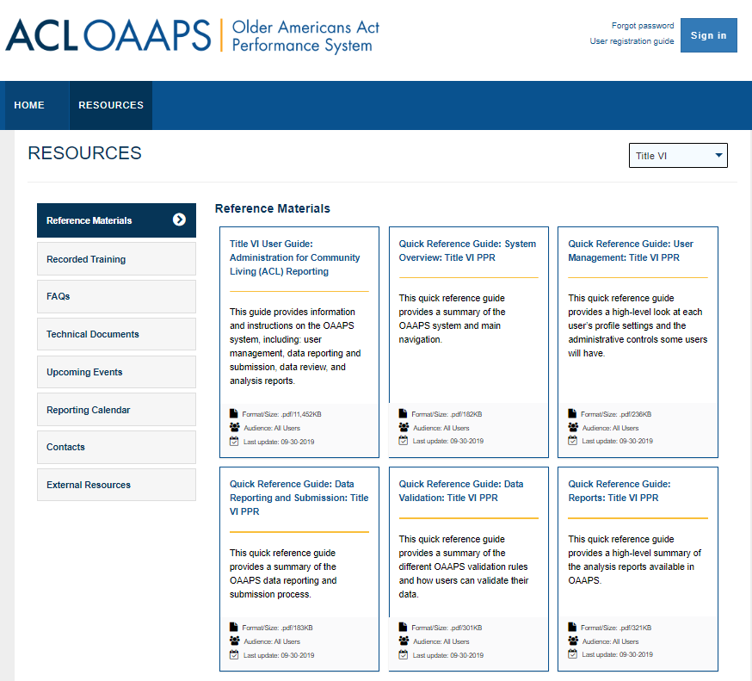
OAAPS Specific Resources
Title VI User Guide
Quick Reference Guides
  System Overview
  User Management
  Data Reporting and Submission
  Data Validation
  Reports
https://oaaps.acl.gov/app/Resources/refMaterials
Notes:
ACL will be offering weekly training on how to use the OAAPS. Stay tuned.

Slide 50
Homework
If you don’t routinely meet with fiscal staff – set up a meeting
Be sure to review fiscal update e-mails from ACL and contact us if you have any questions
Go to the OAAPS website and review the resources https://oaaps.acl.gov/Resources/refMaterials
Or come to the upcoming TA sessions
Join the Tuesday Title VI Program Basics Training

Slide 51
Wrap Up
A Title VI Director requires strong leadership, self-knowledge and on-going learning
Knowledge of the OAA – both Title III & VI is essential
Your activities to achieve the mission of services to Elders includes:
  planning, organizing, budgeting, communicating, coordinating, and evaluating
Policies and procedures guide your program and help to assure all Elders and their caregivers, staff and volunteers are treated fairly
Notes:
Ultimately your goal is to “sit in relationship” with Elders by providing services and supports that encourage a full life.

Slide 52
Resources
Program Support

Slide 53
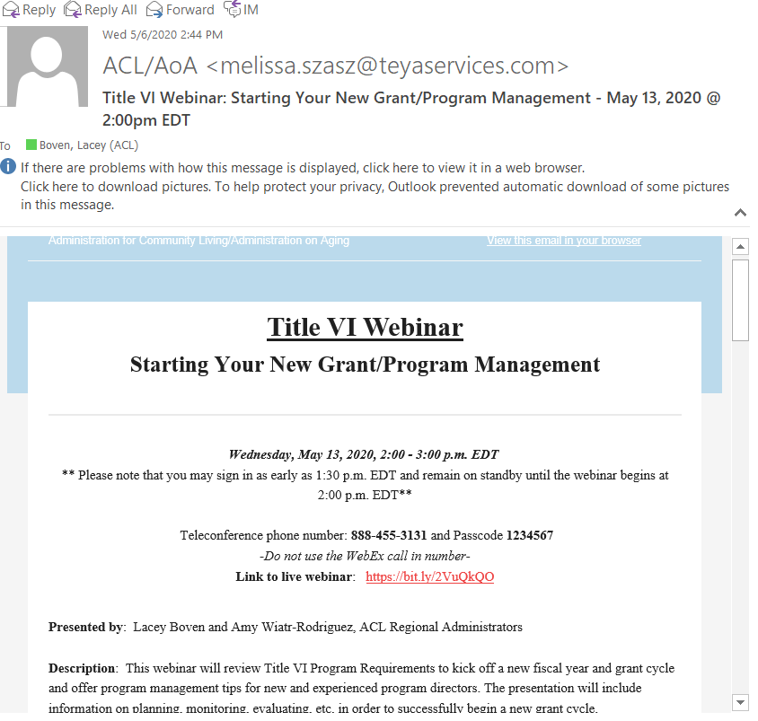
Title VI Communications
Are you currently receiving updates from TEYA?
Friday updates
Special announcements
Webinar/learning opportunities
Funding opportunities and links
Notes:
1st is that ACL contracts with TEYA to provide support to Title VI programs. TEYA does this in a variety of ways
Laura Stevenson laura.stevenson@teyaservices.com
Reach out to your ACL contacts or TEYA to get added to the email distribution list or for more info

Slide 54
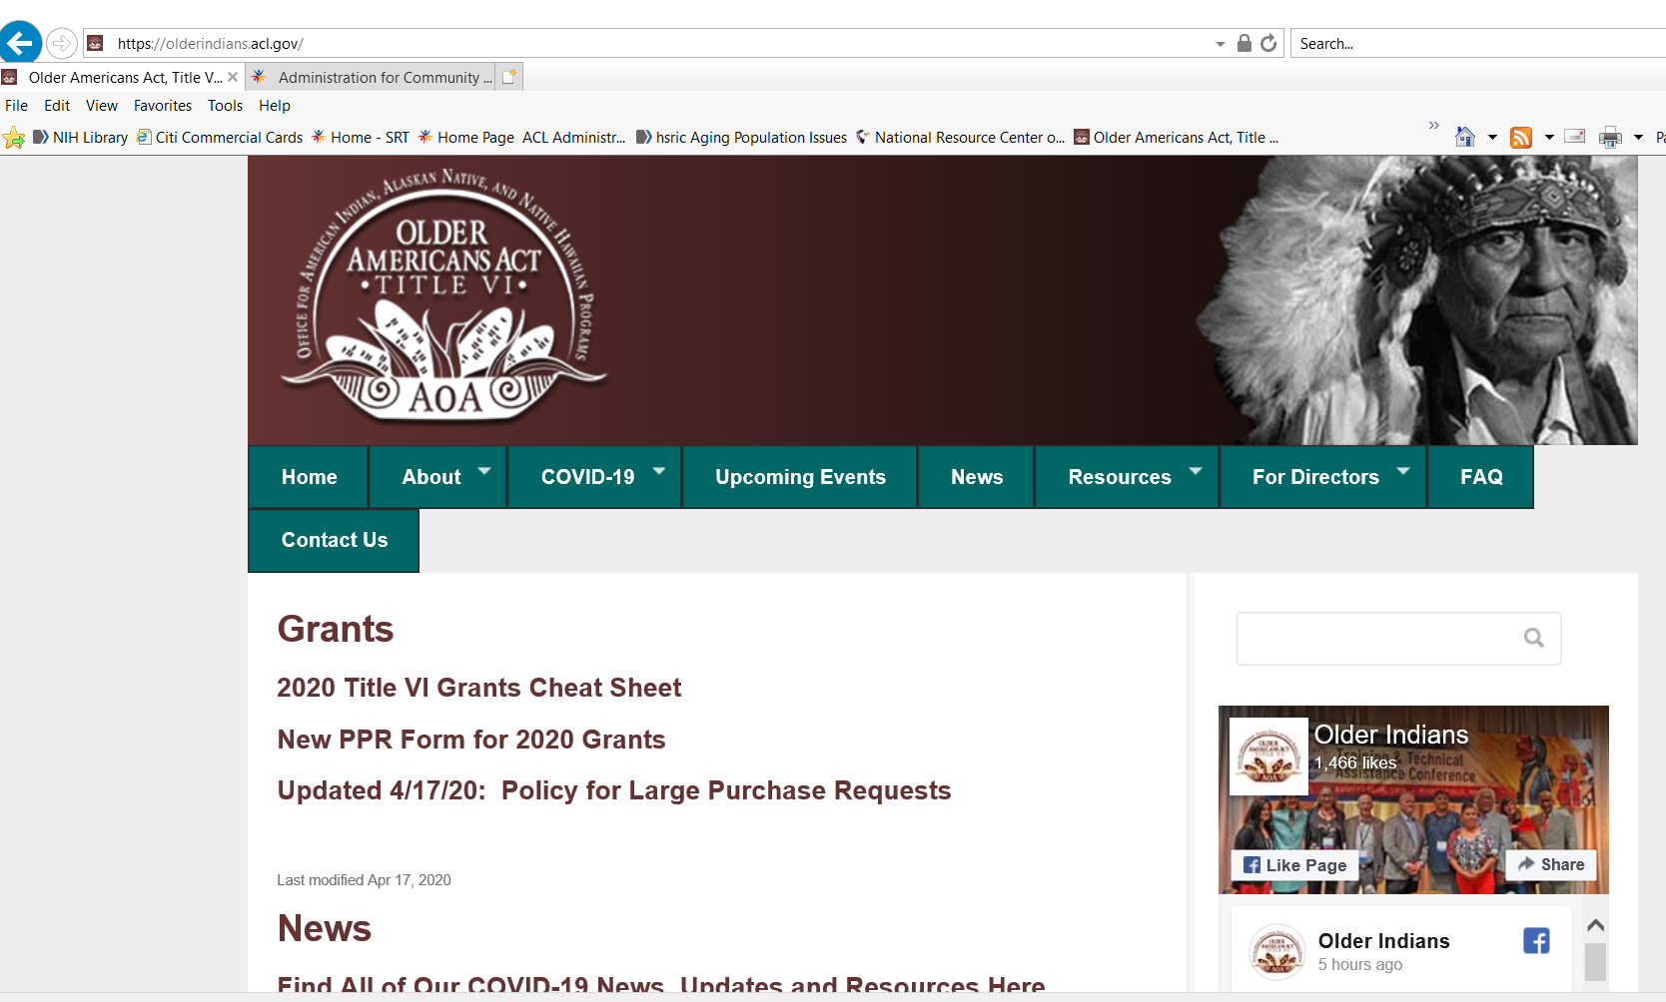
olderindians.acl.gov
Your dedicated website
Managed by amazing friends always looking for feedback
Archived presentations
Resources and updates
Notes:
There is also a robust website at the following – you can always find the latest info on the home page, as well as archived resources and updates

Slide 55
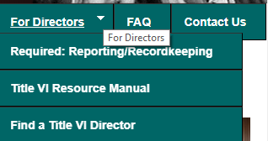
olderindians.acl.gov
For Directors Tab has key resources:
Required: Reporting / Recordkeeping (See page 68 of Resource Manual)
Title VI Resource Manual (expands on much of the information shared in this webinar)
Find a Title VI Director (connect with your peers)

Slide 56
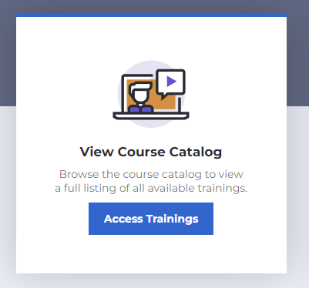
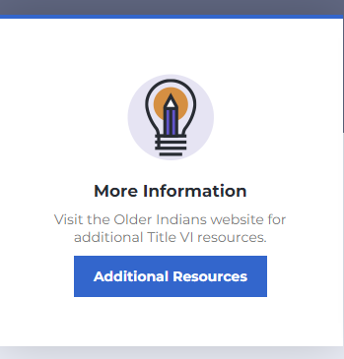
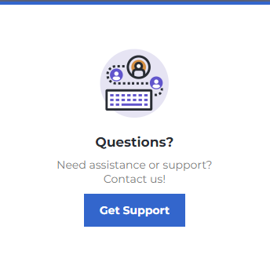
Learning Management System
https://olderindians.inquisiqlms.com/Default.aspx
Notes:
The Older Indians LMS is for Title VI Directors to access online courses, complete mandatory and online trainings, view training history, certifications, curricula, and more.
Older Indians Learning Management System (LMS): https://olderindians.inquisiqlms.com/
When signing into the Older Indians LMS for the first time, you will need to register, then create a username and password. We strongly recommend using your Title VI email address for your username.

Slide 57
Thank You!
For all that you do for the Elders!
Louise Ryan
Region X Regional Administrator
206-615-2299
Louise.Ryan@acl.hhs.gov

