Slide 1
Click on your profession to see in which states you may be mandated to report maltreatment*
Accountant
Animal Control
Attorney
Bankers
Broker/Dealers, Investment Advisors
Care Facility Owner/Employees
Case Manager
Clergy
Code Enforcement
Coroners
Dentist
EMTs
Fire Fighter
Funeral Home Operator
Government Funded Service Provider to Elderly
Guardian/Conservator
Health and Human Services Employees
Homecare Planning Agency
Home Health Aids
Hospices
Law Enforcement
Medical Administration
Medical Professional
Mental Health
Counselor/Therapist
Notary
Paid Caregivers
Pharmacists
Postal Employee
Probation Officers
Psychologists
School Personnel
Senior Transportation Services
Sheltered Workshop
Social Workers
Trustee
Unpaid Caregivers
*Disclaimer: State laws may include conditions such as “only if licensed by…” or “only if employed by…” or “only if maltreatment is encountered during the course of employment”. This chart is provided only as a guide to help you determine whether you need to check your state statute.

Slide 2
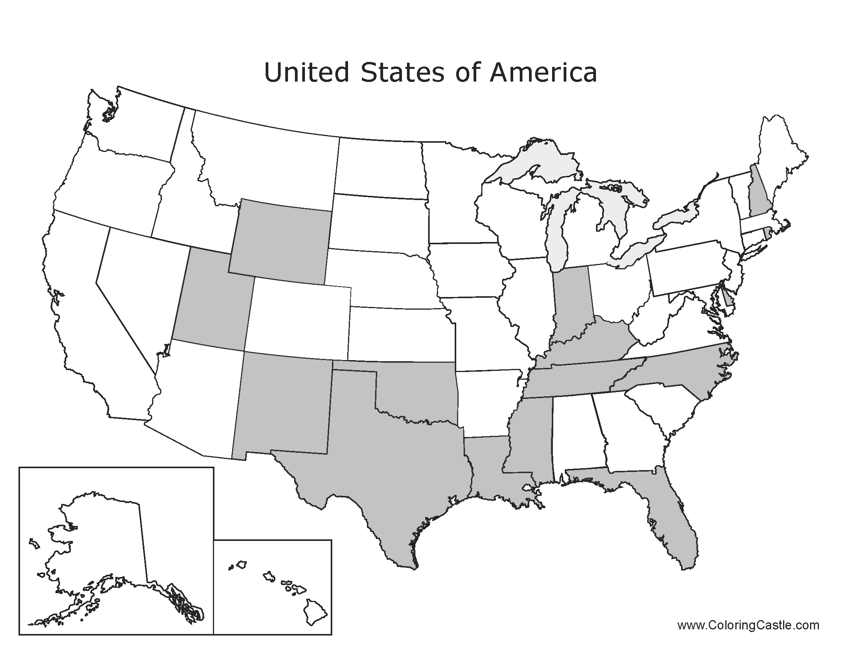
States where everyone is mandated to report

Slide 3
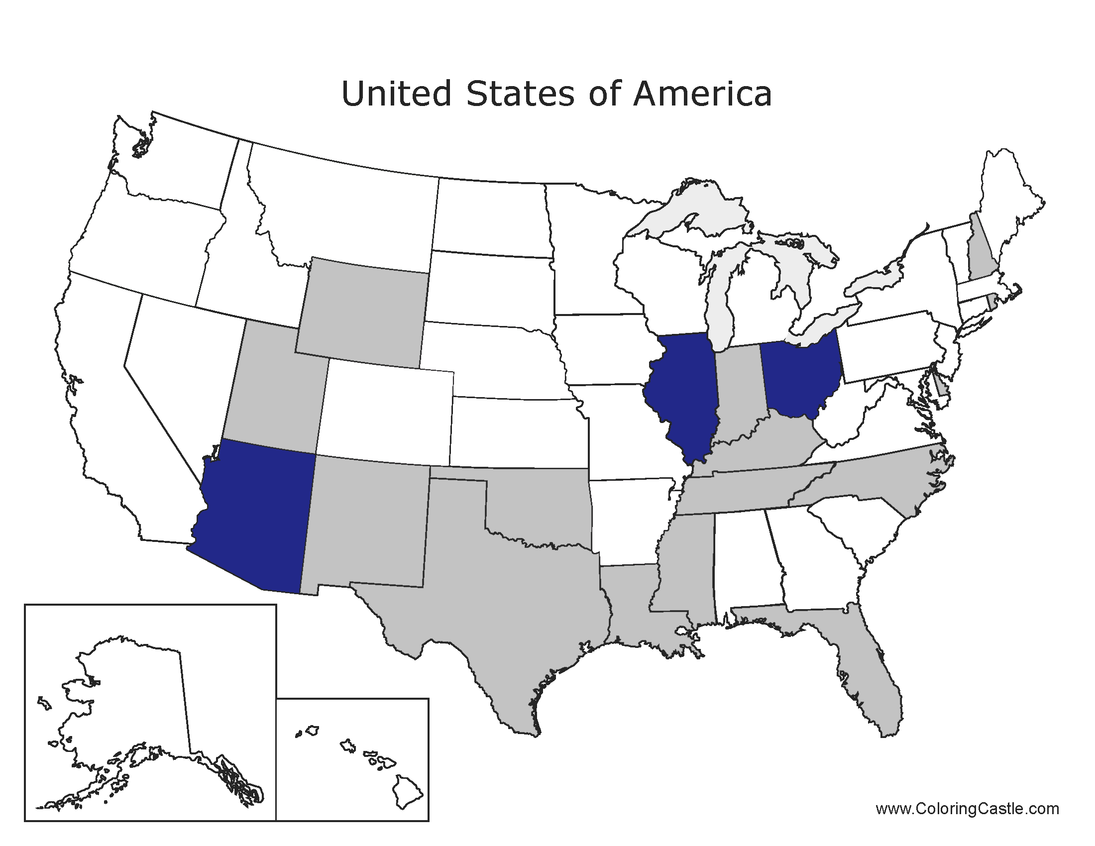
Accountants

Slide 4
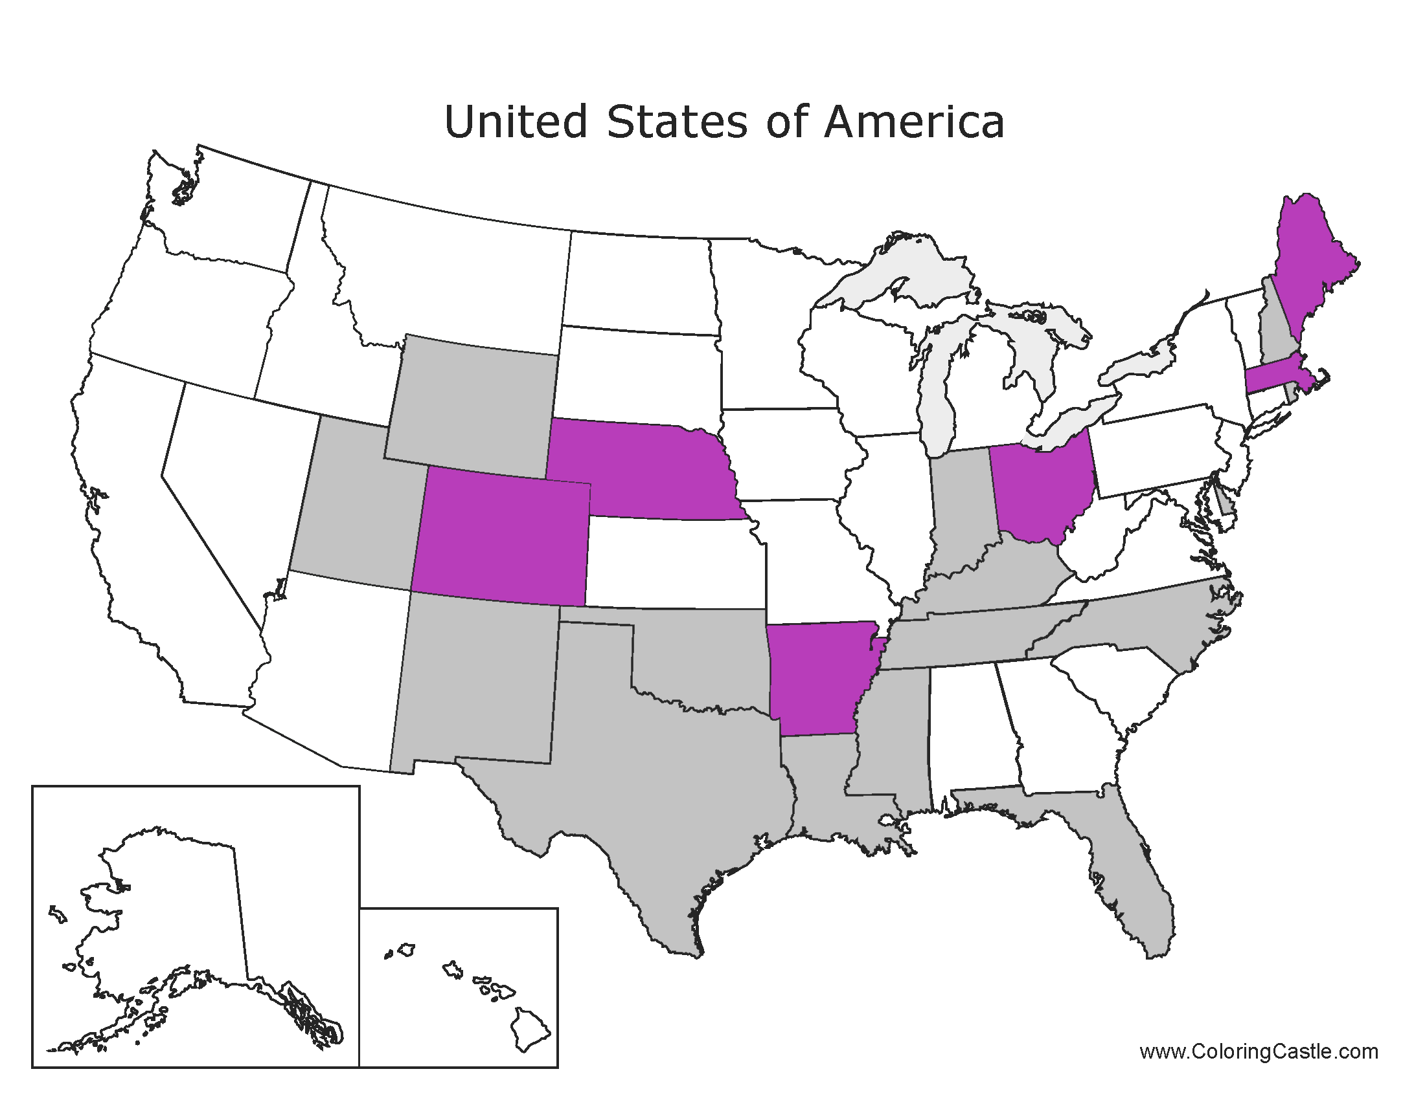
Animal Control

Slide 5
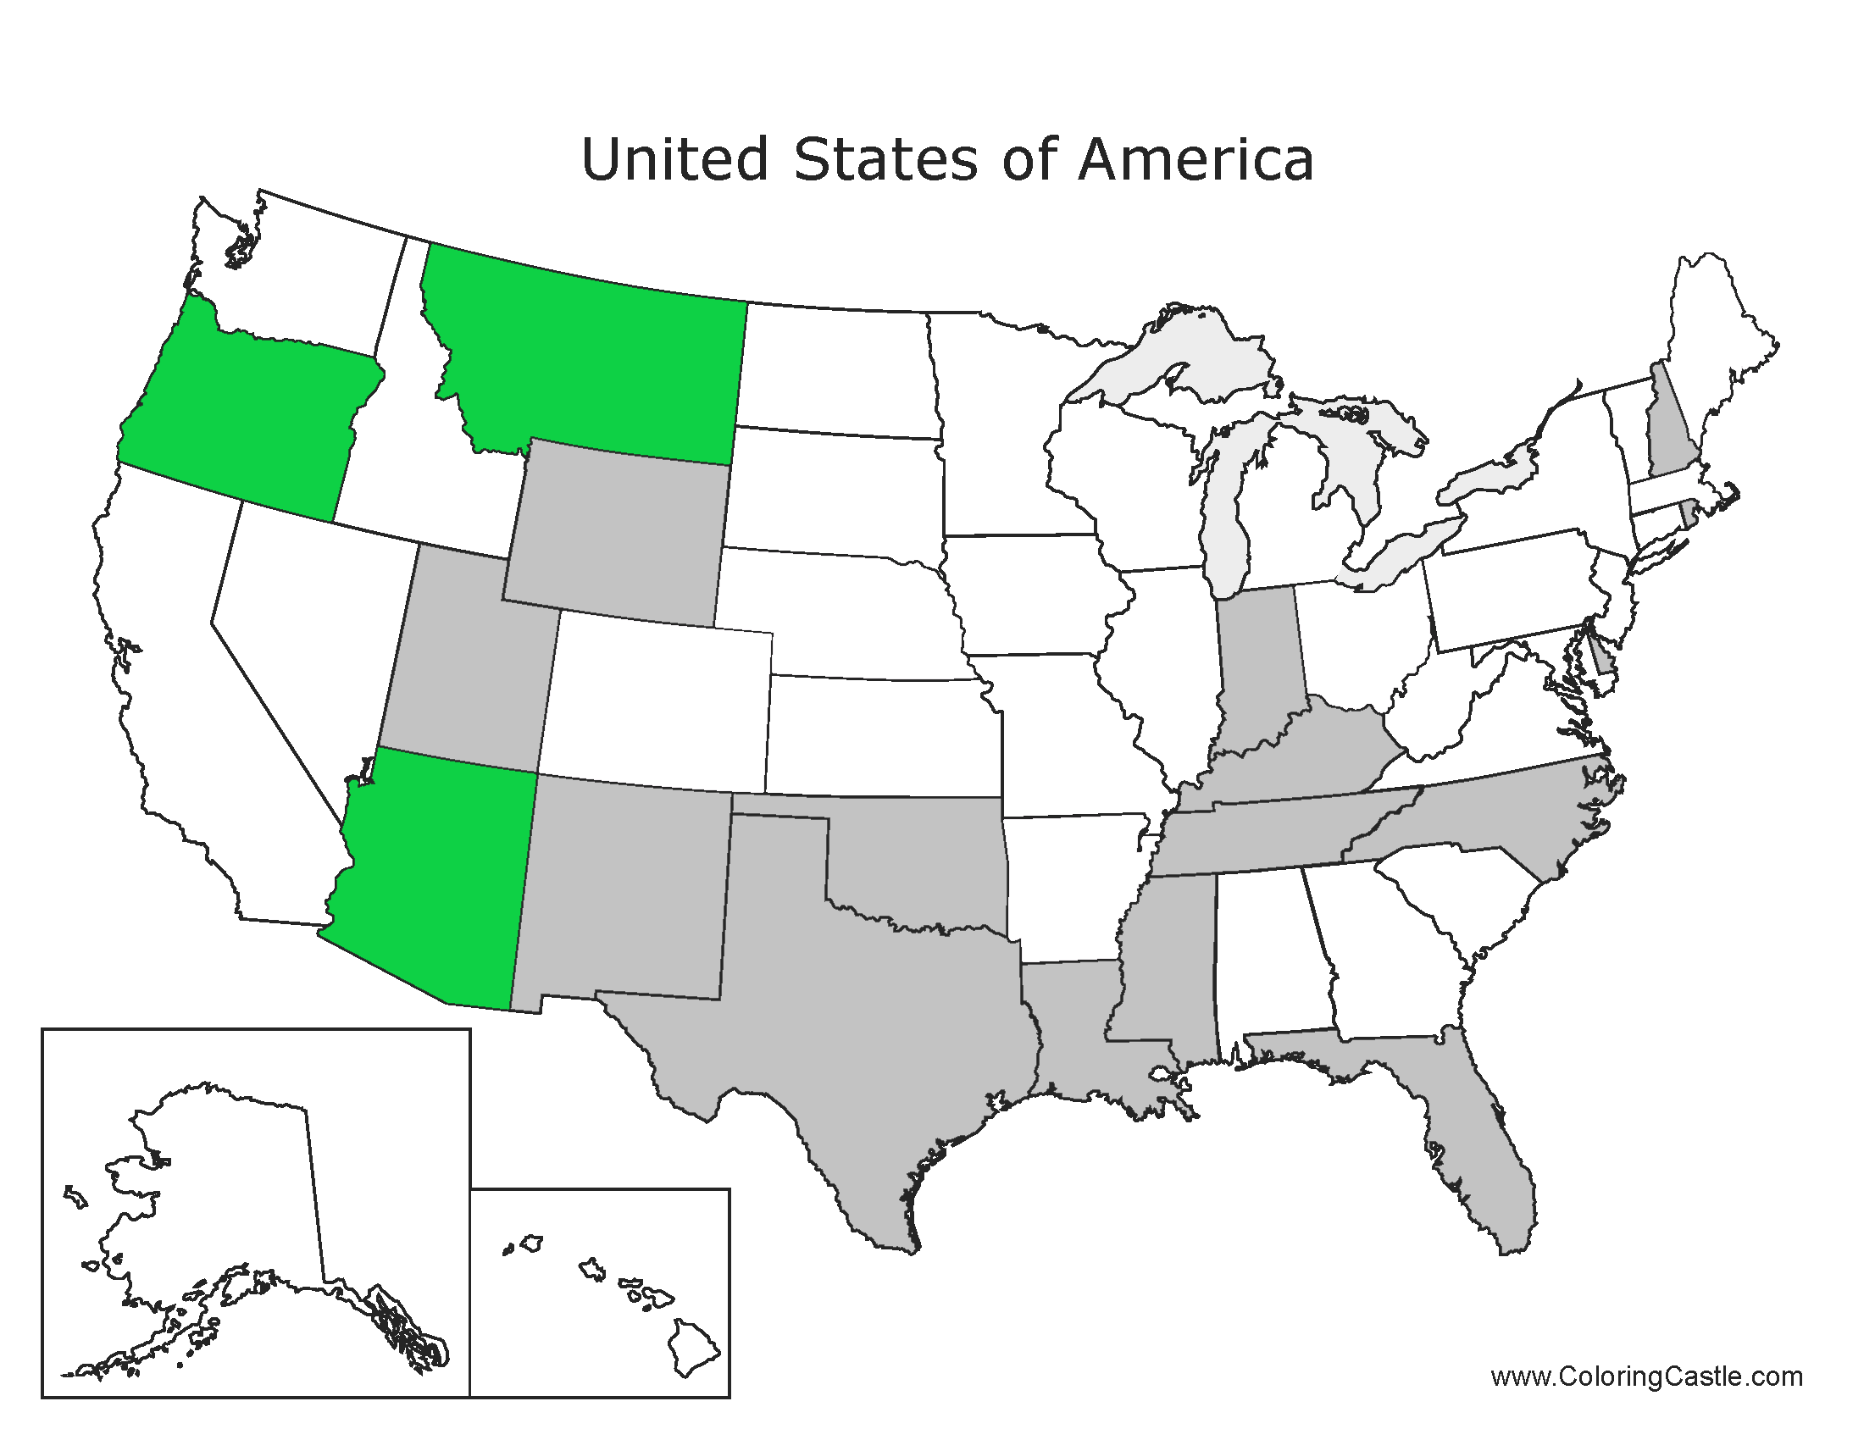
Attorneys

Slide 6
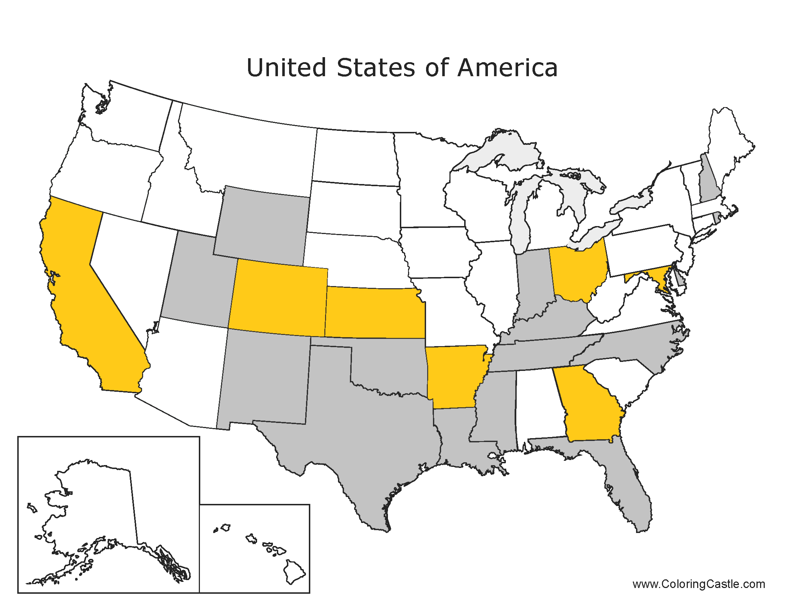
Bankers

Slide 7
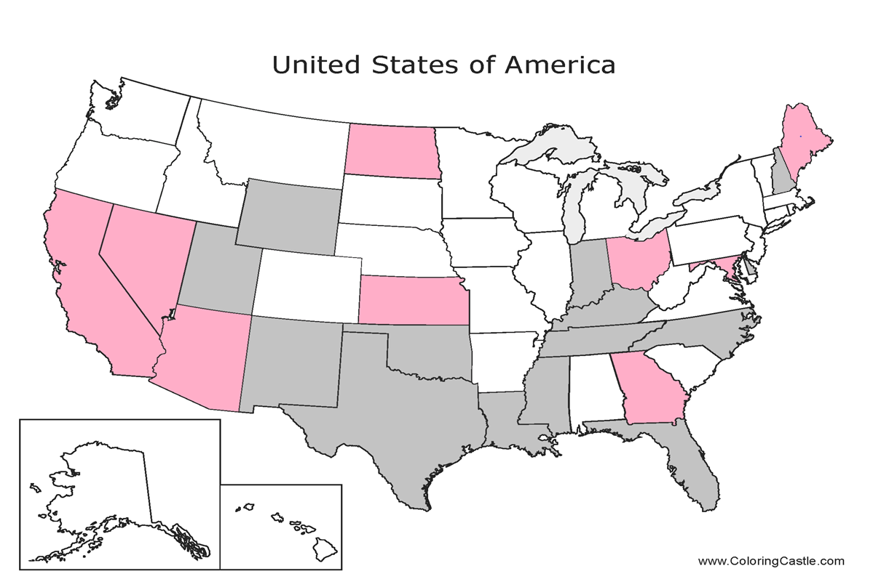
Broker/Dealers, Investment Advisors

Slide 8
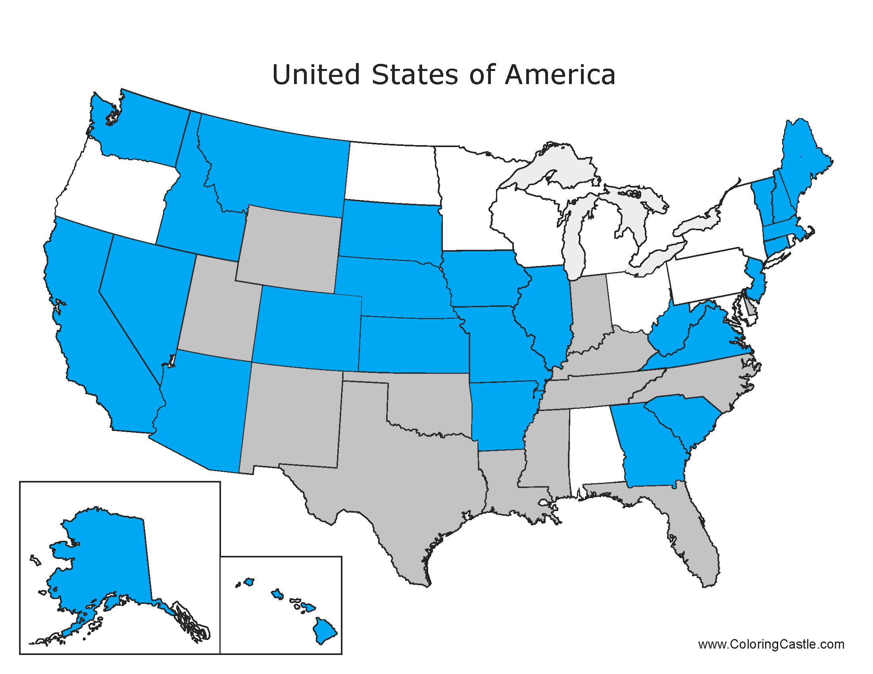
Care Facility Owner/Employees

Slide 9
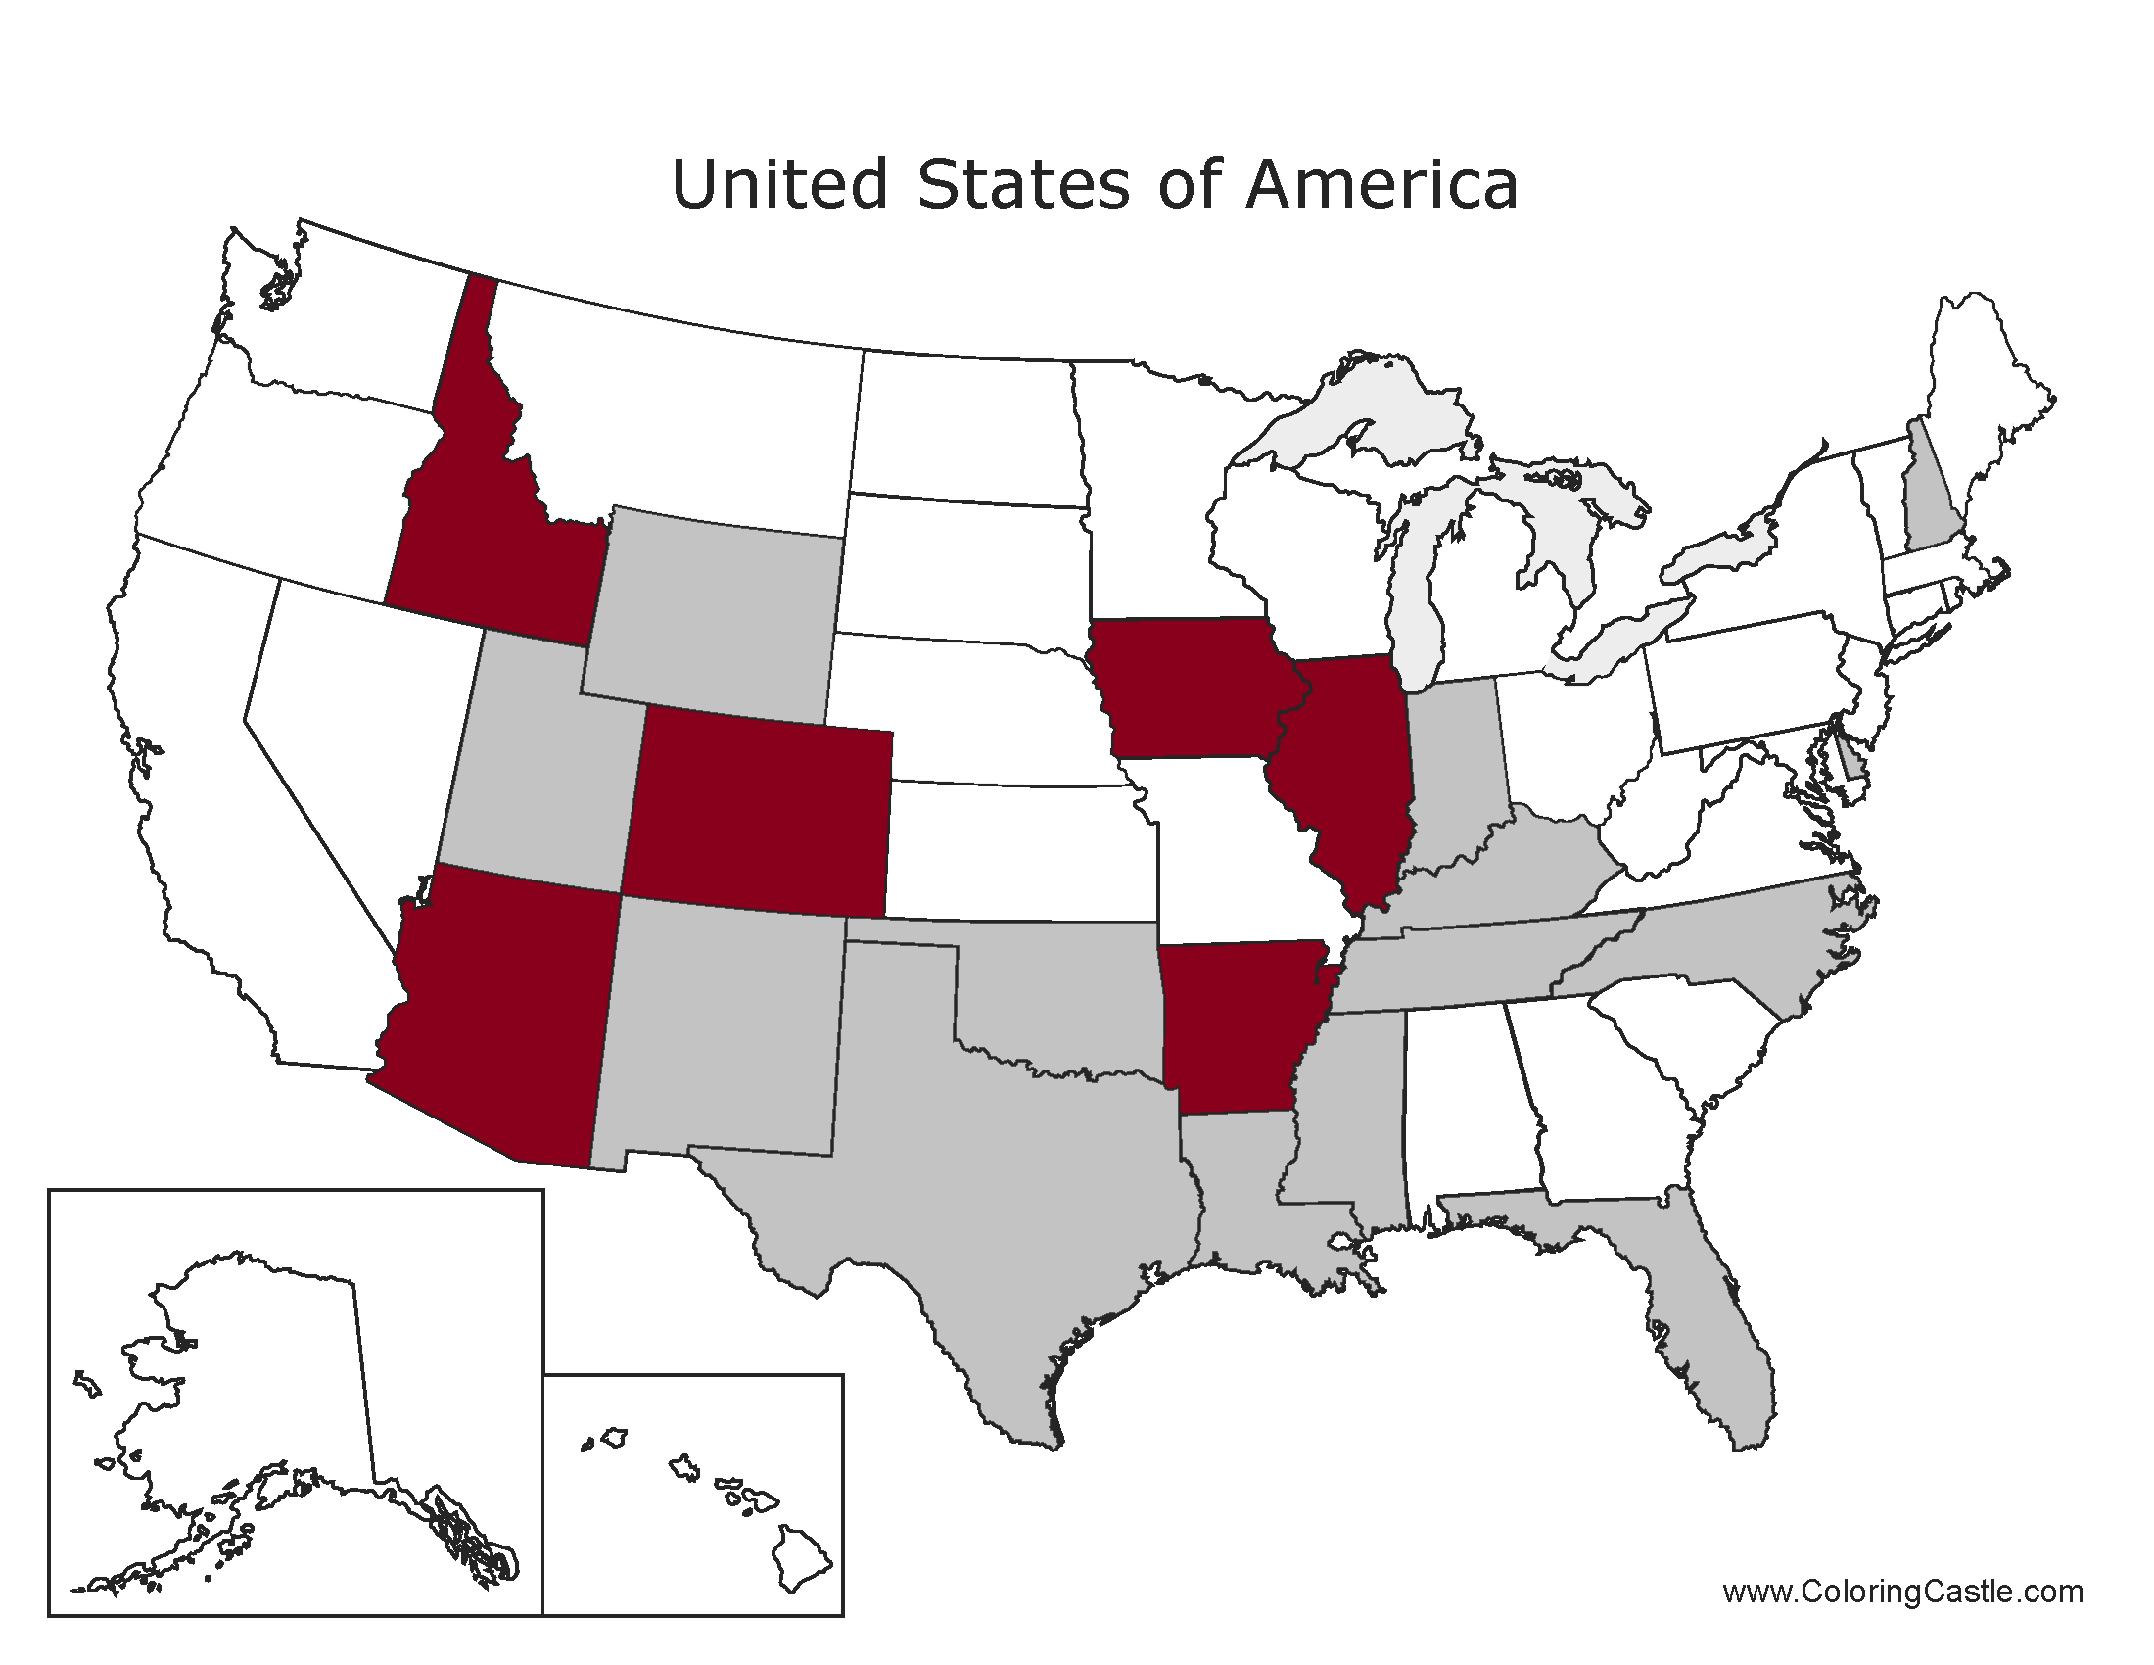
Case Manager

Slide 10
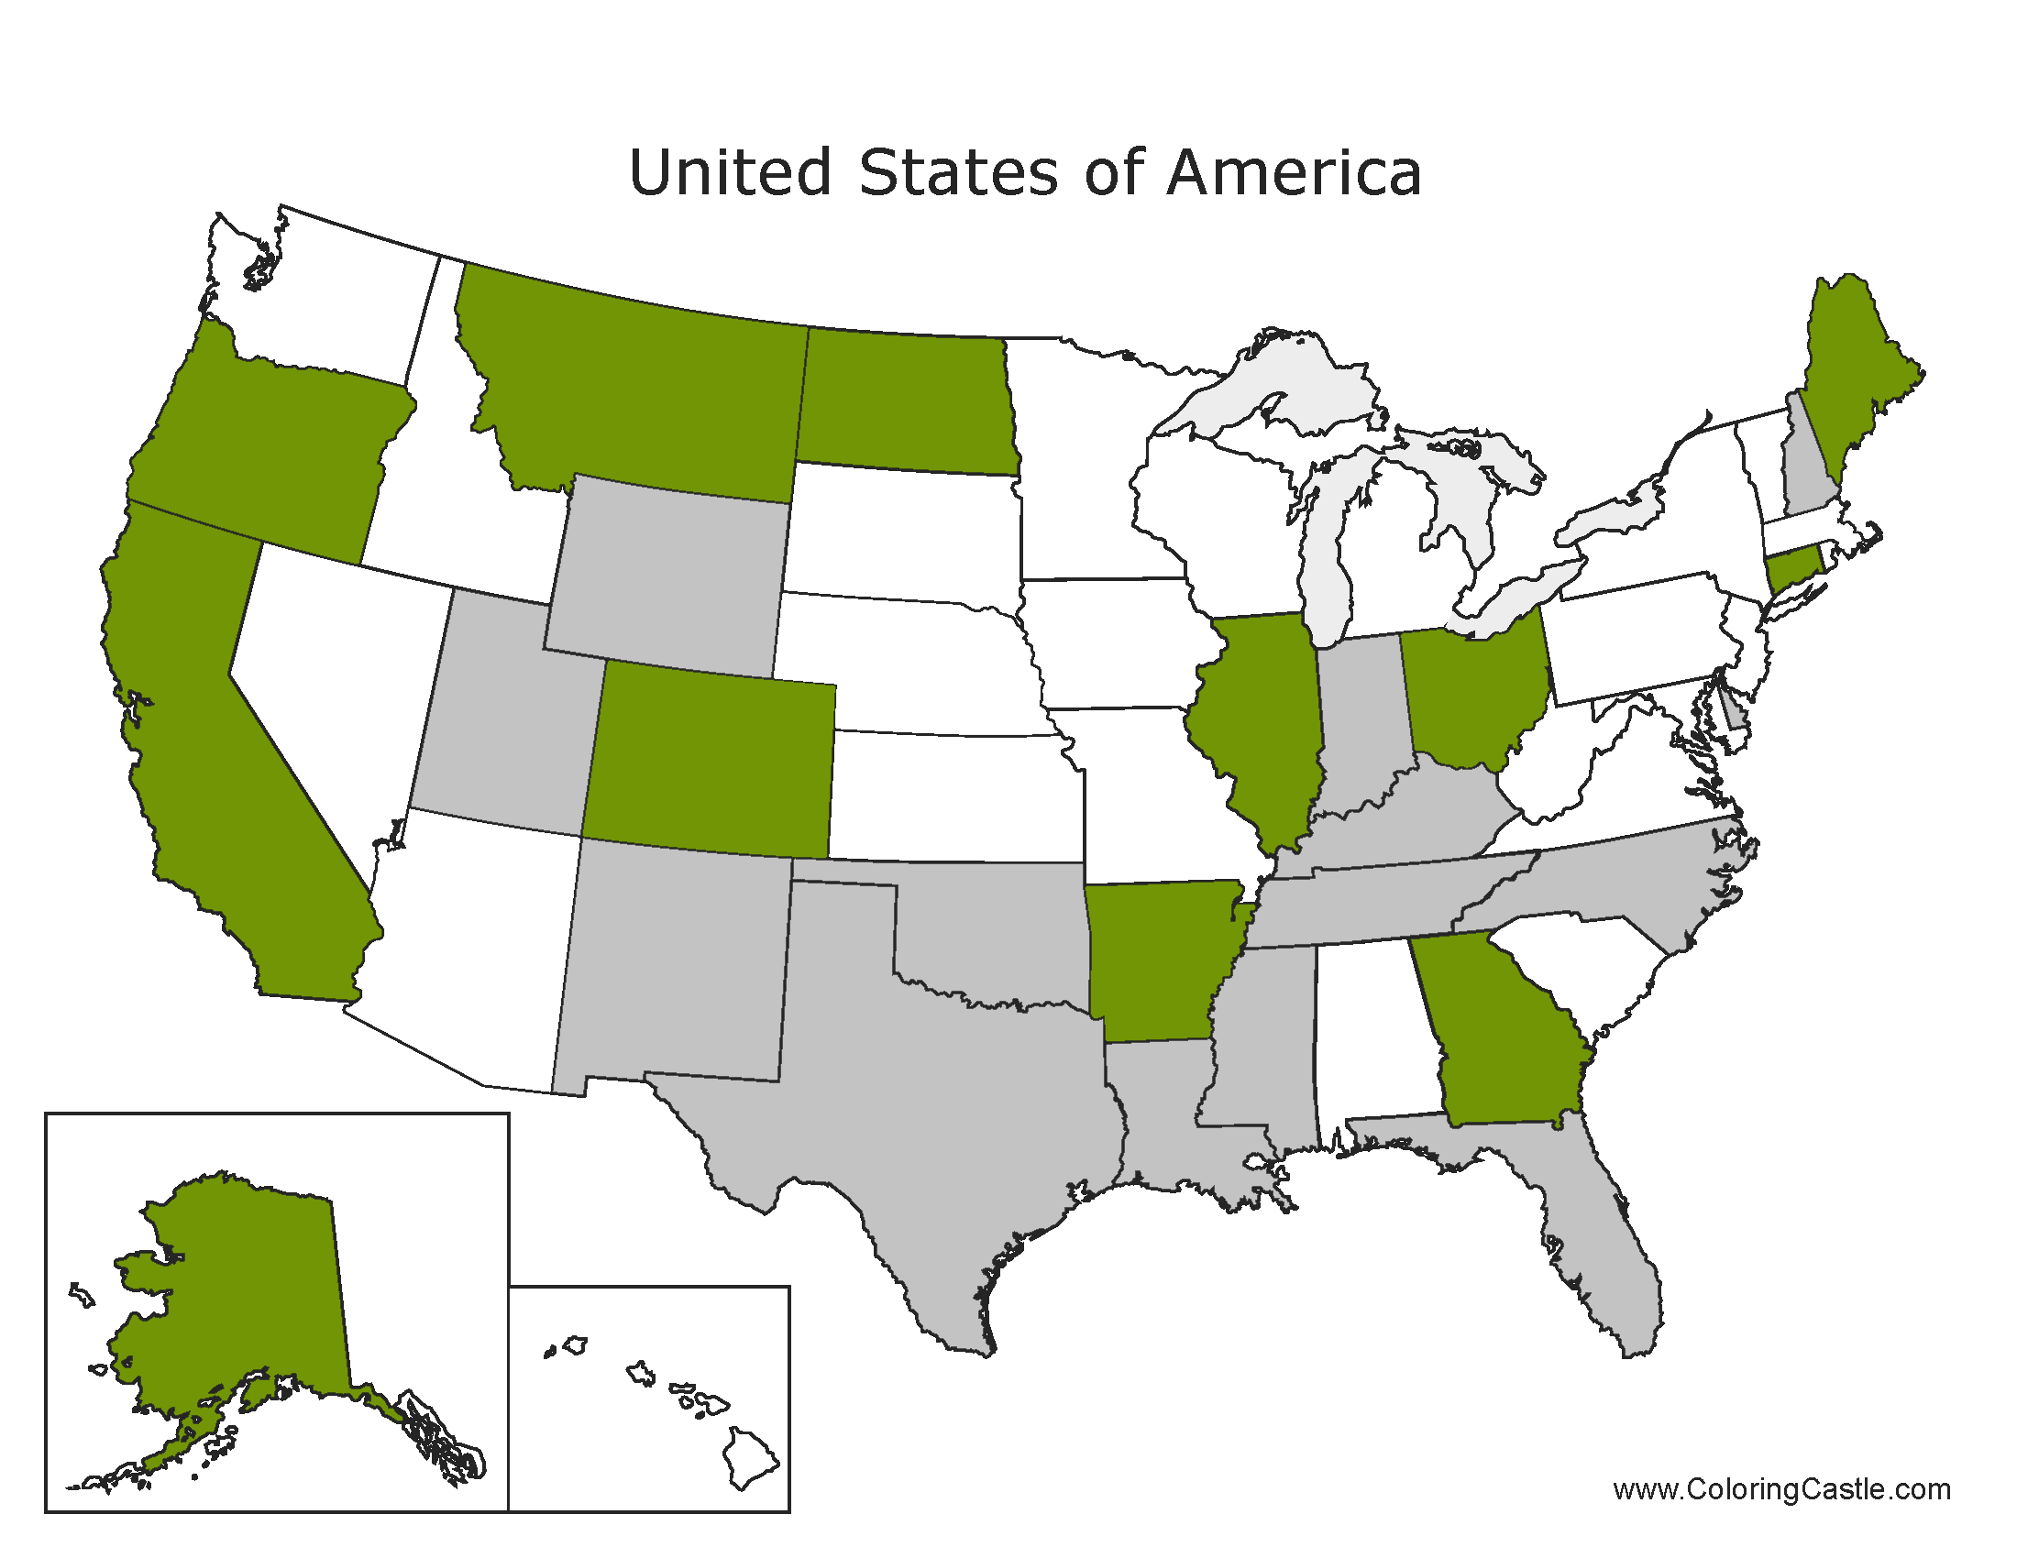
Clergy

Slide 11
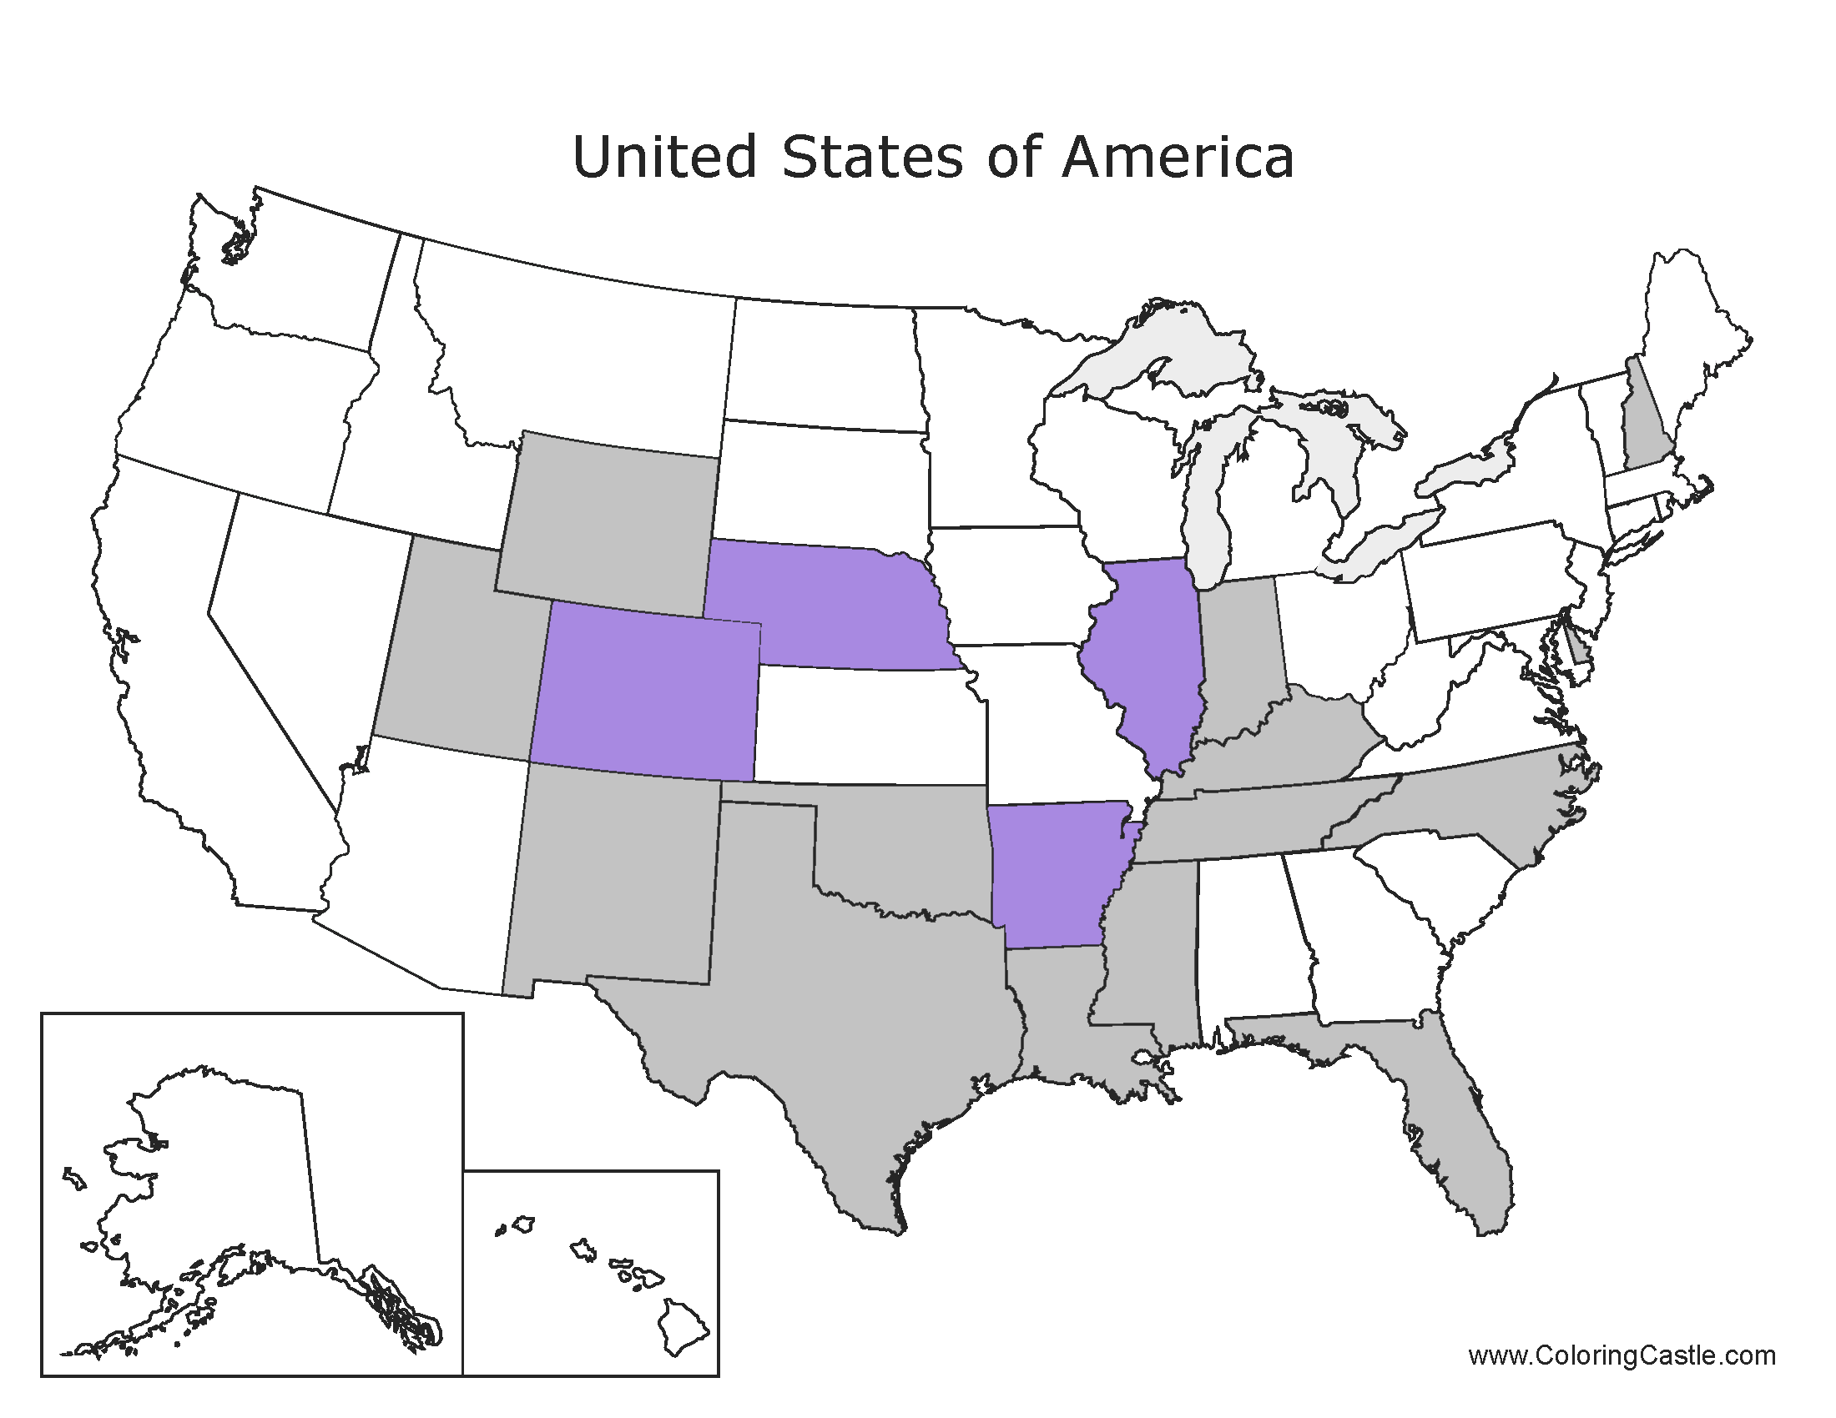
Code Enforcement

Slide 12
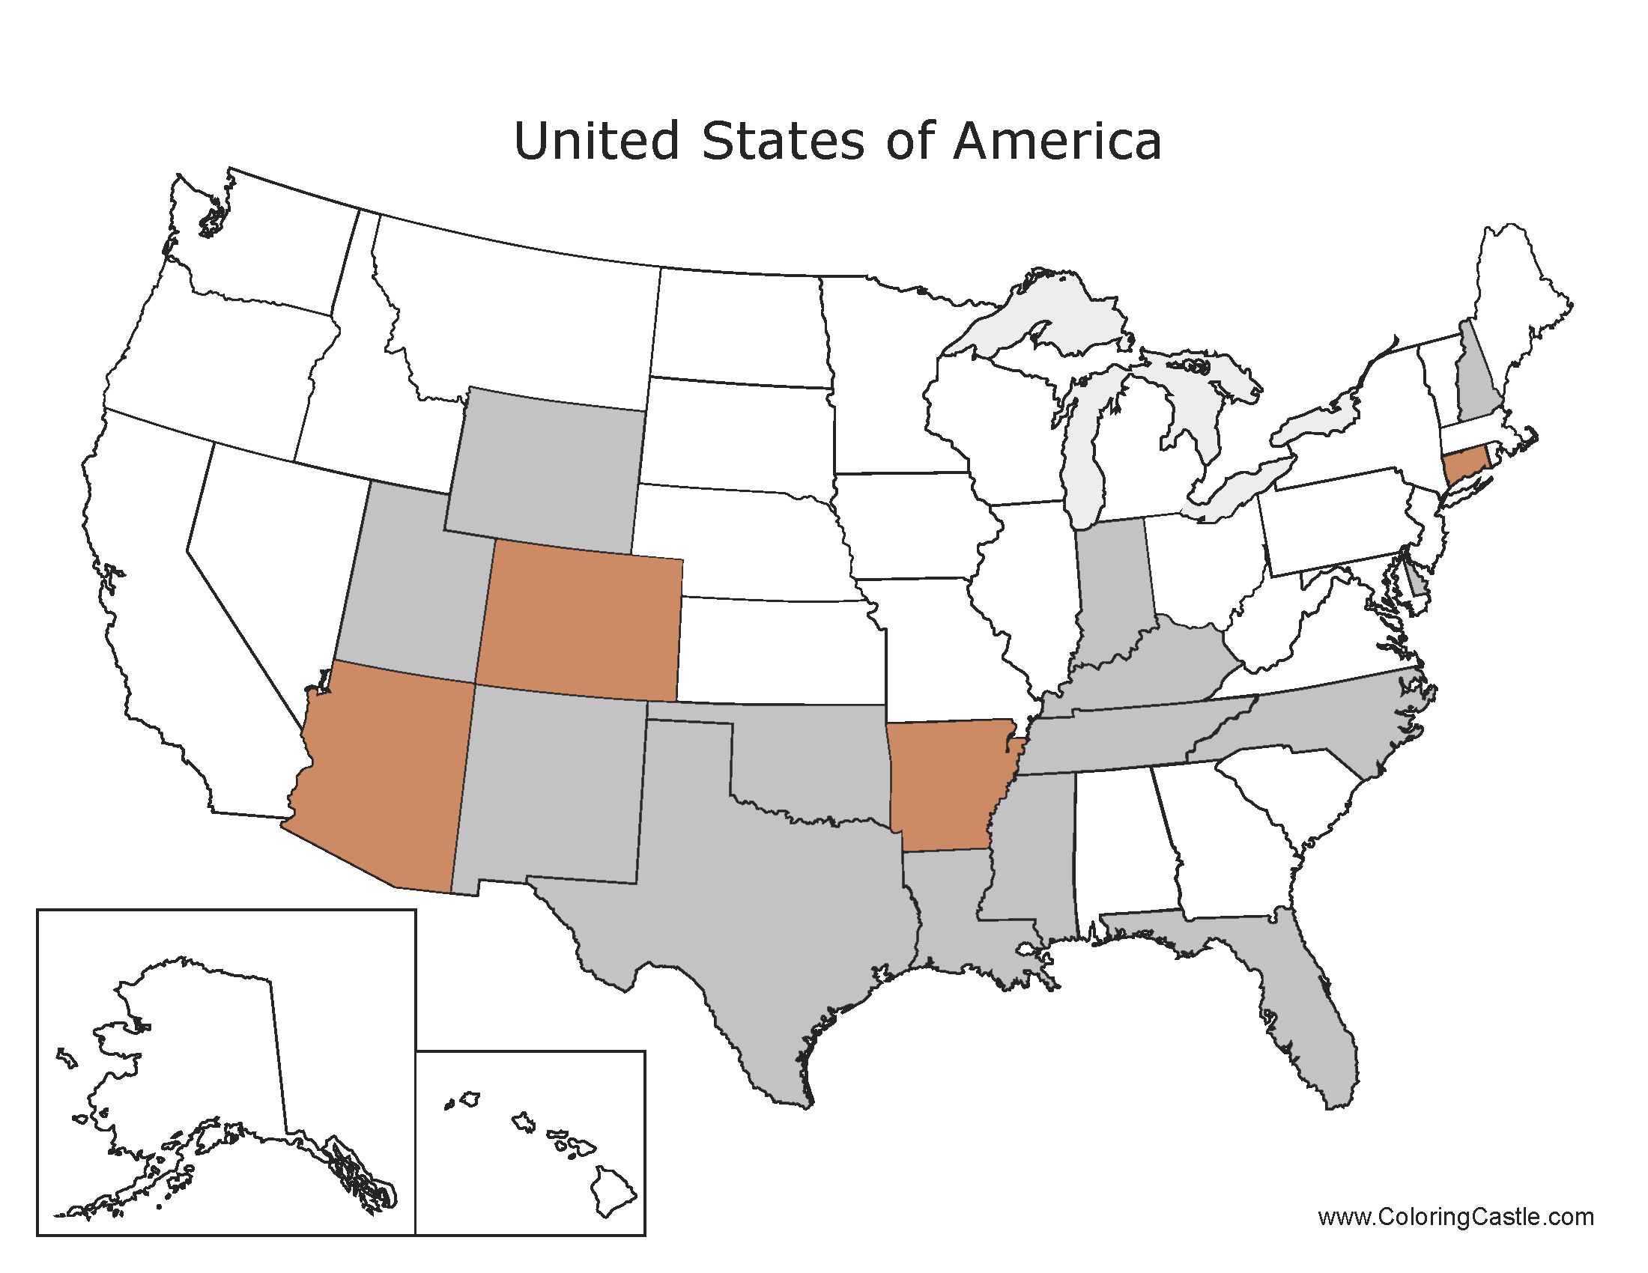
Coroners

Slide 13
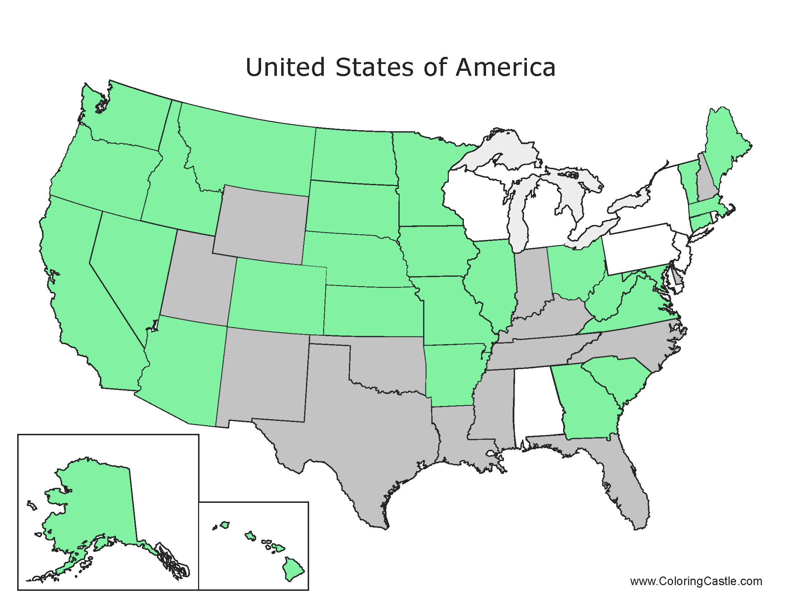
Dentist

Slide 14
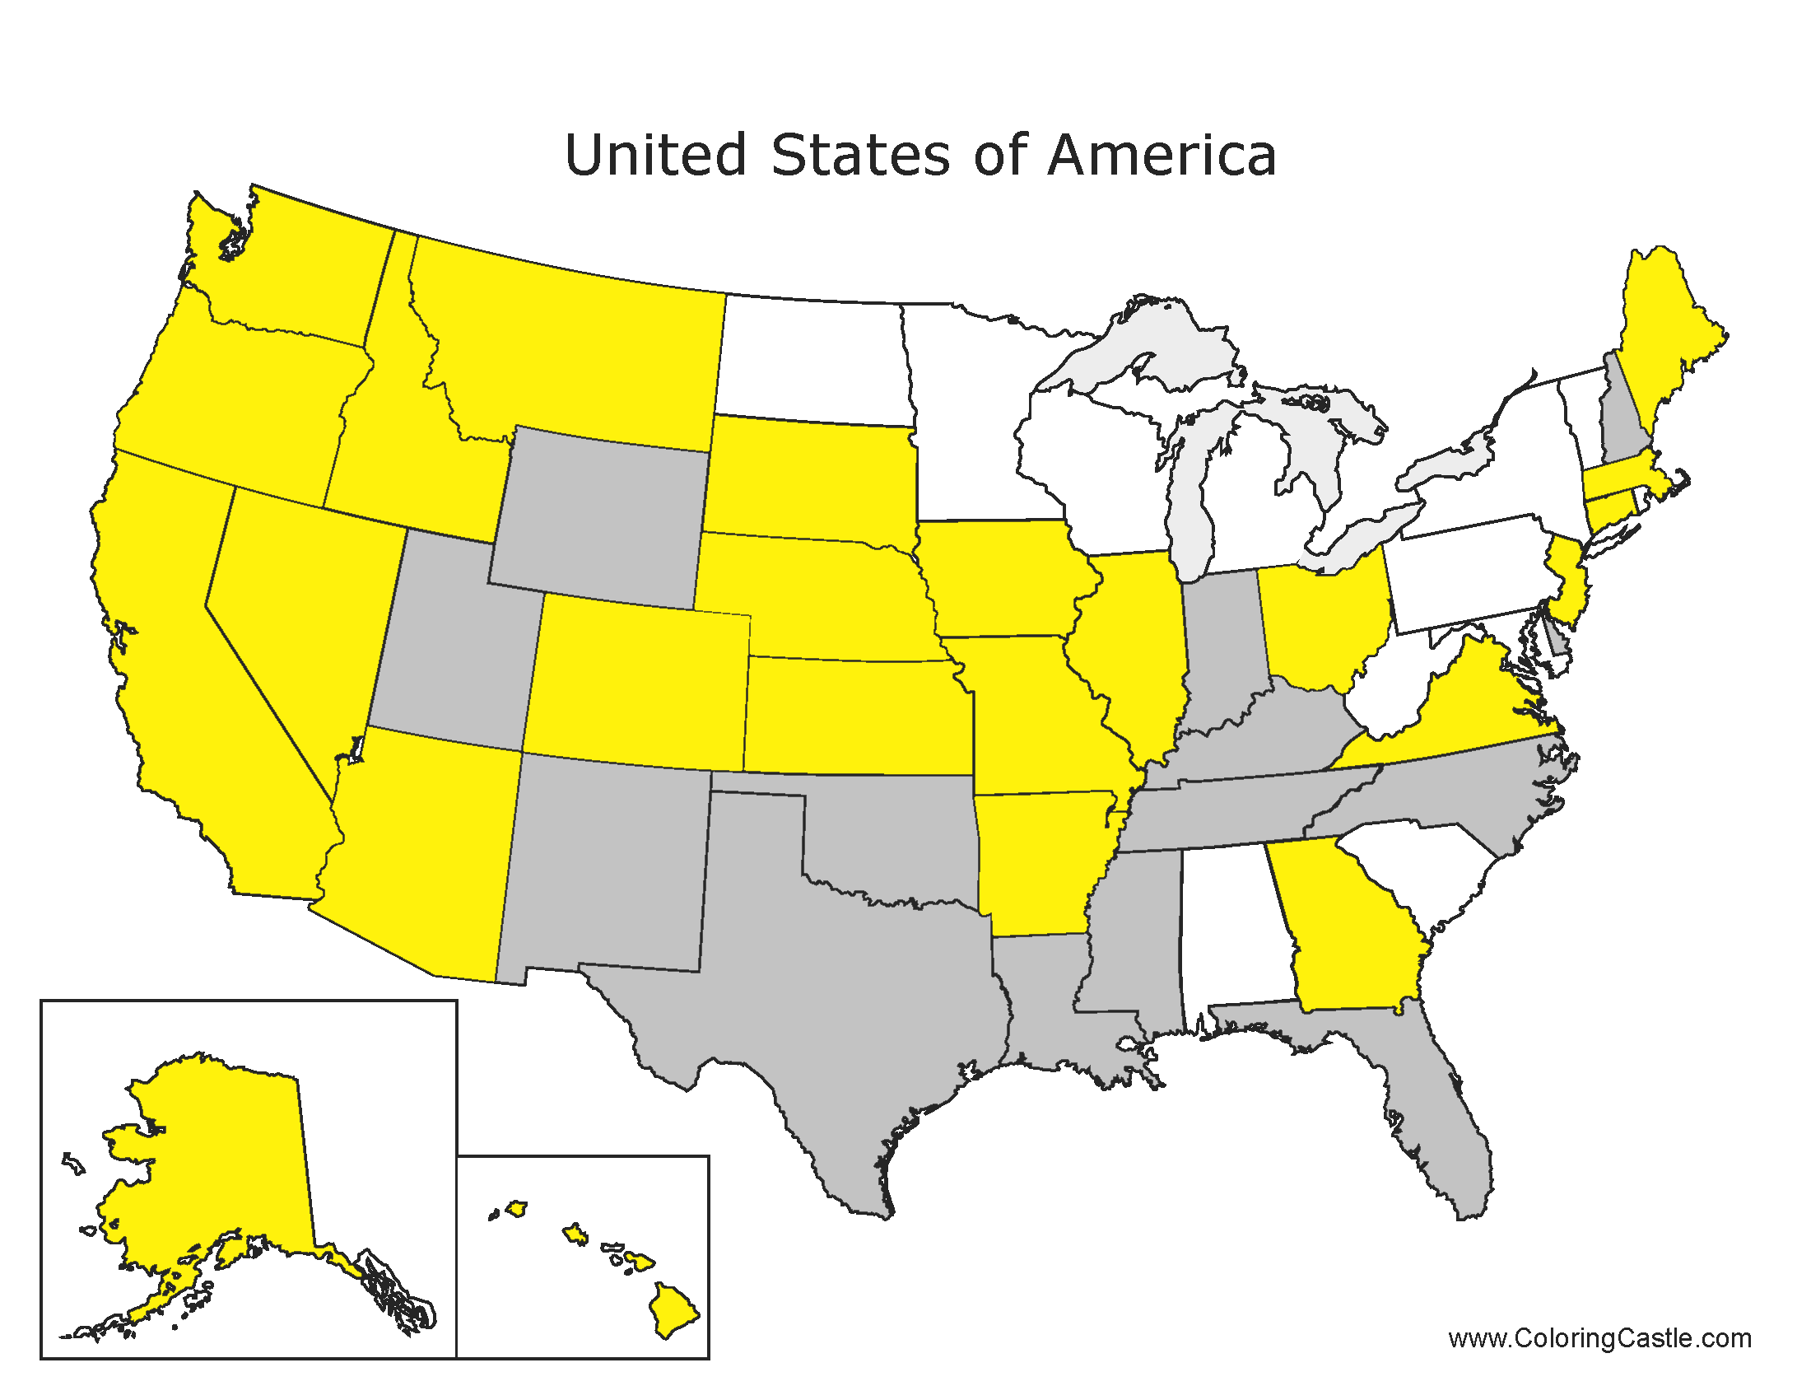
EMTs

Slide 15
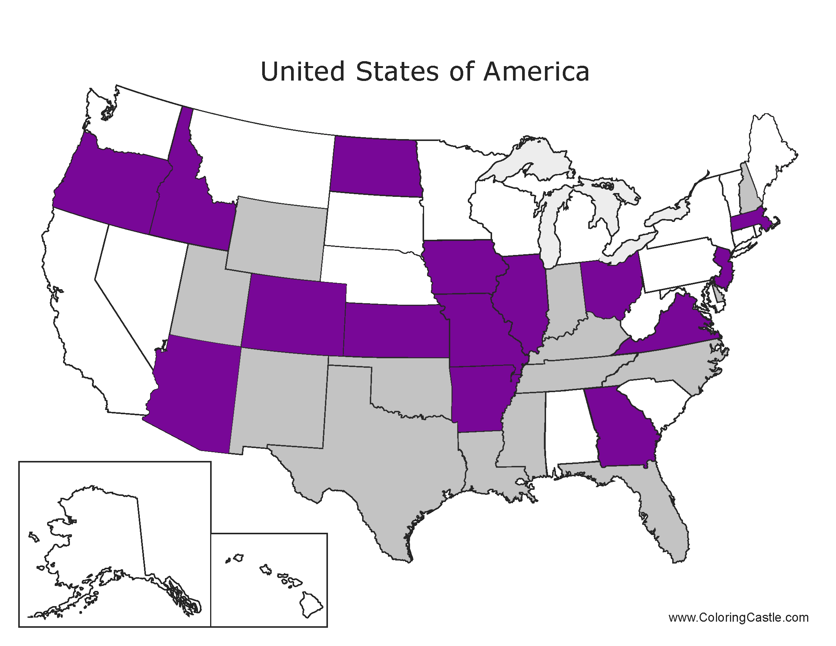
Fire Fighter

Slide 16
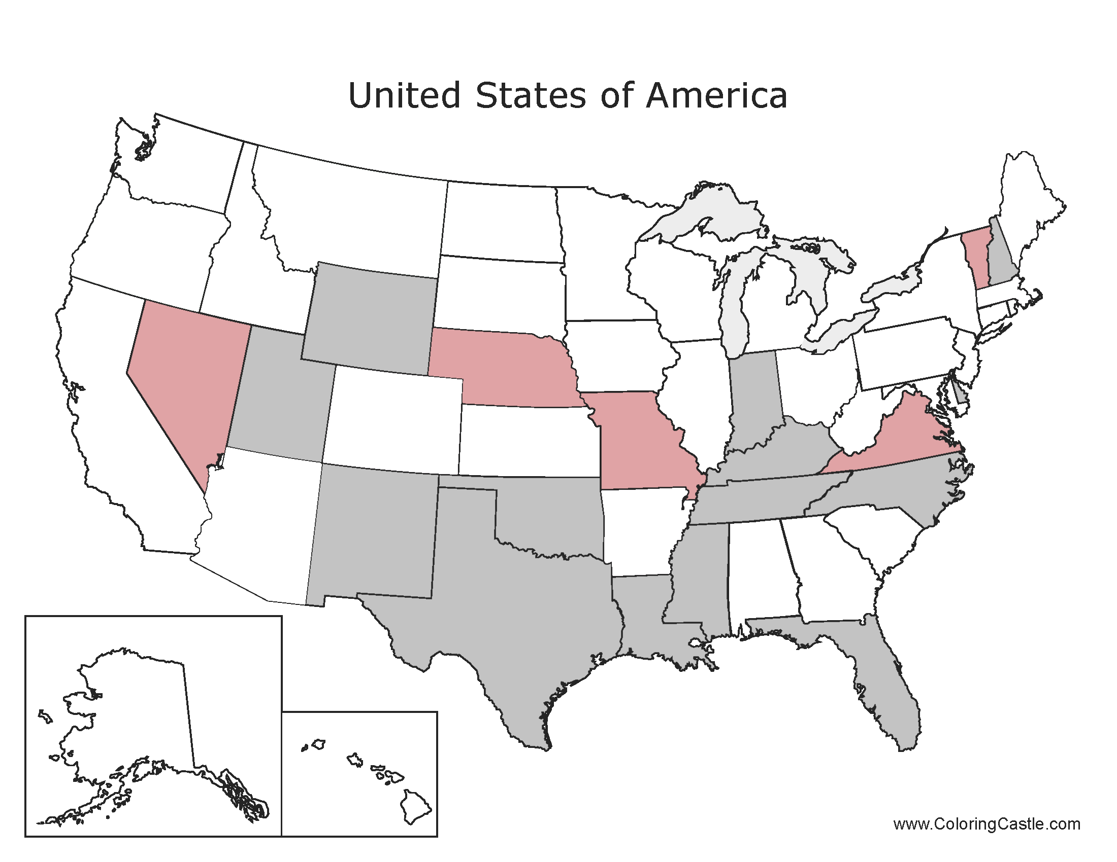
Funeral Home Operator

Slide 17
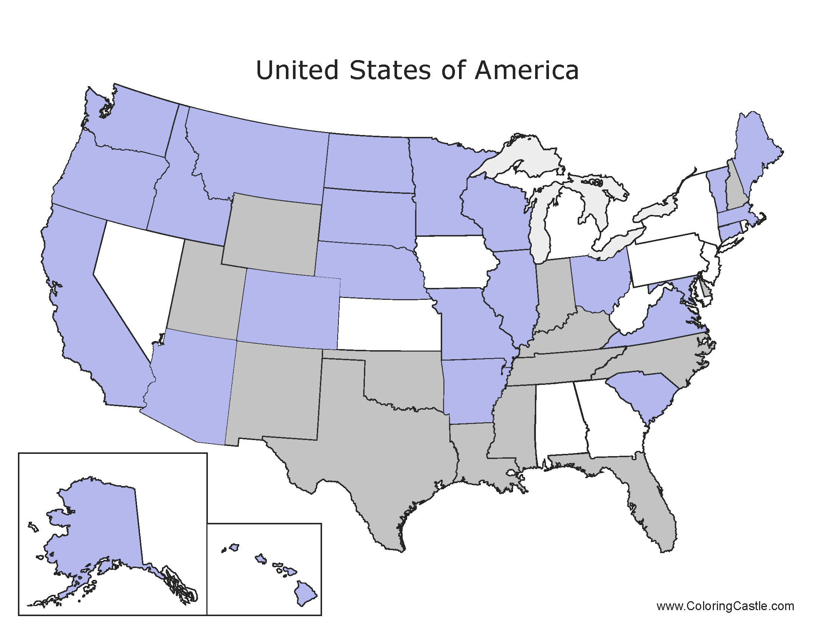
Government Funded Service Provider to Elderly

Slide 18
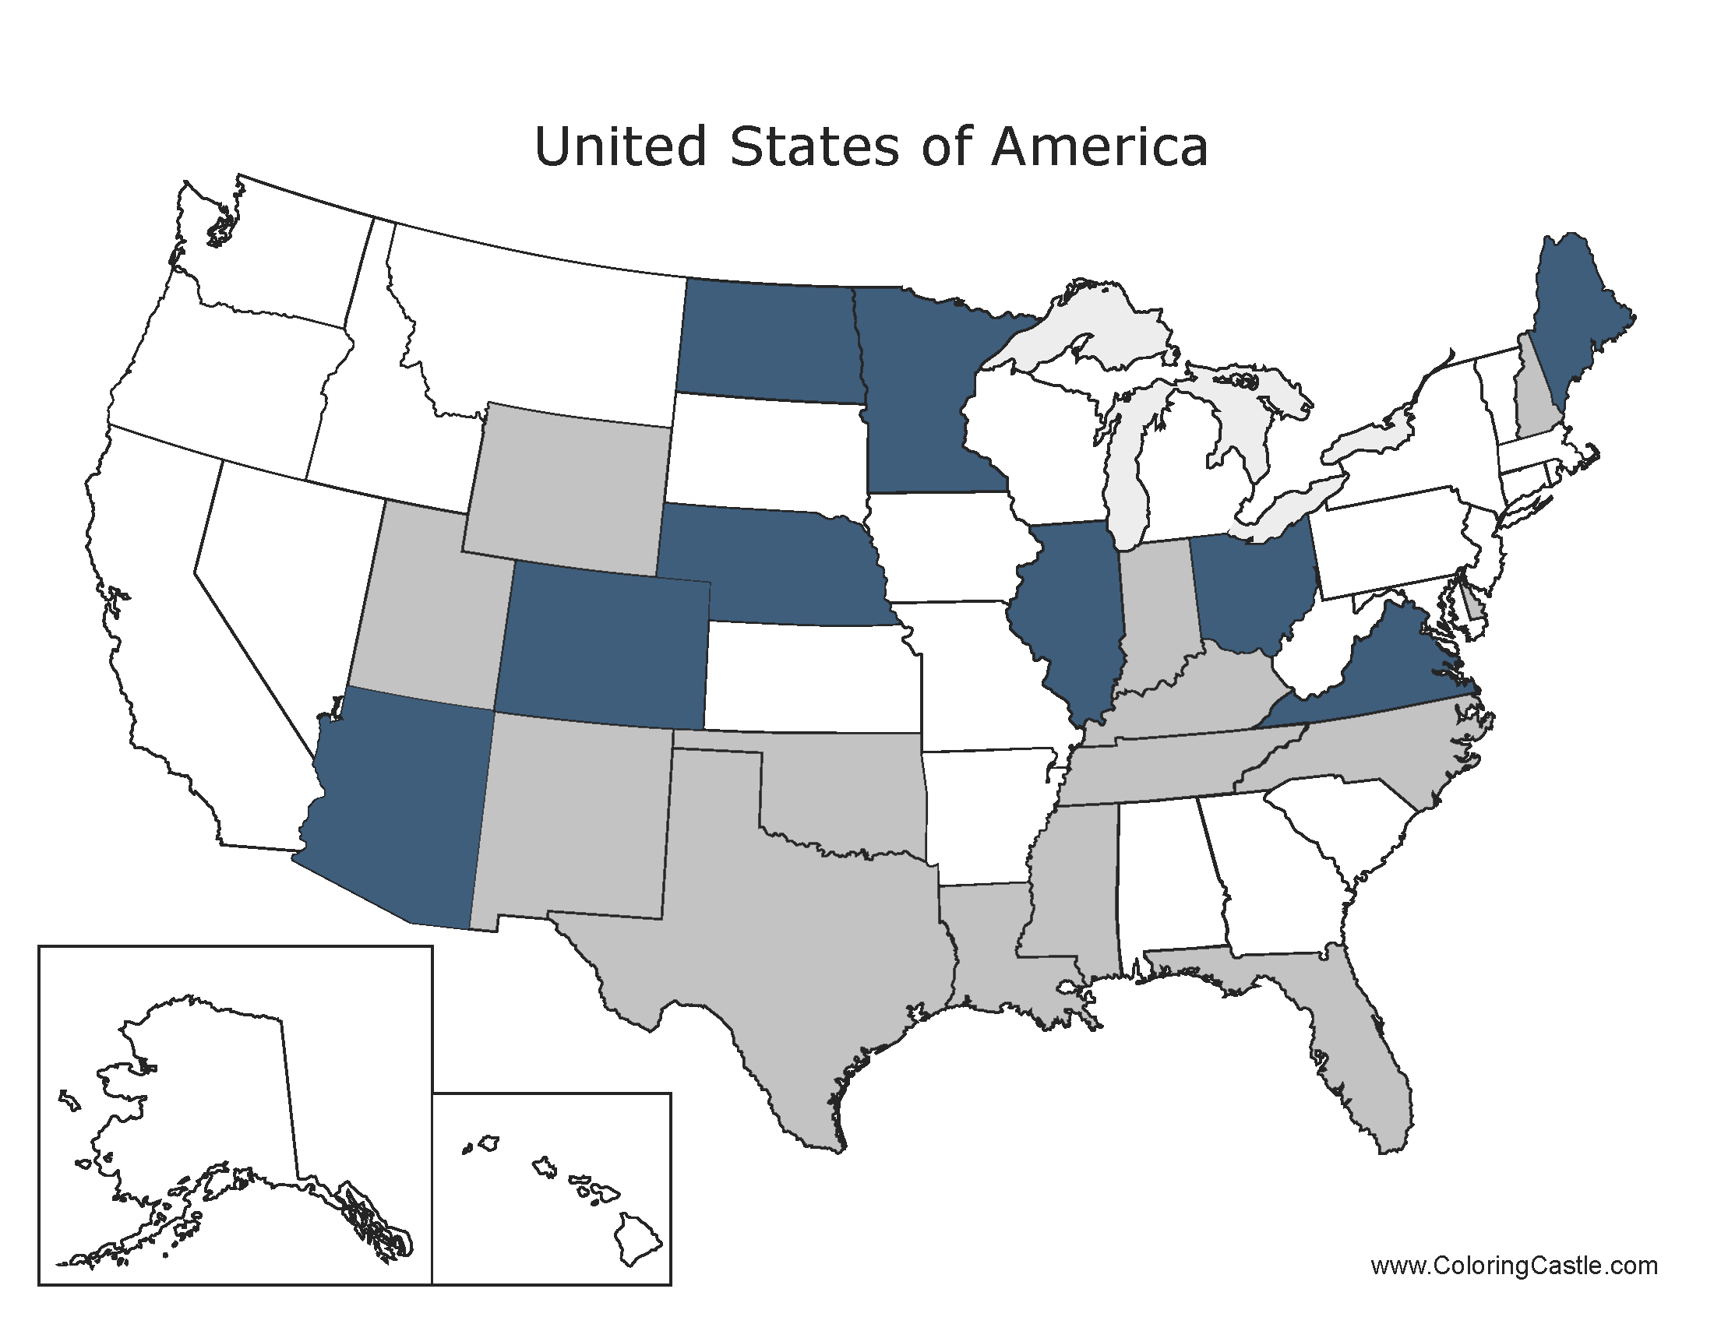
Guardian/Conservator

Slide 19
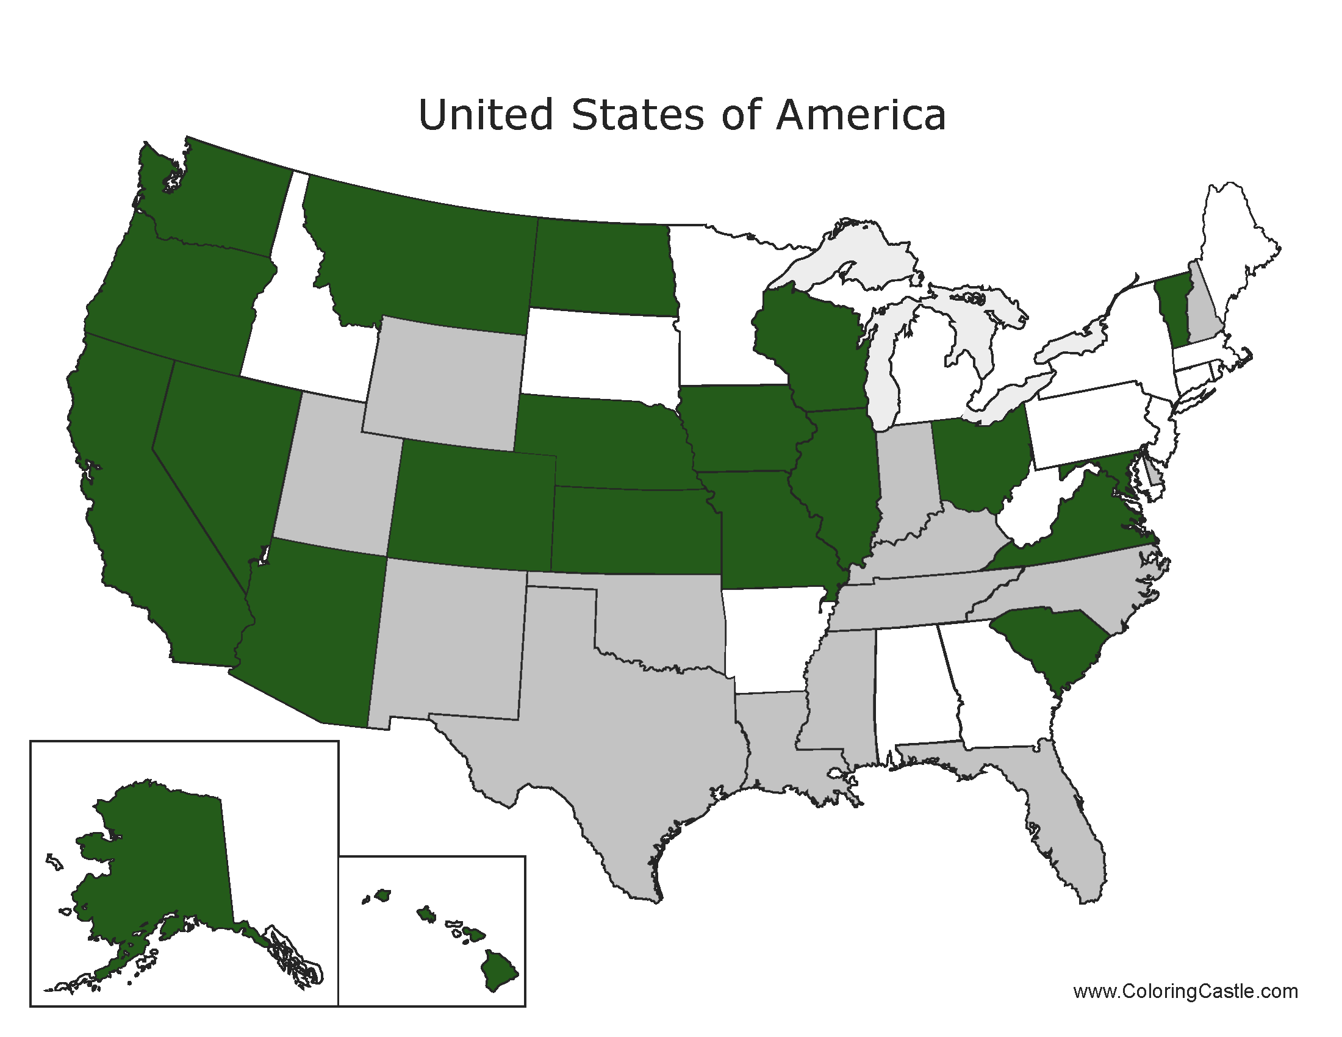
Health and Human Services Employees

Slide 20
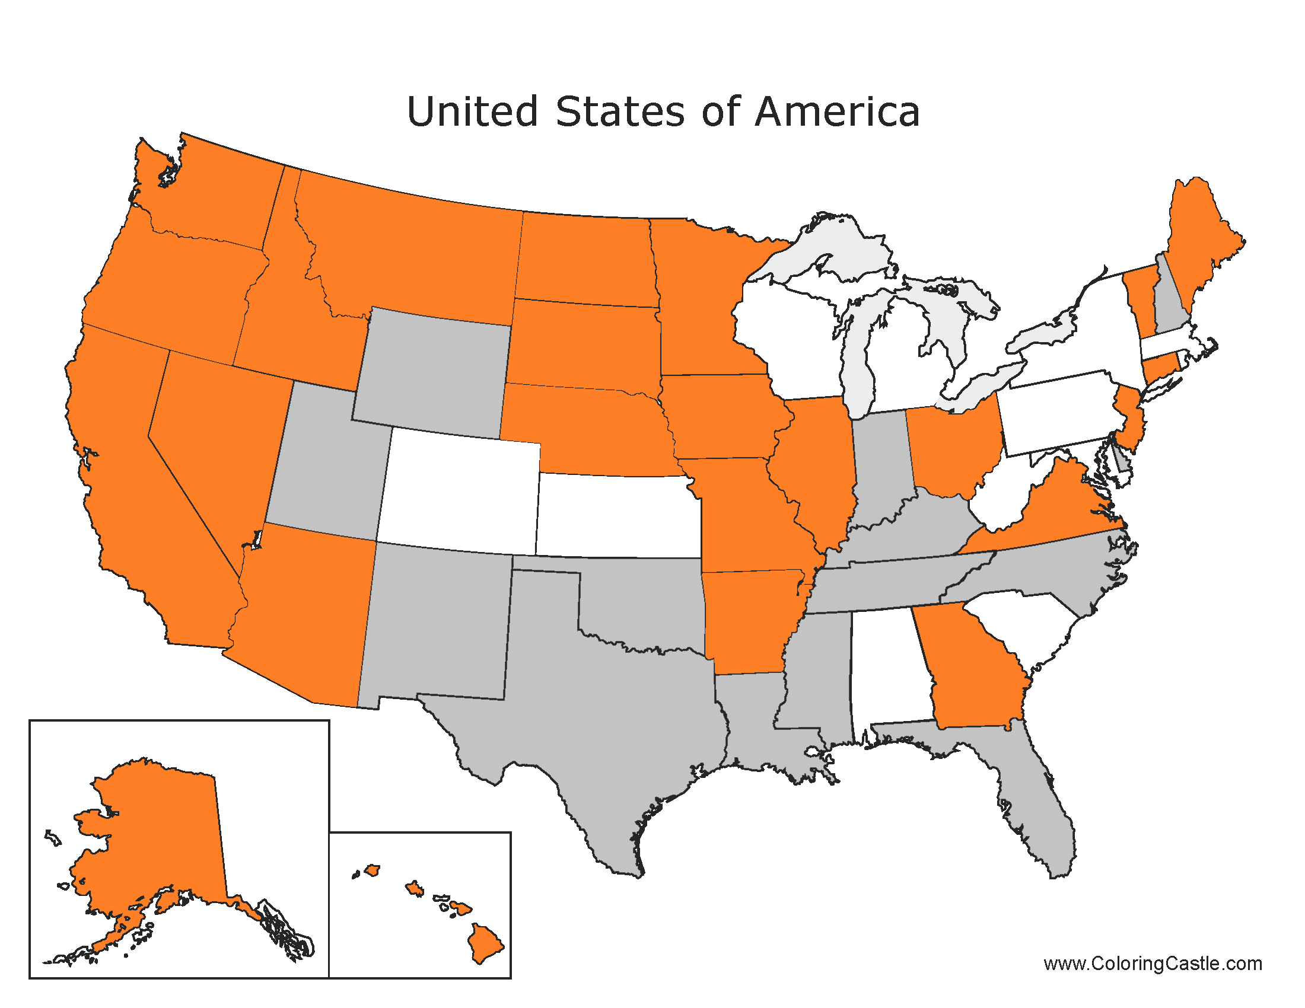
Homecare Planning Agency

Slide 21
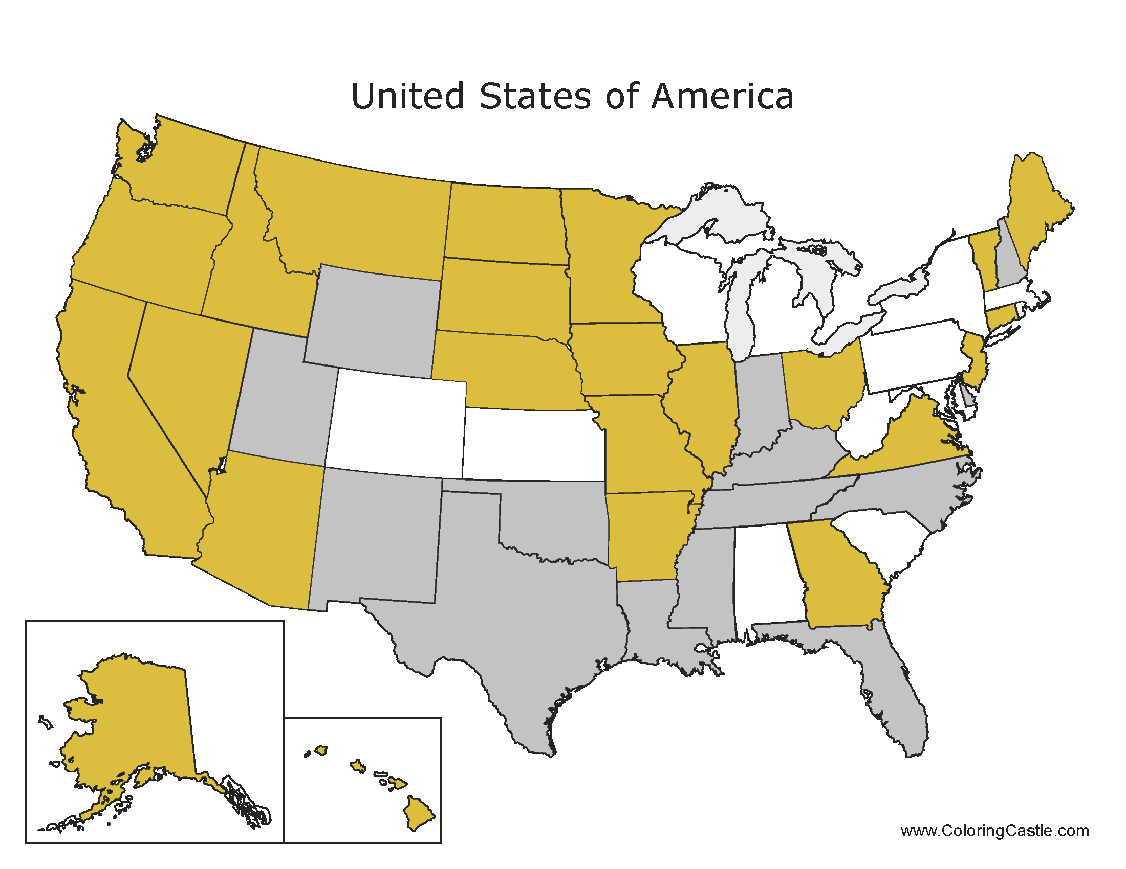
Home Health Aids

Slide 22
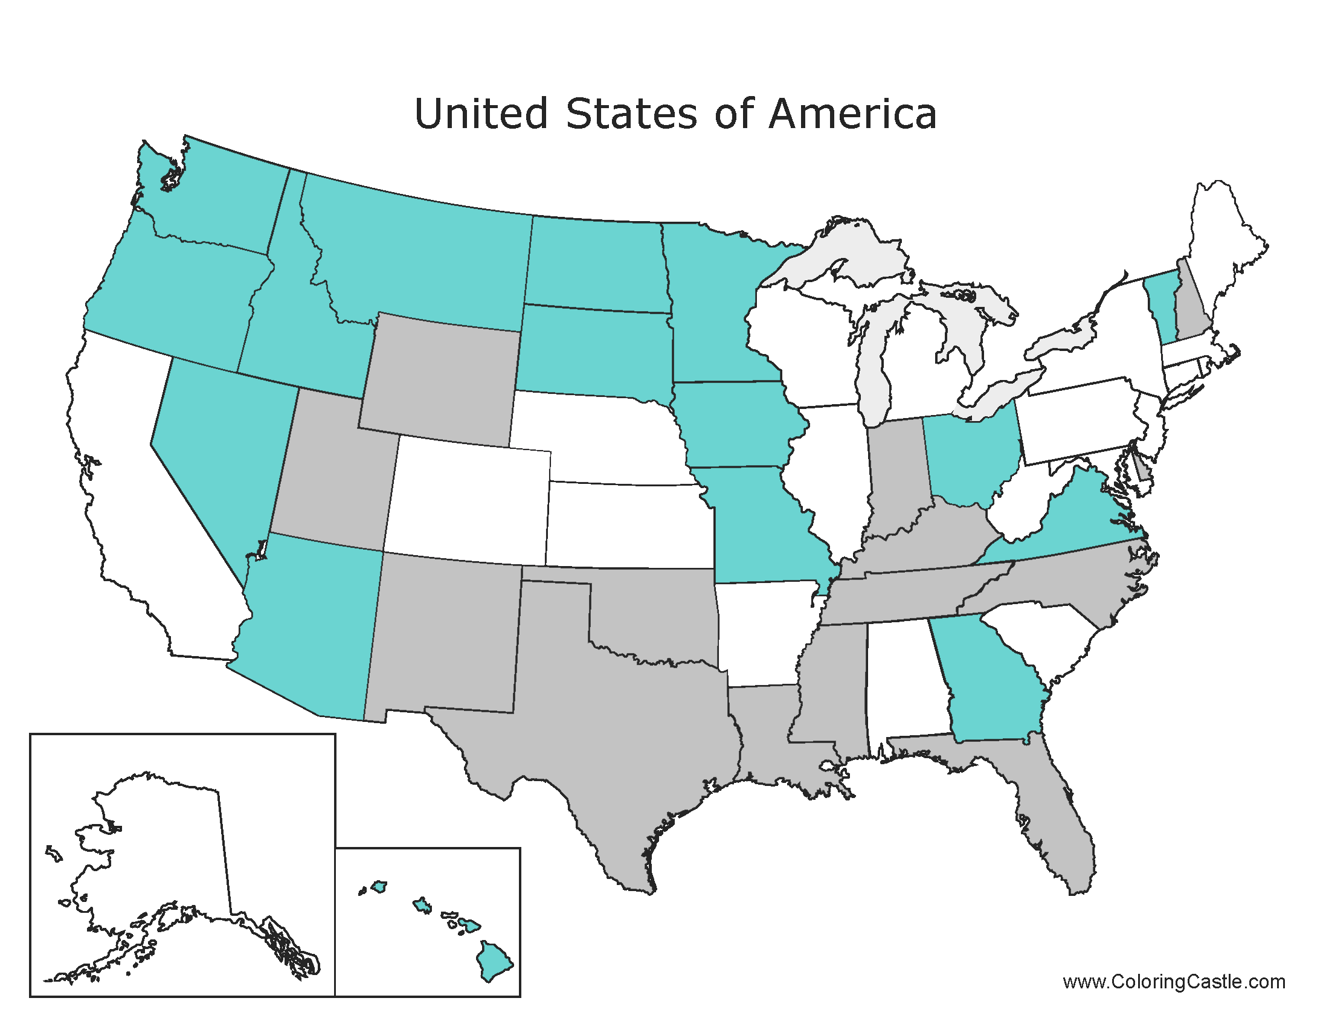
Hospices

Slide 23
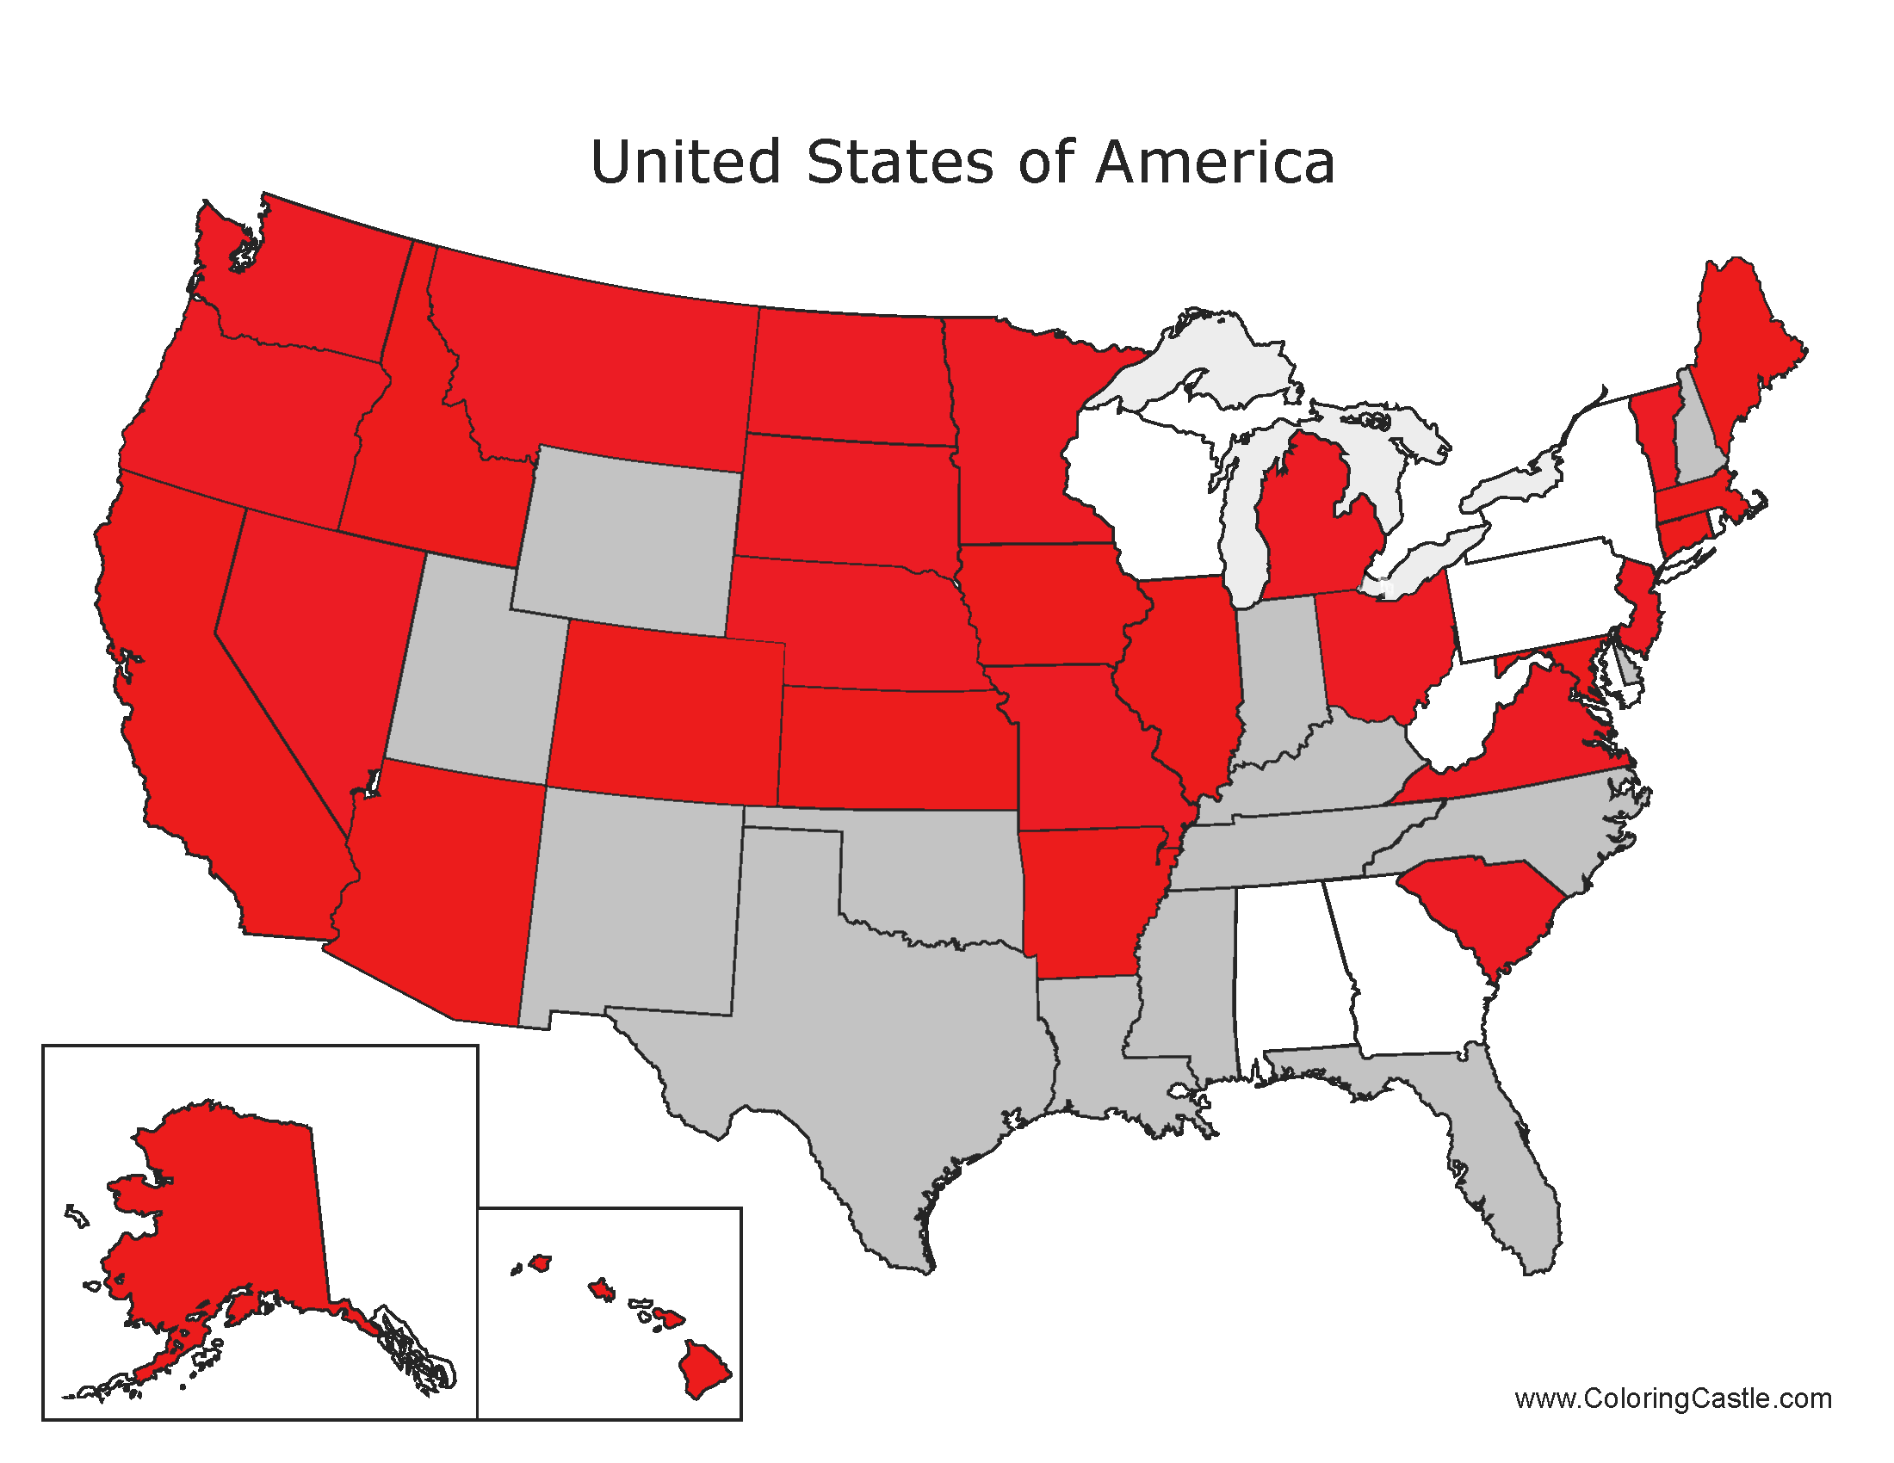
Law Enforcement

Slide 24
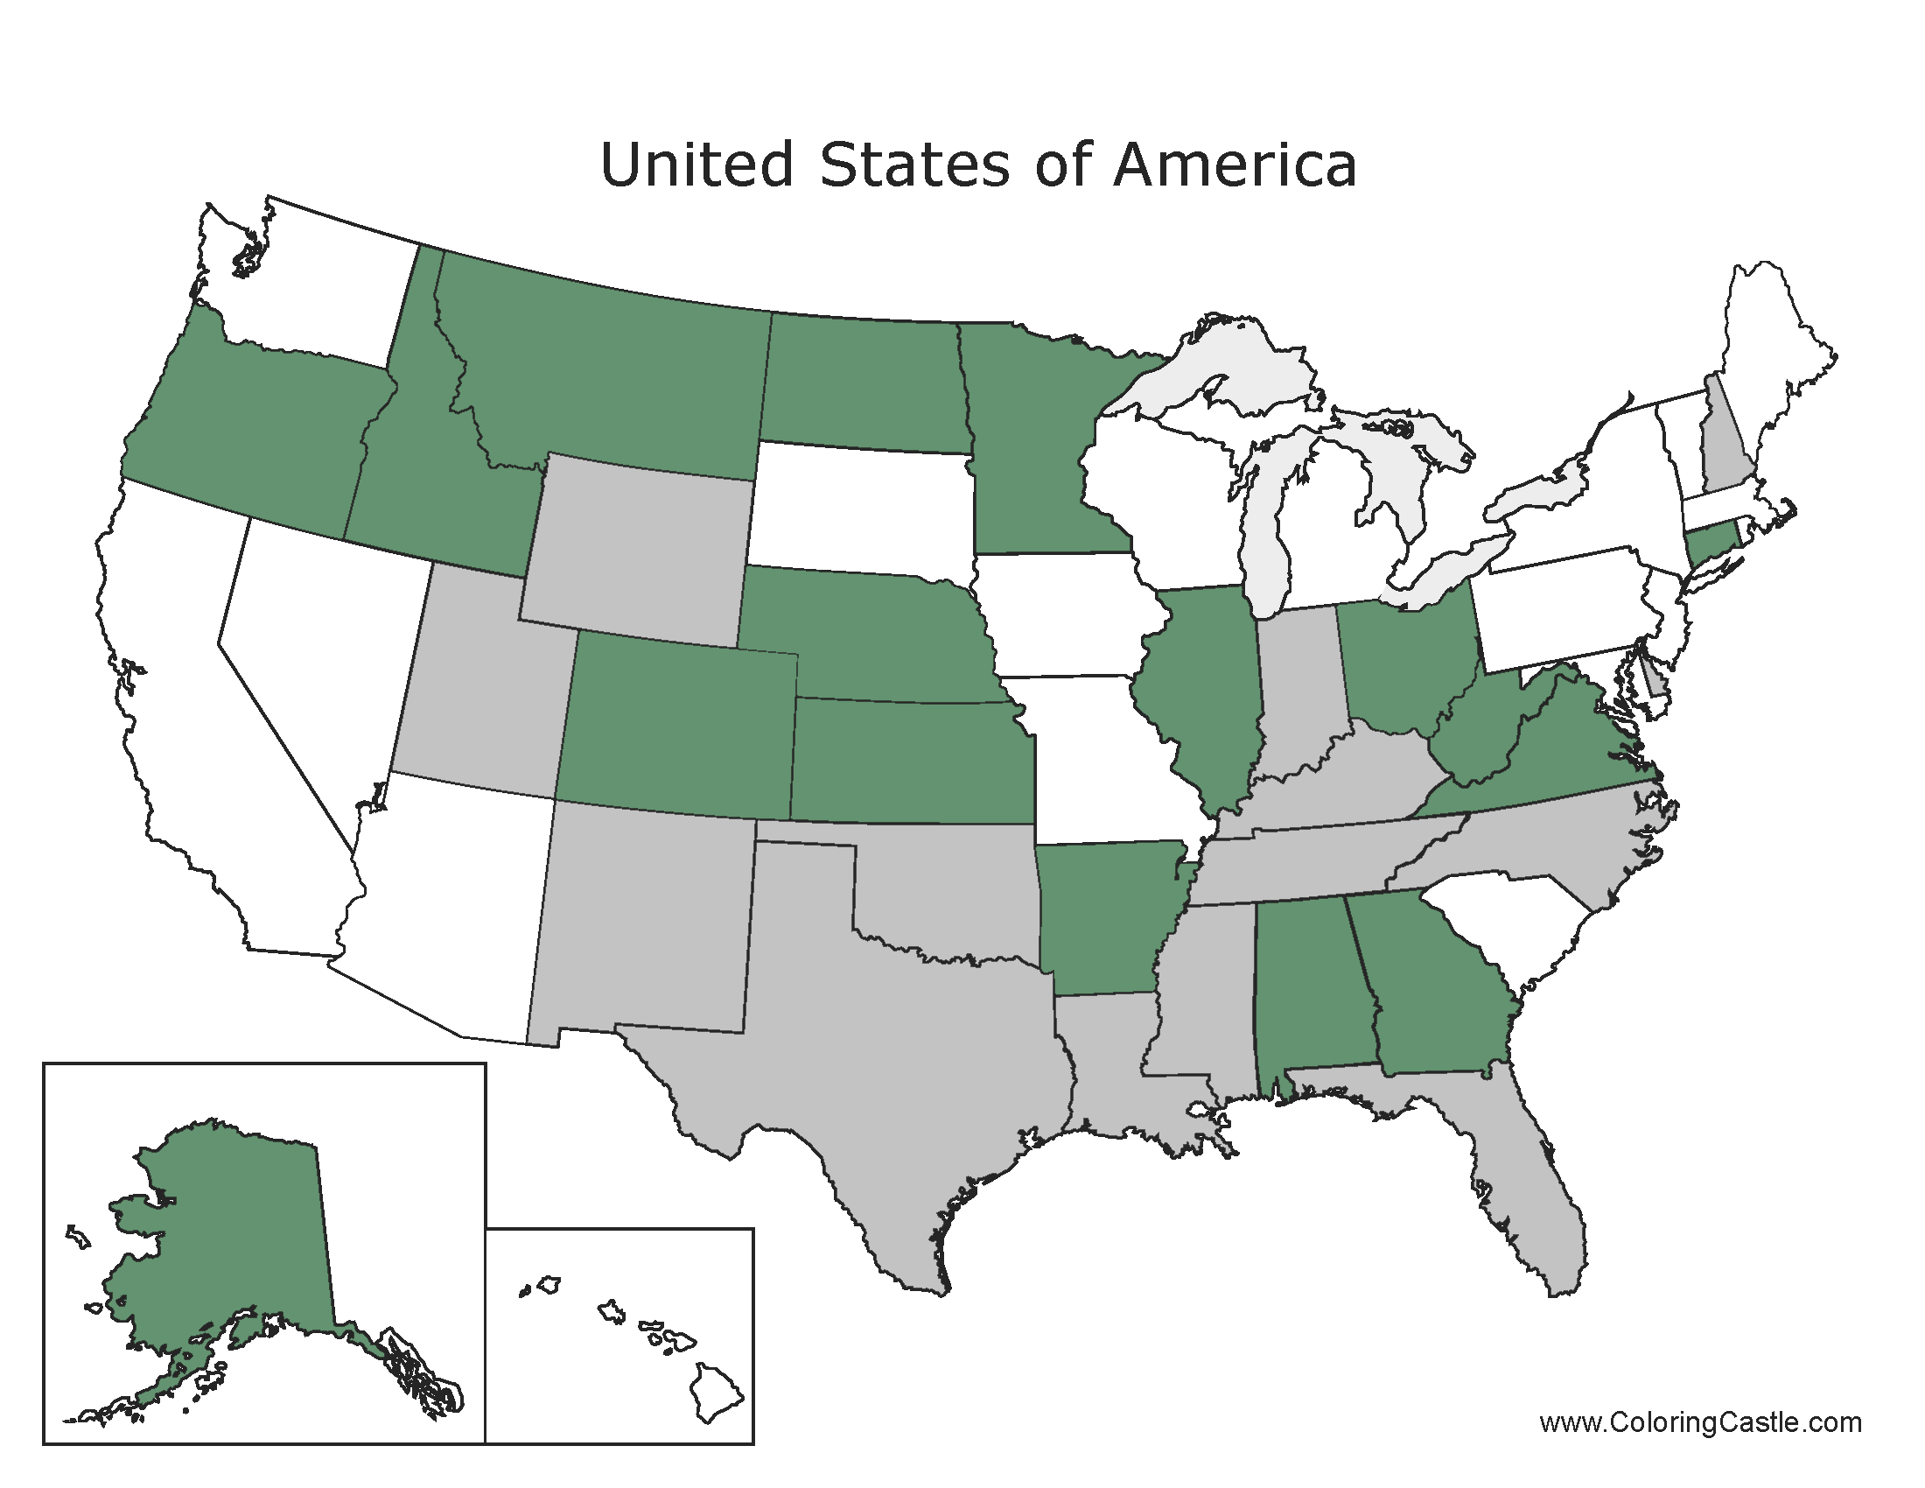
Medical Administration

Slide 25
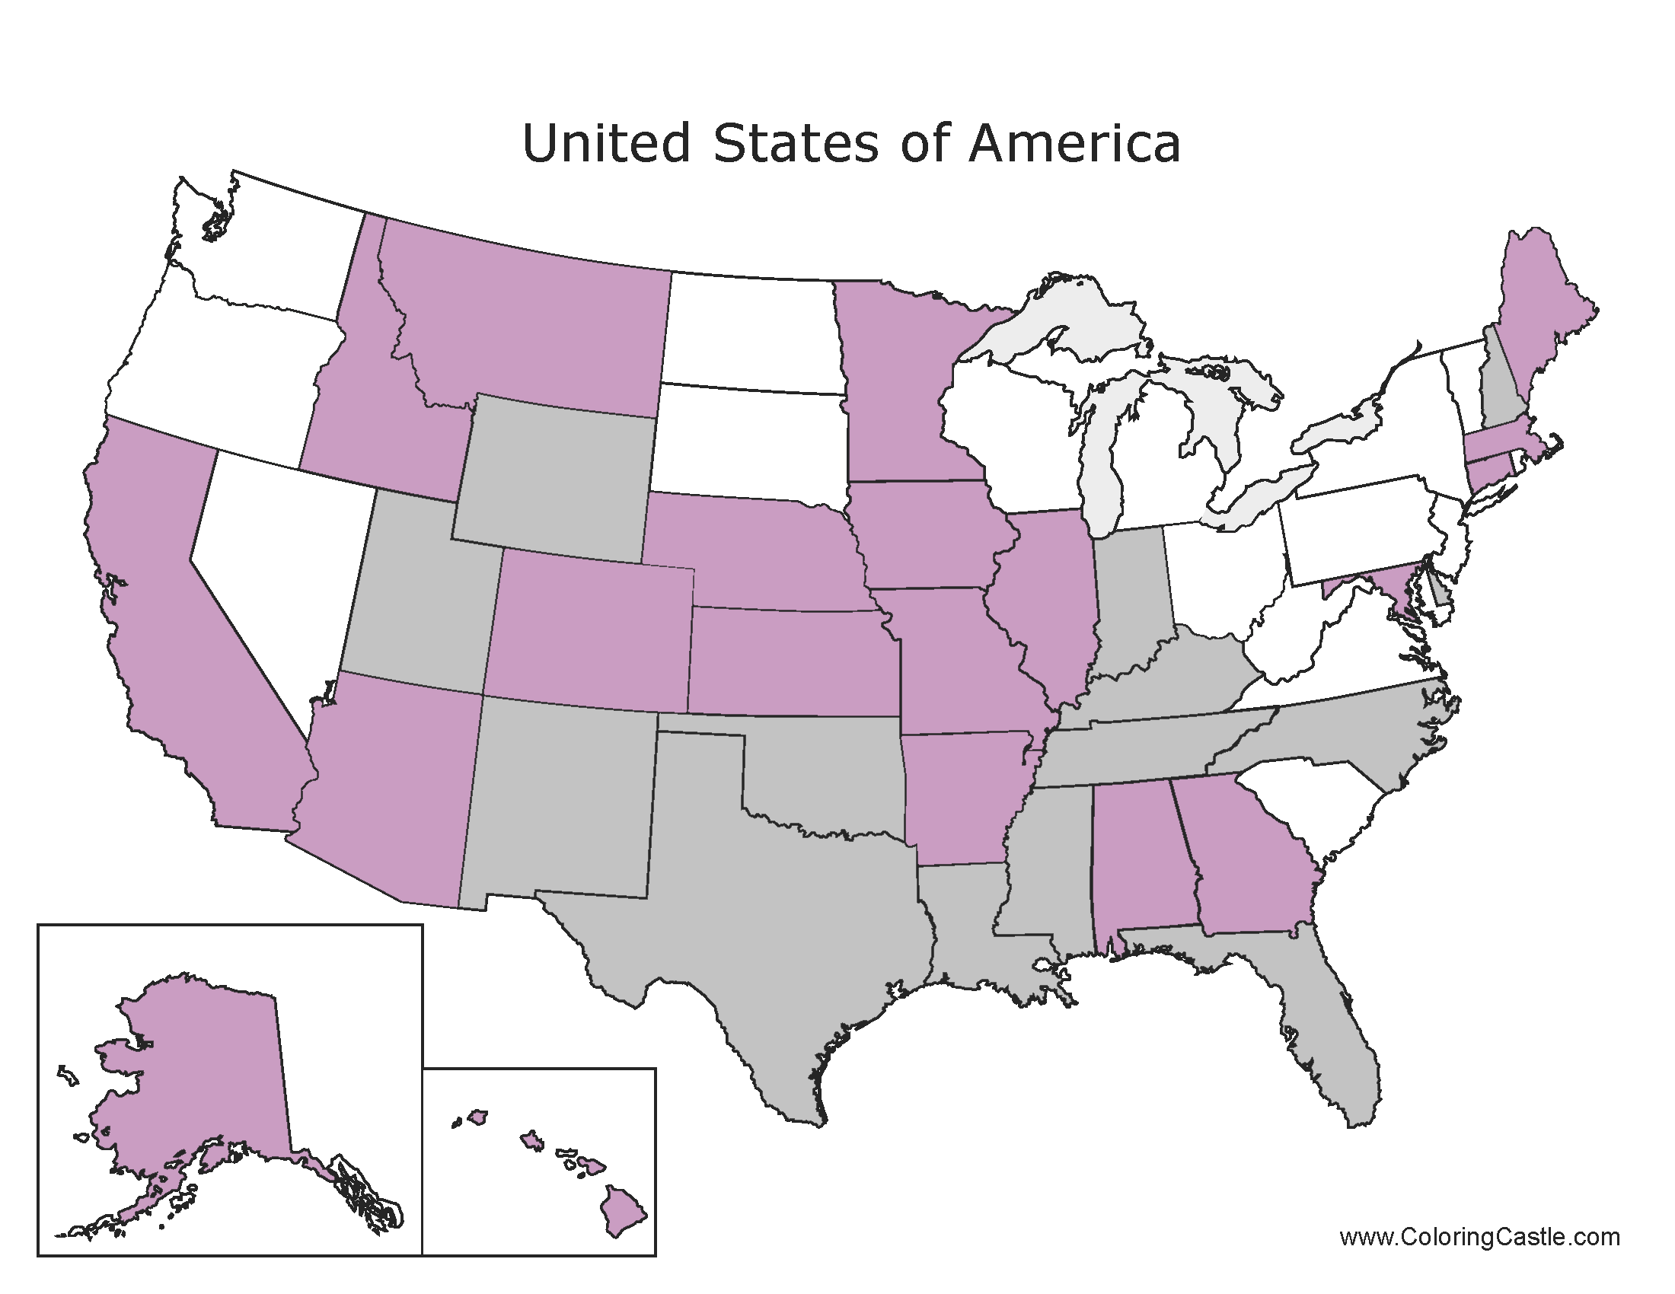
Medical Professional

Slide 26
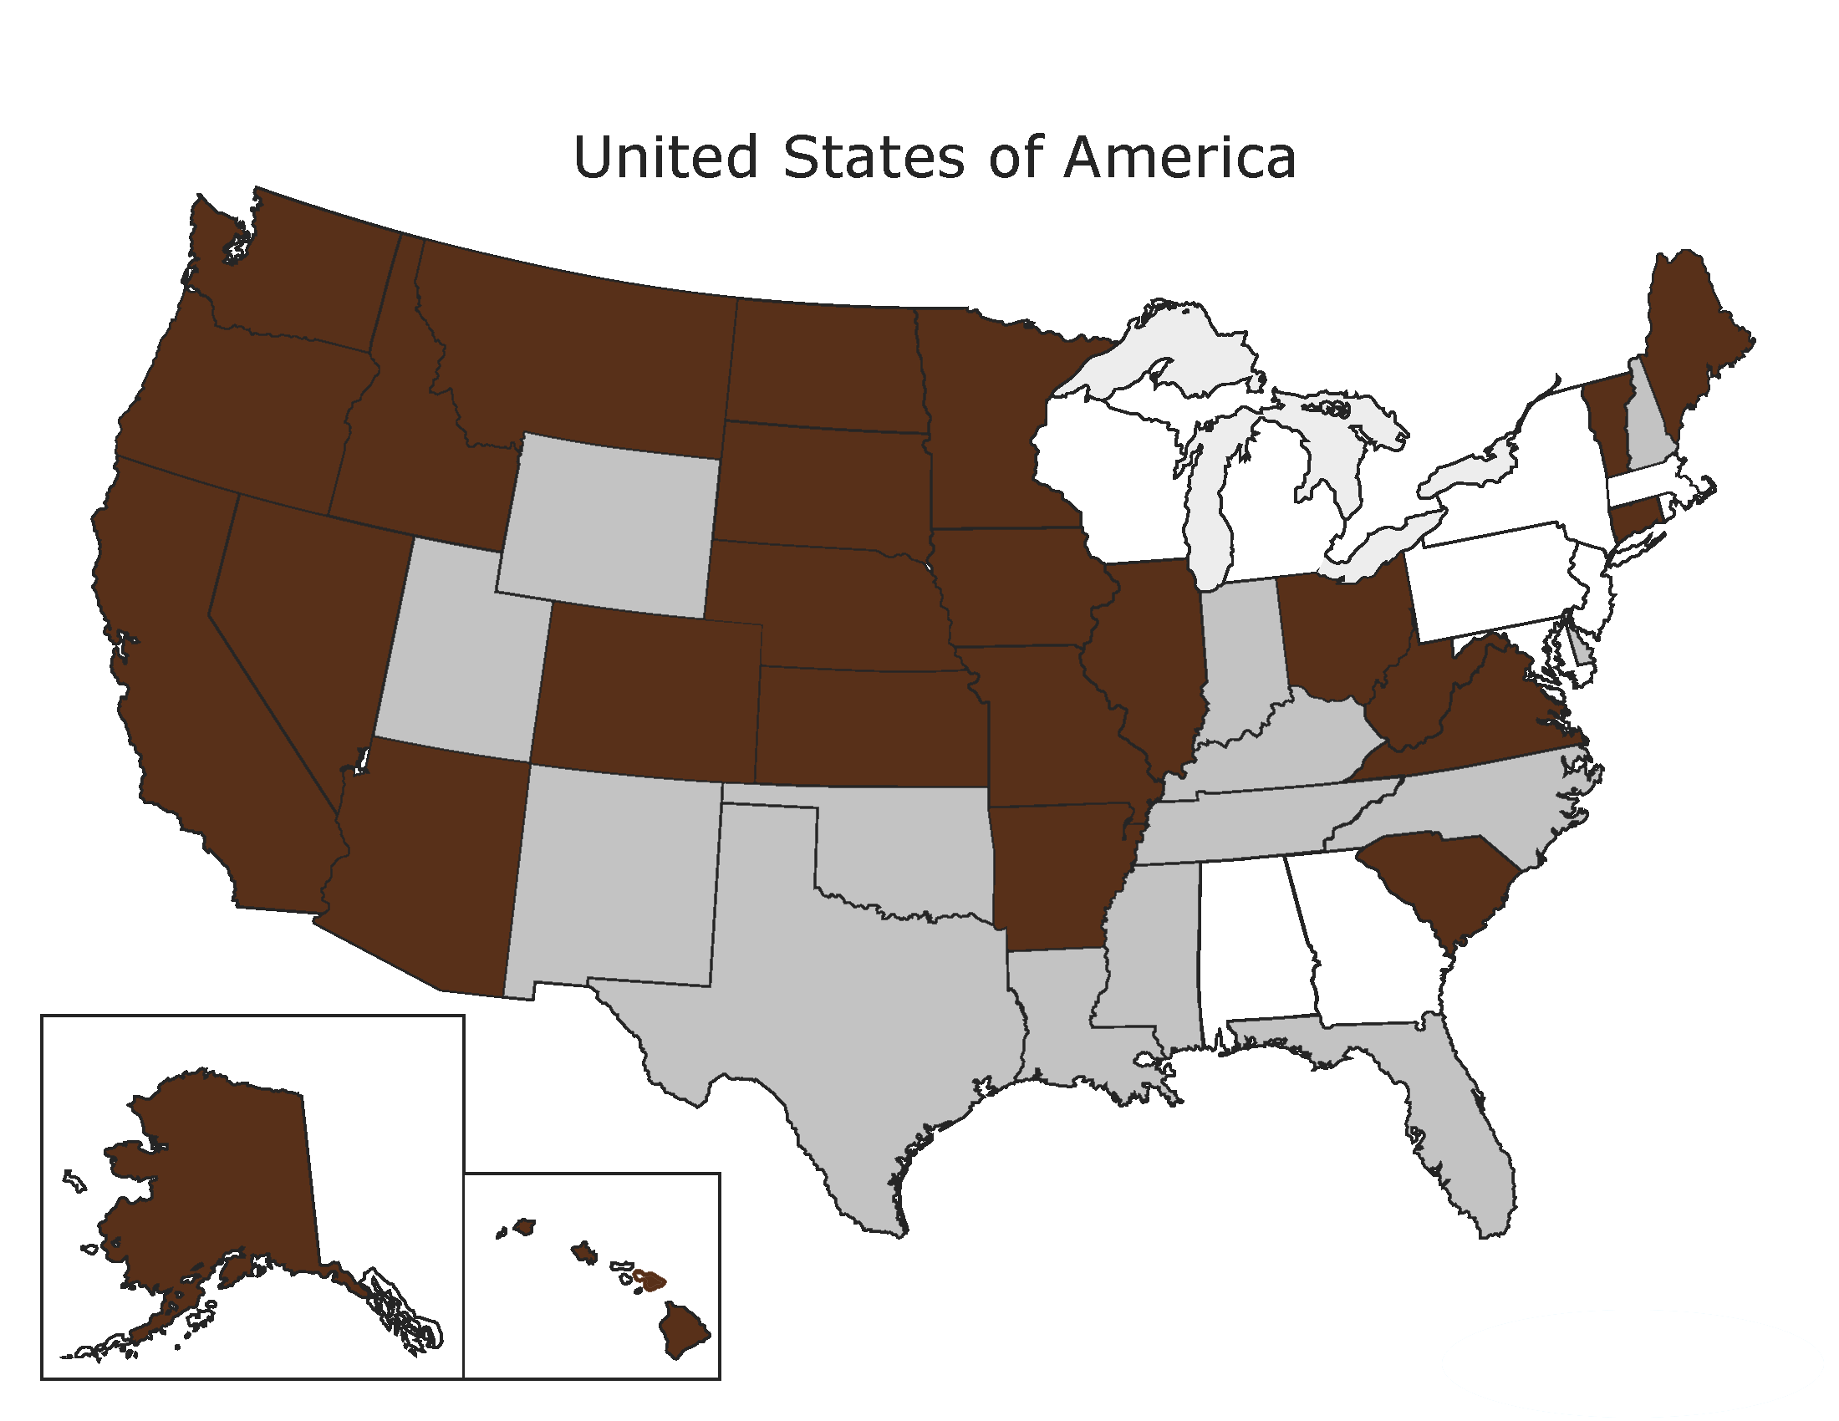
Mental Health Counselor/Therapist

Slide 27
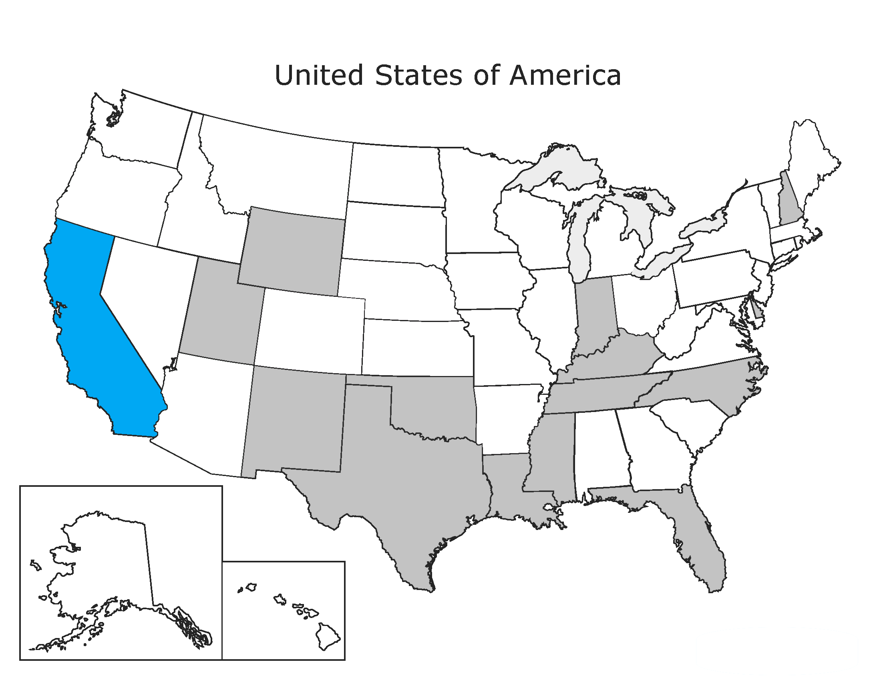
Notary

Slide 28
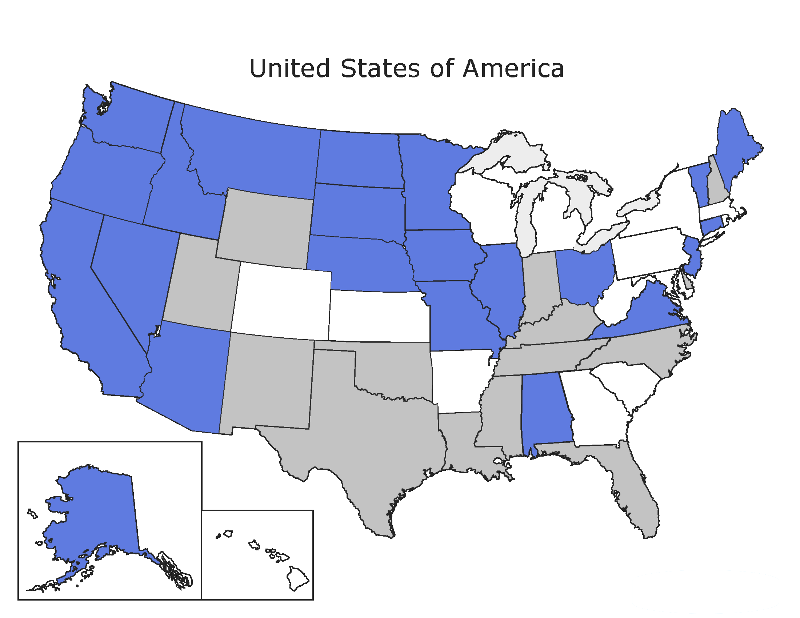
Paid Caregivers

Slide 29
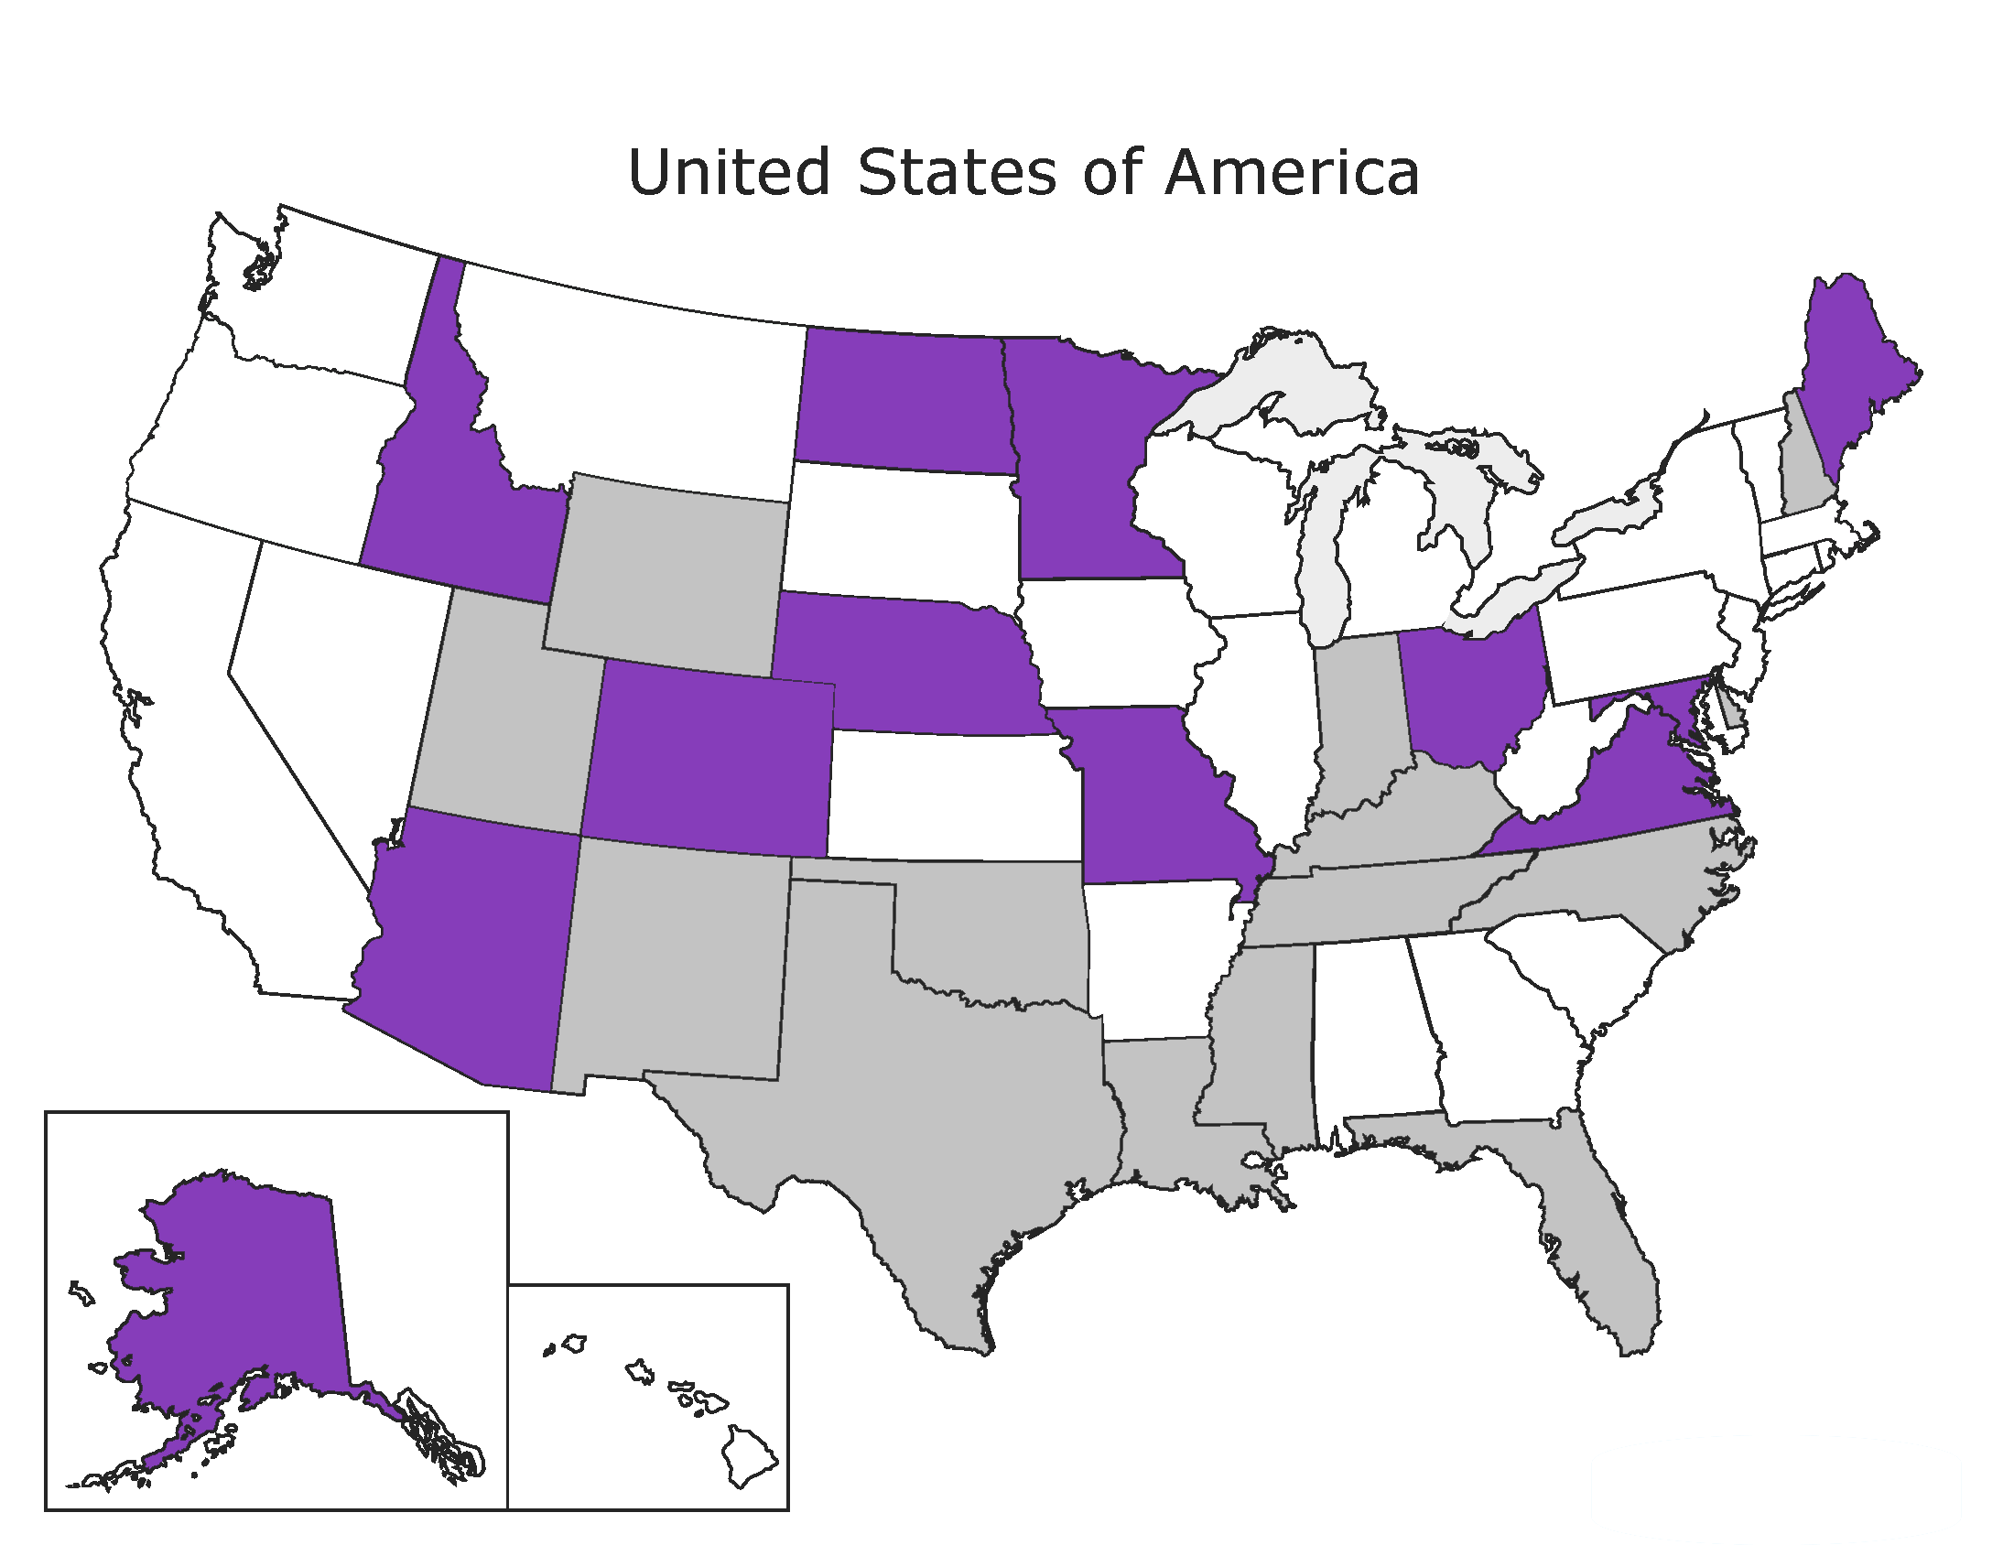
Pharmacists

Slide 30
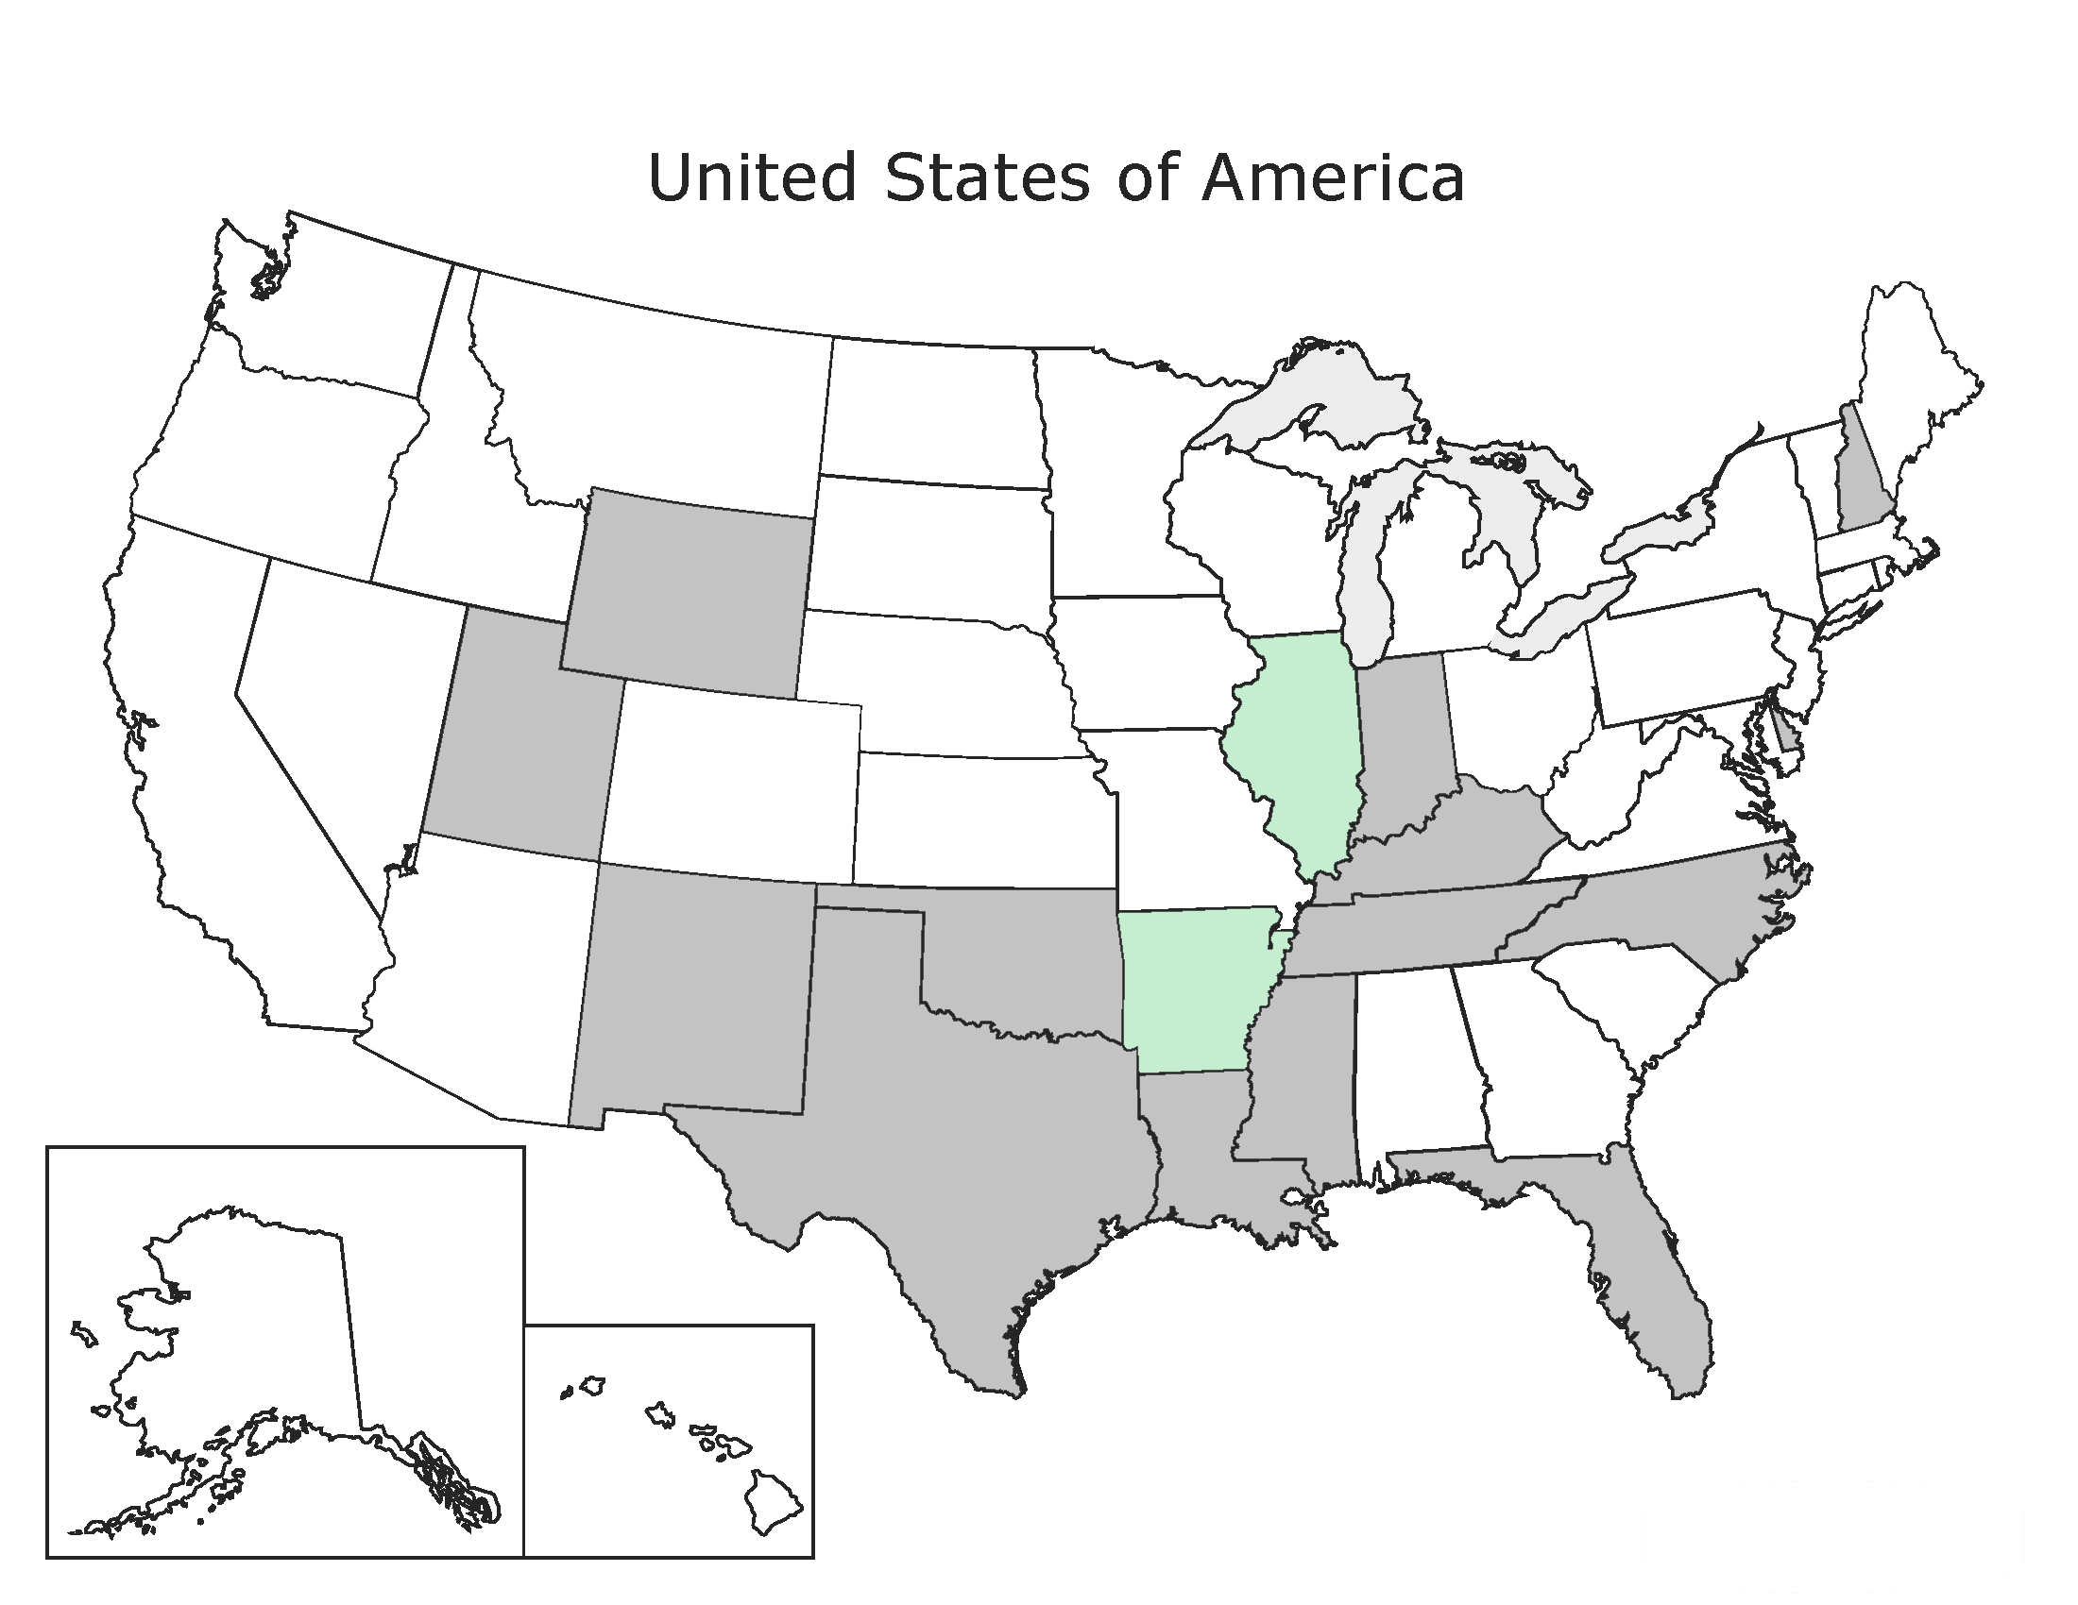
Postal Employee

Slide 31
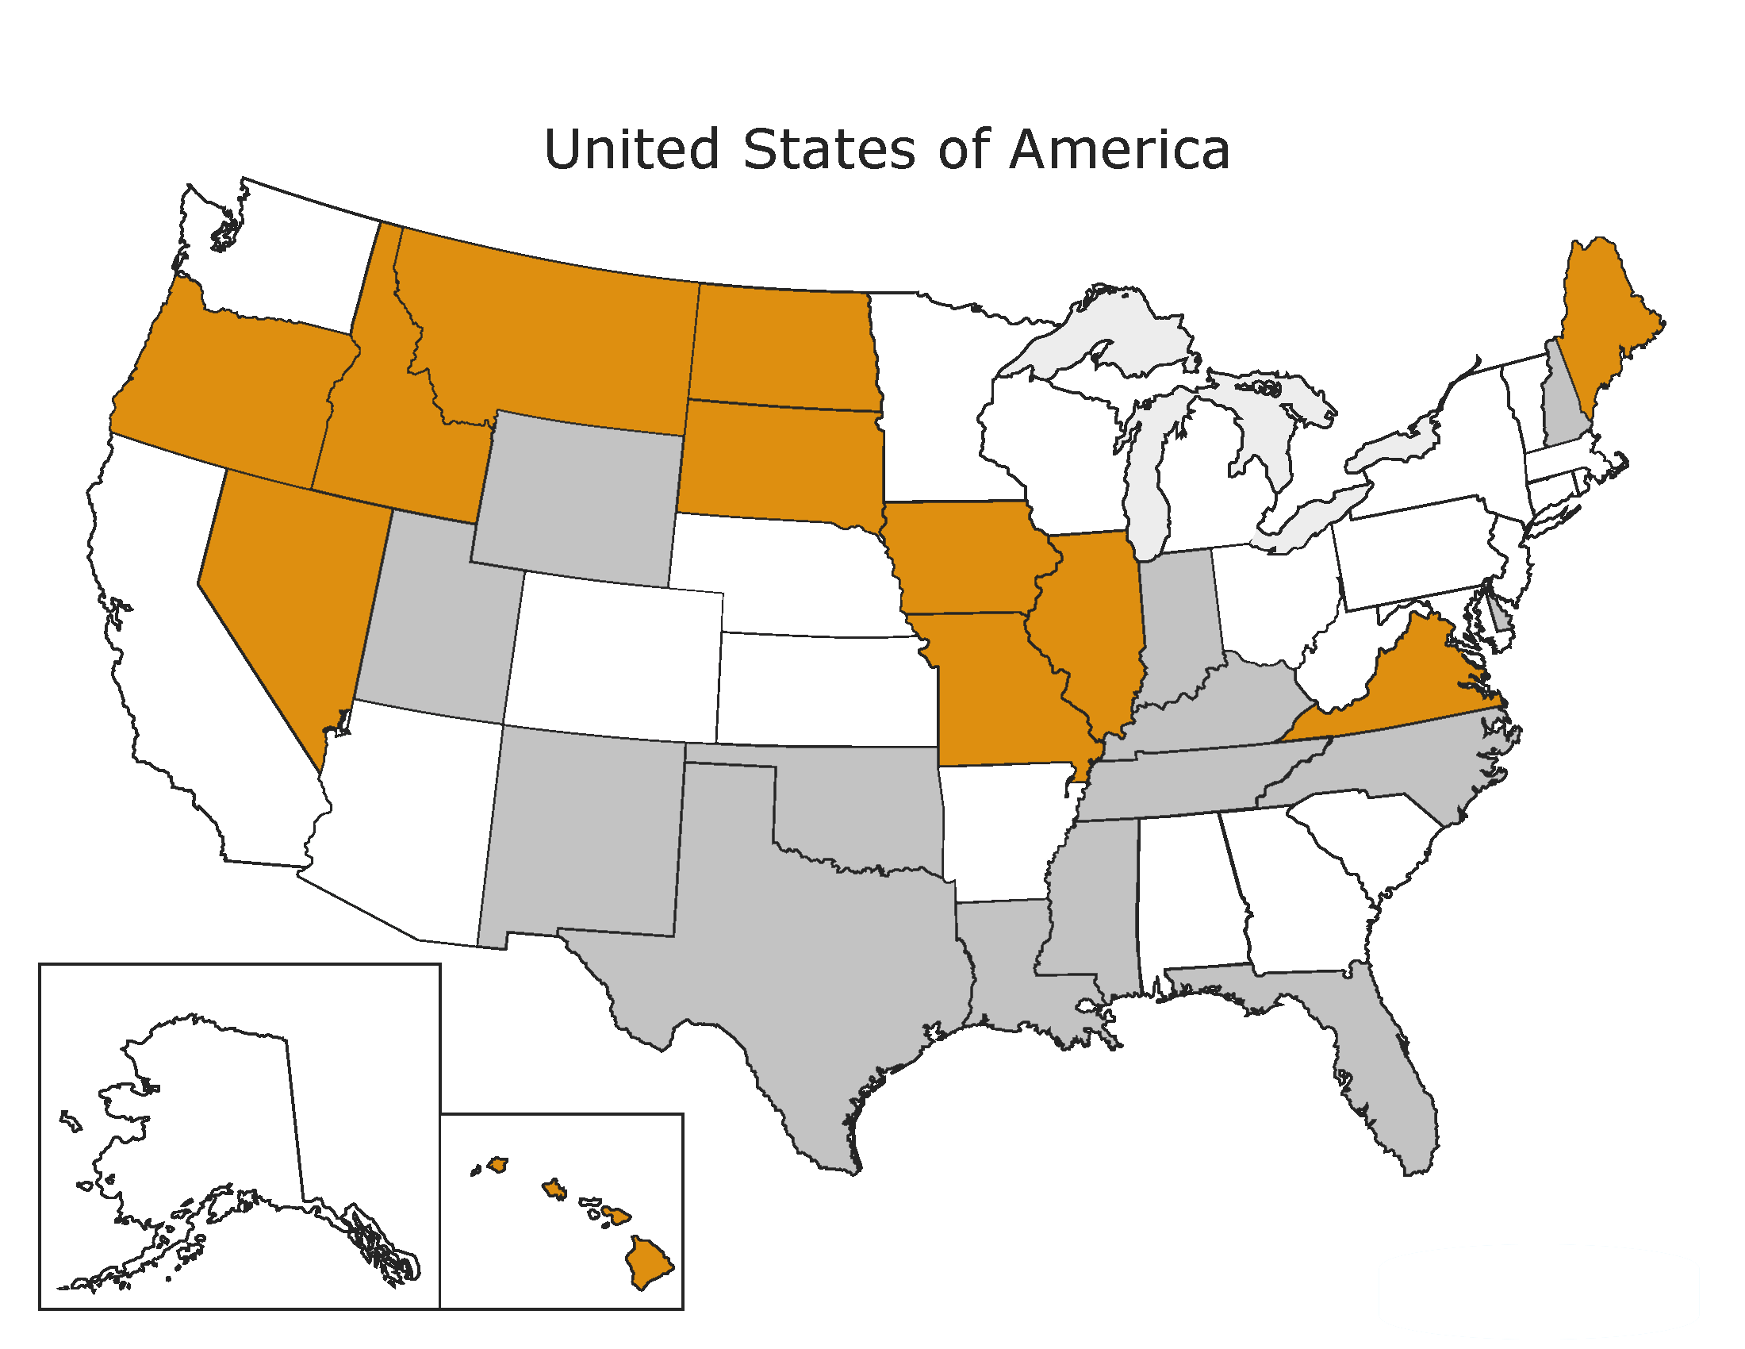
Probation Officers

Slide 32
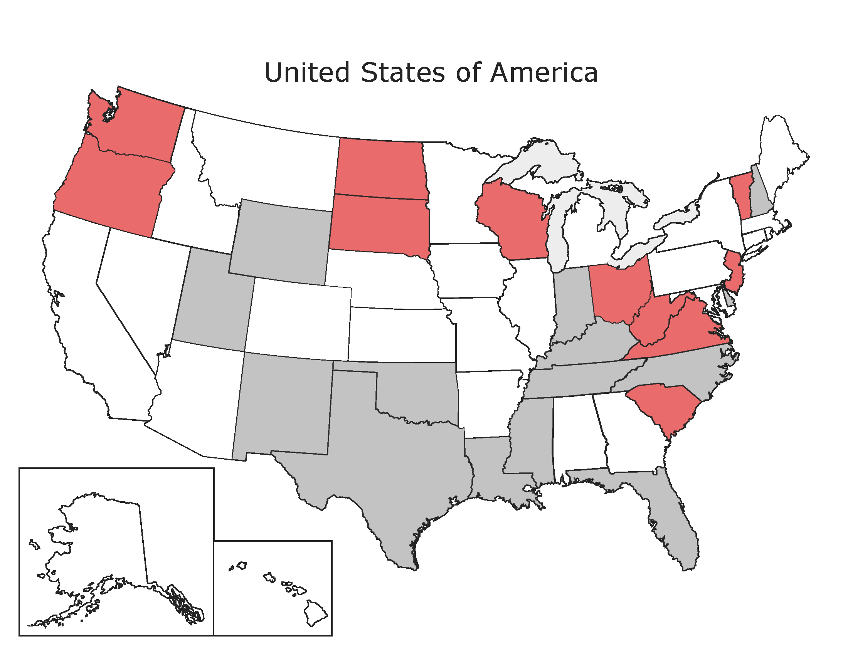
Psychologists

Slide 33
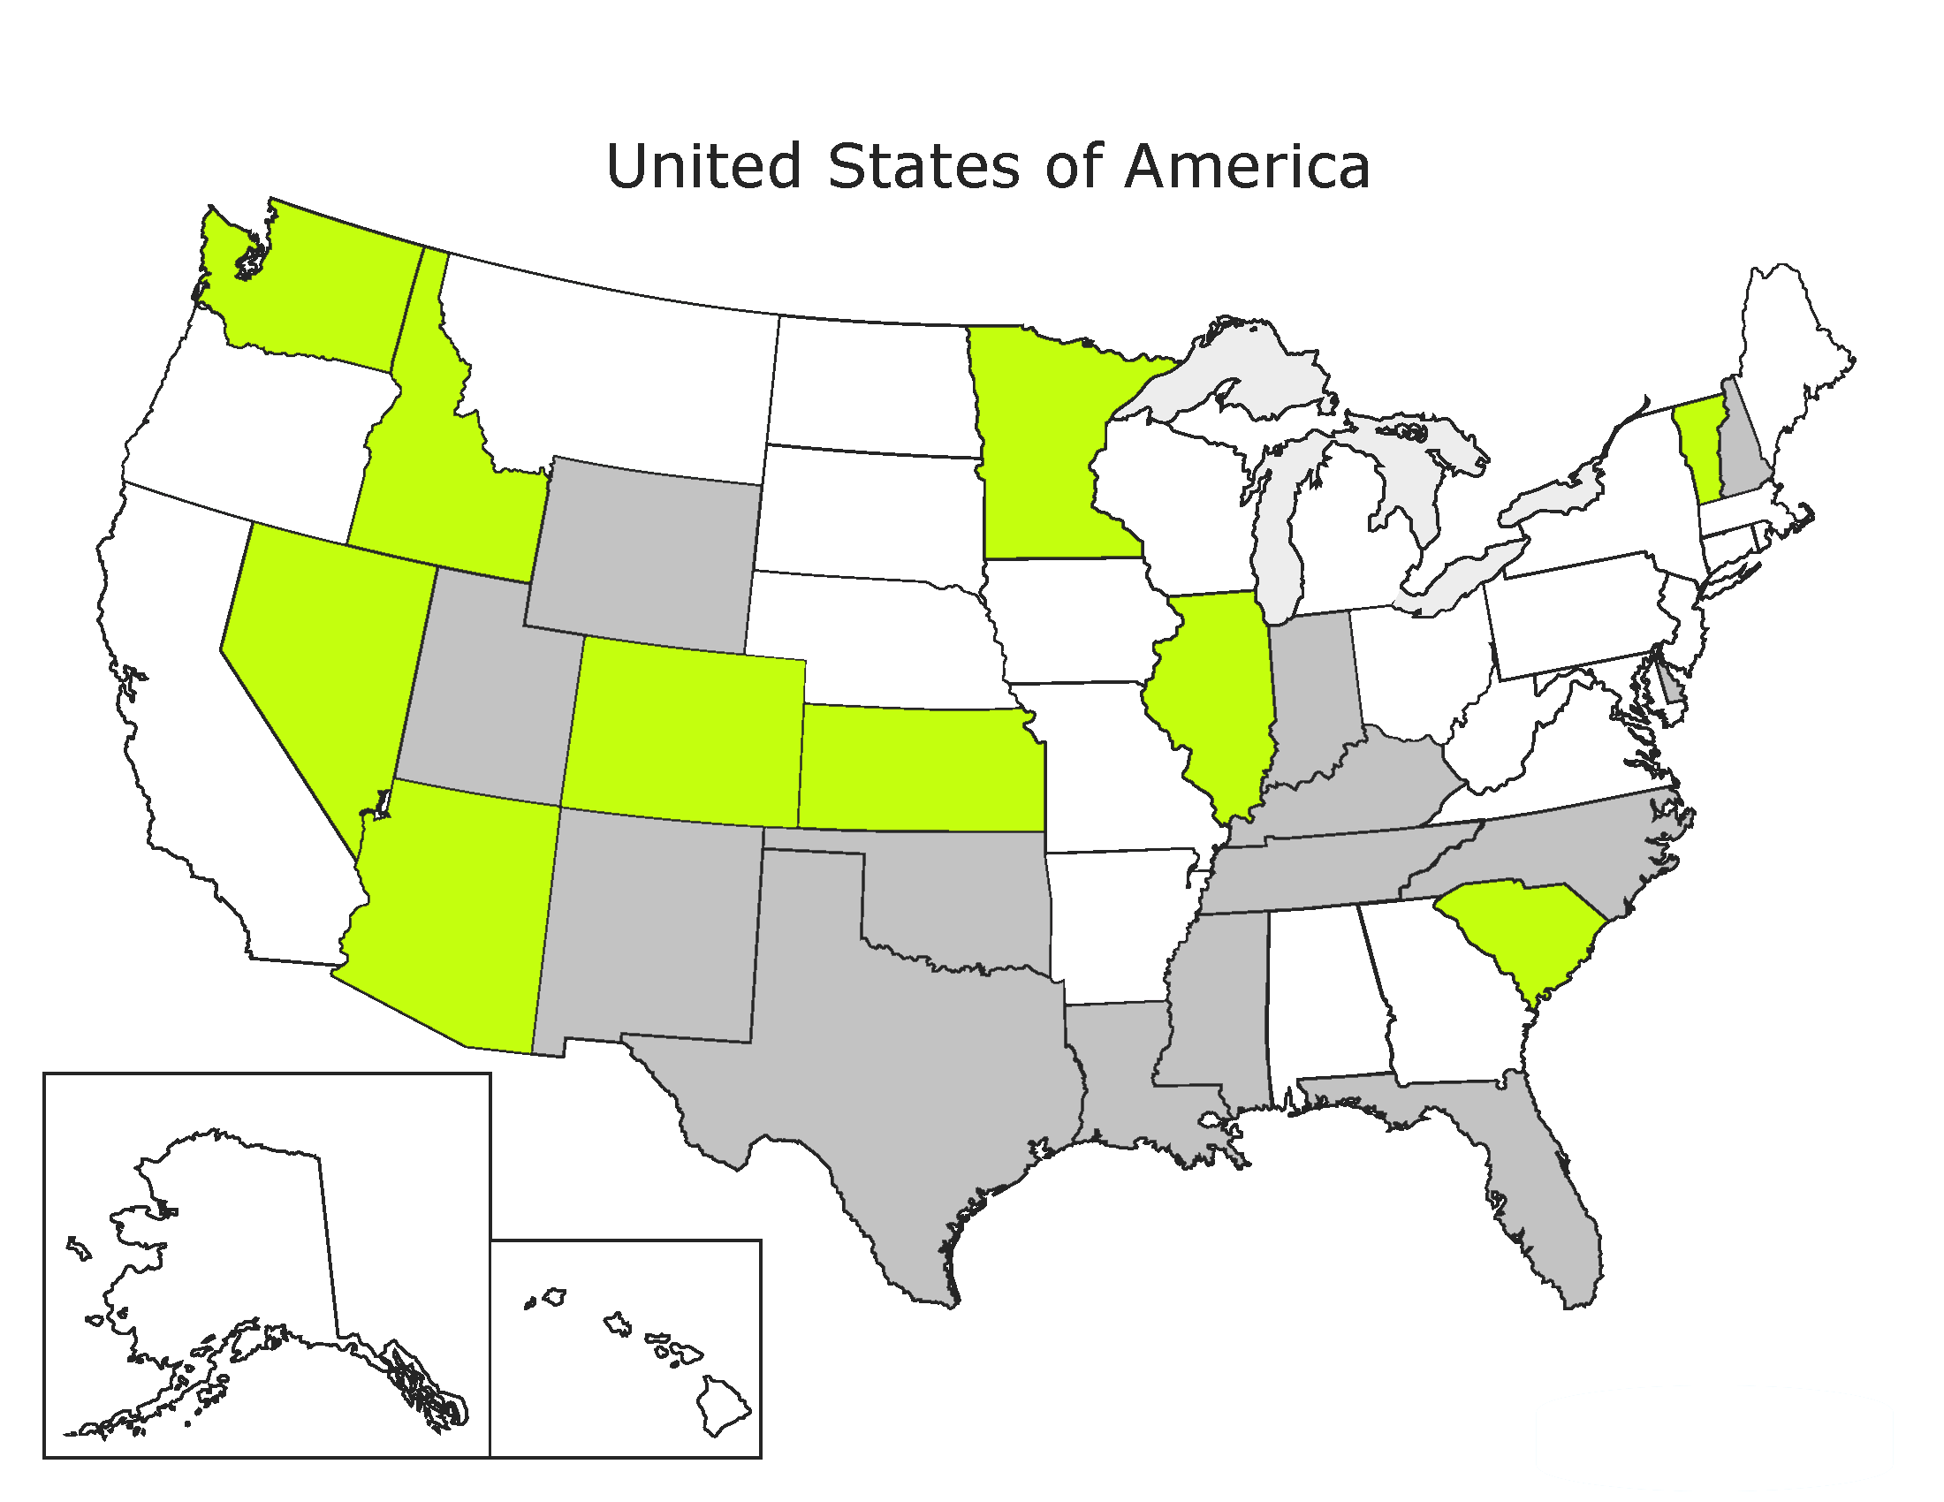
School Personnel

Slide 34
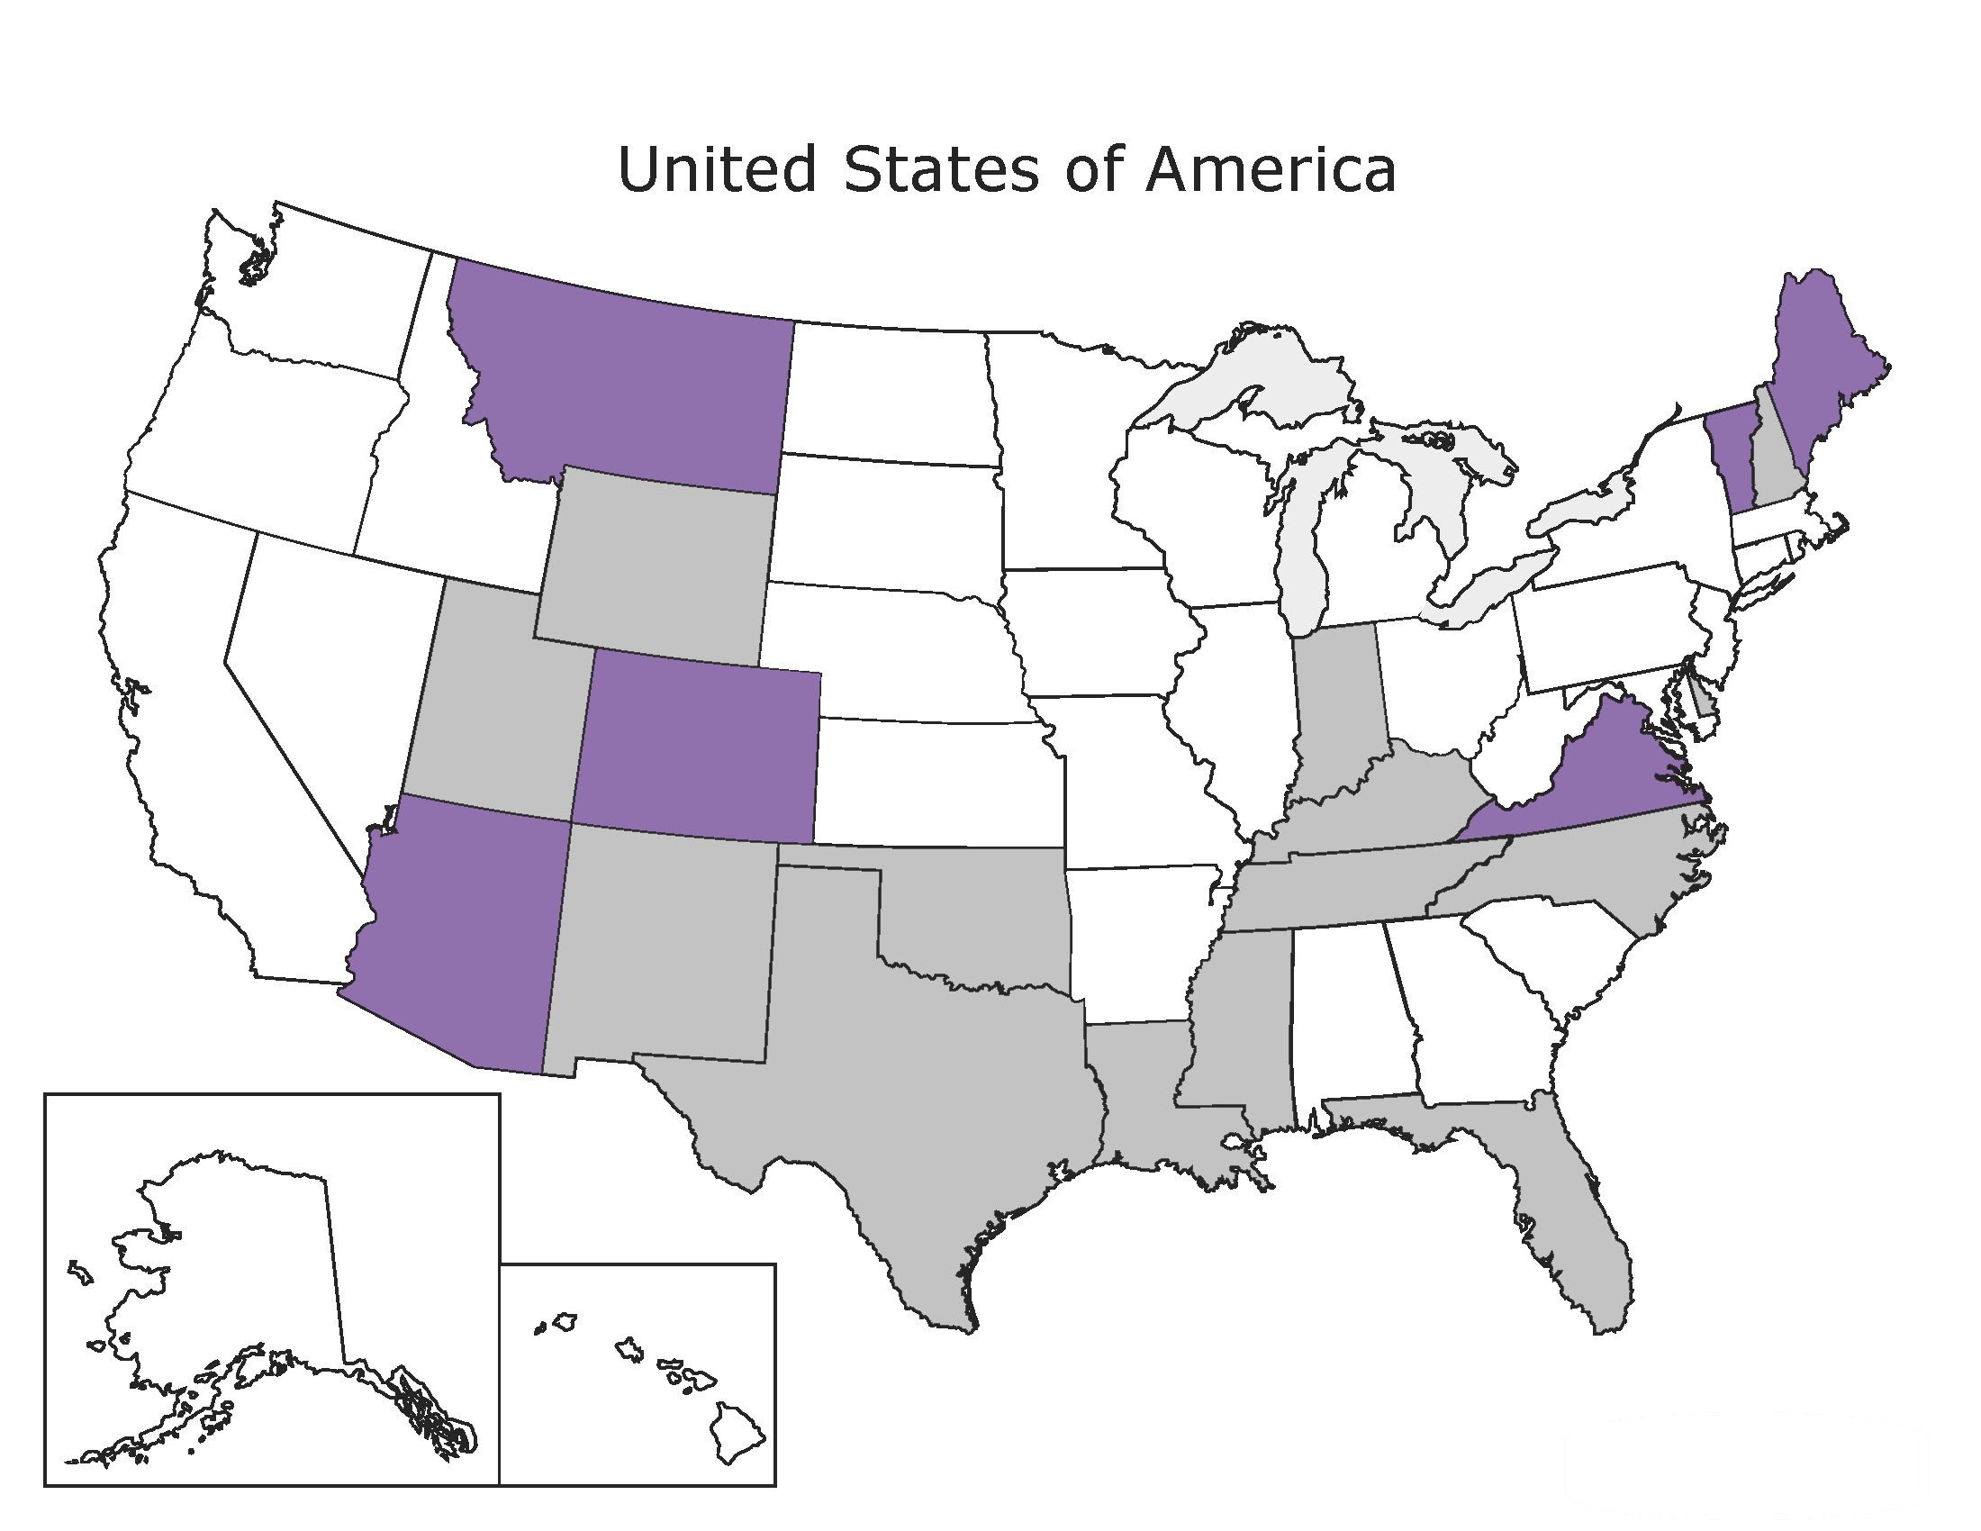
Senior Transportation Services

Slide 35
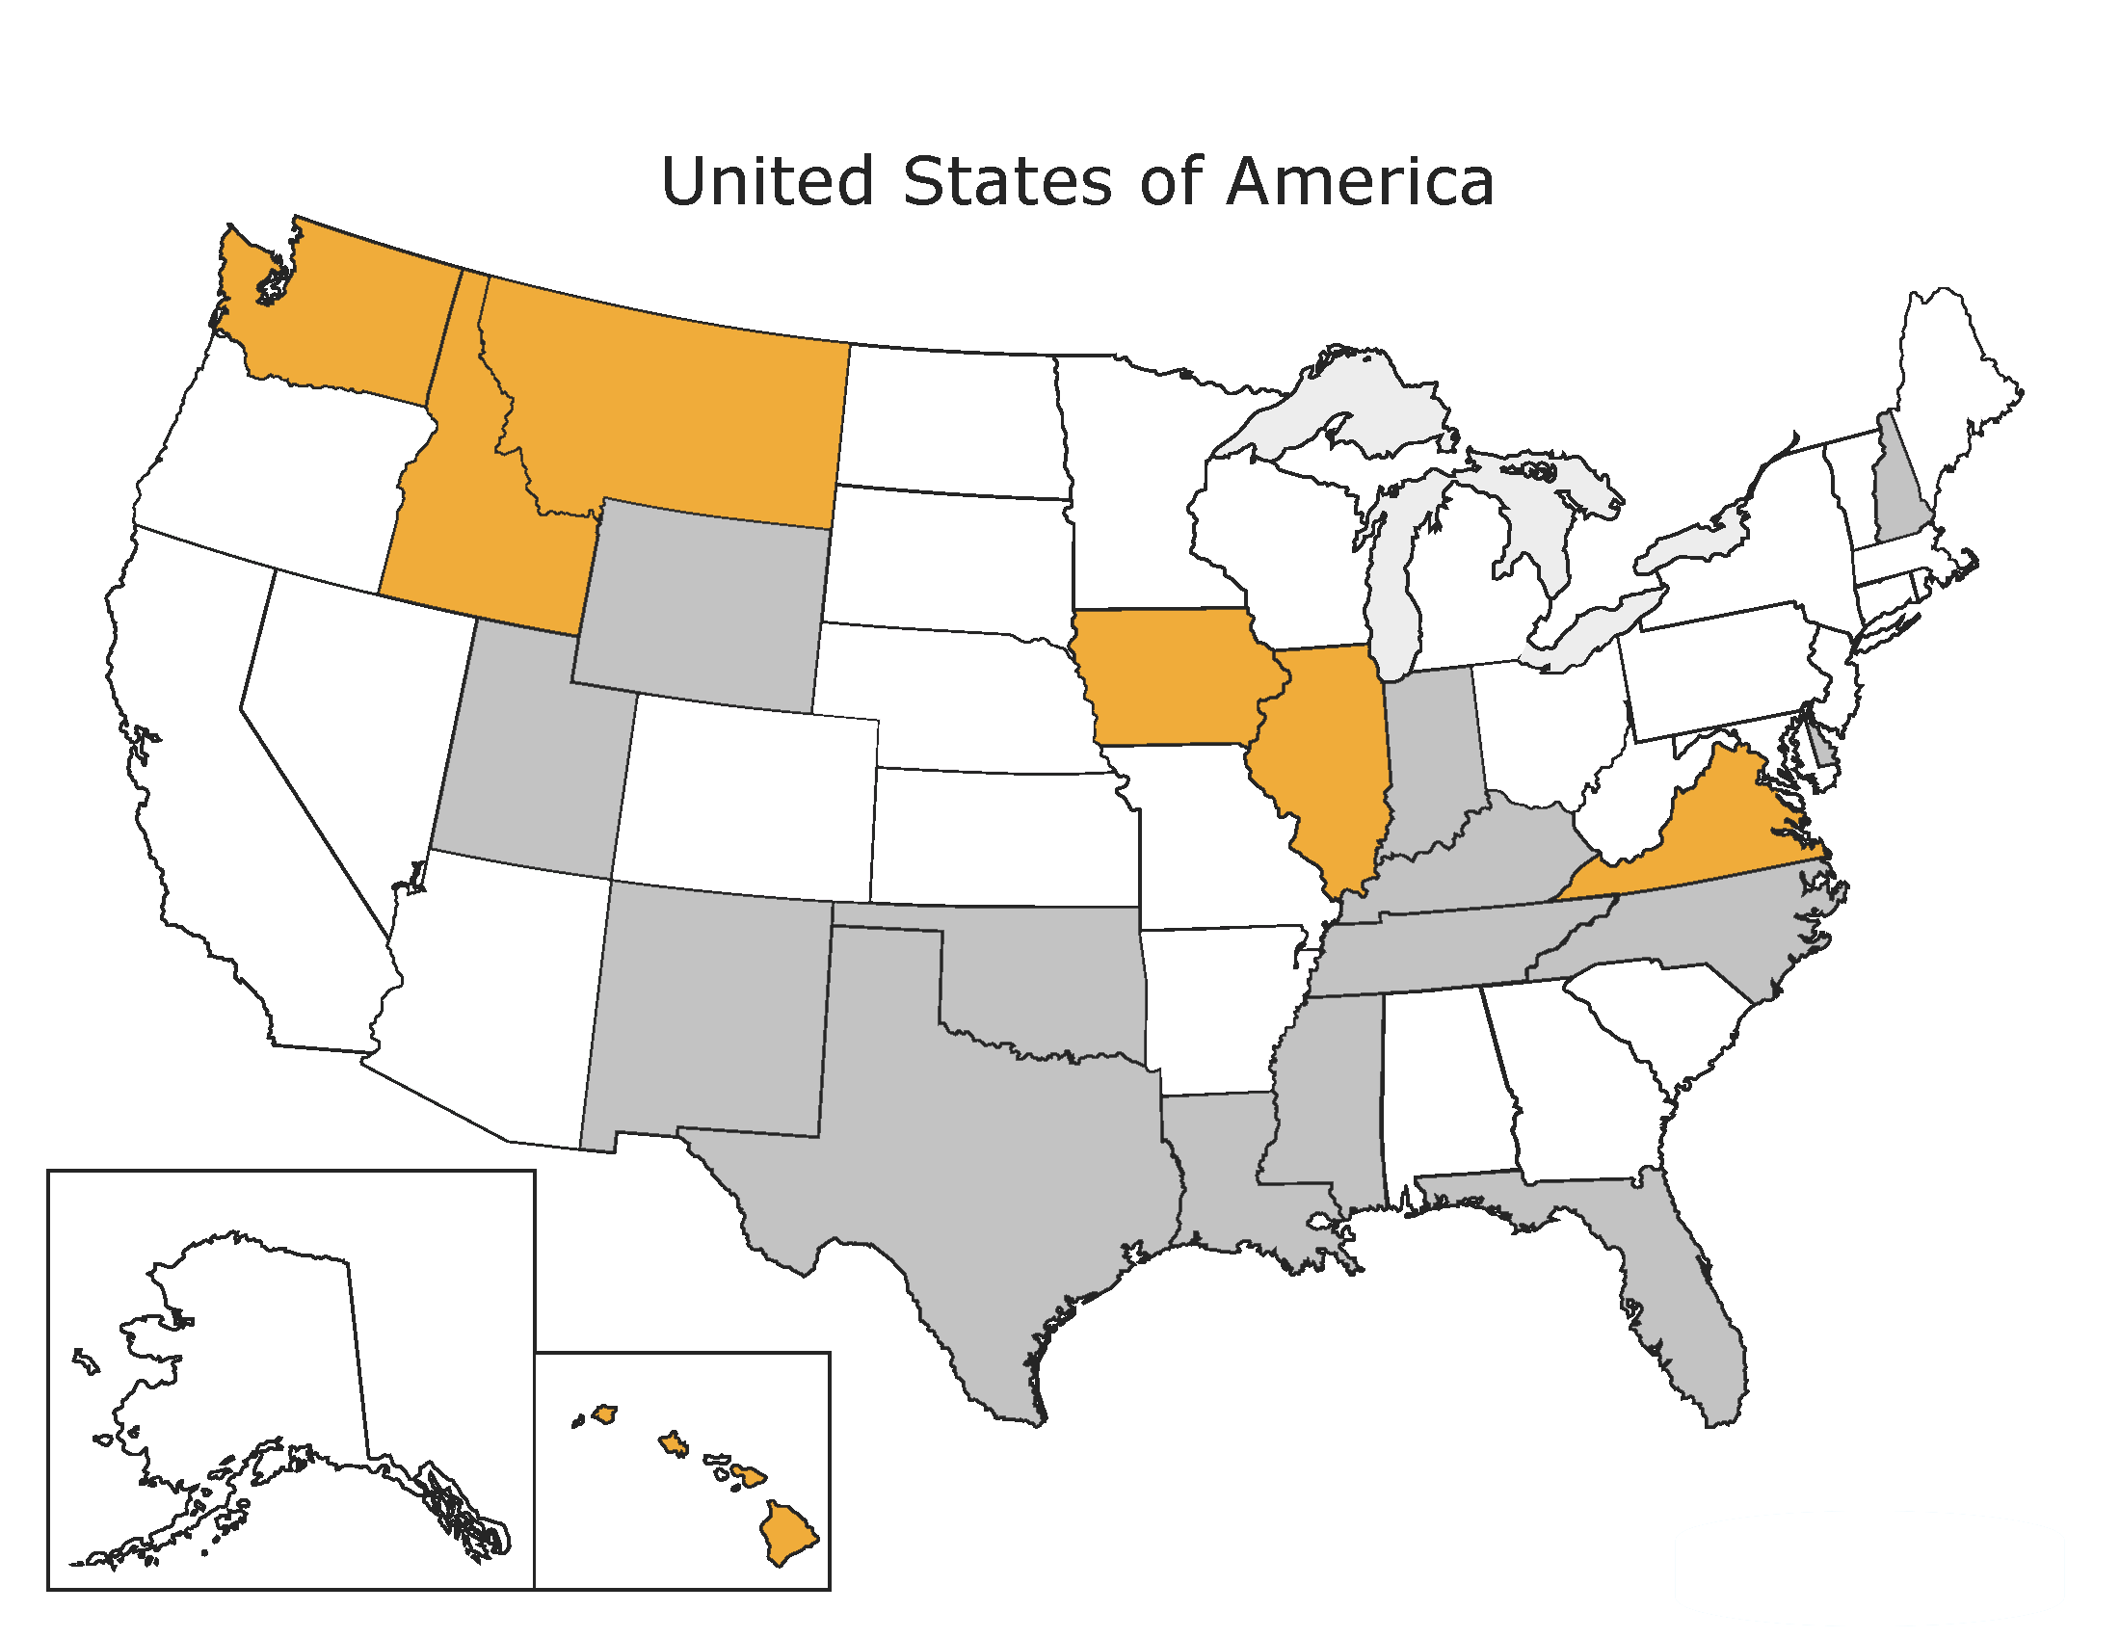
Sheltered Workshop

Slide 36
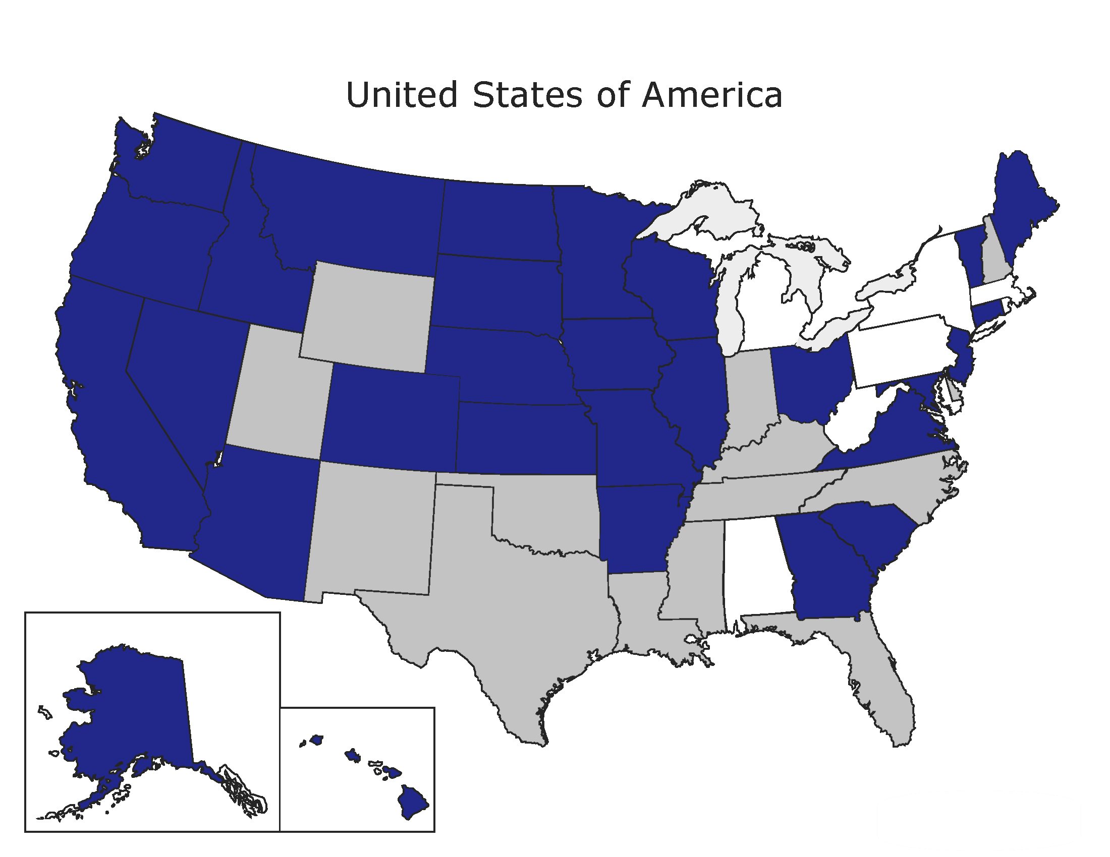
Social Workers

Slide 37
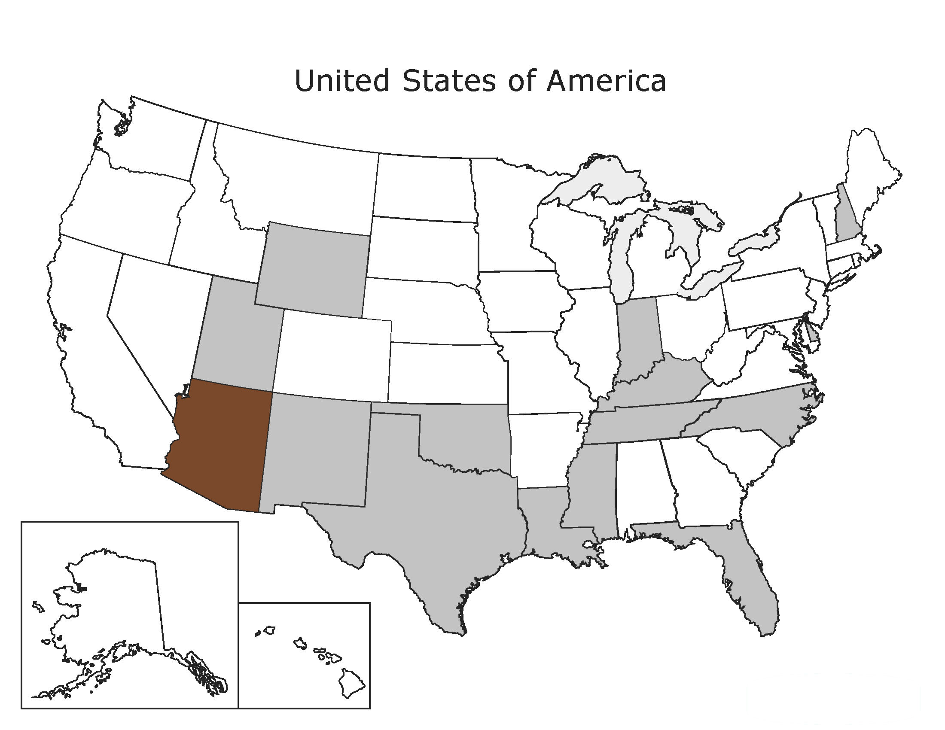
Trustee

Slide 38
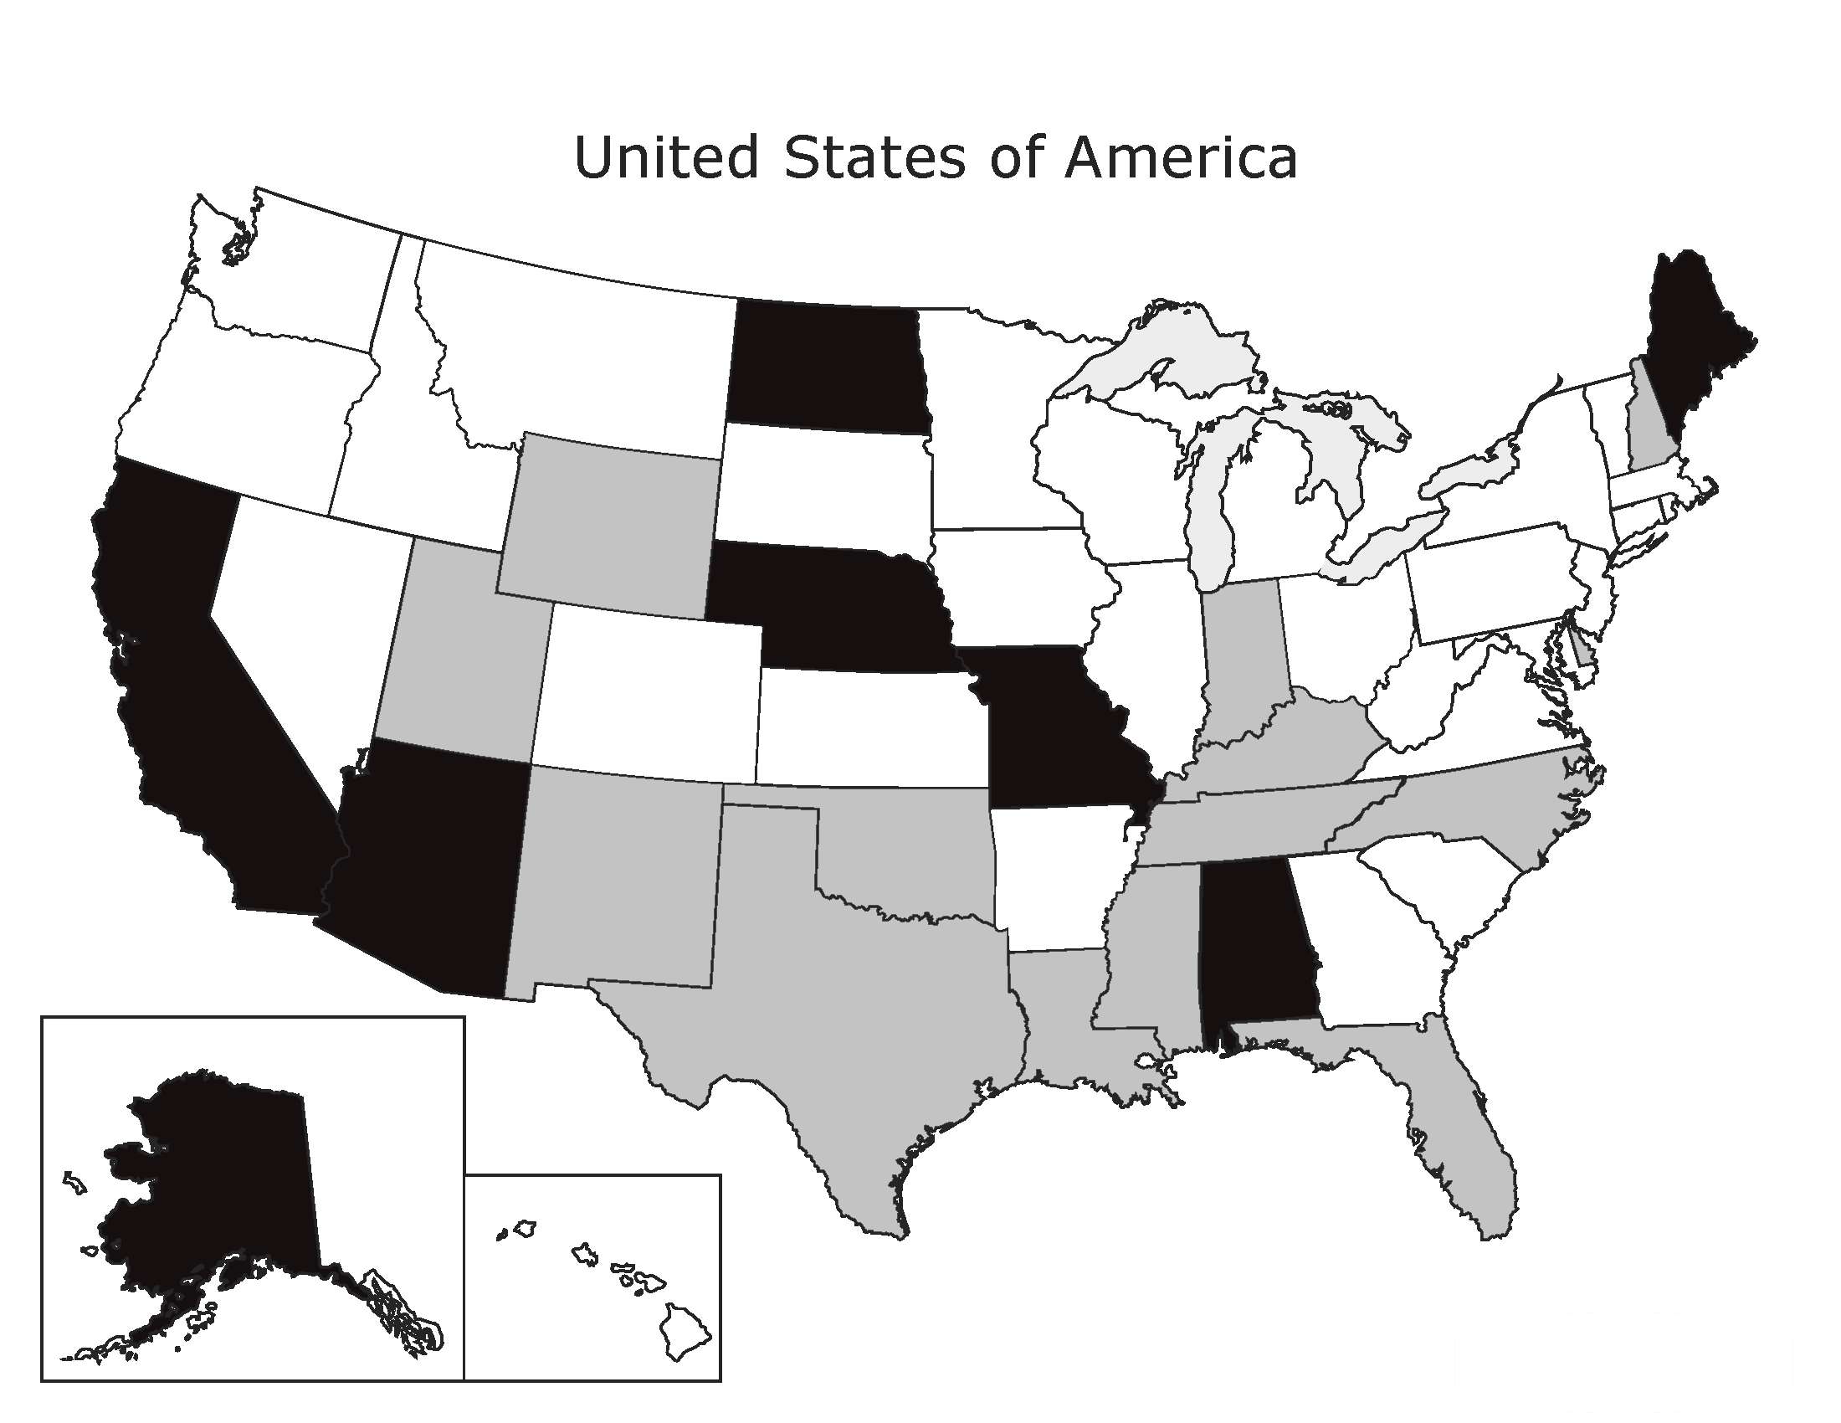
Unpaid Caregivers

