Slide 1
OFFICE OF OMBUDSMAN FOR LONG-TERM CARE
2020 Title VI Cluster Training:
OAA Title III and VI Panel
Enhancing the quality of life and the quality of services for consumers of long-term care through advocacy, education and empowerment

Slide 2
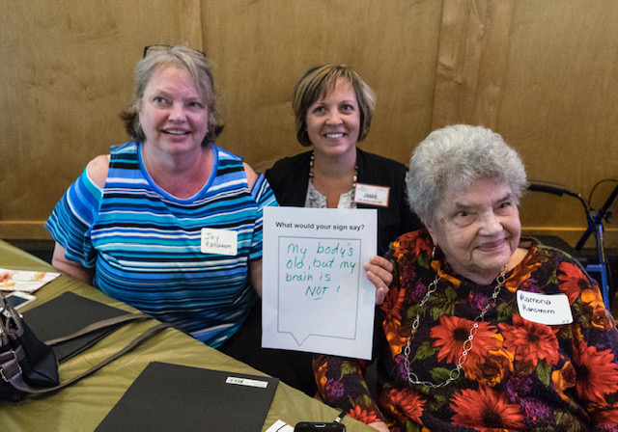
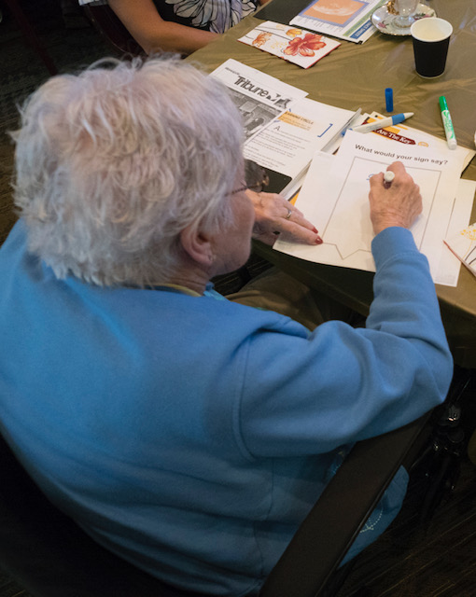
{Hidden}

Slide 3
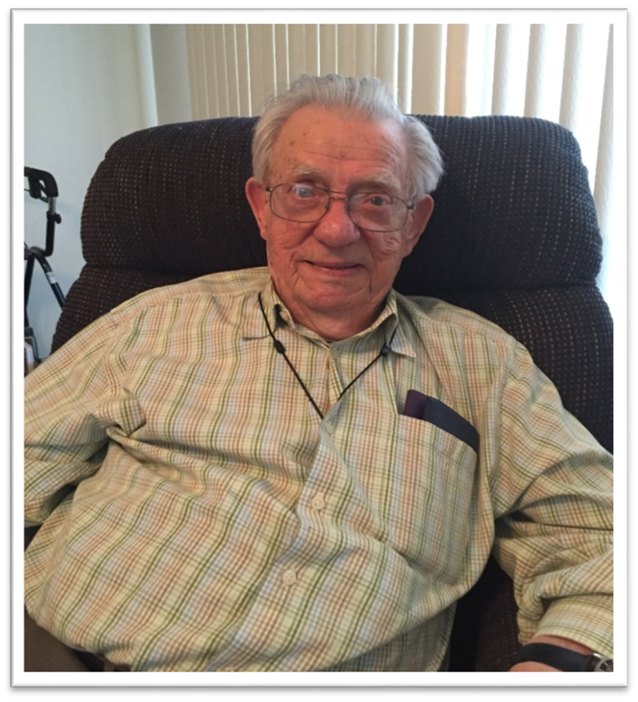
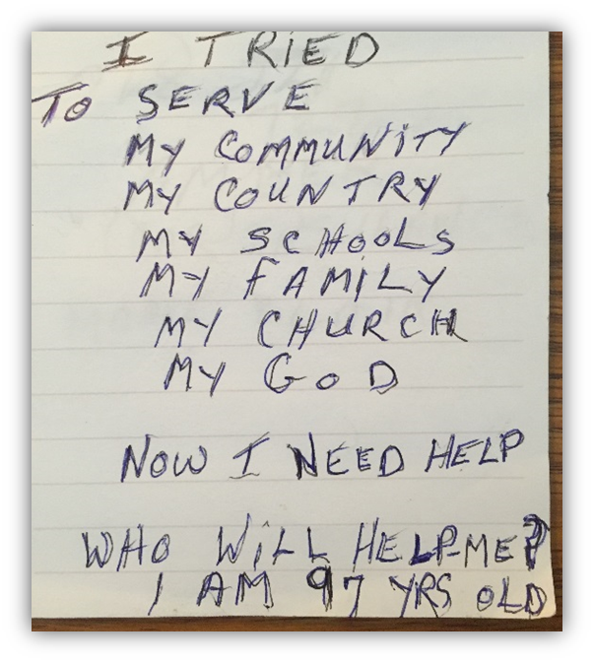
{Hidden}

Slide 4

How We Work
The Client
Person-centered approach
Assure confidentiality to client
Investigate to identify resolutions
Obtain informed consent
Focus on resolution based on client goals
With client permission, collaborate with APS, case manager, provider
Provide information about rights and options, and referrals

Slide 5
What Ombudsmen for Long-Term Care Do
Identify, investigate, and resolve resident complaints
Provide information and consultation to residents and their families as part of cases and also support resident councils and family councils
Advocate for systemic change within long-term care facilities
Inform about the problems of residents by evaluating and reporting on regulations, laws, polices, and actions that may adversely affect people who receive long-term care services

Slide 6
National and State Issues
Reauthorization of the Older Americans Act
Policy Priorities: Proper Staffing levels, Background Studies, Arbitration agreements, Admission/Transfer/Discharge ( Nationally the most common complaint ombudsmen receive).
MN Ombudsman Complaint reporting result for FFY19:
  Residents as complainants highest ever as a total percent (47%) trend up
  Admission/transfer /discharge ,10% increase over last year highest ever year over year increase. Across all settings
  Shortage of staff
  Staff turnover over-use of nursing pools
  Staff unresponsive/unavailable complaints up

Slide 7
Collaboration
Legislative Success: Ombudsman Office critical partner in passing the Elder Care and Vulnerable Adult Protection Act.
Assisted Living Rule-Making Process: Involved in stakeholder meetings
  As of August 1, 2021: ▪ Housing and services of an assisted living facilities will be incorporated under a single license. ▪ Two categories of licensure: the assisted living facility license and the assisted living facility with dementia care license. Serve on Rules Advisory Committee that recommends how the new Assisted Living Licensure laws will be regulated.
Elder Sexual Abuse Video Training
Self-Empowerment Project

Slide 8
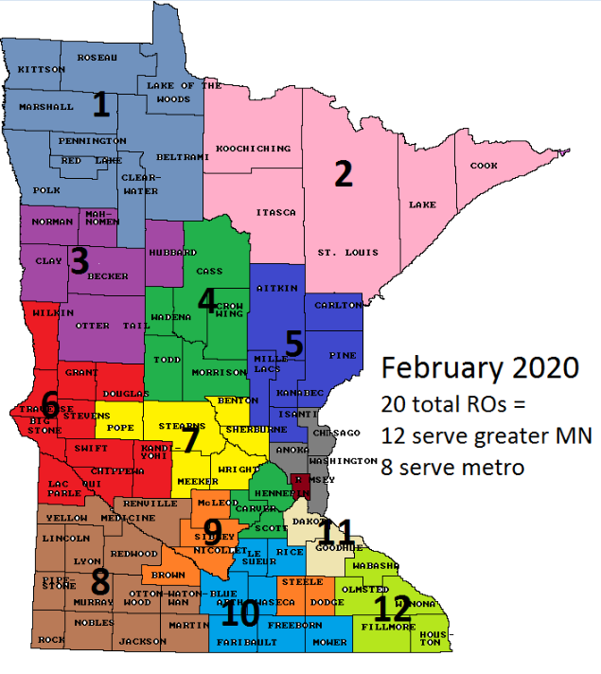
January 2020
1 RO per 6300 resident beds

Slide 9
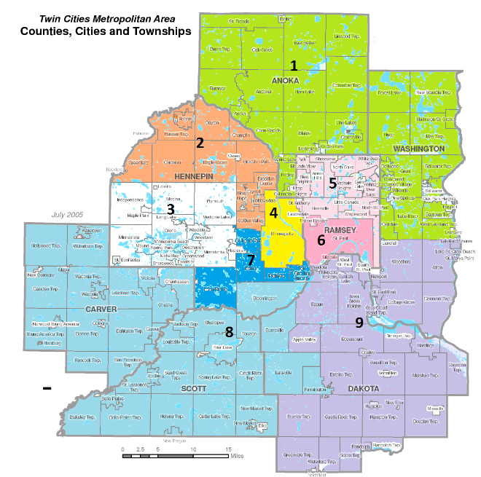
Metro Map
2020

Slide 10
Contact SLTCO
            Cheryl Hennen
            Direct phone: 651-431-2553
            E-mail: cheryl.Hennen@state.mn.us

