Slide 1
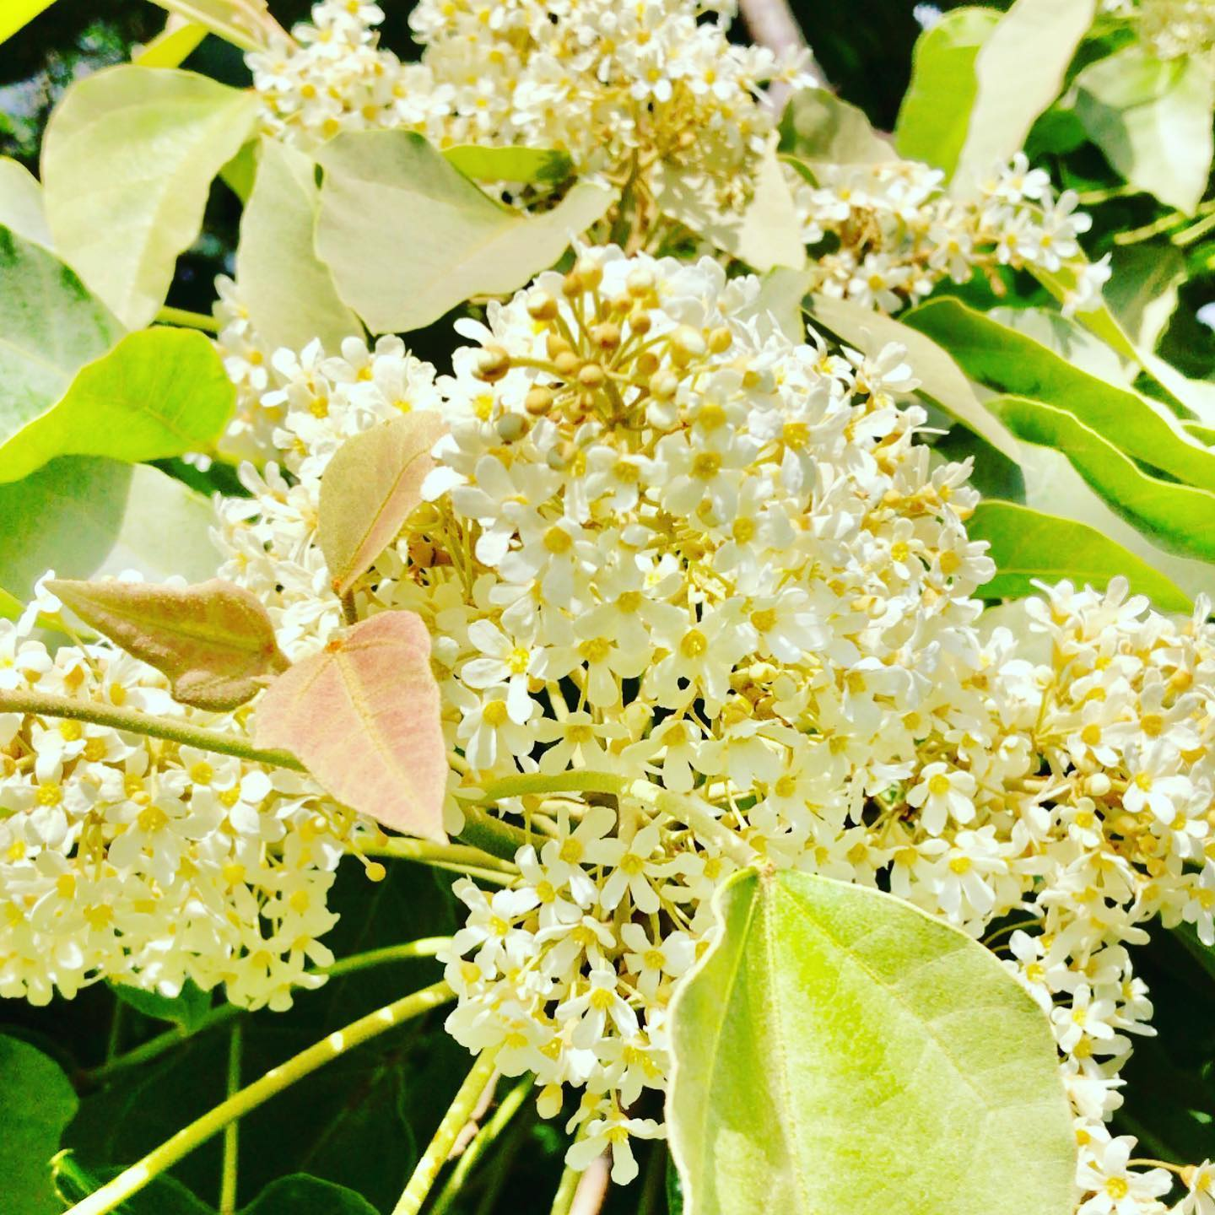
Collecting and Using Qualitative Data in Needs Assessment Hā Kūpuna National Resource Center for Native Hawaiian Elders Thompson School of Social Work & Public Health, UH Manoa Title VI Conference April 19, 2022

Slide 2
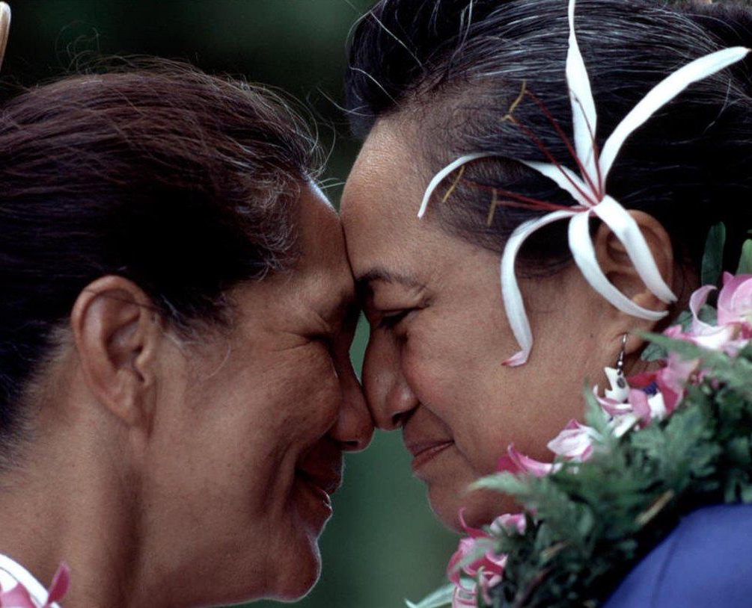
Agenda
Overview of Hā Kūpuna
Interview data
Resource
Example
Focus group data
Resource
Example

Slide 3
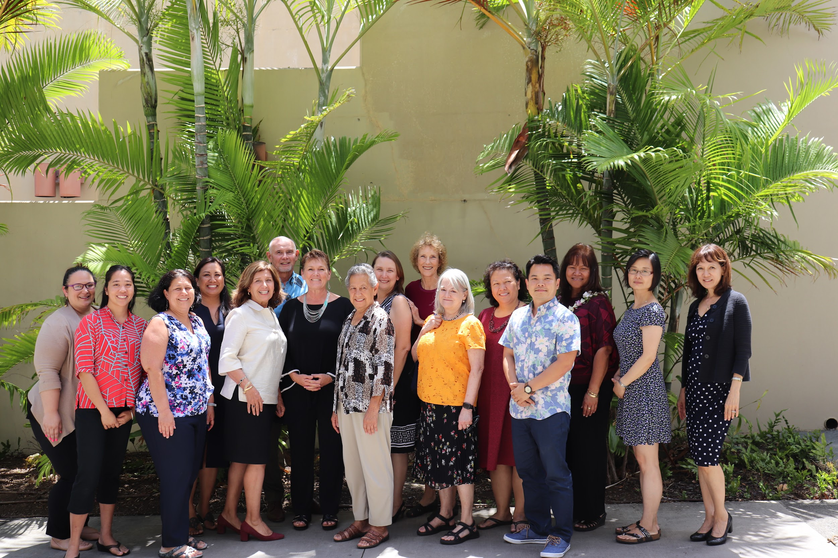
Our Name – Hā Kūpuna
Hā: breath; life
Hā Kūpuna: to pass on knowledge, wisdom, mana from elder to next generation through one’s breath
Mission: to extend quality and quantity of life for kūpuna so they can pass on their knowledge, wisdom, and mana (spiritual gifts and power) to future generations.
Notes:
Kathryn Braun

Slide 4
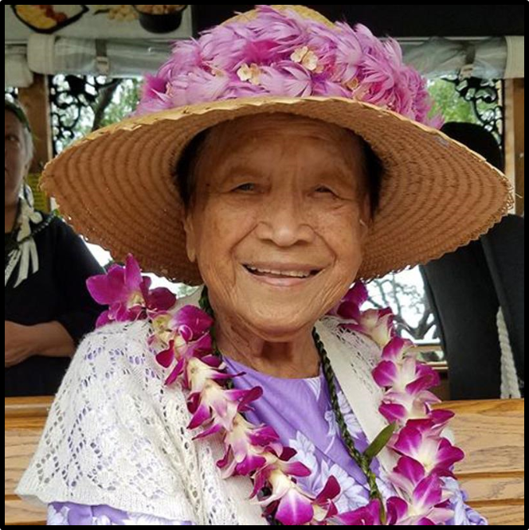
Interview Guide
Hawaiian history and past experiences with research.
Achievements of Native Hawaiian (and other) researchers working in concert with community
Researcher self-reflection
Roles for kūpuna and other community members in research
Tips for working together to:
Develop a research question
Gather, transcribe, and code data
Report data in community-friendly ways.

Slide 5
Healthcare Experiences
20 elders
Mostly female, ave age = 75
4 Hawaiian communities
3 interviews each
Get to know you
Values learned that should be passed on
Healthcare experiences
Themes
Childhood experiences with healthcare
Positive and negative healthcare experiences
Experiences with social services
Caregiving and long-term care
Advice for providers

Slide 6
{Hidden}
“If any of us got sick, we had the lā‘au, no other medicine. [M]y grandfather was the one that was a kahuna [expert]… He had all the plants; the lā‘au that he needed if anybody got sick. [T]hey were raised in Waikapu in Waihe‘e where they had the mountains, with everything that they needed, with the lā‘au and the water that came down in their area in their village, so they were raised the same way with using what they had around.”
“You learn and treat the whole person, not just a symptom. And you got to understand where the genesis of that system comes from and treat that instead of just giving a drug to numb… you got to treat the root of it. And they don't … teach that much in medical schools.”
“I think I would like to see Hawaiian medicine, along with regular American medicine. I think that would really help in introducing Hawaiian medicine. Because it works… I've seen it work.”

Slide 7
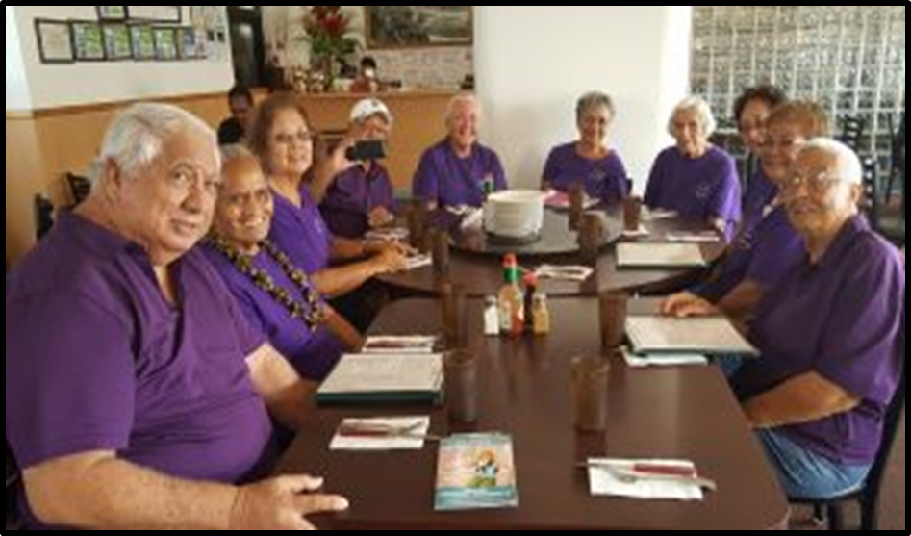
Focus Group Guide
Organizing focus groups
Preparing for a focus group
Conducting a focus group
Recording the data
Analyzing and reporting the data
Forms
Recruitment script
Focus group script
Background data sheet
Data summary sheet

Slide 8
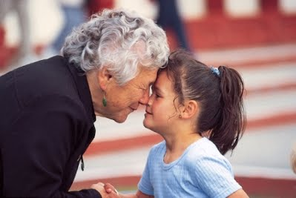
Children living with grandparents with dementia
25 youth
4 focus groups on Homestead lands
2 with youth age 8-11 years
2 with youth age 12-15 years
Themes
Comic book format; story
Memory aid
Adults and peers as messengers
Need for child-appropriate resources
Games

Slide 9
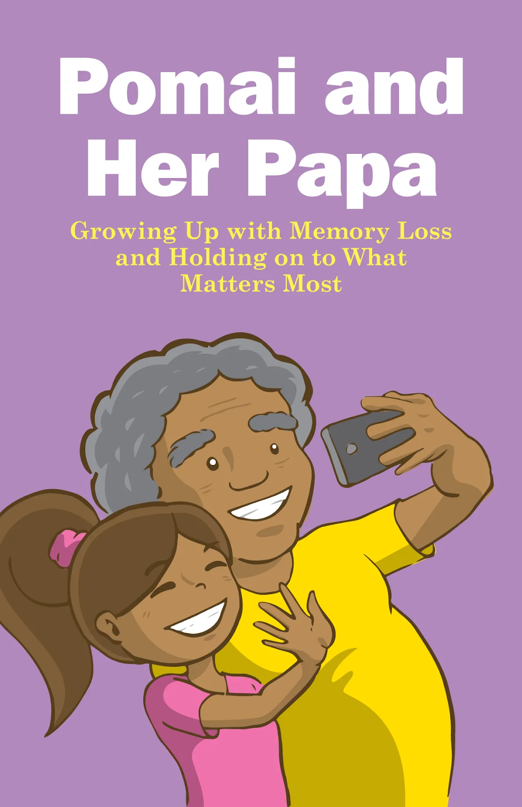
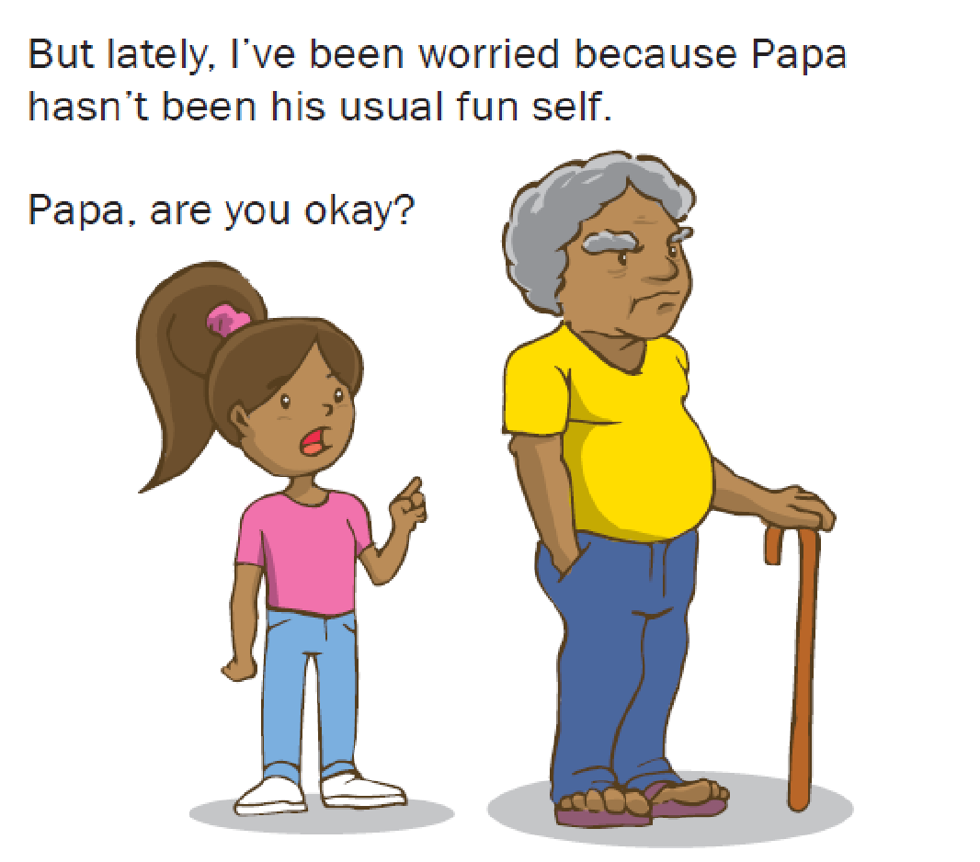
A Storybook on Dementia in Hawaiian Families
She remembers the fun time.
But lately, she notices changes in his memory & behavior.
Notes:
-lots of copies of soft cover

Slide 10
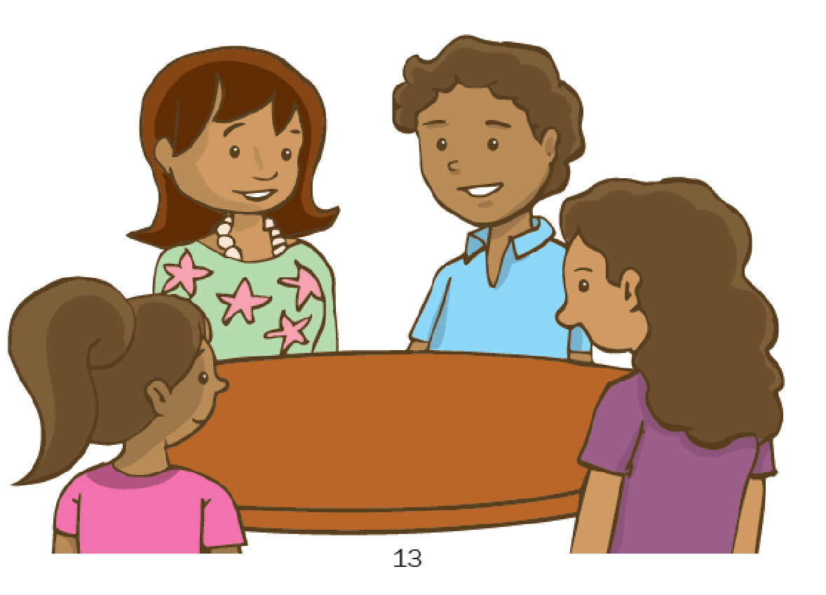
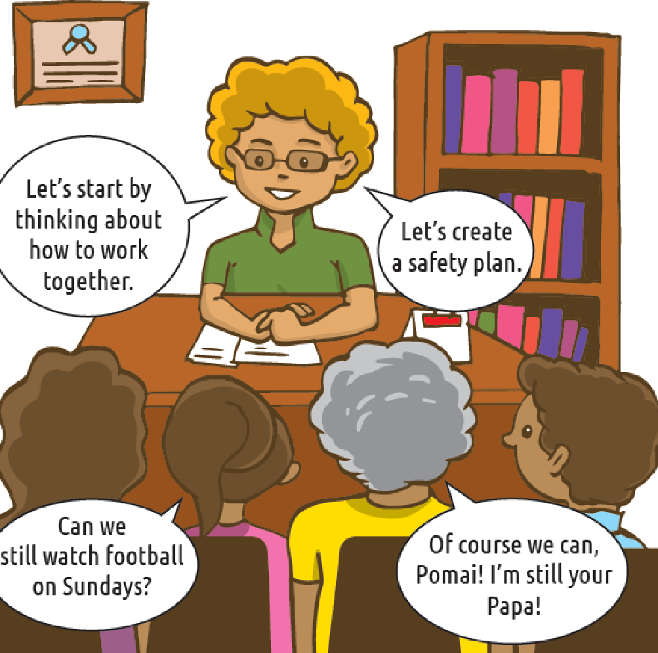
{Hidden}
Her teacher asks “what’s wrong.”
The family meets with the school counselor.
They take papa to the doctor
They meet with a social worker who links them to resources and helps them develop a safety plan.

Slide 11
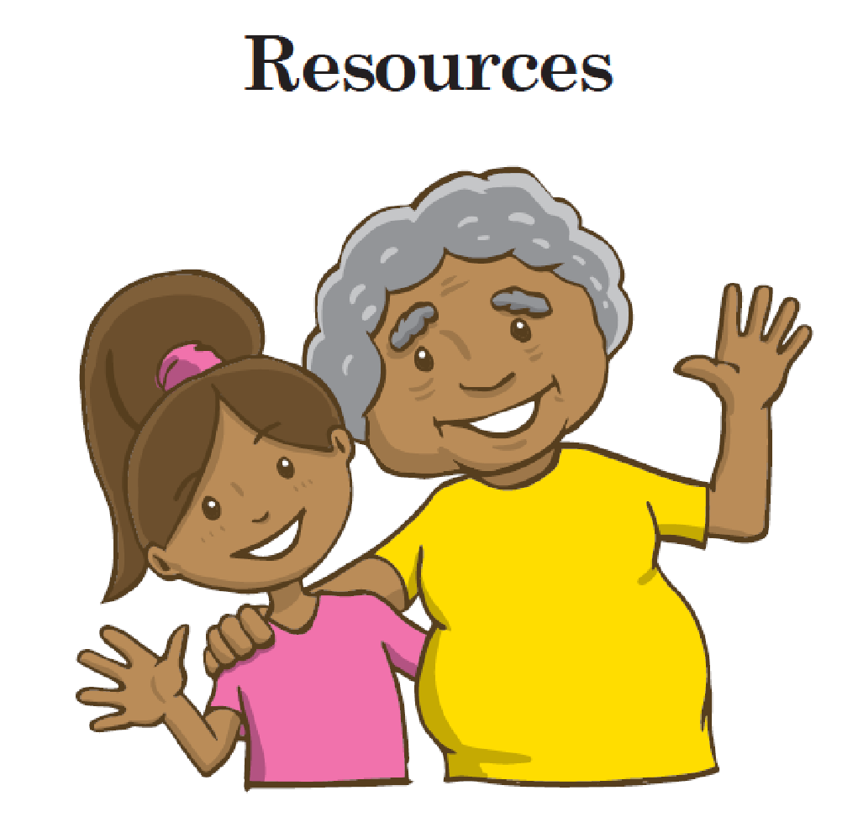
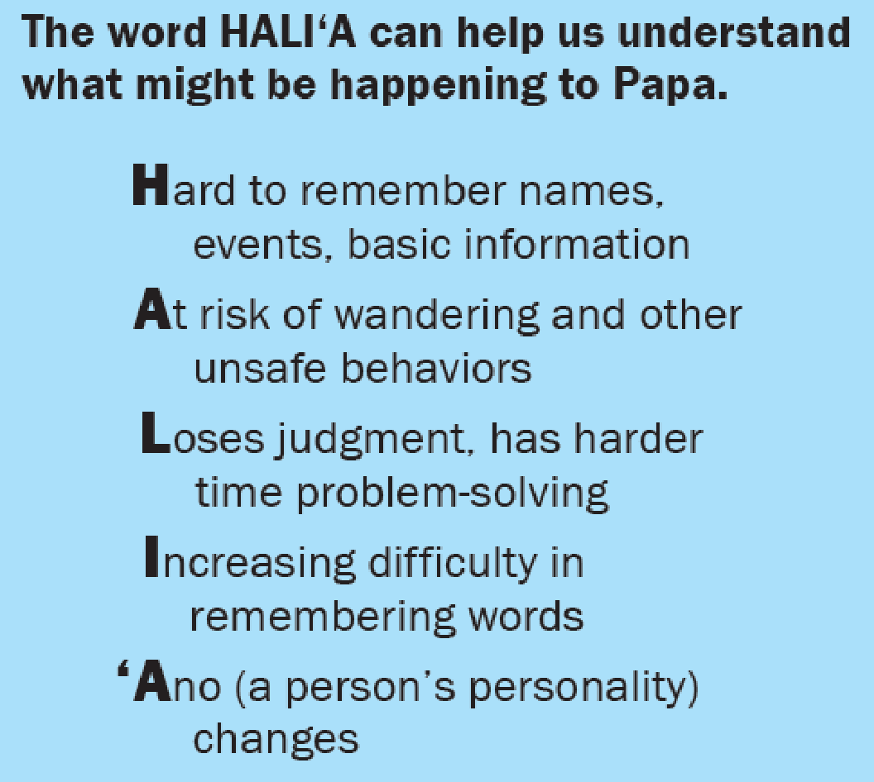
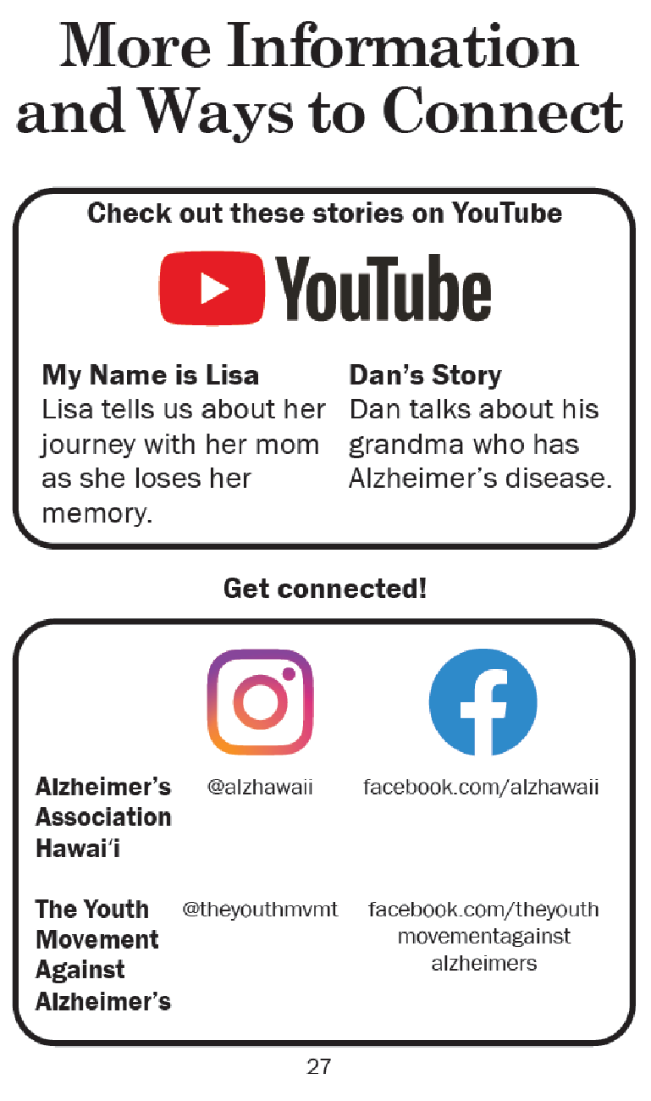
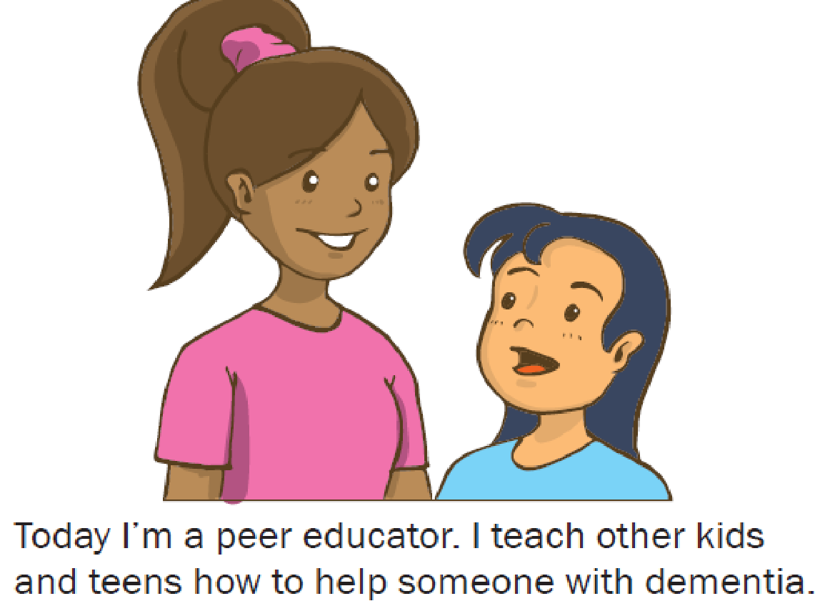
{Hidden}
They get resources.
Pomai becomes a peer educator in high school.
Hardcover books at every public and school library
Free to download at https://manoa.hawaii.edu/hakupuna/pomai-and-her-papa/

Slide 12
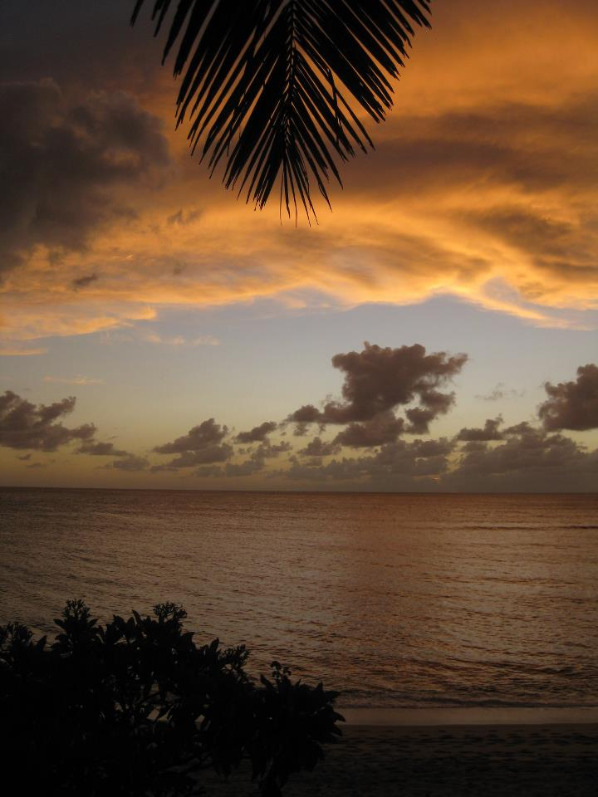
Mahalo, a hui hou! manoa.hawaii.edu/hakupuna kbraun@Hawaii.edu
Now
Pomai and her Papa
Factsheets summarizing our research findings
Soon
Interviewing Guide
Focus Group Guide
Hawaiian words and sayings related to aging and elderhood
ʻEhu ahiahi. Evening twilight. Old age. (Pukui, 1983, p. 36, #295)

