Slide 1
Training & Technical Assistance Conference
2022 NATIONAL TITLE VI
April 18-21, 2022

Slide 2
Dementia Friends
Jolie Crowder, PhD, MSN, RN, CCM Senior Project Director, International Association for Indigenous Aging
Casey Acklin, BA
Coordinator; DEER Program School of Public Health; University of Reno, Nevada
April 20, 2022

Slide 3
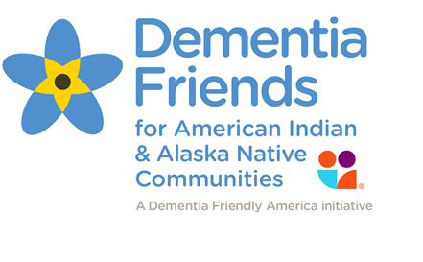
Welcome!
Let’s get ready…
Top of screen click + sign to join so we see you.
STOP and click to take this pre-session questionnaire:
https://www.surveymonkey.com/r/TitleVIPreDF
Chat your name, tribe, location.
Notes:
JOLIE
Thank you for joining us today:
Click + sign at top of session screen.
STOP and this pre-session questionnaire to help us evaluate the content, see if it makes a difference… at the end we will ask you to do the same it’s been very helpful in making changes and improvements:
https://www.surveymonkey.com/r/TitleVIPreDF We will pause for a few minutes to let folks take do this.
When you come back, please put your name, tribe, and location in the chat. Just to get us warmed up, let us know who is here.. We will be using the chat a LOT today so want to make sure folks know where it is!

Slide 4
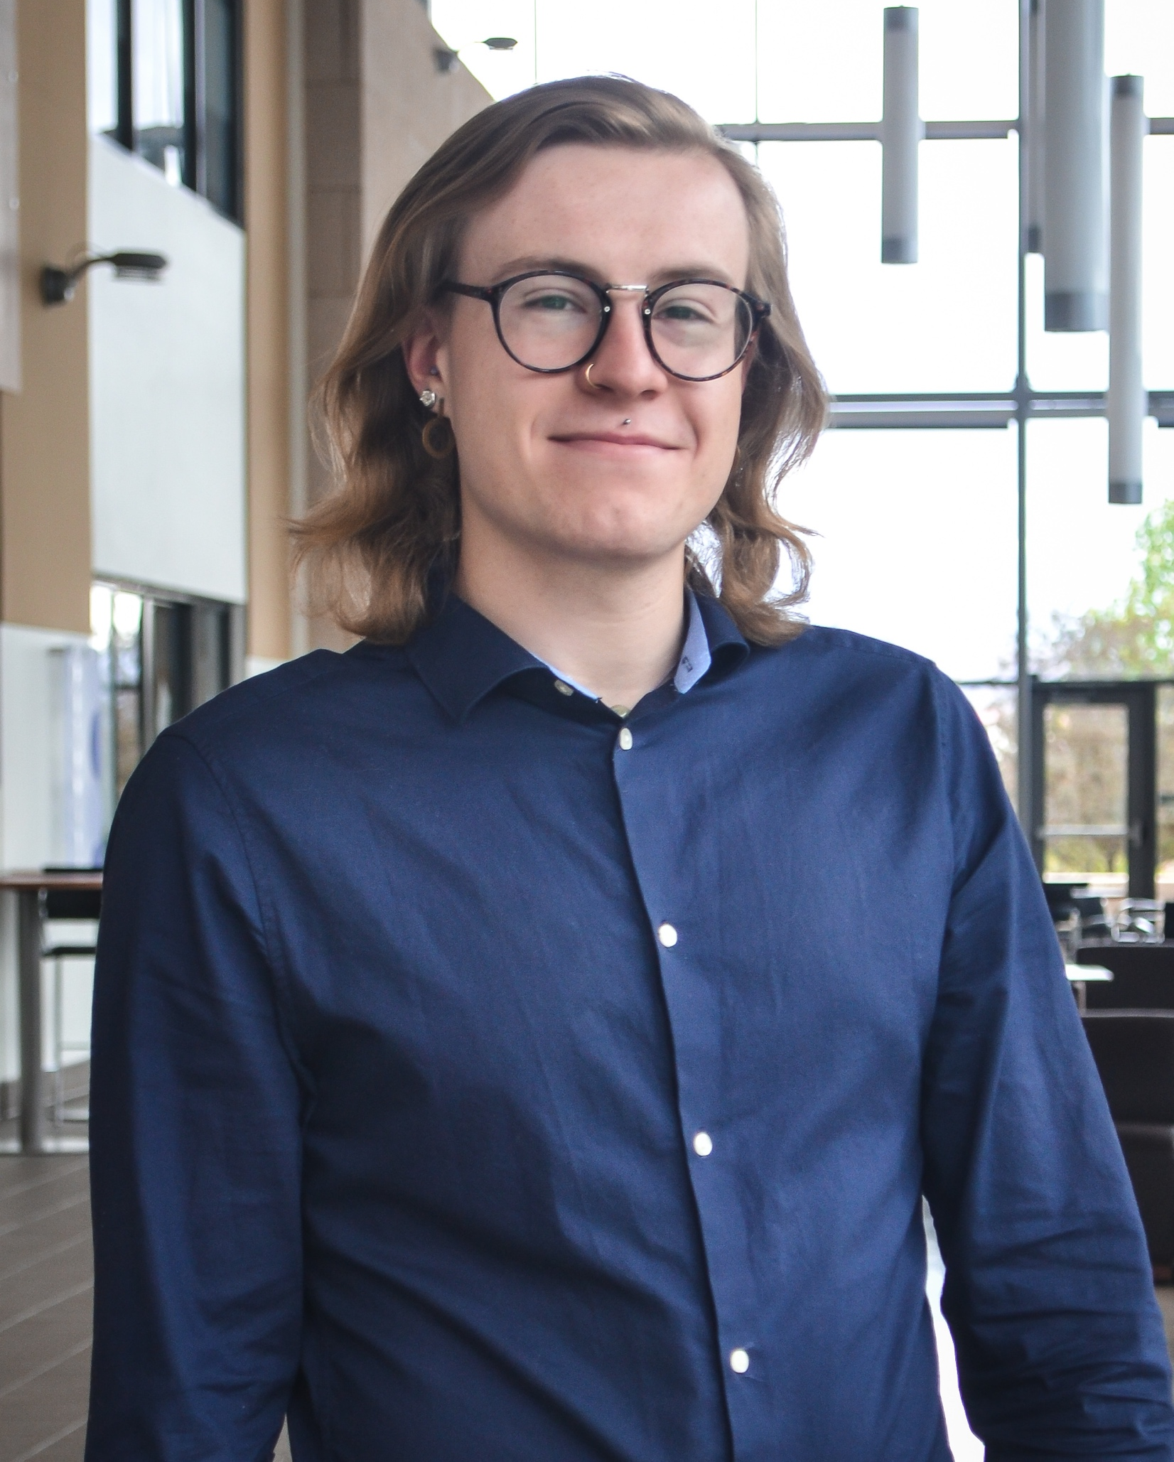
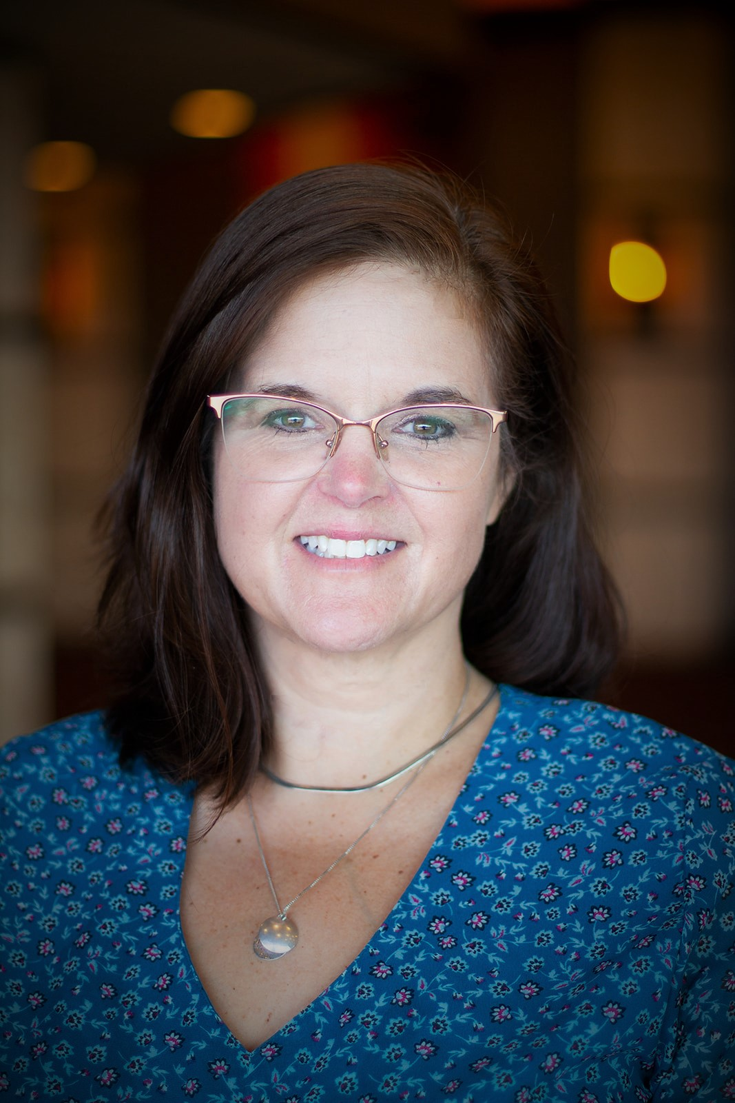
Presenters
Casey Acklin
Jolie Crowder
cacklin@unr.edu
jolie@iasquared.org
This project is supported by the Centers for Disease Control and Prevention (CDC) of the U.S. Department of Health and Human Services (HHS) as part of a financial assistance award totaling $348,711 with 75 percent funded by CDC/HHS. The contents are those of the author(s) and do not necessarily represent the official views of, nor an endorsement, by CDC/HHS, or the U.S. Government.
Notes:
Jolie

Slide 5
Welcome!
Let’s go…
This is a two-part session>> please come back for Part 2!
Attend both Part 1 and Part 2 today get a Dementia Friends Certificate of Participation.
Open the session workbook for notes and exercises.
Engage/chat for group discussions, polls, exercises.
Notes:
JOLIE
This is a two-part session;
Participants who attend both Part 1 and Part 2 will get a Dementia Friends Certificate of Participation
Open the session workbook to take notes and follow along.
Be prepared to engage/chat and work on exercises.

Slide 6
What to Expect From This Session
As a Dementia Friend you will be able to:
Describe dementia, most common types, and risks
Understand six key messages about dementia
Know how to effectively communicate with someone living with dementia
Pick an action you can take as part of becoming a Dementia Friend today
Notes:
CASEY

Slide 7
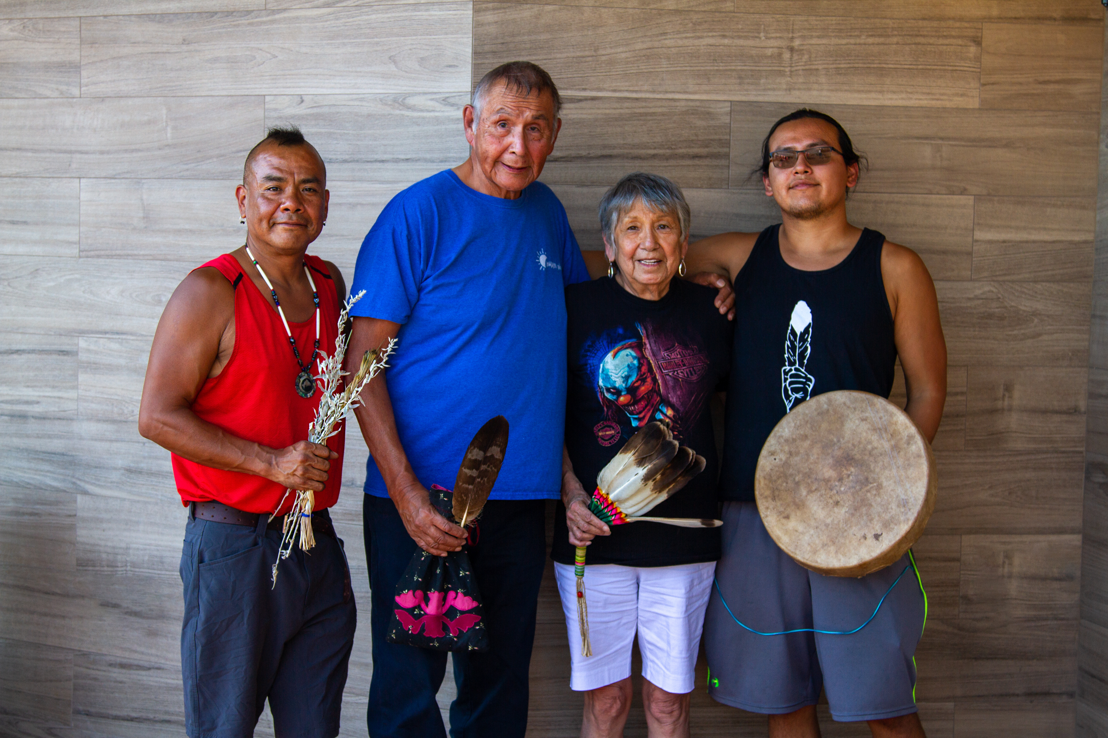
What is Dementia Friends?
Dementia Friends is a global movement that is changing the way people think, act, and talk about dementia.
…each of us can make a difference for people touched by dementia.
Notes:
CASEY

Slide 8
What words come to mind when you hear “dementia?”
Notes:
CASEY

Slide 9
Positive words
Notes:
CASEY

Slide 10
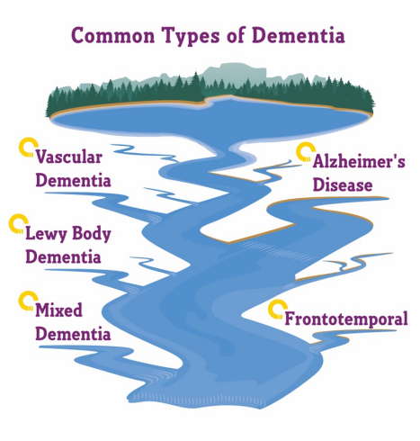
Dementia: What You Should Know
Not a specific disease
Overall term
Many symptoms
Loss of memory or other thinking skills
Severe changes affect ability to do everyday activities
Alzheimer’s disease is thought to be most common type
Notes:
CASEY

Slide 11
Dementia: What You Should Know
Risk factors:
High blood pressure
Brain injuries
Diabetes
Hearing loss
Obesity
& More

Slide 12
Dementia: What You Should Know
~ 1 in 9 people 65+ in the U.S. will develop dementia
~ 3 in 9 American Indian and Alaska Native people 65+ will develop dementia
~ 1 in 6 American Indian and Alaska Native people 45+ report memory problems getting worse
Notes:
JOLIE
f we look at the information in the yellow box on Page 3 of your Session Workbook or on the slide, we can see that the prevalence of dementia is greater among American Indian and Alaska Native people. 3 times that of the general US population in fact.
This next section describes why this is the case and highlights a number of steps we can take to reduce risk of developing dementia. We will review this section together as you follow along in your workbooks

Slide 13
Can We Reduce the Risk of Dementia? Page 3
Yes!
Native people and communities are resilient and have many strengths
sense of community
support
hope
cultural and spiritual practices
ethnic pride
Notes:
JOLIE
So, the big question: Can We Reduce the Risk of Dementia?
Yes! Native people and communities have many strengths and great resiliency drawn from their cultures and traditional ways of life, for example: a strong sense of community and support, hope, coping skills, traditional cultural and spiritual practices, and pride.

Slide 14
Can We Reduce the Risk of Dementia?
American Indian and Alaska Native cultures and traditions have been disrupted by policies resulting in:
Loss of land
Forced assimilation
Relocation
Tribal termination
Historical trauma
Contributing to more chronic disease and other risk factors for memory problems.
Notes:
JOLIE
However, it is important that we recognize that Native people's cultures and traditions have been severely disrupted by discriminatory policies resulting in loss of land, forced assimilation, relocation, tribal termination, and historical trauma. These in turn have contributed to higher rates of chronic disease and other risk factors for developing memory problems. Some of these risk factors include high blood pressure, diabetes, obesity, and commercial tobacco use, just to name a few.
So, let’s look at activities that can help us reduce risk.

Slide 15
Promote Resilience, Re-build Connections & Reduce Risk
Health Promotion: traditional physical activity (dance and drum), preparing and harvest traditional foods and medicine
Cultural Practices: increase knowledge and share oral tribal history and cultural practices, learn and teach language
Social and Emotional Well-being: sense of connection to culture, beading, artwork, practicing song, intergenerational events
Notes:
JOLIE
Some activities that promote resilience, re-build connections to our communities and cultures, and that can also reduce the risk for dementia include:
• Health Promotion activities like increasing traditional physical activity through things like dance and drumming, preparing and harvesting traditional foods and medicines
• Increasing knowledge and sharing of tribal history and cultural practices or learning the tribal language and oral histories
• Things that increase social and Emotional Well-being also reduce our risk for dementia... things like increasing our community connections to people and culture through beading, artwork, practicing song, or creating intergenerational interactions are just a few ideas

Slide 16
Do YOU practice any of these strategies for your own health & wellness?
Notes:
JOLIE
It is time to use our Chat feature again!
Are any of you currently practicing any of these strategies? For yourself or in your community? Can you share a little about your experience in the chat box? What works well for you? For your elders?
Allow participants to share for about 3 minutes, and reinforce the take-away that traditional cultural practices can effectively help support brain health and reduce risk of dementia.
In addition to reducing risk, these same strategies can help people living with dementia to live well, We can each play a role in helping them stay connected to these types of opportunities. Let them know that hope doesn’t end with a dementia diagnosis.

Slide 17
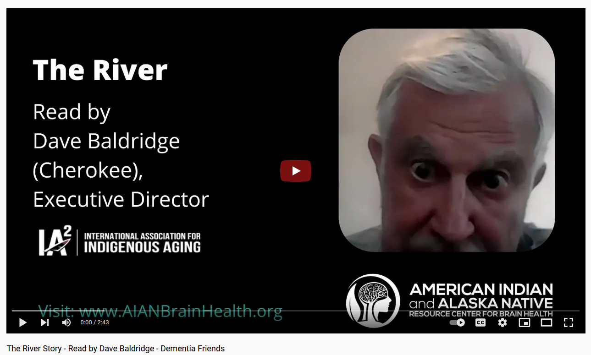
The River – Page 4
Notes:
CASEY

Slide 18
Dementia is caused by diseases or injuries of the brain. The left is a healthy brain. The right is a brain of a person living with advanced Alzheimer’s disease. When the cells of the brain are damaged, they cannot function effectively.

Slide 19
Early Signs of Dementia Vs. Normal Aging
Normal Aging | 10 Early Signs and Symptoms
Sometimes forgetting names or appointments but remembering them later | Memory loss that disrupts daily life
Making occasional errors when balancing a checkbook | Challenges in planning or solving problems
Needing occasional help to use a microwave or record a TV show | Difficulty with familiar tasks at home or at work
Forgetting the day of the week but being able to recall it later | Confusion with time or place
Vision changes related to cataracts | Trouble understanding visual information
Sometimes having trouble finding the right word | Confusion with understanding and communicating thoughts verbally
Losing things from time to time and retracing steps to find them | Misplacing things and losing the ability to retrace steps to find them
Making a bad decision once in a while | Experiencing more slips in judgment or acting impulsively
Sometimes feeling weary of work, family, and social obligations | Withdrawing from work or social activities
Developing very specific ways of doing things and preferring routines | Changes in mood and personality
Notes:
CASEY
The tenth sign is changes in mood and personality.
Emotional ups and downs are something we all experience. For people living with dementia, the ups are often higher, the downs can be lower, and they tend to happen in quicker succession.
People living with dementia can become confused, suspicious, depressed, fearful, or anxious just moments after being lucid, trusting, elated, confident, or relaxed.
These fluctuations can occur with higher frequency in situations that feel outside the comfort zone of a person living with dementia.
BREAK on next slide! UNLESS WE ARE RUNNING AHEAD THEN KEEP ROLLING

Slide 20
15-minute break

Slide 21
POLL TIME! Broken Sentences Exercise in Workbook – 6 Key Messages
Notes:
Now that we have learned a little bit about dementia, let’s focus on putting together the six key messages of today’s session.
JOLIE
Part 7 of 12 – Broken Sentences Worksheet and Six Key Messages
Now, turn to page 6 in your session workbook. We have another exercise called the Broken Sentences matching exercise.
This activity will help you learn the six key messages for a Dementia Friend. We will match the sentences in Column 1 to Column 2 by drawing from each sentence beginning to the matching sentence ending. You should end up with six sentences that make sense and become Dementia Friends’ “Six Key Messages about Dementia.”
FOR TODAY WE ARE GOING TO USE THE POLL FEATURE ONE AT A TIME FOR EACH QUESTION. SO, GET READY TO TAP AWAY ON YOUR KEYBOARD!

Slide 22
SIX Key Messages – Page 6
1. Dementia is caused by…
a)…more common as people get older, but it is not a normal part of healthy aging.
2. There are things you can do to…
b)…diseases of or injuries to the brain.
3. Dementia becomes…
c)…live well, especially with their community’s support.
4. Dementia is not…
d)…reduce the risk of developing dementia.
5. People living with dementia can
e)…just about having memory problems.
6. A person living with dementia is…
f)…a full being - worthy of respect - and is a vital part of their community.
Notes:
Here are the six statements on the left and the 6 answers on the right, but all jumbled up.

Slide 23
SIX Key Messages
1. Dementia is caused by…
a)…more common as people get older, but it is not a normal part of healthy aging.
2. There are things you can do to…
b)…diseases of or injuries to the brain.
3. Dementia becomes…
c)…live well, especially with their community’s support.
4. Dementia is not…
d)…reduce the risk of developing dementia.
5. People living with dementia can
e)…just about having memory problems.
6. A person living with dementia is…
f)…a full being - worthy of respect - and is a vital part of their community.
Notes:
JOLIE
F: …a full being—worthy of respect—and is a vital part of their community. This is our sixth key message.
In the same way that we would look at someone with diabetes or cancer and see them as a person first, people living with dementia are also people first.
To emphasize this, we can use terms like “person living with dementia” rather than “dementED person.” It’s important to remember that building inclusive, DEMENTIE CAPABLE communities isn’t just about making life better for people living with dementia;
it’s about creating more vibrant, diverse, supportive environments for everyone. People living with dementia have much to add to their communities,
BUT THEY MUST BE are offered the opportunity AND SUPPORT to do so.
We’ll return to these six key message later. For now, let’s JUMP into one aspect of daily life that is often taken for granted: planning.
Casey is going to jump in to our next interactive exercise and this one is a real eye-opener.

Slide 24
Everyday Tasks – Page 7
Develop a step-by-step instruction list to…
check out at the grocery store
Make sure someone following your list could complete the task as if they had never done it before in their life.
Notes:
CASEY
Breana, is going to help out with Jolie pitching in.

Slide 25
Take 1 minute to write down all the steps AFTER you have put your groceries up until you walk away to leave
Notes:
CASEY
Breana, you will jot down a list and then share it with us

Slide 26
Write in the chat the number of steps you wrote down to check out
Notes:
CASEY

Slide 27
Here’s what Breana found…
Watch for any steps we might have missed!
Notes:
CASEY
Switch to screen share, then type in Breana’s list. Ask people to add tasks from chat, Jolie fill in, Casey fill in, etc.

Slide 28
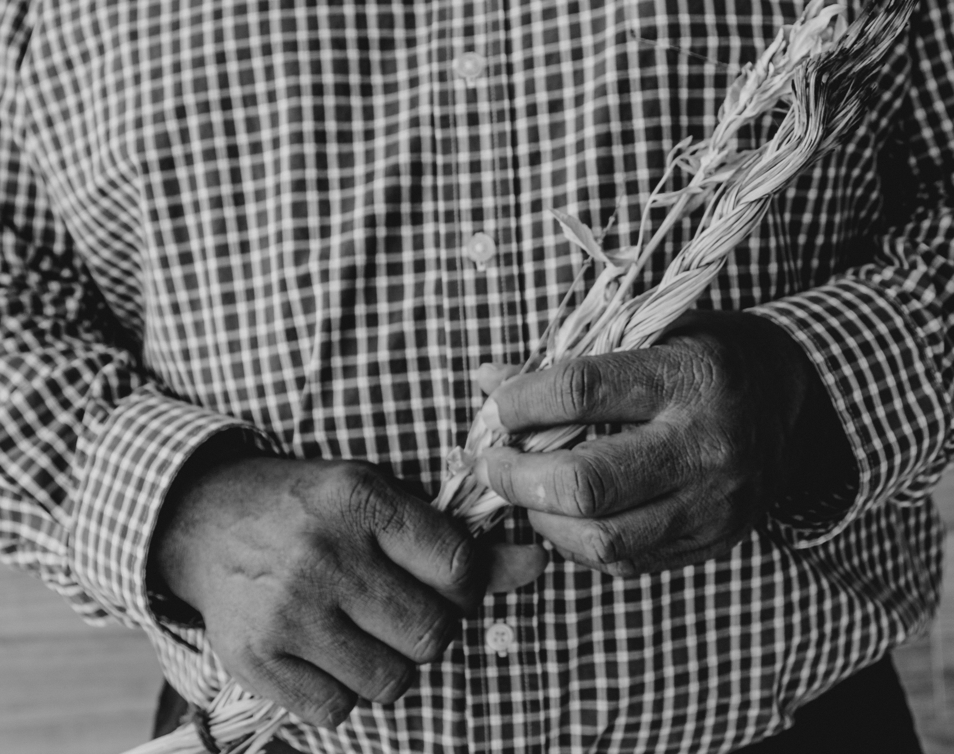
Everyday Tasks
Even simple tasks are actually really complex.
For someone with dementia, any one of these steps can become hard.
With your support, it is possible for people living with dementia in your community to continue living successfully and accomplishing big and small tasks.
Notes:
CASEY

Slide 29
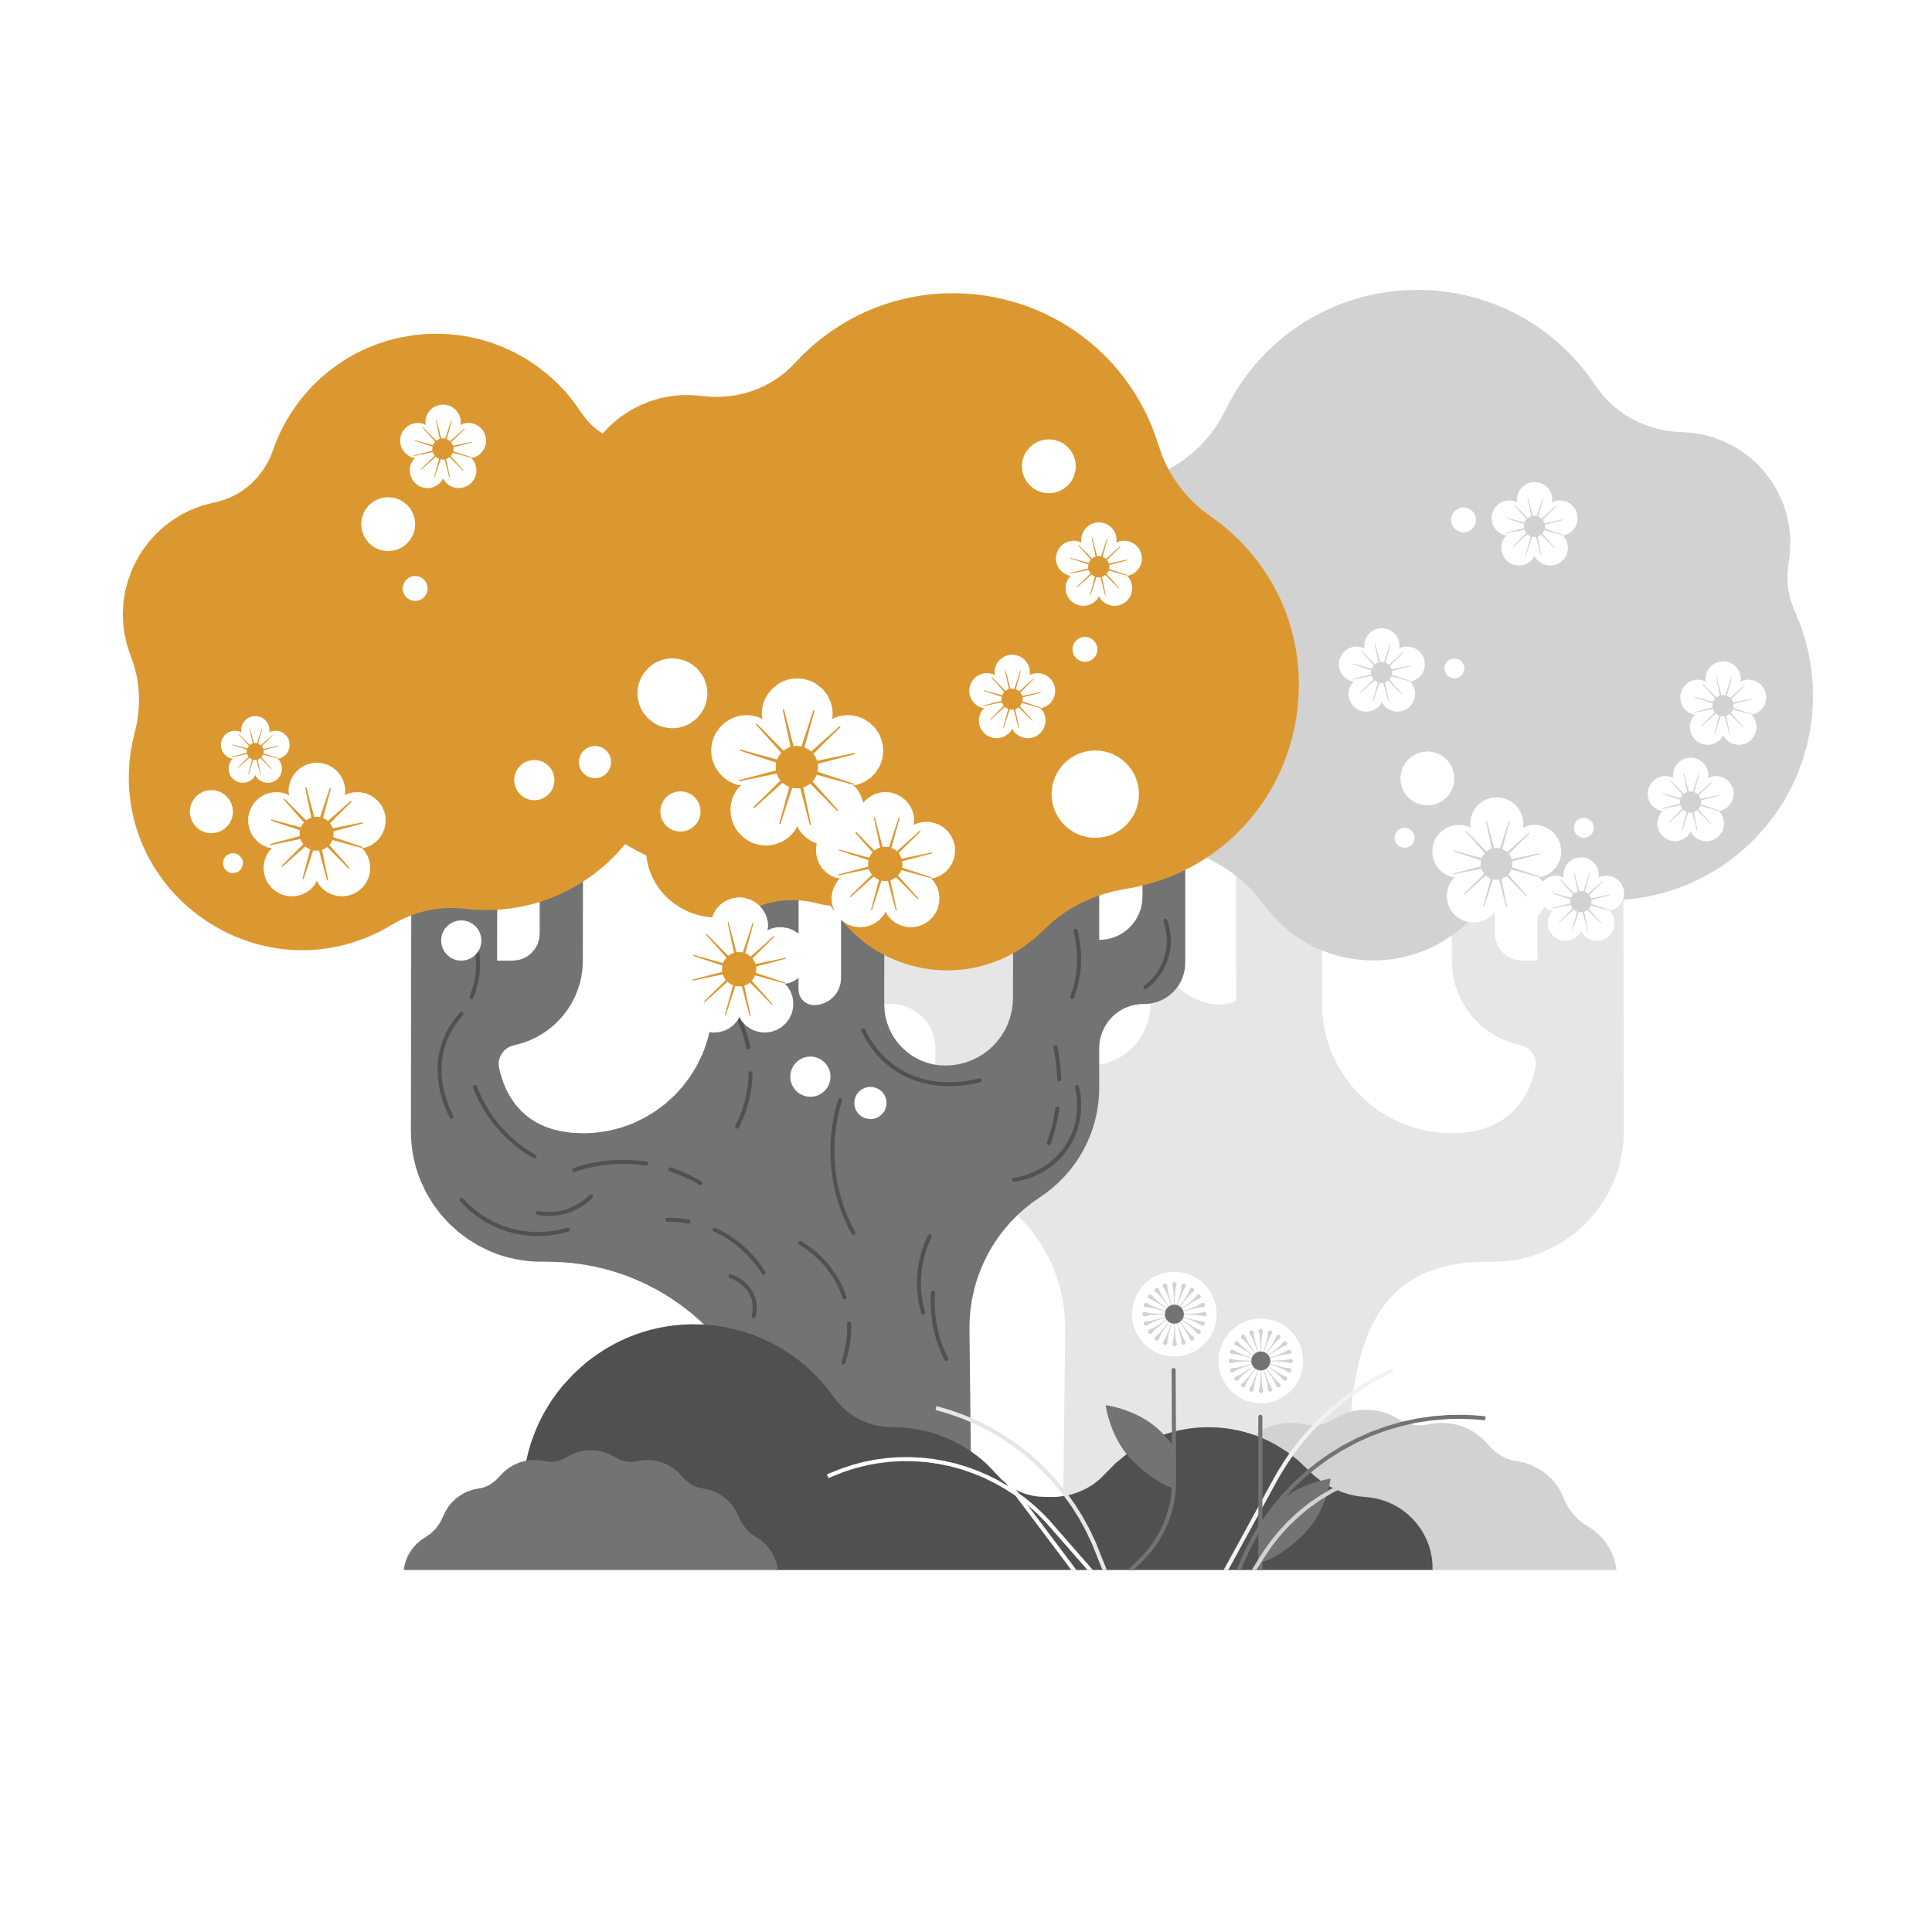
Communication Best Practices – Page 8
Try not to…
Instead…
talk to someone like a child.
get frustrated.
correct someone.
be defensive.
talk too fast.
rely on words alone.
treat the person with dignity & respect.
be patient and supportive.
look for the meaning.
acknowledge feelings & emotions.
give time to process/speak.
use body language.
Notes:
JOLIE
Encourage nonverbal communication. What does that mean? If you don’t understand what is being said, ask the person to “show” you by pointing or gesturing.

Slide 30
Conversation Tips – Page 9
Come from the front, identify yourself, and keep good eye contact, unless it is culturally taboo.
Speak slowly and clearly. Use a gentle and relaxed tone.
Use statements not questions.
Give visual cues.
Do not quiz.
Notes:
JOLIE
Avoid quizzing the person with questions like “Do you remember when…?” or “Do you remember who this person is?” It doesn’t help and often leads to frustration.

Slide 31
The Six Key Messages – Page 10
Dementia is caused by diseases of or injuries to the brain.
There are things you can do to reduce the risk of developing dementia.
Dementia becomes more common as people get older but is not a normal part of healthy aging.
Dementia is not just about having memory problems.
People living with dementia can live well, especially with their community’s support.
A person living with dementia is a full being—worthy of respect—and is a vital part of their community.
Notes:
CASEY

Slide 32
Understanding Into Action – Page 11
Elders are our community’s lifeblood.
Even with dementia they can continue to serve as leaders, storytellers, and serve as active community members.
As a Dementia Friend you help protect our elders and preserve meaning.
THINK: What does “dementia-friendly” mean to you?

Slide 33
What action will you choose to do after today? (See pg 11) No action is too big or too small—every bit will make a difference!
Notes:
CASEY
Also: Resource section

Slide 34
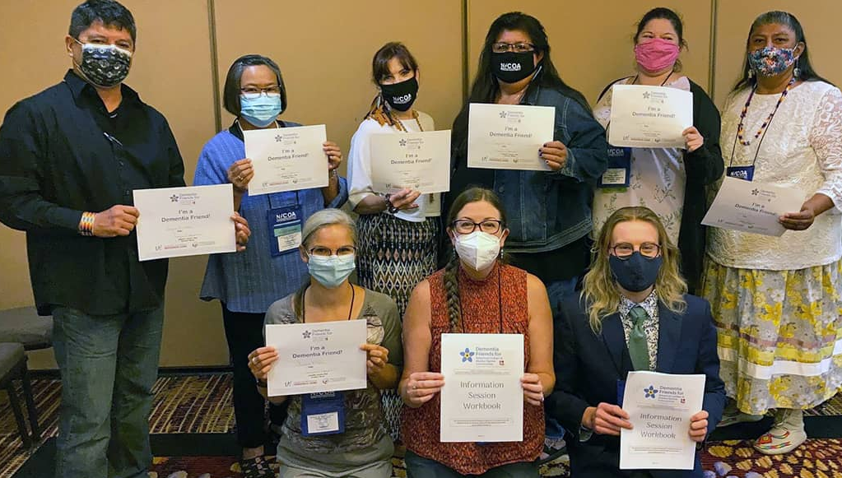
Thank You for Becoming a Dementia Friend!
Take our post-session questionnaire and evaluation:
https://www.surveymonkey.com/r/TitleVIDFpost
Visit our website for more information:
https://iasquared.org/dementia-friends/
Notes:
https://www.surveymonkey.com/r/TitleVIDFpost

Slide 35
Become a Dementia Friends Champion
Bring Dementia Friends Information Sessions to your tribal or Alaska Native community
Receive free training including a Champions guide with full script
Offer sessions as big or as small at any time convenient for you
Commit to lead a minimal # of information sessions per year with help from Master Trainers and other Champions

Slide 36
Presenters and contributors
Casey Acklin
Jolie Crowder
Breana Dorame
cacklin@unr.edu
jolie@iasquared.org
breana@iasquared.org

