Slide 1
ACL Title VI Data Tools: What We Have, How You Can Use It

Slide 2
What We’ll Cover
Title VI Reporting Workbooks
OAAPS Reports
AGID
Infographic Tool
Evaluation Tools
Notes:
Data is your friend.
Title VI needs better data to better be able to tell the story of the services that you all are providing in Indian Country.
Delicate balance between getting good data that tells a story without making the process of data collection too painful (then you don’t get good data)
Good program data really comes from consistent data collection
Good data means that you can see how your program is changing so you can figure out what you’re doing that is working or what might not be working as well as you want
Data tells you how you are doing – learning from evaluation gives you a temperature check on how programs are running and if you are meeting the needs of your elders and caregivers; and in the case of the Title VI Evaluation; it gave ACL a chance to check in and see how you all as our grantees were doing and what was working well and what you needed help with and what you might need from us! WE SHOULD ALL BE EVALUATING WHAT WE’RE DOING ALL THE TIME – EVALUATION ESSENTIALLY MEANS CHECKING IN TO SEE HOW THINGS ARE GOING.
ACL built some Data Tools for Title VI with our contractors and I want to talk about those and how you can use them so that YOU can do more with your OWN data. Data isn’t just for the federal government, it’s for everybody.
And last but not least, I’m going to talk about what we have coming up and what we want your help and insight with. “Nothing About Us Without Us” ☺ Everything we have built recently has had you involved from the beginning has been better for it and we want to continue working that way!

Slide 3
Title VI Data Tracking Workbooks
ACL developed two versions of the Title VI Tracking workbooks.
One in Microsoft Excel and one in Microsoft Access – meaning that if you have Microsoft on your computer you can use either of these programs to help you track your day-to-day PPR-related data.
Can capture daily/weekly/monthly counts by elder or caregiver for services counted in the PPR
Some customization allowed to better fit your program’s specific needs.
Statistics page that runs monthly, quarterly, and annual numbers for you.
Can upload data straight into OAAPS.
Budget feature to help you keep track of your spending
https://oaaps.acl.gov/Resources/techDocs
Notes:
The Title VI Tracking Workbook boasts several features to aid you in tracking your data, and more importantly provides automatic calculations of totals for services and other reporting metrics required for the PPR.
The features include:
Captures data for one grant year. That way, you can keep each grant year’s data separate from one another. Each grant year, you simply start with a new workbook.
Create profiles client/elders and caregivers (if you provide services to caregivers under your grant). Profiles comprise names, addresses and contact information, notes, and other information to help you keep track of them.
Enter the individual or group services you provide clients/elders and caregivers (if applicable). You enter counts of individual services like congregate meals and hours of chore services by person (based on profiles you create) and you enter counts for group services like contacts of telephoning and social events as a total – for example, two social events on a given day.
Enter staffing information like number of full time and part time staff and financing information like funds spent on congregate meals and other sources of funds that support your Title VI services. This information is required for your annual PPR.
View total counts of the services you provide clients/elders and caregivers (if applicable). You can view the total counts by month, quarterly, as well as year-to-date so you can see how well you are meeting your service delivery goals.
Get automatic automatically compiled data for your PPR, including service total counts. You can copy this data into a separate Microsoft Excel file that you can upload into OAAPS.
There’s also an optional budget feature that you can use to enter your revenues and direct and indirect expenses so you can see how well you are staying within your budget. A stand-alone version is also available in case you wish to manage your budget information separate from the Title VI Tracking Workbook.

Slide 4
Title VI Tracking Workbook
The Title VI Tracking Workbook is designed to help you get good, consistent data.
Two types of workbooks are available:
Microsoft Excel
A/B: For grantees who only provide services to clients/elders and are required to fill out Part A/B of your PPR.
A/B/C: For grantees who provide services to clients/elders and caregivers and are required to fill out Parts A/B and C of your PPR.
Microsoft Access
User manuals for each type of workbook, as well as How-To Guides to help you with specific tasks are also available.
https://oaaps.acl.gov/Resources/techDocs
Notes:
When ACL was updating the PPR and talking to T6 grantees and RAs they heard a lot about the difficulties that grantees have in tracking data
ACL asked for additional input from Title VI Directors and Staff, as well as ACL Regional Administrators and decided to develop a tool (i.e., the workbook) to help improve data quality and make tracking and reporting data easier for you, as a grantee
ACL developed Microsoft Excel- and Access-based versions of the workbook.
Afterwards, ACL conducted a pilot to test the workbook with grantees and made enhancements based on their feedback.
There are two types of workbooks available: Microsoft Excel and Access.
There are two versions of the Microsoft Excel workbook.
One is designed for grantees who provide services only to clients/elders and are required to fill out Part A/B of your PPR.
The other is designed for grantees who provide services to clients/elders and caregivers and are required to fill out Parts A/B and C of your PPR.
There are user manuals to help you with all tasks, as well as how-to guides to help you with specific tasks available.

Slide 5
Title VI Tracking Workbook Features
Captures data for one grant year (can use daily/weekly/monthly entry)
Create profiles for clients/elders and caregivers (if applicable)
Can split clients/elders by site
Enter counts of the services you provide clients/elders and caregivers (if applicable)
Track staffing, finance, and storytelling (clients/elders) information for your PPR
https://oaaps.acl.gov/Resources/techDocs
Notes:
The Title VI Tracking Workbook boasts several features to aid you in tracking your data, and more importantly provides automatic calculations of totals for services and other reporting metrics required for the PPR.
The features include:
Captures data for one grant year. That way, you can keep each grant year’s data separate from one another. Each grant year, you simply start with a new workbook.
Create profiles client/elders and caregivers (if you provide services to caregivers under your grant). Profiles comprise names, addresses and contact information, notes, and other information to help you keep track of them.
Can split your clients/elders by site so you can easily tell who is where.
Enter the individual or group services you provide clients/elders and caregivers (if applicable). You enter counts of individual services like congregate meals and hours of chore services by person (based on profiles you create) and you enter counts for group services like contacts of telephoning and social events as a total – for example, two social events on a given day.
Enter staffing information like number of full time and part time staff and financing information like funds spent on congregate meals and other sources of funds that support your Title VI services. This information is required for your annual PPR.

Slide 6
Title VI Tracking Workbook Features (cont.)
View monthly, quarterly, and year-to-date statistics on total counts of services you provide clients/elders and caregivers (if applicable)
Get automatically compiled data (including service total counts) for your PPR that you can upload into OAAPS
Optional budget feature to calculate revenue versus expenses (also available as separate, stand-alone Microsoft Excel tool).
https://oaaps.acl.gov/Resources/techDocs
Notes:
View total counts of the services you provide clients/elders and caregivers (if applicable). You can view the total counts by month, quarterly, as well as year-to-date so you can see how well you are meeting your service delivery goals.
Get automatically compiled data for your PPR, including service total counts, that you can upload into OAAPS.
There’s also an optional budget feature that you can use to enter your revenues and direct and indirect expenses so you can see how well you are staying within your budget. A stand-alone version is also available in case you wish to manage your budget information separate from the Title VI Tracking Workbook.

Slide 7
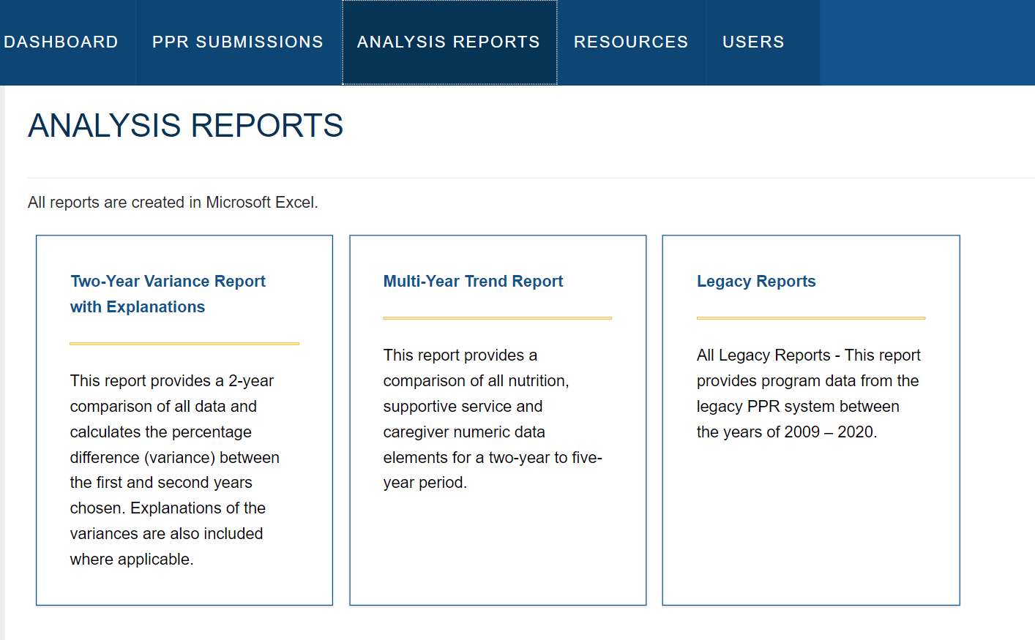
OAAPS Analysis Reports
There are three types of new reports to help you analyze and view PPR data previously submitted by your program.
oaaps.acl.gov
You must be signed in and can only see your own data.
Notes:
Analysis reports are an exciting new feature on OAAPS. In the top menu bar, you will see the Analysis Reports tab. If you select the tab, you will find three types of reports which we will go over now. These reports will allow you to look at and identify trends in your PPR data as far back as 2009.
Not only will you be able to analyze your data, ACL staff will be able to view and compare data across these reports at the various levels- grantee, regional, and national.
I also want to make sure that you know that all users have the option to download and print reports
Each of the analysis reports has its own purpose.
Two-Year Variance Report with Explanations
Compares all the data from one year to the next and gives the percent change (variance).
Multi-Year Trend Report
Compares data elements up to a five-year period to help identify trends in service delivery.
Legacy Reports
Documentation of all data that has been submitted between the years of 2009 and 2020.

Slide 8
Reports with Charts
Both the Two-Year Variance Report and the Multi-Year Trend report will show the data in Excel. The reports will also include charts to help visualize your data.
Notes:
Both the Two-Year Variance Report and the Multi-Year Trend report will show the data in Excel. The reports also include charts or graphs to help visualize your data.
This is an example of a chart that is generated with one of the reports. This bar graph is from the Multi-Year Trend report and shows how congregate meals served by one grantee have changed each year from 2015 on the top to 2019 on the bottom.

Slide 9
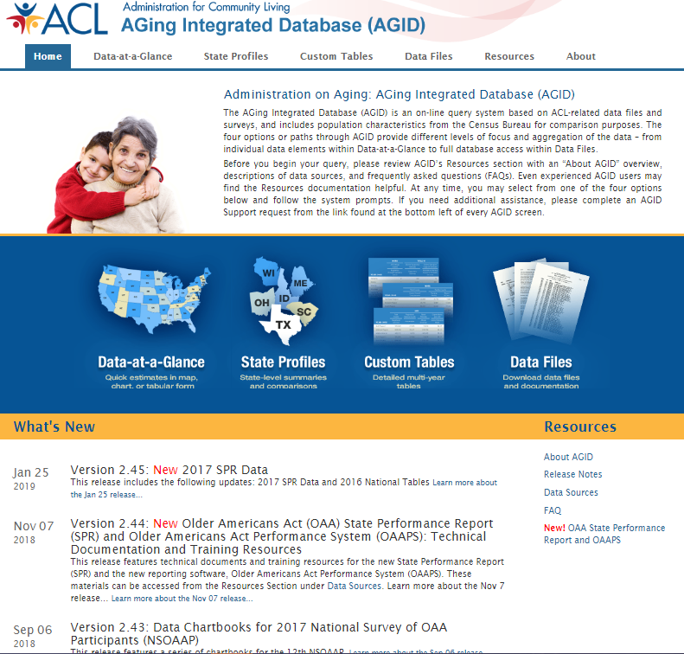
4 Different Ways to Access Data
https://agid.acl.gov
AGID is ACL’s public data portal and stands for Aging, Independence, and Disability database.*
You do not have to sign in and you can see anyone’s data – including state data.
* Screen capture here needs an update
Notes:
LET’S TALK ABOUT AGID! There are four different ways to access data.
Data-at-a-Glance: a quick table form, with options of maps, graphs, and charts.
State Profiles, Custom Tables, and Data Files give you more expansive views of the data.
All four options are user-friendly, depends on what data you need or would like to see.
Note that once you create your tables, charts, or graphs, you will have the options of “Save” (to Excel or CSV files), “Share” (such as email), or “Print” (to a printer or pdf files).
We will review these sections in detail next.

Slide 10
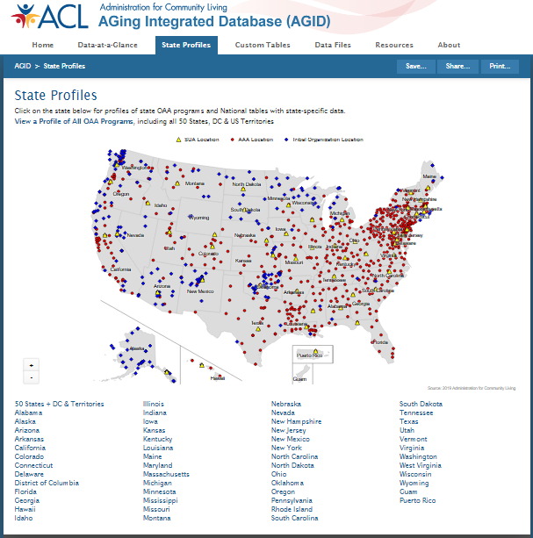
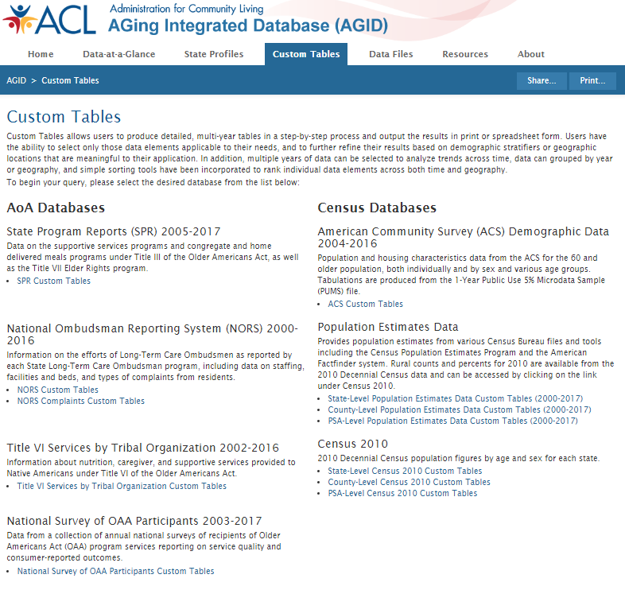
Navigating AGID
Notes:
A couple of different ways to look at data on AGID

Slide 11
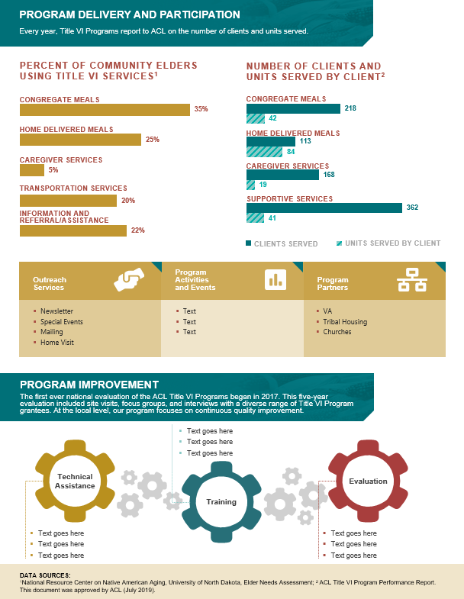
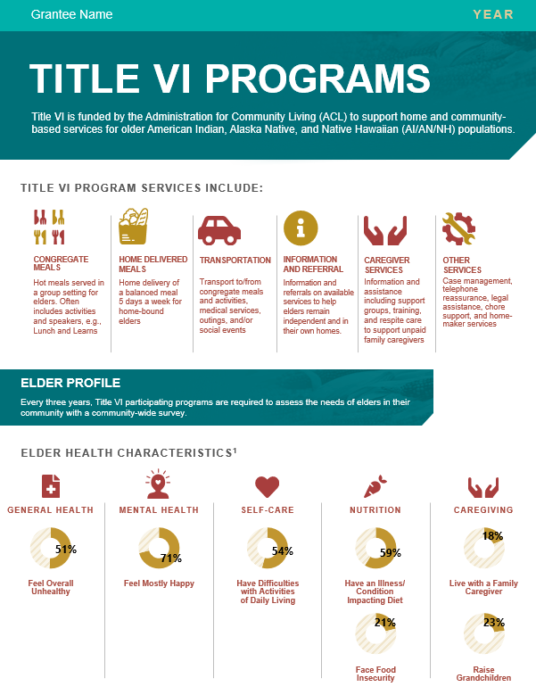
Title VI Infographic Toolkit
ACL created an Infographic tool to use PPR and UND Needs Assessment data to help Title VI grantees create a visual representation of what their programs are doing to share with stakeholders.
Program Delivery and Participation
Grantee Name and Year
Program
Improvement
Overview of Title VI Program
This tool is made up of a PDF User Guide and an Excel Infographic Worksheet
Elder Profile
Infographic Tool User Guide
Infographic Tool Slide Deck
Infographic Link Presentation Recording
Notes:
Gretchen
The infographic has 5 key sections:
Your program name and year
An overview of Title VI
An Elder Profile
Program delivery and participation
Program improvement
You are able to enter in your specific program information into each section except the overview. We’ll walk through each section and then show you how you can enter in your program’s data.

Slide 12
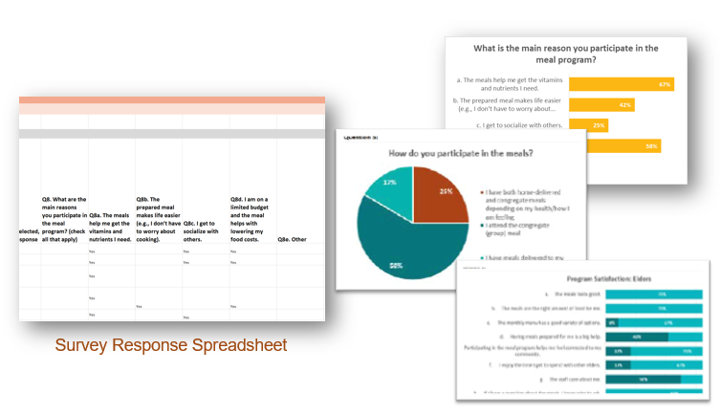
Title VI Evaluation Toolkit
The Title VI Evaluation Toolkit is made up of an Excel Evaluation Workbook and a PDF User Guide.
The Excel Evaluation Workbook has suggested questions and answer categories for Part A/B and Part C grants (these are customizable by programs).
The PDF User Guide has instructions on how to use the Excel Evaluation Workbook as well as how to go about evaluating your program – from how to approach your survey to how to share the results.
Evaluation Tool User Guide
Evaluation Tool Slide Deck
Evaluation Tool Presentation Recording
Notes:
Evaluation Tool User Guide
Evaluation Tool Slide Deck
Evaluation Tool Presentation Recording

Slide 13
Remember that Data is Power
Title VI Office Hour
Wednesdays at 3:30 - 4:30 p.m. ET
Join on your computer or mobile app
Click here to join the meeting
Or call in (audio only)
+1 206-420-5032,,874866474# United States, Seattle
Phone Conference ID: 874 866 474#
Kristen.Hudgins@acl.hhs.gov
202-795-7732

