Slide 1

Using Title VI, Part C, to Support Informal Caregivers
Presented by:
Amy Wiatr-Rodriguez, ACL Regional Administrator and
Jasmine Aplin, ACL/AoA

Slide 2

There are only four kinds of people in the world:
Those who have been caregivers Those who are currently caregivers Those who will be caregivers, and Those who will need caregivers
First Lady, Rosalynn Carter

Slide 3
Program Management
Management means getting the job done through:
  planning,
  organizing,
  budgeting,
  staffing,
  directing, and
  evaluating
Policies and procedures guide your program and help to assure all staff and
clients are treated equally.
  Please ensure that you have current policies and procedures for your Part C, Caregiver Support Program (if not, that will be step 1)

Slide 4
Planning and Organizing
Identify what you want to accomplish – your program goals.
Conduct a needs assessment.
Identify actions for both meeting grant requirements and addressing the priority needs.
Identify what results you expect to accomplish because of these actions.
Establish a work plan with specific tasks.
Prioritize duties.
Plan for evaluating program outcome.
If any of these sound familiar, you could be working on your funding application—which is very likely—because it’s due in a week!

Slide 5
Title VI Application – Due December 18
This is the ideal opportunity to plan for your caregiver program
When you complete your application, be sure to identify parts A & C as what you are applying for in order to received funding to support caregivers
Applications are in a fillable Word document at: https://acl.gov/grants/funding-2020-2023-older-americans-act- title-vi-native-american-programs
– Don’t forget your signatures (there are several spots for your chair to sign), attached resolution and service map!
Due in 1 week!! No late applications will be accepted!

Slide 6
Programming Around Need
Listen to your elders and caregivers – understand their needs and
likes.
Respect their personal dignity and uniqueness.
Get to know them personally and understand their history.
Design services which are varied enough to match individual
preferences and skills.

Slide 7
Budgeting
Although a budget is not a required part of your Title VI application, many
Tribal Councils require programs to submit a budget.
Even if you are not required to, you are encouraged to develop a budget as soon as you know your funding amount.
You need to find out what indirect cost your tribe is charging your
program, as well as what is included in that cost.
Coordinate your record keeping with your finance office so that everyone has the same information on which to make decisions.
While carry over of unexpended funds are allowed within a project period, large carry over amounts indicate poor program planning or may be a red flag that your program is in trouble.

Slide 8
Spending Remaining Funds – Part C
Check with your fiscal team to see what you have remaining in Part C—it is very likely that any remaining Title VI funds are in Part C
Expect communication from your Regional Administrator if there is a high remaining balance
The grant period ends March 31, 2020 and all grant awards must be obligated by 3/31/2020 and fully liquidated with a final report submitted by 6/30/2020.

Slide 9
{Hidden}
Thanks…that’s part of why I am here.
Tell me what to do to spend the funds…fast.
Okay, I hear you.
You need to have policies and procedures
  review, update, do that you need to do and use funds for your staff time to get that done.
Refresh your lending closet
Host trainings for caregivers
  We will review a quick one on the next slide for emergency preparedness because it’s good for everyone.
And then…let’s all understand who we are serving…
I promise programming ideas when we review the requirements. ☺

Slide 10
Preparing for Emergency and Disaster Situations
An emergency/disaster requires immediate and effective intervention of multiple government and private sector organizations to help meet the needs of the community and area just after the disaster occurs and the area and people begin to recover.
Just in Case: “Emergency Readiness for Older Adults and Caregivers” has step-by-step information to help older adults prepare for a disaster/emergency.
It includes helpful checklists, contact lists, and a medication list that can
be filled in.

Slide 11
Title VI, Part C—Caregiver Support Services
Must also have a Part A/B grant
Services are for two types of unpaid caregivers:
  informal provider of care to a frail older individual or to an individual with Alzheimer’s disease or a related disorder (for instance family, friends, or other relatives caring for an older individual)
  older relative caregivers (for instance grandparents raising
grandkids, or an elder caring for an adult with a disability)
Program services are for the caregiver; not for the elder who receives the care

Slide 12
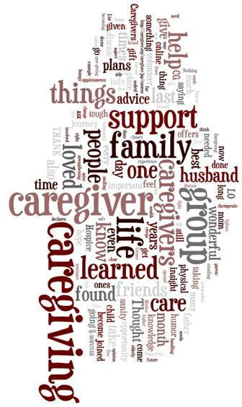
You might be a caregiver if…
You regularly look in on or call a friend or loved one to see how they are doing or if they need assistance
You are helping with, or are doing, routine tasks for someone, such as grocery shopping, bill paying, household chores, or transportation
You are assisting someone with medications or personal care tasks
You are communicating with health care professionals or other providers, services and agencies
You are providing complex medical care like wound care; changing IVs; operating medical equipment/devices

Slide 13
What do we mean by “Informal Caregiving”?
Family caregivers provide an array of services that can include:
  Emotional,
  Financial,
  Nursing,
  Social,
  Homemaking,
  and other services needed on a daily or intermittent basis.
Sometimes it means 24-hour care for someone who is unable to dress, feed, go to the bathroom, or think for him or herself.
Caregiving can last a lifetime or as little as a few days or months.

Slide 14
What do we mean by “frail”?
“Frail’’ means that the older individual is functionally impaired because the individual—
is unable to perform at least two activities of daily living without substantial human assistance, including verbal reminding, physical cueing, or supervision; or
due to a cognitive or other mental impairment, requires substantial supervision because the individual behaves in a manner that poses a serious health or safety hazard to the individual or to another individual.

Slide 15
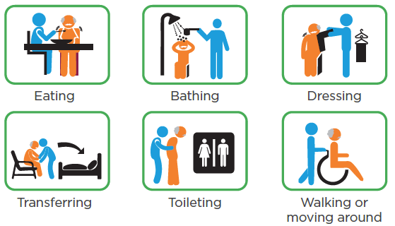
Activities of Daily Living
https://www.advancedrm.com/measuring-adls-to-assess-needs-and-improve-independence/#

Slide 16
Who are Caregivers?
In Indian Country, the most likely caregivers are family members, friends of the family, neighbors, or members of a church or social club who are close to the person needing care.
Many caregivers do not identify themselves as such since caring for elders is a traditional activity in Indian Country; caregivers see themselves as simply doing what needs to be done.

Slide 17
Title VI, Part C—Adult Family Caregiver: Defined
(3) The term ‘‘family caregiver’’ means an adult family member, or another individual, who is an informal provider of in-home and community care to an older
individual or to an individual with Alzheimer’s disease or a related disorder with neurological and organic brain dysfunction [OAA Section 302 (3)].

Slide 18
Title VI, Part C—Older Relative Caregiver: Defined
Older Relative Caregiver means a caregiver who— (A)(i) is age 55 or older; and
(ii) lives with, is the informal provider of in-home and community care to, and is the primary caregiver for, a child or an individual with a disability

Slide 19
Title VI, Part C – Older Relative Caregiver: Grandparents Raising Grandchildren
in the case of a caregiver for a child—
  is the grandparent, step grandparent, or other relative (other than the parent) by blood, marriage, or adoption, of the child; and
  is the primary caregiver of the child because the biological or adoptive parents are unable or unwilling to serve as the primary caregivers of the child; and
  has a legal relationship to the child, such as legal custody, adoption, or guardianship, or is raising the child informally; and

Slide 20
Title VI, Part C—Older Relative Caregiver: Caring for Someone with a Disability
(C )in the case of a caregiver for an individual with a disability, is the parent, grandparent, or other relative by blood, marriage, or adoption, of the individual with a disability.

Slide 21
Examples of Caregiver and Services
A granddaughter provides care of a great-grandmother who is 80. The granddaughter is going on a trip and needs someone to take care of her grandmother while she is away.
  Part C can pay for someone to help provide care for her grandmother while she is away.
A son provides care for his father who has Alzheimer’s disease and is having incontinence issues.
  Part C can pay for incontinence supplies

Slide 22
Identifying Caregivers
Caring for elders is a traditional activity in Indian Country, caregivers are simply doing what needs to be done.
  It may be difficult for caregivers to identify themselves
In Indian Country, the most likely caregivers are family members (spouses, daughters, granddaughters, sons, grandsons, etc.), friends of the family, neighbors, or members of a church or social club who are close to the person needing care.
  Advertise where the caregivers are located
Word of mouth is the best way to find caregivers.
  Often an initial request is simply information, ensure intake staff are aware of the program

Slide 23
Meeting the Needs of Your Caregivers
It is important to recognize that the services available through this program include services for the caregiver, not for the elder who needs care.
If caregivers are supported while they do their work, they can provide care longer and better. This support can help the elder, but services must be directed to the caregiver.
If an elder doesn’t have a caregiver, Title VI part C resources are not available to them.

Slide 24
Finding Out About Your Caregivers
Consider your intake process:
  What is the experience of the person calling into your center?
  Is the person answering the phone knowledgeable about services available and where to send the caller?
  Are they able to identify a caregiver?
  Will they ask questions beyond what the caller identified to assist with the needs of the caregiver?

Slide 25
Title VI, Part C – Required Services
Information to caregivers about available services
Assistance to caregivers in gaining access to the services
Individual counseling, organization of support groups, and caregiver training to assist the caregivers in the areas of health, nutrition, and financial literacy, and in making decisions and solving problems relating to their caregiving roles
Respite care to enable caregivers to be temporarily relieved from their caregiving responsibilities; and
Supplemental services, on a limited basis, to complement the care provided by caregivers

Slide 26
Required Service 1: Information
Information and assistance services may be one way to identify caregivers as it is often the first thing a caregiver seeks is information about caregiver services or assistance in getting the service.
Caregivers may need information about:
– services, equipment, and the illness or condition their loved one is experiencing.
Ex: Staff time to answer caregiver calls and referrals; Completing a caregiver intake; Sharing information about an illness/diagnosis; Mailing/Newsletters/Brochures for self-care, services available in the community, etc.; Referrals to support groups, trainings, legal needs, resources, respite, etc.

Slide 27
Required Service 2: Assistance Services
Assistance may be direct assistance with:
  Paperwork, finding resources, or helping them access programs that can provide assistance with Medicare, Medicaid, yard work or heavy chores, housecleaning, or other tasks.
Your Title VI, Part A program may be able to provide the services identified.
  Remember that assistance under the Caregiver Support Program is to assist the caregiver in accessing the service, not providing the service.
Ex: Application assistance for Medicaid, SNAP, Housing, LIHEAP, tribally funded resources, etc.; Accompanying with a caregiver to get access to services

Slide 28
Required Service 3: Caregiver Counseling, Training, and Support Groups – Counseling
Caregivers may need to learn new skills about helping with activities of daily living, medical treatments and prescription drugs, or changes that occur as their loved one ages and their illness progresses.
Caregivers may need counseling and training about the best way to take care of themselves and training in how to perform some caregiver responsibilities, such as getting an elder out of bed.
Ex: Counseling support for communication; balancing responsibility

Slide 29
Required Service 3: Caregiver Counseling, Training, and Support Groups – Training
Training required by the OAA includes health, nutrition, and financial literacy, and training in making decisions and solving problems relating to their caregiving roles.
Training can be about general things such as communication with elders with dementia (including Alzheimer’s Disease), end-of-life signs, or incontinence or as specific as catheter care, tube feeding, or filling insulin syringes.
It is important that the person doing the training be qualified to
provide it.
Ex: Financial literacy training; disaster preparedness training; training and resources related to a specific chronic illness; Nutrition Education and cooking demonstrations, skill development training

Slide 30
Required Service 3: Caregiver Counseling, Training, and Support Groups - Support Groups
In a support group, members provide each other with various types of nonprofessional, nonmaterial help for a particular shared issue.
The help may take the form of providing relevant information, relating personal experiences, listening to others’ experiences, providing sympathetic understanding and establishing social networks.
Some programs have used a Caregiver Stress Test to help open up the
discussion.
Confidentiality is an important aspect of support groups.
Ex: Support groups for people caring for a person living with dementia, grandparents raising grandchildren, working caregivers, caring for someone receiving end of life services for recently passed

Slide 31
Required Service 4: Supplemental Services
Include such things as:
  Home Modification/Repairs: Putting in ramps or handrails into an Elder’s home.
  Consumable Items: Incontinence supplies, Ensure, school supplies, uniforms for school or sports, cleaning supplies, etc…
  Lending Closet: Clothing exchange; Durable Medical Equipment (chair lifts, wheelchairs, walkers, emergency response systems), anything lent on a short-term basis.
  Financial Support: limited (emergency) help with utility bills
  Homemaker/Chore/Personal Care Service: chopping wood, mowing a lawn, snow clearing.

Slide 32
Required Service 5: Respite
Respite care is care provided to caregivers so that they can have a break (preference to caregivers of the frail or grandparents raising grandchildren).
Respite care can be provided in the home of the elder or the caregiver or it can be provided at an out-of-home setting such as the respite person’s home, senior center, or day care center.
Some programs provide the care by giving the caregiver a voucher and allowing them to choose their own provider and circumstances.
Ex: Adult Day programs, summer camps, in home services, shopping assistance, etc.

Slide 33
Respite Policy Considerations
If the respite provider is not a family member, you will want to check your tribe’s policies about background checks.
It is important to develop policies on:
  Who can provide respite – will you allow spouses or children, relatives vs paid providers,
  How are you going to pay for respite – volunteer-based or paid (rate of pay)
  How you are going to pay for respite – agency-based model, give money directly to family, voucher program
  Other issues – service limits, service locations (at home or facility-based), service hours (weekdays/weekends/overnights)

Slide 34
Coordinating Caregiver Programs
If there is another program providing a required service for caregivers in your community, you do not have to provide it with your funds, but must coordinate with the program to ensure caregivers can use the program.
The OAA also requires coordination with Title III programs.
Area Agencies on Aging can assist with information or application assistance, trainings, and supplemental services
Do you currently coordinate with the AAA responsible for your planning and service area?

Slide 35
Remember…
Program services are for the caregiver; not for the elder who receives the care.
While there may be a need to find a caregiver for a person who lives alone and does not have a family caregiver, a grantee cannot hire a caregiver for them with their Title VI Part C funds.

Slide 36
Quality Assurance
Quality assurance can be used for many purposes, including program
management, program improvement, and accountability.
Quality assurance can help you decide if you are providing timely and relevant services, if your services are improving the quality of life for the family caregivers and the areas in which you can improve.
By using regular quality assurance measures, you can help ensure you are providing quality family caregiver support services that meet the needs of your caregivers.
Because of the diversity of programs, no single approach or set of criteria
for quality assurance will apply to all programs.
– Review Steps for Developing Quality Assurance

Slide 37
Keeping Track of Services Provided
Keeping track of the elders and caregivers who participate in your services
is an essential part of the Title VI Director’s job.
The records you keep on a daily basis will become the annual report required by your grant.
Having a good way to keep track of each caregiver who receives services, which services they received, and frequency will help you to apply for grants, contact service providers about needs, and keep track of the number of participants your grant is serving.

Slide 38
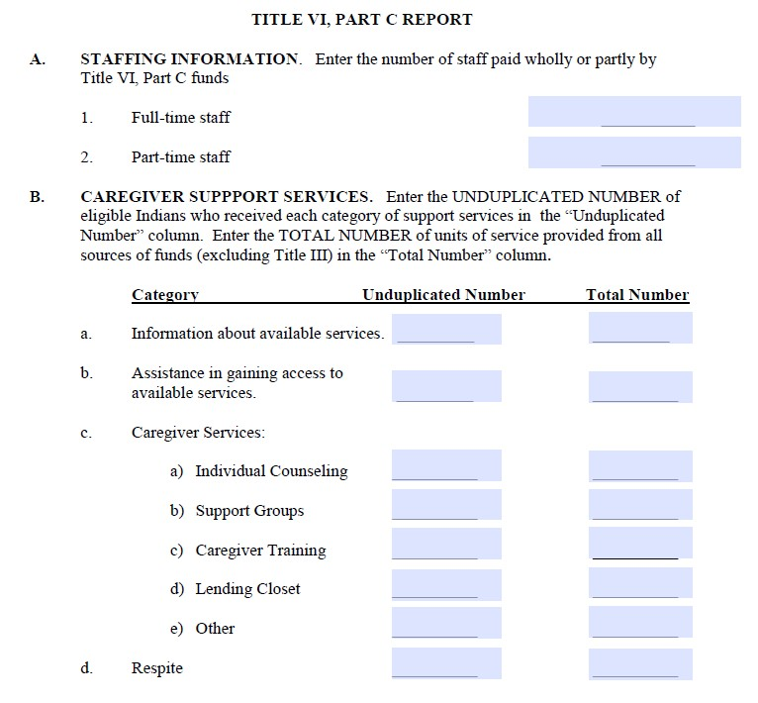
Reporting: Current PPR

Slide 39
Why is the PPR being updated
The Administration for Community Living (ACL heard many tribal leader express how important data is in Indian Country
ACL heard the need for consistency in terms and definitions for the Title III and Title VI Programs
ACL wanted to streamline data collection being done in the PPR with data collected from the UND Needs Assessment and the n4a Title VI survey

Slide 40
Where will the updated PPR be located
A new web-based performance system is being built for the Title
III, Title VI, and Title VII Programs
The performance system will include the updated PPR
The performance system will:
  Improve the management of the Title III, Title VI, and Title VII reporting
  Provide new features to help Title VI programs review and manage their own data
  Allow Title VI programs to have more access to the data

Slide 41
When will the updated PPR go into effect?
The updated PPR will be a part of the 2020-2023 grant cycle
Grantees will be expected to repot on the elements in the updated PPR for the April 2021 report.
This means you will need to updated any and all systems to reflect any changes in the updated PPR to ensure you have the information necessary in time for reporting season.

Slide 42
What changes have been completed on the PPR?
Title VI PPR terms and definitions align with the Title III State Program Performance Report (SPR) definitions
The data units have been updated
Examples have been included with the definitions
Part C definitions have been added
Currently, the updated PPR includes sixty-three data elements
Eliminated seven data elements that are less useful

Slide 43
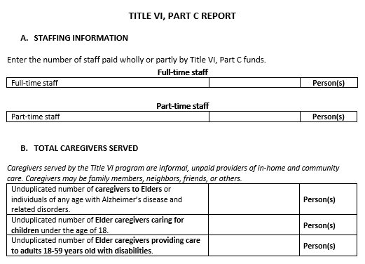
Title VI, Part C Report
New section on Total Caregivers served seeks to understand how many caregivers the program serves by type of caregiver.
  Caregivers to Elders
  Elder caregivers caring for children under the age of 18
  Elder caregivers providing care to adults 18-59 years old with disabilities.
ACL worked a lot in the Caregiver portion of the report to better alight data collection with Title III.

Slide 44
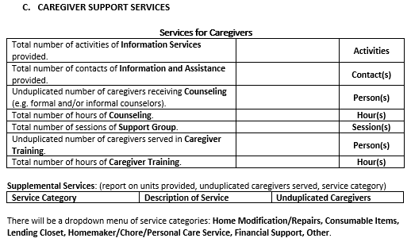
Title VI, Part C Report
Information Services used to be Information about available services, and aligns with Title III.
  Refers to public information outreach activities such as putting information in a newsletter, or having a radio announcement, or producing and sharing a flyer.
Information and Assistance now asks for contacts instead of unduplicated people. This aligns with Title III.
Counseling used to be Individual Counseling.
  Changed this to include group counseling meetings.
Support Group will be captured as
sessions.
Supplemental Services takes the place of lending closet, and aligns with Title III.
  This change will allow programs to include a greater range of services that are provided on a limited basis.

Slide 45
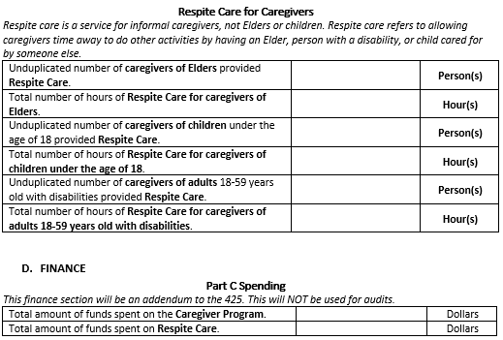
Title VI, Part C Report
To align with Title III reporting, ACL is asking the programs to separate respite care provided by type of caregiver.
o Please refer to the DRAFT-Title VI PPR Definitions document for an explanation of types of caregivers.
The newly added Finance section
seeks information on expenditures for the Caregiver program overall, and the Respite Care in particular.

Slide 46
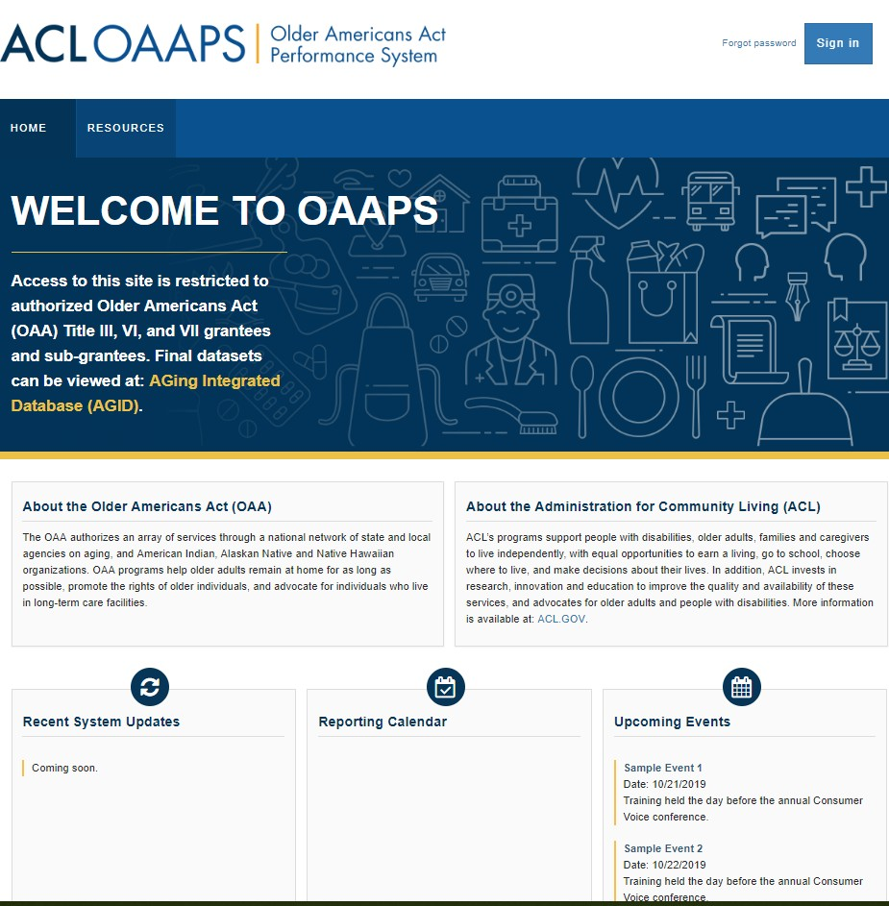
You’ve mentioned a new reporting system. What’s that all about?
We made you a new reporting system!
ACL has invested in an updated reporting system for Titles III, VI, and VII.
We call it the Older Americans Act Performance System or OAAPS

Slide 47
Tell me more…
The Older Americans Act Performance System (OAAPS) is a new web-based reporting
tool for ACL’s Older Americans Act (OAA) grantees to submit program performance data
to ACL for review and approval.
The system will be used to submit Title VI program performance reports (PPR)
OAAPS will also used by other OAA grant programs:
  Title VII – Long-Term Care Ombudsman Program (NORS – National Ombudsman Reporting System)
  Title III - Nutrition and Supportive Programming for grantees (SPR – grantee Program Report)
OAAPS accommodates multiple levels of users:
  Title VI Grantees
  ACL staff (regional and central office)
Our goal when developing the system was to:
  ensure ease of use
  maintain functions that exist in the current system
  provide enhanced functions (e.g. data review)

Slide 48
What are the major steps for completing the PPR updates and the Title VI performance system?
2019 Next Steps | 2020 Next Steps
Finish testing and updating the web-based performance system. | Continue to provide training and technical assistance for the updated PPR.
Provide training and technical assistance for the updated PPR. | Provide training and technical assistance for the web-based performance system.
Allow Title VI users early access to the system

Slide 49
Caregiver Resources
There is a wealth of information on the Internet designed to assist family members and caregivers
of older adults. Here are a few useful links to get you started.
National Alzheimer’s Call Center
The National Call Center is available to people in 56 states and territories, 24/7, 365 days a year, to provide expert advice, care consultation, information, and referrals and can help with questions about memory problems, how to deal with challenging behaviors, and tips for taking care of someone with Alzheimer’s disease or other forms of dementia.
ARCH –The National Respite Locator Service
This service helps parents, caregivers, and professionals find respite services in their state and local area that match their specific needs.
Ask Medicare
This initiative offers information, tools and materials to assist the caregiver and their loved
ones in making informed healthcare decisions.
Family Caregiver Alliance
This site features information on programs at national, state and local levels that support and sustain caregivers.
National Alliance for Caregiving
This site features publications and resources for caregivers, including the Family Care Resource Connection, where you can find reviews and ratings of more than 1,000 books, videos, websites and other materials on caregiving.
49

Slide 50

Questions

