Slide 1
ADPI Grant Evaluation:
Marrying Indigenous Evaluation & 3rd Party Western Approaches
Jolie Crowder, PhD, MSN, RN, CCM
April 20, 2022

Slide 2
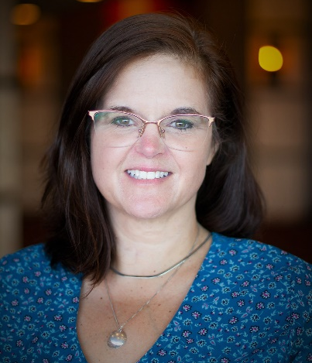
Welcome
Dr. Jolie Crowder, Senior Project Director, IA²

Slide 3
When evaluation is the discussion topic before lunch . . .
Notes:
At least here on the East Coast, this session is ending right before lunch time.
You guys have heard the most exciting parts of today’s presentation from Amber and Erin.
I have the pleasure of bringing us to the conclusion with the super exciting topic of evaluation. If you’re pretty nerdy like me, it actually IS pretty exciting.
The good news is that I only have a few slides which I hope leaves time for questions and can cut this short if needed.
You’ll also find a poster presentation we put together along with our other posters from IA2 in the virtual meeting space so you can feel free to visit that later.
I’d like to thank Amber for inviting me to be part of her presentation and allowing Iasquared to work with Great Lakes Inter Tribal Council and the 6 tribes they partner with. We are really humbled to be a partner not only with Amber and GLITC but also with Absentee Shawnee Health System in Oklahoma, Intertribal Council of Arizona and Wichita Affiliated Tribes also in Oklahoma as the 3rd party evaluator for their ADPI grants.
Amber invited me to share some reflections from this perspective today.

Slide 4
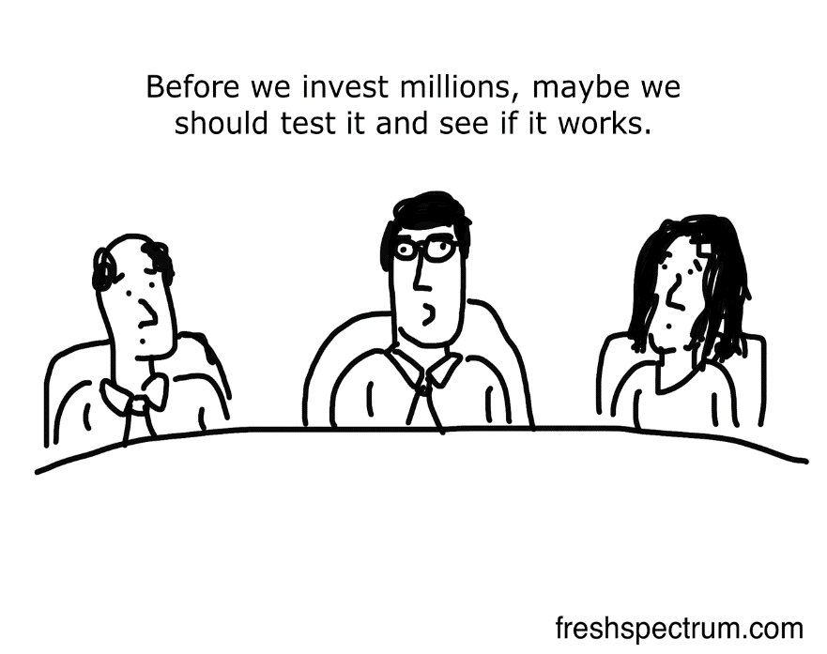
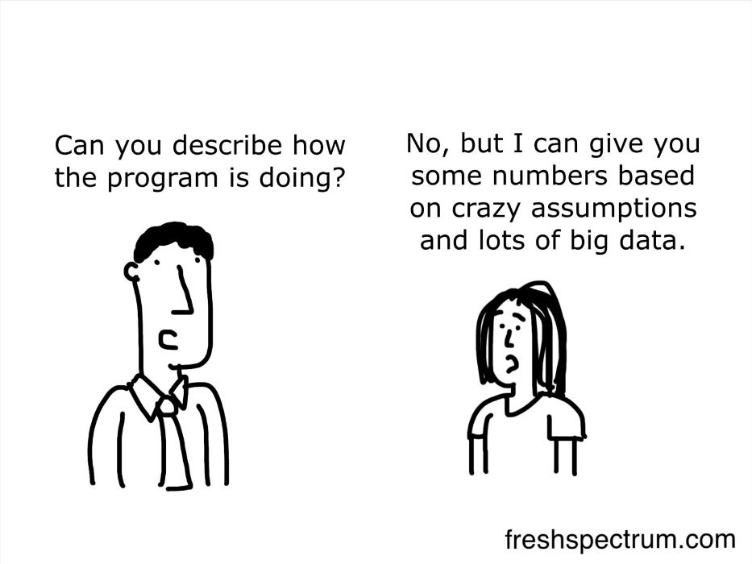
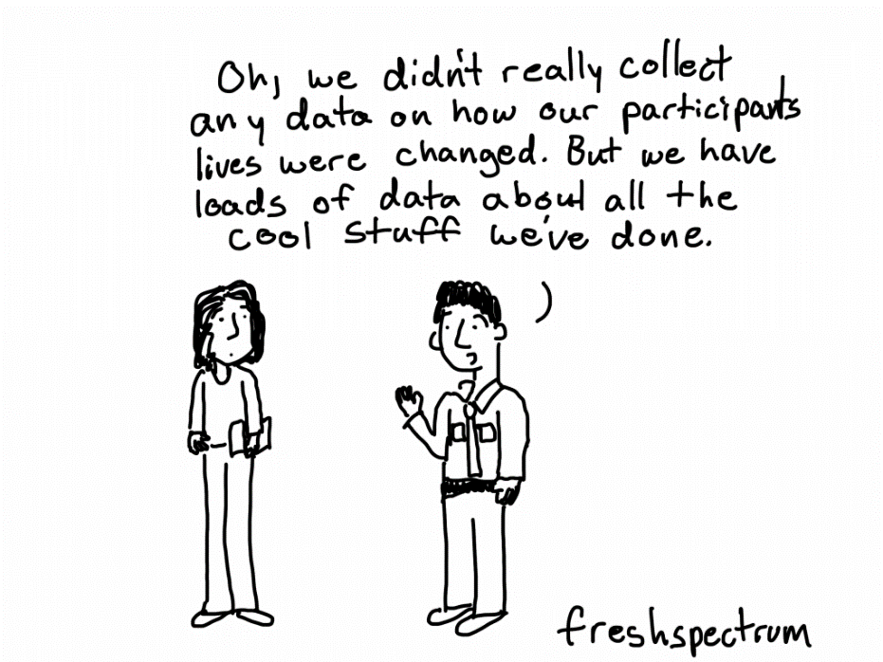
Why do you use evaluation/ data?
In your job. For your tribe. For your community
Notes:
Evaluation might not be the first thing you think about when you wake up or the last thing before you go to sleep.
But, without realizing it, we actually use data all the time to make decisions. We just don’t give it a second thought and we usually take it for granted. We don’t think of it as “evaluation.”
Nowadays when you try a new restaurant usually either subconsciously or even for some, automatically we resort to posting our ratings online before the last forkful of food hits our mouth.
--You think about different outcomes of the experience, -- how good the food was, how good the service was, whether you’d eat there again or not. Assign values. That is a value judgment.
Anyone who has a kid or has ever been to school knows what evaluation is all about.
--Your kids do homework that’s graded, they take quizzes and tests and get report cards. Those are forms of evaluation. Teachers are making value judgments that are both objective – meaning was an answer right or wrong, and subjective – was the quality of the work good or bad in their opinion of your kids every day.
That’s evaluation.
You collect and analyze information about activities, characteristics or outcomes to make a value judgment, to improve the program and in some cases to decide whether to continue it or to kill it.
A tribe shared a story of their effort to adopt REACH for Indian Country a few years back. I’m going to take some liberties in the retelling, but in essence, they went to training and then started off with one super enthusiastic person enrolled from the community. They were excited. They thought they had a winner of a new evidence-based intervention for their community. Past evaluations of the intervention from other communities and research showed it makes a measurable impact on the lives of participants. It worked. It worked so well the entire VA health system adopted it for use.
But it never took off past that one person in their community. No matter the passion, time, effort, and expense.
They didn’t need to pay an outside 3rd party evaluator for a 100-page evaluation report to tell them it just plain didn’t work. They also hadn’t planned for or considered evaluation. What was missing was the formal assessment of why, and a deeper dive into the process, and factors that make up the “contextual fit” of interventions like this for communities. It is possible recommendations could have been identified along the way to help make it work with adaptations, or potentially confirm the sunk costs and decide to move on sooner. Or as importantly identify important lessons learned to apply when considering future evidence-based interventions. As Erin shared- there are decisions and then there are informed decisions.
A good portion of my daily work is programmatic work much like you guys.
I empathize that when we are all hard at work on the day-to-day work of doing great things and helping an endless stream of people it is hard to realize the value of capturing hash marks for every phone call, or zip codes, or surveys about what someone learned in a session. Most especially if nobody ever comes back to tells us what the results were.

Slide 5
ACL Evaluation Requirements
Independent 3rd party evaluator
Pre-Post outcome measures
For every direct service
Every encounter (can’t randomly select, can’t only do some)
Must include a quality of life (QOL) measure for PLWD
Lessons Learned
Aggregated data/ report only
OMB data collection (not part of evaluation)
Notes:
Here is a bit more about what I’ve taken away as key ACL requirements for tribal ADPI grant evaluations.
Beyond a 3rd party evaluator- meaning a neutral, external entity they require pre-post measures for all direct service activities and mandate use of a quality of life measure for people living with dementia for some element of the project work.
Grantees are required to report on lessons learned, but they aren’t prescriptive about how those lessons are identified or reported.
All of the evaluation data is provided in an aggregated evaluation report.
The pre-post measure requirement to count an activity as a direct service is probably one of the more challenging requirements for some folks so far in the process.

Slide 6
Principles of Indigenous Evaluation
Prioritize self-determination>> balance power relationships by Indigenous led or co-led approaches
Team should include local Indigenous community members
Critical to build strong relationships and trust between and within evaluators and communities
Indigenous community knowledge and practice should be foundational
Acknowledge community capacity and resources by investing in time and relationships
Evaluations should:
- be responsive and flexible to meet the needs of the local community
- respect and adhere to local Indigenous protocols, culture, wisdom and language
- acknowledge oral traditions are more sacred, respected, and protected in Indigenous evaluation context
- recognize evaluation process and evaluating process are as / more important than outcomes
- emphasize reciprocity, shared learnings, and capacity building
https://journals.sagepub.com/doi/abs/10.1177/1098214020940409
Notes:
This slide is a summary of some principles that as an evaluator I find I am constantly trying to learn and embed and work on as a partner and team member with the tribal communities I am privileged to work with
At the outset, I would acknowledge that I am not American Indian or Alaska Native myself. I have worked with communities for almost a decade now though still don’t consider myself an expert in any subject matter versus a partner in a process.
For evaluation with tribal communities to be successful I have learned that have to approach it as a team so that the evaluator and the evaluation design and evaluation is sensitive to community context. The team is really all of us. Not just Amber and I. Not just me. I am the neutral third party, the evaluation workhorse. Researches the instruments and makes sure they match the requirements the feds have laid out and reflect GLITC and the tribal community’s needs. I input data, crunch numbers, read stories and talk to people mining for themes.
The evaluators job is also to give back the information in a way that is meaningful to you, to your tribal leaders, to your communities.
But, the folks in the community are really the experts in this approach. You are the keepers or gateways to knowledge, practices, resources, protocols... More than half of the principles on this list are GLITCs and any tribal communities' to own if they choose too. As an evaluator working in multiple indigenous communities, my role is figuring out how each community is different and adapting the approach to fit the context.
It may go without saying to this group that it is critical to recognize that tribal communities as sovereign nations hold power. Even though in this instance, the 3rd party evaluation is mandated by ACL, that doesn’t provide carte blanche or blanket authority to do anything really. Even with a tribal resolution and commitment to participate in the project.
For that reason and many others it means that relationships, trust, time, and capacity building are all fundamental to evaluation work with tribal communities.
I go into every relationship anticipating that I will learn as much from the community partners as I hopefully have to offer. My boss Dave has often reminded me that if I’ve seen one tribal community, I’ve now seen one tribal community.
What I have learned over the years is that it is actually possible to bring the credibility and objectivity of a 3rd party evaluator to these projects and still be guided by principles of indigenous evaluation, and mutual trust and respect. But it is and should be very much different than other non-tribal communities and clients I have worked with.

Slide 7
Together Strong: Great Lakes Inter Tribal Council Alzheimer’s Disease Program Initiative
Problem Statement / Local Context:
Alzheimer’s and dementia is under-recognized and addressed in our tribal communities, the resources to help caregivers and people living with dementia (PLWD) within tribes vary, tribal dementia care specialists (DCS) knowledge and training varies, tribal communities have unique needs not being met by mainstream DCS programs and training
Inputs
Strategies And Activities
Outputs
Short Term Outcomes
Intermediate Outcomes
Long Term Outcomes
- ACL funding
- GLITC Program Manager & other staff
- Anihwahya consulting
- Tribal dementia capability specialist (DCS)
- Community partners (aging, health, law enforcement, casinos)
- WI DCS
- RTI/ TA Center & ACL
- Savvy Caregiver for Indian Country (SCIC) consultant
- Family caregivers
- PLWD
- Road Map for Indian Country (RMIC), Healthy Brain Resources
- State adapted Dementia Friends/Friendly content
1. Introduce and implement SCIC (evidence-based intervention)
2. Adapted WI DCS training for cultural relevance to tribes
3. Create Dementia Friendly Tribal Community Tools and Training (state materials adaptation; incl RMIC)
4. Create Dementia Capable Scorecard
1. # of staff trained in SCIC, # of participants in SCIC programs by tribal DCS
2. new training content, # of staff trained with new resources
3. # / type resources created by GLITC, # of tribes who use the materials, # of community partners, # of community participants
4. scorecard, train tribes to use scorecard
1. DCS staff increased knowledge & satisfaction with training, Caregivers reduced burden, increased knowledge & satisfaction with sessions, PLWD increased QOL.
Best practices to foster creation of dementia-capable tribal communities
1. Tribal DCS implement SCIC into routine practice
2. Improved DCS client satisfaction
3. Members and partners refer to / engage DCS (# referrals/ calls to DCS)
2. & 3. Caregivers reduced burden & satisfaction with services, PLWD increased QOL
4. Tribal adoption of scorecards (# tribes using scorecard)
Sustainable network of education, referral, person-centered services for tribal members with ADRD and caregivers
Reduce health disparities and inequities w/in home and community-based services (HCBS) programs for people with dementia
Increased tribal leadership awareness of ADRD sig & support of programs
2. DCS staff increased knowledge working with tribal populations & satisfaction with training
3. Community partner increased ADRD knowledge, attitude, behavior; satisfaction
4. Awareness and satisfaction with scorecard measures (DCS), satisfaction with scorecard training
Assumptions: tribal DCS staff need new interventions for caregivers and training support, DCS and tribes see value in the project, tribal partners willing to fully participate, indigenous and authentic participation principles are a core to the approach, tribal sovereignty of partners is recognized
External Factors: pandemic, WI DCS program / changes, long term funding options
This Photo by Unknown Author is licensed under CC BY-NC
Notes:
For the next few slides I wanted to share some tools and resources that I hope might be practically useful for someone if they are looking to dive into dementia work.
This complicated beautiful thing is the overall logic model for the entire GLITC project.
Way too small for anyone to actually read today, but you might be able to use it as a leave behind if you are interested. This includes the original or early version of all their planned activities.

Slide 8
Together Strong: Great Lakes Inter Tribal Council Alzheimer’s Disease Program Initiative
Problem Statement / Local Context:
Alzheimer’s and dementia is under-recognized and addressed in our tribal communities, the resources to help caregivers and people living with dementia (PLWD) within tribes vary, tribal dementia care specialists (DCS) knowledge and training varies, tribal communities have unique needs not being met by mainstream DCS programs and training
Inputs
Strategies And Activities
Outputs
Short Term Outcomes
Intermediate Outcomes
Long Term Outcomes
- GLITC Program Manager & other staff
- Anihwahya consulting
- Tribal dementia capability specialist (DCS)
- Savvy Caregiver for Indian Country (SCIC) intervention and trainer (Dr. Henderson)
Introduce and implement Savvy Caregiver for Indian Country (evidence-based intervention)
- # of staff trained in SCIC
- # of participants in SCIC programs by tribal DCS
- DCS staff increased knowledge & satisfaction with training
- Caregivers reduced burden, increased knowledge & satisfaction with sessions
- PLWD increased QOL
Best practices to foster creation of dementia-capable tribal communities
- Tribal DCS implement SCIC into routine practice
- Improved DCS client satisfaction
- Caregivers reduced burden & satisfaction with services, PLWD increased QOL
- Sustainable network of education, referral, person-centered services for tribal members with ADRD and caregivers
- Reduce health disparities and inequities w/in home and community-based services (HCBS) programs for people with dementia
- Increased tribal leadership awareness of ADRD sig & support of programs
Notes:
This is the initial logic model for just Savvy Caregiver for Indian Country related elements. Which is the evidence-based intervention they selected.
Our initial short term outcomes were:
Increased knowledge and satisfaction for DCS who went through the training
Caregivers would report reduced burden and increased knowledge and satisfaction
And
People living with dementia would report increased quality of life
You could see some of the intermediate and long term outcomes that were identified

Slide 9
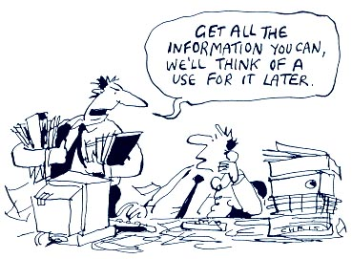
How we proposed to evaluate SCIC – Data collection
Who and What | When
Caregiver: OMB / tribal intake form + email | First meeting or call/contact
Caregiver: Pre-post Zarit Burden | First meeting and last formal SCIC session
Caregiver: Pre-post Brief Tool for Dementia-Friendly Education and Training Sessions, Individual (ACL) (Tentative, pending feedback from tribal DCS) | First meeting and last formal SCIC session
Person living with dementia: Pre-post QOL-AD | First meeting and last formal SCIC session
Caregiver: Brief anonymous online survey – overall satisfaction, engagement, relevance (tool TBD, based on Kirkpatrick Model) | Via email 1-7 days after last formal SCIC session
Notes:
This is what we initially started in terms of planned instruments in our evaluation plan for evaluating Savvy Caregiver for Indian Country sessions. Then where we ended up with after a reality check and discussions with the tribal partners working with GLITC. In both their community and several others, I have heard consistently about the burden of data collection. People are tired of being I quote “guinea pigs”. Even if we or I can do a really great job of explaining why evaluation is important that doesn’t negate these perceptions.
So, we opted to eliminate the knowledge change pre-post tool and for the time being the satisfaction instrument.
The Zarit Burden instrument which is used with caregivers, can actually be used to provide reasonably clinically relevant information about their degree of burden. Meaning, how overwhelmed they feel with their caregiving role.
The same idea is behind the qualify of life measure for the person living with dementia.

Slide 10
Visit Poster Presentation to Learn More

Slide 11
About IA²
The International Association for Indigenous Aging, a 501(c)3 non-profit educational association, works to:
Ensure the provision of appropriate and quality services and resources for indigenous elders
Expand opportunities for elders’ involvement in environmentalism, community participation, health maintenance, volunteerism/civic engagement, consumerism, senior enterprise
Enhance the protection of the rights of elders including their freedom from abuse and neglect and their right to autonomy
Educate the public, policymakers, and practitioners about indigenous elders
Improve the status of older indigenous elders worldwide
Notes:
IA squared was found almost 20 years ago by Dave Baldridge and Bill Benson, both of whom have been long time advocates working in Indian country. Our focus is improving the quality of life for Indigenous elders and we’ve done work in a number of areas, principally on health-focused areas but our projects have spanned topics such as training for elder fatality reviews in tribal communities to development of intergenerational projects designed to address sudden unexplained infant death.

Slide 12
Last Page
Jolie Crowder jolie@iasquared.org
301.861.0632
admin@iasquared.org
http://iasquared.org

